Slide 1
Turing Machine
A Turing machine (TM) is defined by a 7-tuple
M = (Q, Σ, Γ, δ, q₀, B, F), where
Q - is a finite set of states
Σ - is a finite set of input symbols
Γ - is a finite set of tape symbols, Σ ⊆ Γ
q₀ ∈ Q - is the start state (initial state)
B∈ Γ - is the blank symbol
F ⊆ Q - is the set of accept states (final states)
δ : Q × Γ → Q × Γ × {L, R}
In some formulation the head remains stationary
δ : Q × Γ → Q × Γ × {L, R, S}

Slide 2
Instantaneous Description
An Instantaneous Description (ID) of a Turing machine is a string of the form α₁qα₂ , where α₁ , α₂ ∈ Γ* , q ∈Q.
This means that at that particular instance α₁α₂ is the content of the TM. q is the current state and the tape head points to the first symbol of α₂
The relationship between IDs can be described as follows:
If X₁ X₂ . . . . X_{i-1} q X_{i} X_{i+1} . . . . X_{n} is an ID and δ(q, X_{i}) = (p, Y, R) then the next ID will be
X₁ X₂ . . . . X_{i-1} Y p X_{i+1} . . . . X_{n}
If δ(q, X_{i}) = (p, Y, L) then the next ID will be
X₁ X₂ . . . . pX_{i-1} Y X_{i+1} . . . . X_{n}

Slide 3
Instantaneous Description
q X₁ X₂ . . . . X_{i-1} X_{i} X_{i+1} . . . . X_{n} is the initial ID
ID₀ Ⱶ ID₁ Ⱶ . . . . Ⱶ ID_{n} is denoted by
ID₀ Ⱶ* ID_{n}
Ⱶ* is a reflexive transitive closure of Ⱶ
A string w is accepted by the TM M = (Q, Σ, Γ, δ, q₀, B, F) if
q₀ w Ⱶ* α₁q_{f} α₂ for some α₁ , α₂ ∈ Γ* , q_{f} ∈F.
The language accepted by the TM M is defined as
T(M) = { w / w∈ Σ* , q₀ w Ⱶ* α₁q_{f} α₂ for some α₁ , α₂ ∈ Γ* , q_{f} ∈F }

Slide 4
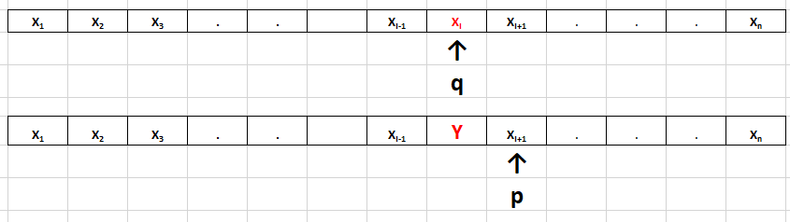
If X₁ X₂ . . . . X_{i-1} q X_{i} X_{i+1} . . . . X_{n} is an ID and δ(q, X_{i}) = (p, Y, R) then the next ID will be
X₁ X₂ . . . . X_{i-1} Y p X_{i+1} . . . . X_{n}

Slide 5
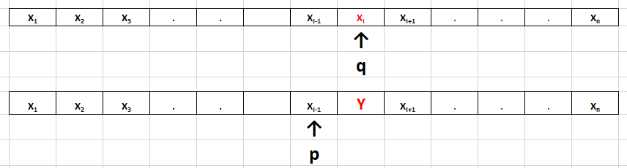
If δ(q, X_{i}) = (p, Y, L) then the next ID will be
X₁ X₂ . . . . pX_{i-1} Y X_{i+1} . . . . X_{n}

Slide 6
Example-1
Construct a TM which will accept the language L = { a^{n}b^{n} / n ≥ 1}
M = (Q, Σ, Γ, δ, q₀ , B , F), where
Q = {q₀ , q₁ , q₂ , q₃ , q₄} , Σ = {a , b} , Γ ={X , Y , a , b , B} , F = { q₄ }
δ(q₀ , a ) = (q₁ , X , R )
δ(q₁ , a ) = (q₁ , a , R )
δ(q₁ , Y ) = (q₁ , Y , R )
δ(q₁ , b ) = (q₂ , Y , L)
δ(q₂ , Y ) = (q₂ , Y , L)
δ(q₂ , a ) = (q₂ , a , L )
δ(q₂ , X ) = (q₀ , X , R )
δ(q₀ , Y ) = (q₃ , Y , R )
δ(q₃ , Y ) = (q₃ , Y , R )
δ(q₃ , B ) = (q₄ , B , L )
Algorithm/Logic
Change “a” to “x”
Move RIGHT to the First “b”
If none: Reject
Change “b” to “y”
Move LEFT to leftmost “a”
Repeat the above steps till no more “a”
Make sure no “b” remain
a | a | a | b | b | b

Slide 7
a | a | b | b
q₀aabb Ⱶ Xq₁abb Ⱶ Xaq₁bb Ⱶ Xq₂aYb Ⱶ q₂XaYb Ⱶ X q₀aYb Ⱶ XXq₁Yb
Ⱶ XXYq₁b Ⱶ XXq₂YY Ⱶ Xq₂XYY Ⱶ XXq₀YY Ⱶ XXYq₃Y Ⱶ XXYYq₃B Ⱶ XXYq₄Y
Y / Y , R
Y / Y , R
a / a , R
Y / Y , L
Y / Y , R
a / a , L
a / X , R
b / Y , L
B / B , L
q₀
q₁
q₂
q₃
q₄
X / X , R

Slide 8
Example-2
Construct a TM which will accept the language L = { a^{n}b^{n}c^{n} / n ≥ 1}
M = (Q, Σ, Γ, δ, q₀ , B , F), where Q = {q₀ , q₁ , q₂ , q₃ , q₄ , q₅} ,
Σ = {a , b , c} , Γ ={X , Y , Z, a , b , c , B} , F = { q₅ }
δ(q₀ , a ) = (q₁ , X , R ) δ(q₃ , X ) = (q₀ , X , R )
δ(q₁ , a ) = (q₁ , a , R ) δ(q₀ , Y ) = (q₄ , Y , R )
δ(q₁ , Y ) = (q₁ , Y , R ) δ(q₄ , Y ) = (q₄ , Y , R )
δ(q₁ , b ) = (q₂ , Y , R) δ(q₄ , Z ) = (q₄ , Z , R )
δ(q₂ , b ) = (q₂ , b , R) δ(q₄ , B ) = (q₅ , B , L )
δ(q₂ , Z ) = (q₂ , Z , R)
δ(q₂ , c ) = (q₃ , Z , L )
δ(q₃ , Z ) = (q₃ , Z , L )
δ(q₃ , b ) = (q₃ , b , L )
δ(q₃ , Y ) = (q₃ , Y , L )
δ(q₃ , a ) = (q₃ , a , L )

Slide 9
Example-3
Example:2 Given two positive integers x and y, design a TM that computes x + y
First represent x and y in unary.
w(x), w(y) ∈ {1}⁺ such that |w(x)|= x and |w(y)|= y
q₀ w(x)0w(y) Ⱶ* q_{f} w(x + y)0
x = 3 , y =2
w(x) = 111 and w(y) = 11
q₀111011 Ⱶ* q_{f}111110

Slide 10
Example-3
M = (Q, Σ, Γ, δ, q₀ , B , F), where
Q = {q₀ , q₁ , q₂ , q₃ , q₄} , Σ = {1} , Γ ={0, 1, B} , F = { q₄ }
δ(q₀ , 1 ) = (q₀ , 1 , R )
δ(q₀ , 0 ) = (q₁ , 1 , R )
δ(q₁ , 1 ) = (q₁ , 1 , R )
δ(q₁ , B ) = (q₂ , B , L)
δ(q₂ , 1 ) = (q₃ , 0 , L)
δ(q₃ , 1 ) = (q₃ , 1 , L )
δ(q₃ , B ) = (q₄ , B , R )
q₀111011 Ⱶ 1q₀11011 Ⱶ 11q₀1011 Ⱶ 111q₀011 Ⱶ 1111q₁11 Ⱶ 11111q₁1
Ⱶ 111111q₁B Ⱶ 11111q₂1B Ⱶ 1111q₃10 Ⱶ 111q₃110 Ⱶ 11q₃1110
Ⱶ 1q₃11110 Ⱶ q₃111110 Ⱶ q₃B111110 Ⱶ Bq₄111110

Slide 11
Example-4
Design a TM to make a copy of a string over {0, 1}.
Input: B1100#B Output : B1100#1100B
M = (Q, Σ, Γ, δ, q₀ , B , F), where
Q = {q₀ , q₁ , q₂ , q₃ , q₄} , Σ = {0, 1} , Γ ={0, 1, #, X, Y, B} , F = { q₄ }
δ(q₀ , 0 ) = (q₁ , X , R ) δ(q₀ , 1 ) = (q₂ , Y , R )
δ(q₁ , 0 ) = (q₁ , 0 , R ) δ(q₂ , 0 ) = (q₂ , 0 , R )
δ(q₁ , 1 ) = (q₁ , 1 , R ) δ(q₂ , 1 ) = (q₂ , 1 , R )
δ(q₁ , # ) = (q₁ , # , R) δ(q₂ , # ) = (q₂ , # , R)
δ(q₁ , B ) = (q₃ , 0 , L) δ(q₂ , B ) = (q₃ , 1 , L)
δ(q₃ , 0 ) = (q₃ , 0 , L ) δ(q₃ , 1 ) = (q₃ , 1 , L )
δ(q₃ , # ) = (q₃ , # , L ) δ(q₃ , X ) = (q₀ , 0 , R )
δ(q₃ , Y ) = (q₀ , 1 , R ) δ(q₀ , # ) = (q₄ , # , R )

Slide 12
q₀1100# Ⱶ Yq₂100# Ⱶ Y1q₂00# Ⱶ Y10q₂0# Ⱶ Y100q₂# Ⱶ Y100#q₂B
Ⱶ Y100q₃#1Ⱶ Y10q₃0#1 Ⱶ Y1q₃00#1 Ⱶ Yq₃100#1 Ⱶ q₃Y100#1
Ⱶ 1q₀100#1 Ⱶ 1Yq₂00#1 Ⱶ 1Y0q₂0#1 Ⱶ 1Y00q₂#1 Ⱶ 1Y00#q₂1
Ⱶ 1Y00#1q₂B Ⱶ 1Y00# q₃11 Ⱶ 1Y00q₃ #11 Ⱶ 1Y0q₃0#11
Ⱶ 1Yq₃00#11 Ⱶ 1q₃Y00#11 Ⱶ 11q₀00#11 Ⱶ 11Xq₁0#11 Ⱶ 11X0q₁#11
Ⱶ 11X0#q₁11 Ⱶ 11X0#1q₁1 Ⱶ 11X0#11q₁B Ⱶ 11X0#1q₃10
Ⱶ 11X0#q₃110 Ⱶ 11X0q₃#110 Ⱶ 11Xq₃0#110 Ⱶ 11q₃X0#110 Ⱶ 110q₀0#110
Ⱶ 110Xq₁#110 Ⱶ 110X#q₁110 Ⱶ 110X#1q₁10 Ⱶ 110X#11q₁0 Ⱶ 110X#110q₁B
Ⱶ 110X#11q₃00 Ⱶ 110X#1q₃100 Ⱶ 110X#q₃1100
Ⱶ 110Xq₃#1100 Ⱶ 110q₃X#1100 Ⱶ 1100q₀#1100 Ⱶ 1100#q₄1100

Slide 13
Example-5
Design a TM which recognizes palindromes over alphabet {a, b}.
T(M) = { w∈ {a, b}* / w = w^{R} }
abbbba
babbab even length
abbabba
bbababb odd length

Slide 14
M = (Q, Σ, Γ, δ, q₀ , B , F), where Q = {q₀ , q₁ , q₂ , q₃ , q₄ , q₅ , q₆} ,
Σ = {0, 1} , Γ ={0, 1, #, X, Y, B} , F = { q₆ }
δ(q₀ , a ) = (q₁ , B , R ) δ(q₀ , b ) = (q₄ , B , R )
δ(q₁ , a ) = (q₁ , a , R ) δ(q₄ , a ) = (q₄ , a , R )
δ(q₁ , b ) = (q₁ , b , R ) δ(q₄ , b ) = (q₄ , b , R )
δ(q₁ , B ) = (q₂ , B , L) δ(q₄ , B ) = (q₅ , B , L)
δ(q₂ , a ) = (q₃ , B , L) δ(q₅ , b ) = (q₃ , B , L)
δ(q₃ , a ) = (q₃ , a , L ) δ(q₃ , b ) = (q₃ , b , L )
δ(q₃ , B ) = (q₀ , B , R ) δ(q₀ , B ) = (q₆ , B , R )
δ(q₂ , B ) = (q₆ , B , R ) δ(q₅ , B ) = (q₆ , B , R )

Slide 15
q₀abbbba Ⱶ Bq₁bbbba Ⱶ Bbq₁bbba Ⱶ Bbbq₁bba Ⱶ Bbbbq₁ba
Ⱶ Bbbbbq₁a Ⱶ Bbbbbaq₁B Ⱶ Bbbbbq₂a Ⱶ Bbbbq₃bB Ⱶ Bbbq₃bbB
Ⱶ Bbq₃bbbB Ⱶ Bq₃bbbbB Ⱶ q₃BbbbbB Ⱶ Bq₀bbbbB Ⱶ BBq₄bbbB
Ⱶ BBbq₄bbB Ⱶ BBbbq₄bB Ⱶ BBbbbq₄B Ⱶ BBbbq₅bB Ⱶ BBbq₃bBB
Ⱶ BBq₃bbBB Ⱶ Bq₃BbbBB Ⱶ BBq₀bbBB Ⱶ BBBq₄bBB Ⱶ BBBbq₄BB
Ⱶ BBBq₅bBB Ⱶ BBq₃BBBB Ⱶ BBBq₀BBB Ⱶ BBBBq₆BB

Slide 16
q₀
b / B , R
a / B , R
a / a , R
a / a , R
b / b , R
B / B , R
b / b , R
q₄
q₁
q₆
B / B , L
B / B , L
B / B , R
B / B , R
q₅
q₂
b / B , L
a / B , L
B / B , R
q₃
a / a , L
b / b , L

Slide 17
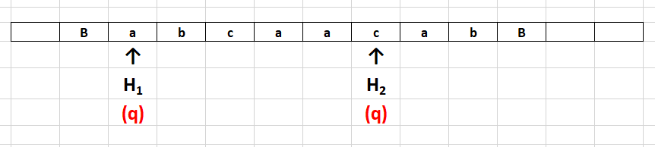
Multi-head Turing Machine
A Turing machine with single tape can have multiple heads.
Let us consider a TM with two heads H₁ and H₂
Each head can capable of performing read / write / move operation independently.

Slide 18
The transition behaviour of 2-head one tape Turing machine can be defined as given below:
δ(q, a, c) = (p, (X, R), (Y, L))
Where
a - symbol under the head H₁
c - symbol under the head H₂
X - symbol to be written in the cell under H₁
Y - symbol to be written in the cell under H₂

Slide 19
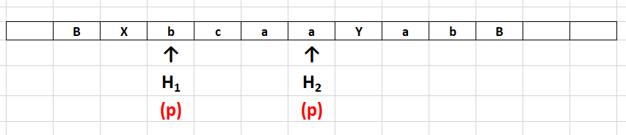

Slide 20
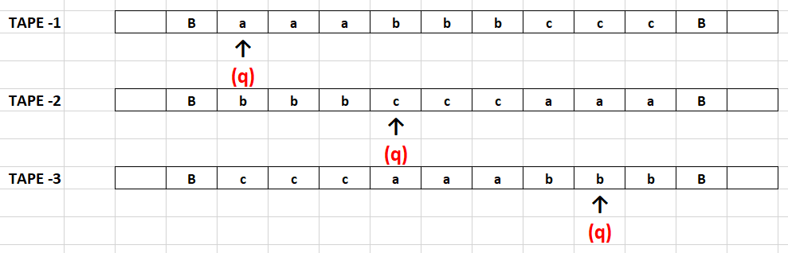
Multi-tape Turing Machine
Multi – tape Turing machine has multiple tapes (more than one but finite number of tapes) with each tape having its own independent head.
Let us consider the case of three tape TM.

Slide 21
The transition behaviour of 3-tape Turing machine can be defined as given below:
δ(q, a, c, b) = (p, (X, R), (Y, L), (Z, R))
Where
q - current state
p - next state
a - symbol under the head on tape 1
c - symbol under the head on tape 2
b - symbol under the head on tape 3
X - symbol to be written in the cell on tape 1
Y - symbol to be written in the cell on tape 2
Z - symbol to be written in the cell on tape 3

Slide 22
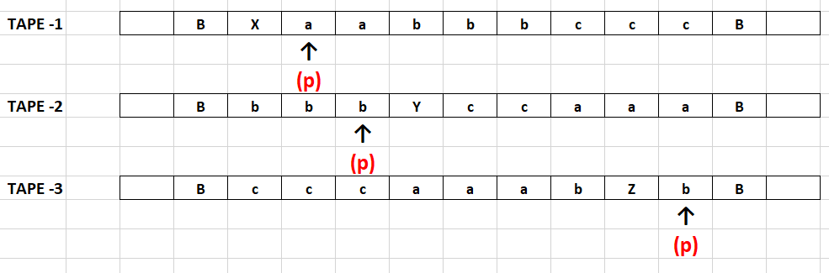

Slide 23
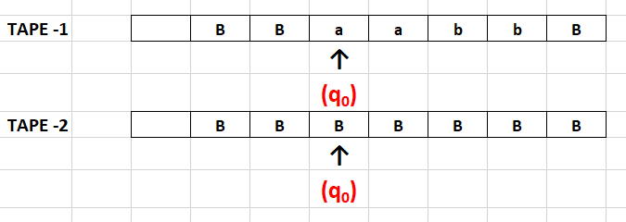
Example: Construct a two tape Turing machine to convert an input w into WW^{R}.
Initial configuration:

Slide 24
Final configuration:
Tape-1 B B a a b b b b a a B
Tape-2 B B a a b b B

Slide 25
δ(q₀, a, B) = (q₀, (a, R), (a, R))
δ(q₀, b, B) = (q₀, (b, R), (b, R))
δ(q₀, B, B) = (q₁, (B, N), (B, L))
δ(q₁, B, a) = (q₁, (a, R), (a, L))
δ(q₁, B, b) = (q₁, (b, R), (b, L))
δ(q₁, B, B) = (q₂, (B, N), (B, N))
(B / a , R)
(a / a , L)
(a / a , R)
(B / a , R)
(B / b , R)
(b / b , L)
(b / b , R)
(B / b , R)
(B / B , N)
(B / B , N)
q₀
q₁
q₂
(B / B , L)
(B / B , N)

Slide 26
Recursive and Recursively Enumerable Languages
Def: 1
The language accepted by a Turing machine (TM) is called recursively enumerable set (RE).
Def: 2
The language accepted by a Turing machine (TM) which halts on all inputs is called recursive set (Rec).

Slide 27
Chomsky Hierarchy
Non-recursively enumerable
Recursively-enumerable
Recursive
Context-sensitive
Context-free
Regular

Slide 28
Properties of recursive and recursively enumerable sets
The union of two recursive sets is recursive.
The union of two recursively enumerable sets is recursively enumerable.
The complement of recursive set is recursive.
If L and L’ are recursively enumerable, then L is recursive.

Slide 29
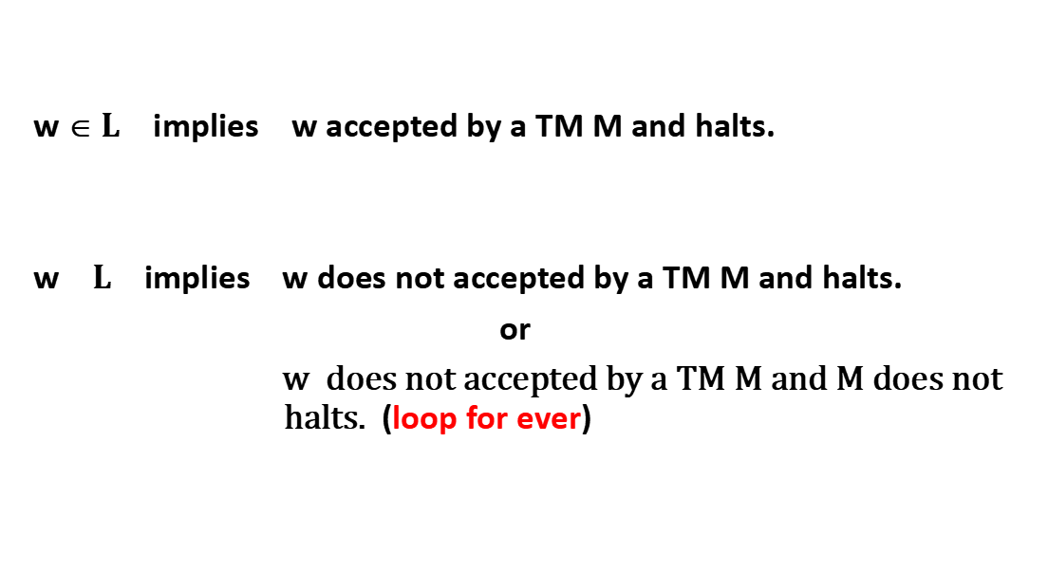
w ∈ $L$ implies w accepted by a TM M and halts.
w $L$ implies w does not accepted by a TM M and halts.
or
$\text{w} \text{does} \text{not} \text{accepted} \text{by} \text{a} \text{TM} \text{M} \text{and} \text{M} \text{does} \text{not} \text{halts}\text{.}$ (loop for ever)

Slide 30
1) The union of two recursive sets is recursive.
Proof:
Let L1 and L2 are two recursive sets.
Yes
w
M1
No
Yes
w
M2
No

Slide 31
M accepts L₁ U L₂ , it is a recursive set. (Since it halts for all inputs)
Yes
w
M1
No
Yes
M2
No
M

Slide 32
2) The union of two recursively enumerable sets is recursively enumerable.
Proof:
Let L1 and L2 are two recursively enumerable sets.
Yes
w
M1
Yes
w
M2

Slide 33
M accepts L₁ U L₂ , it is a recursive enumerable set.
Yes
M1
w
Yes
M2
M

Slide 34
3) The complement of recursive set is recursive.
Proof:
Let L is recursive set.
Yes
w
M
No

Slide 35
M’ accepts L’ , it is a recursive set.
Yes
No
w
M
No
Yes
M’

Slide 36
4) If L and L’ are recursively enumerable, then L is recursive.
Proof:
Let L and L’ are two recursively enumerable sets.
Yes
w
M
Yes
w
M’

Slide 37
M’’ accepts L , it is a recursive set (Since it halts for all inputs).
Yes
M
w
Yes
No
M’
M’’

Slide 38
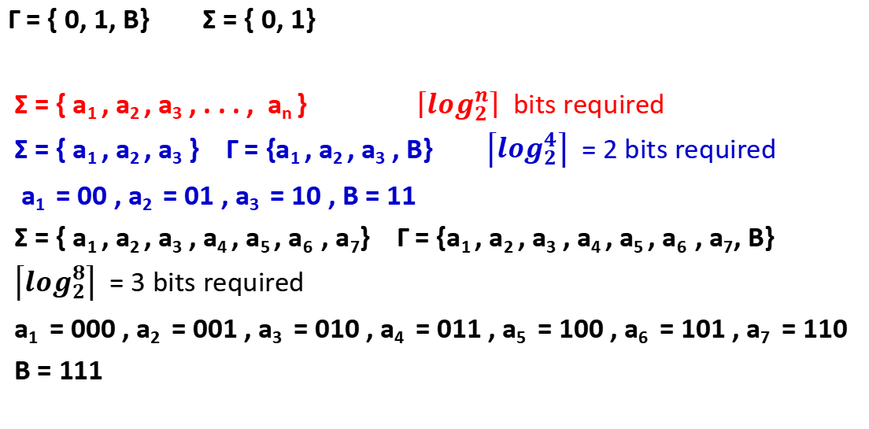
Two symbols are enough (apart from blank symbol)
Γ = { 0, 1, B} Σ = { 0, 1}
Σ = { a₁ , a₂ , a₃ , . . . , a_{n} } $\left\lceil \log_{2}^{n}\right\rceil$ bits required
Σ = { a₁ , a₂ , a₃ } Γ = {a₁ , a₂ , a₃ , B} $\left\lceil \log_{2}^{4}\right\rceil$ = 2 bits required
a₁ = 00 , a₂ = 01 , a₃ = 10 , B = 11
Σ = { a₁ , a₂ , a₃ , a₄ , a₅ , a₆ , a₇} Γ = {a₁ , a₂ , a₃ , a₄ , a₅ , a₆ , a₇, B}
$\left\lceil \log_{2}^{8}\right\rceil$ = 3 bits required
a₁ = 000 , a₂ = 001 , a₃ = 010 , a₄ = 011 , a₅ = 100 , a₆ = 101 , a₇ = 110
B = 111

Slide 39
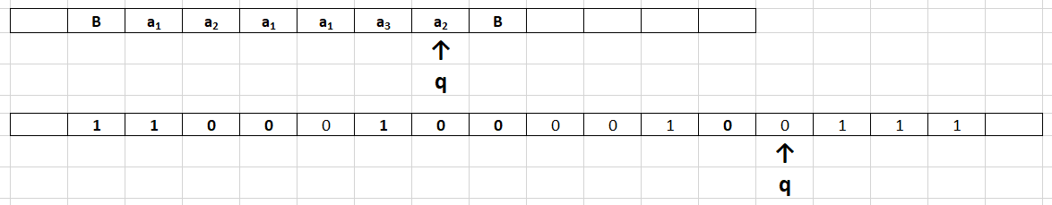

Slide 40
Encoding of Turing machine
M = (Q, Σ, Γ, δ, q₁, B, F) where
Q = {q₁ , q₂ , q₃ , . . . , q_{n} } q₁ – initial state
Γ = { 0, 1, B} Σ = { 0, 1}
δ(q_{i} , X_{j} ) = (q_{k} , X_{l} , L/R ) X₁ = 0 , X₂ = 1 , X₃ = B
L = 1 , R = 2
1 ≤ i, k ≤ n , 1 ≤ j, l ≤ 3 , 1 ≤ m ≤ 2
0^{i} 1 0^{j} 1 0^{k} 1 0^{l} 1 0^{m}
111 0^{i} 1 0^{j} 1 0^{k} 1 0^{l} 1 0^{m} 11 0^{i} 1 0^{j} 1 0^{k} 1 0^{l} 1 0^{m} 11 . . . 11 . . . 11 . . . 111

Slide 41
Consider the following Turing machine with alphabet { 0, 1, B} and state set {q₁ , q₂ , q₃ , q₄ , q₅ }, q₁ is the initial state, q₅ is the final state and the transitions are
δ(q₁ , 0 ) = (q₂ , 0 , R ) δ(q₃ , B ) = (q₄ , 1 , R )
δ(q₂ , 0 ) = (q₃ , 0 , R ) δ(q₄ , 0 ) = (q₃ , 1 , L )
δ(q₃ , 0 ) = (q₄ , 1 , R ) δ(q₄ , 1 ) = (q₅ , 1 , R )
δ(q₃ , 1 ) = (q₄ , 1 , L) δ(q₄ , B ) = (q₃ , 1 , L)
1110¹ 1 0¹ 1 0² 1 0¹ 1 0² 110² 1 0¹ 1 0³ 1 0¹ 1 0² 11 0³ 1 0¹ 1 0⁴ 1 0² 1 0² 11
0³ 1 0² 1 0⁴ 1 0² 1 0¹ 11 0³ 1 0³ 1 0⁴ 1 0² 1 0² 11 0⁴ 1 0¹ 1 0³ 1 0² 1 0¹ 11
0⁴ 1 0² 1 0⁵ 1 0² 1 0² 11 0⁴ 1 0³ 1 0³ 1 0² 1 0¹ 111

Slide 42
Enumeration of Turing machine
111m₁11m₂ 11 m₃ 11 m₄11 m₅ 11 m₆11m₇11m₈111
Each m_{i} is of the form 0^{i} 1 0^{j} 1 0^{k} 1 0^{l} 1 0^{m}
i^{th} integer in binary represents i^{th} Turing machine, say T_{i}
1 - T₁
10 - T₂ If the binary integer is not proper encoding, then the
11 - T₃ respective TM with no moves.
100 - T₄
101 - T₅
110 - T₆
111 - T₇
. . . . .
. . . . .

Slide 43
Enumeration of Turing machine
We can talk about i^{th} TM
i^{th} integer in binary represents i^{th} TM
Some Turing machines do not have any moves

Slide 44
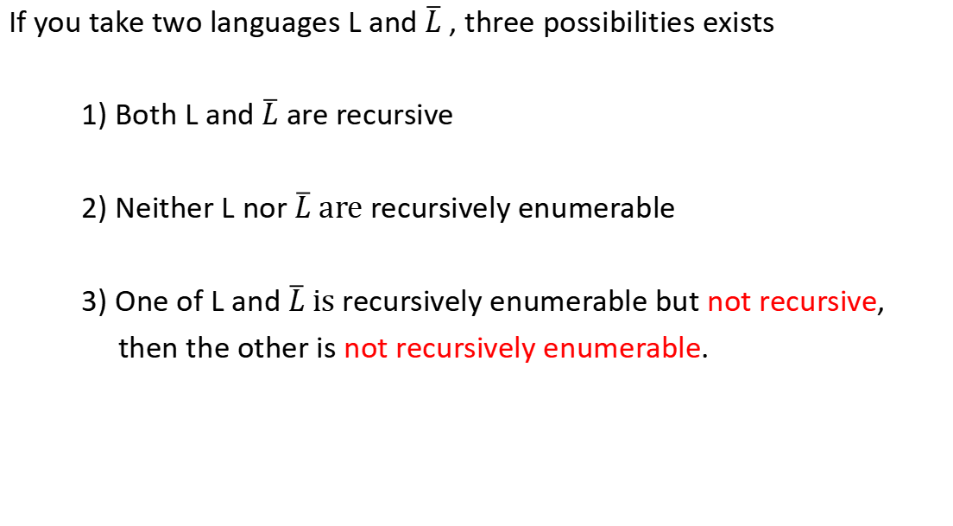
If you take two languages L and $\overline{L}$, three possibilities exists
1) Both L and $\overline{L}$ are recursive
2) Neither L nor $\overline{L} \text{are}$recursively enumerable
3) One of L and $\overline{L} \text{is}$recursively enumerable but not recursive,
then the other is not recursively enumerable.

Slide 45

$\overline{L}$
r.e not r.e r.e not r.e
L
L rec rec
$\overline{L}$
not r.e not r.e
r.e L$\overline{L}$ L$\overline{L}$ $\text{r}\text{.}\text{e}$
rec rec

Slide 46
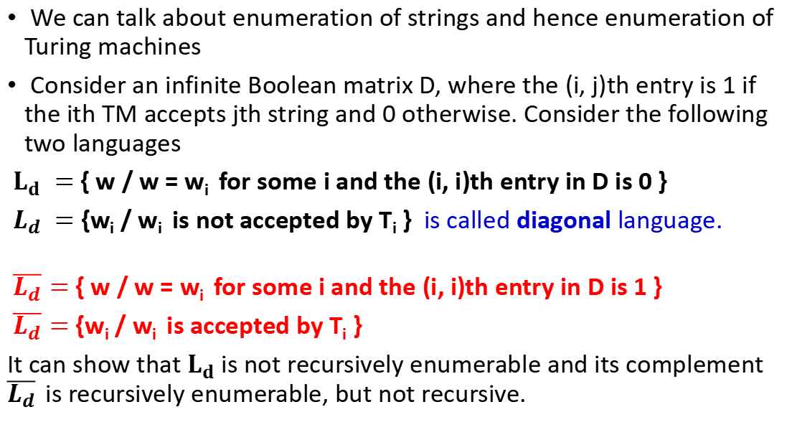
We can talk about enumeration of strings and hence enumeration of Turing machines
Consider an infinite Boolean matrix D, where the (i, j)th entry is 1 if the ith TM accepts jth string and 0 otherwise. Consider the following two languages
$L_{d} =$ { w / w = w_{i} for some i and the (i, i)th entry in D is 0 }
$L_{d} =$ {w_{i} / w_{i} is not accepted by T_{i} } is called diagonal language.
$\overline{L_{d}}$ $=$ { w / w = w_{i} for some i and the (i, i)th entry in D is 1 }
$\overline{L_{d}}$ $=$ {w_{i} / w_{i} is accepted by T_{i} }
It can show that $L_{d}$ is not recursively enumerable and its complement $\overline{L_{d}}$ is recursively enumerable, but not recursive.

Slide 47
w₁ w₂ w₃ w₄ w₅ . . . w_{i} . . .
T₁ 0 1 1 0 1 0 0 1 1 0 1 0
T₂ 1 1 0 1 0
T₃ . . 1 . .
T₄ . . . 0
T₅
.
.
.
T_{i}

Slide 48
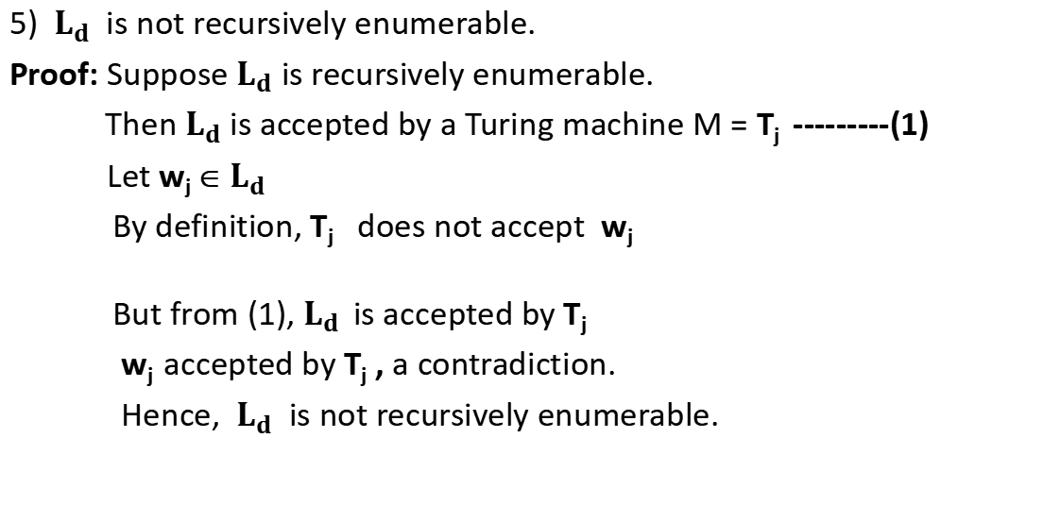
5) ${ L}_{d}$ is not recursively enumerable.
Proof: Suppose $L_{d}$ is recursively enumerable.
Then $L_{d}$ is accepted by a Turing machine M = T_{j} ---------(1)
Let w_{j} ∈ $L_{d}$
By definition, T_{j} does not accept w_{j}
But from (1), $L_{d}$ is accepted by T_{j}
w_{j} accepted by T_{j} , a contradiction.
Hence, ${ L}_{d}$ is not recursively enumerable.

Slide 49
Universal Turing machine (U)
Universal TM is a TM which can simulate any other TM including itself.
Universal TM is denoted by U.
We are considering TMs with tape alphabets {0, 1, B}. Encoding of such TM T is a binary string d_{T} .
U has three tapes. The first tape is represented with d_{T} t that is the encoding of T and the input to T. It will be of the form
111 . . . . . 11 . . . . . 11 . . . . . 11 . . . . . 11 . . . . . 111 t . . . .
Here t is a string over an alphabet {0, 1}

Slide 50
Universal Turing machine (U)
We assume that the states of the TM T are {{q₁ , q₂ , q₃ , . . . , q_{n} } ,
where q₁ is the initial state.
The second tape contains information about the state.
At any instance, T is supposed to be in state q_{i} , 1 ≤ i ≤ n
The universal TM U while simulating TM T will have 0^{i} in tape 2.
Tape 3 is used for simulation.

Slide 51
FC
111 . . . . . 11 . . . . . 11 . . . . . 11 . . . . . 11 . . . . . 111 1100110
000000
1100110

Slide 52
U simulates T on t
halts and accepts halts and rejects gets into a loop

Slide 53
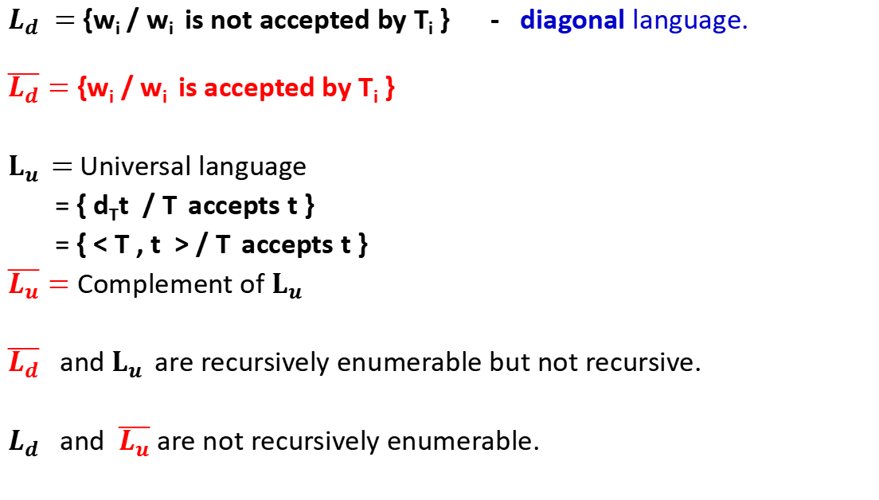
$L_{d} =$ {w_{i} / w_{i} is not accepted by T_{i} } - diagonal language.
$\overline{L_{d}}$ $=$ {w_{i} / w_{i} is accepted by T_{i} }
$L_{u } \text{=}$ Universal language
= { d_{T}t / T accepts t }
= { < T , t > / T accepts t }
$\overline{L_{u}}$ $=$ Complement of $L_{u }$
$\overline{L_{d}}$ and $L_{u }$ are recursively enumerable but not recursive.
$L_{d}$ and $\overline{L_{u}}$ are not recursively enumerable.

Slide 54

not r.e
r.e $L_{d}$ $\overline{L_{u}}$
$L_{u }$ $\overline{L_{d}}$
rec

Slide 55
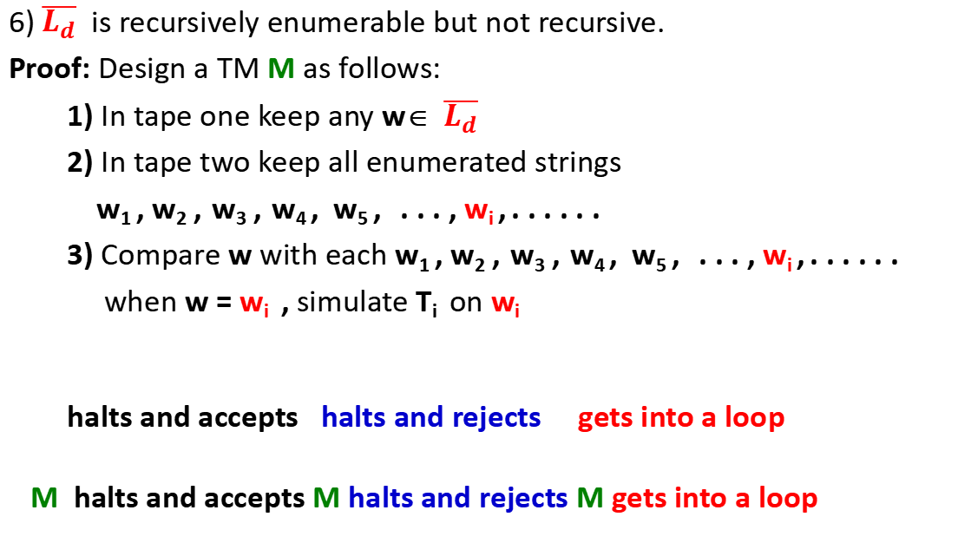
6) $\overline{L_{d}}$ is recursively enumerable but not recursive.
Proof: Design a TM M as follows:
1) In tape one keep any w∈ $\overline{L_{d}}$
2) In tape two keep all enumerated strings
w₁ , w₂ , w₃ , w₄ , w₅ , . . . , w_{i} , . . . . . .
3) Compare w with each w₁ , w₂ , w₃ , w₄ , w₅ , . . . , w_{i} , . . . . . .
when w = w_{i} , simulate T_{i} on w_{i}
halts and accepts halts and rejects gets into a loop
M halts and accepts M halts and rejects M gets into a loop

Slide 56
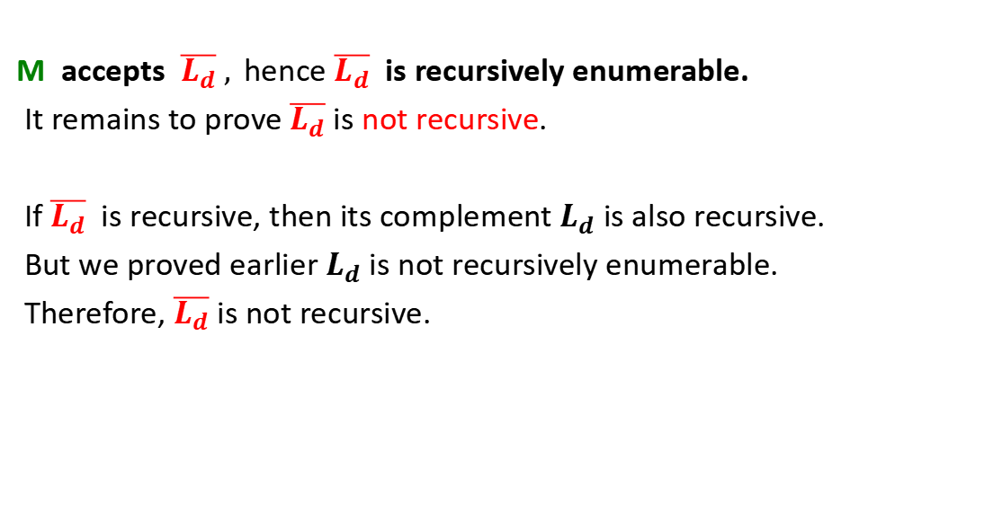
M accepts $\overline{L_{d}} ,$hence $\overline{L_{d}}$ is recursively enumerable.
It remains to prove $\overline{L_{d}}$ is not recursive.
If $\overline{L_{d}}$ is recursive, then its complement $L_{d}$ is also recursive.
But we proved earlier $L_{d}$ is not recursively enumerable.
Therefore, $\overline{L_{d}}$ is not recursive.

Slide 57
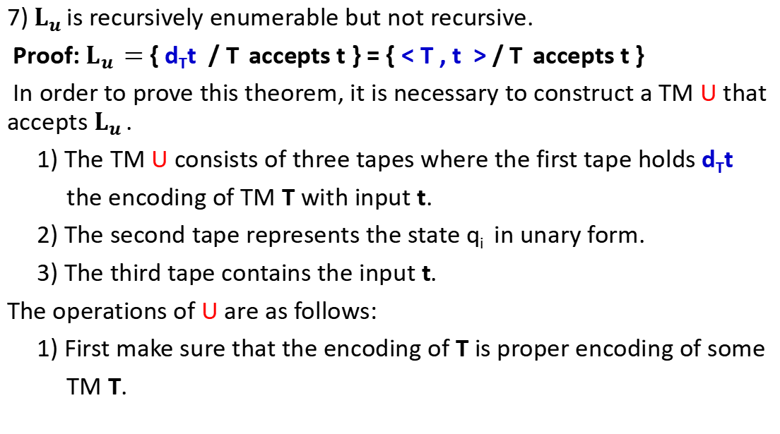
7) $L_{u }$is recursively enumerable but not recursive.
Proof: $L_{u } \text{=}$ { d_{T}t / T accepts t } = { < T , t > / T accepts t }
In order to prove this theorem, it is necessary to construct a TM U that accepts $L_{u }$.
1) The TM U consists of three tapes where the first tape holds d_{T}t
the encoding of TM T with input t.
2) The second tape represents the state q_{i} in unary form.
3) The third tape contains the input t.
The operations of U are as follows:
1) First make sure that the encoding of T is proper encoding of some
TM T.

Slide 58
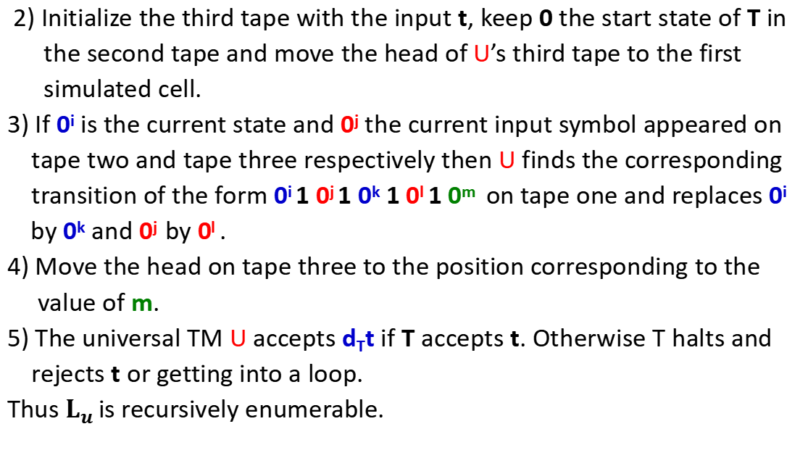
2) Initialize the third tape with the input t, keep 0 the start state of T in
the second tape and move the head of U’s third tape to the first
simulated cell.
3) If 0^{i} is the current state and 0^{j} the current input symbol appeared on
tape two and tape three respectively then U finds the corresponding
transition of the form 0^{i} 1 0^{j} 1 0^{k} 1 0^{l} 1 0^{m} on tape one and replaces 0^{i}
by 0^{k} and 0^{j} by 0^{l} .
4) Move the head on tape three to the position corresponding to the
value of m.
5) The universal TM U accepts d_{T}t if T accepts t. Otherwise T halts and
rejects t or getting into a loop.
Thus $L_{u }$is recursively enumerable.

Slide 59
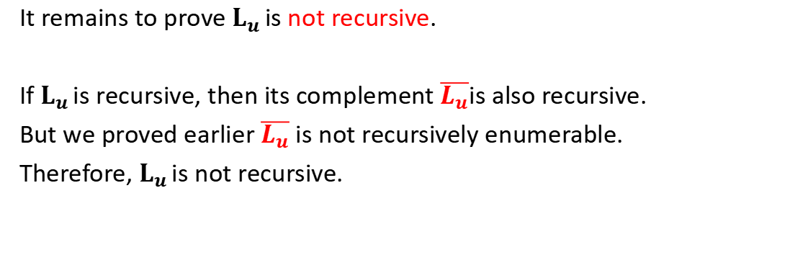
It remains to prove $L_{u }$is not recursive.
If $L_{u }$is recursive, then its complement $\overline{L_{u}}$is also recursive.
But we proved earlier $\overline{L_{u}}$ is not recursively enumerable.
Therefore, $L_{u }$is not recursive.

Slide 60
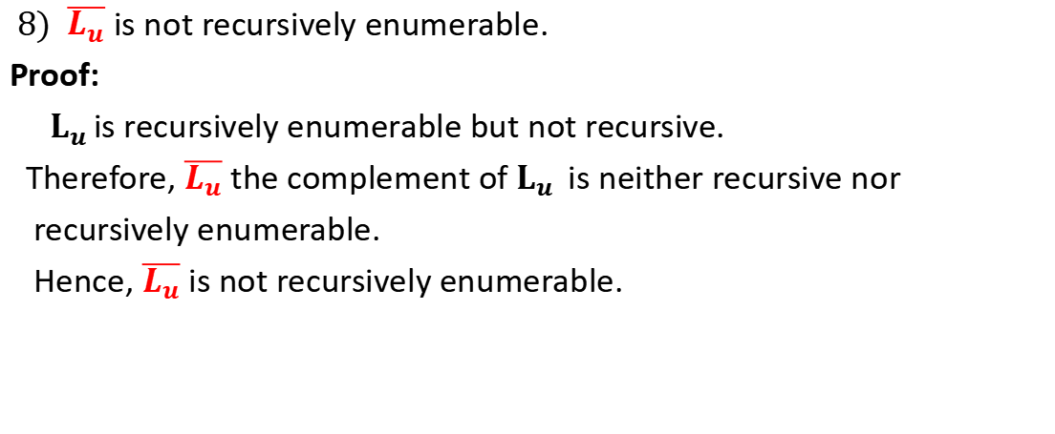
$8) \overline{L_{u}}$ is not recursively enumerable.
Proof:
$L_{u }$is recursively enumerable but not recursive.
Therefore, $\overline{L_{u}}$ the complement of $L_{u }$ is neither recursive nor
recursively enumerable.
Hence, $\overline{L_{u}}$ is not recursively enumerable.

Slide 61
Halting Problem
The halting problem for Turing machines can be stated as follows:
Given a TM in an arbitrary configuration will it eventually halt?
This problem is said to be recursively unsolvable or undecidable in the sense that there can not exist an algorithm which will take as input a description of a TM T and input t and say whether T on t will halt or not.

Slide 62
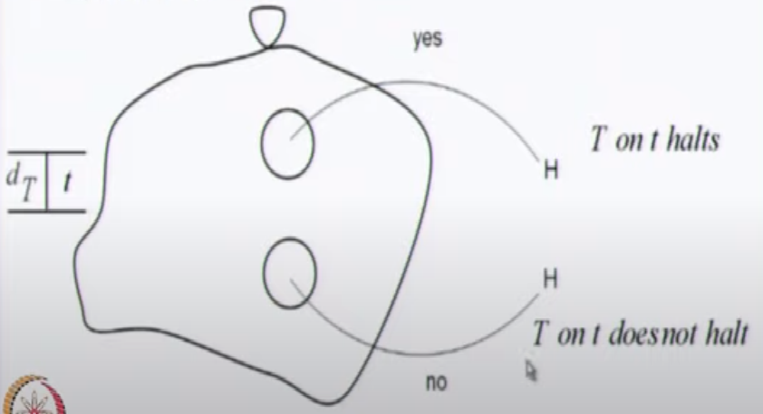
Halting Problem
Suppose the halting problem is decidable. Then there exists an algorithm (or TM) to solve this problem. We call this TM as ‘halt’. This machine ‘halt’ takes as input an encoding d_{T} of a TM with input t and tells whether T on t will halt or not. The state diagram as follows:

Slide 63
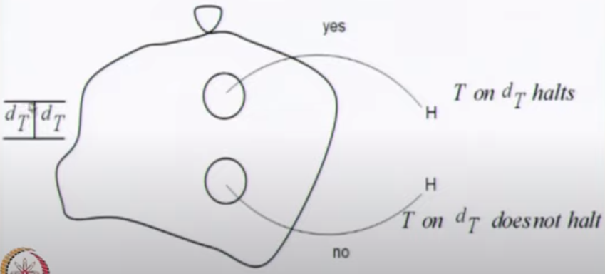
The machine ‘halt’ can be modified a little and we can think of a TM ‘copy halt’ as follows:

Slide 64
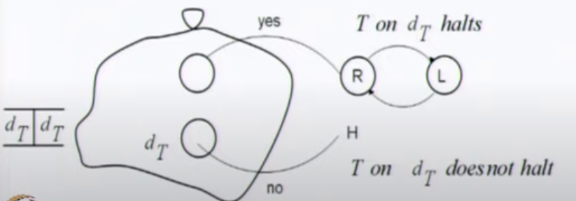
Now we can modify ‘copy halt’ a little and have a machine ‘contradict’ as follows:

Slide 65
does not halts halts
This is a contradiction.
Hence no such TM exists.
Therefore, halting problem of TM is undecidable.
contradict on d_{contradict}
halts does not halts

Slide 66
Computable Functions
A recursive function is defined in terms of itself.
The recursive definition of factorial is
n! = n * (n-1)! for n ≥1
2. The recursive definition of the exponential x^{n} is defined as
x^{n} = x * x^{n-1} for n ≥1
A recursive function can be generalized by defining it in addition to in terms of itself, possibly in terms of some other functions.
Such generalization defines primitive recursion.
Turing machine is viewed as a mathematical model of partial recursive function.

Slide 67
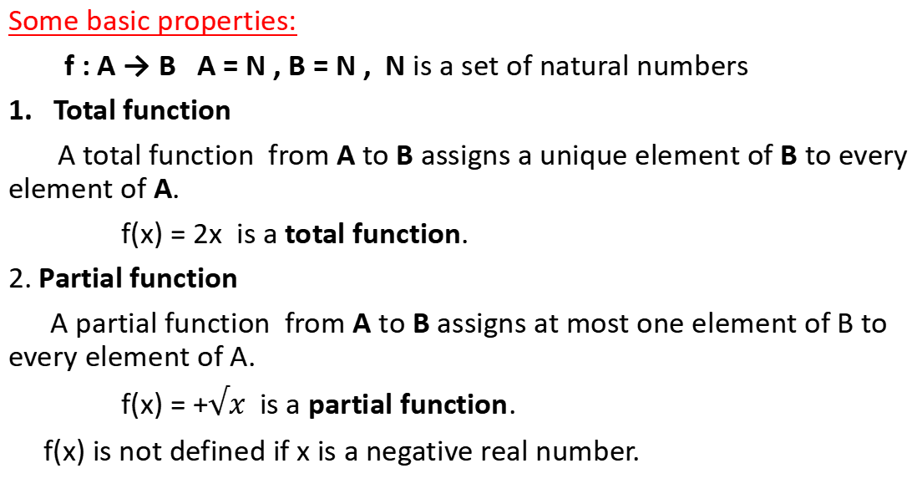
Some basic properties:
f : A → B A = N , B = N , N is a set of natural numbers
Total function
A total function from A to B assigns a unique element of B to every element of A.
f(x) = 2x is a total function.
2. Partial function
A partial function from A to B assigns at most one element of B to every element of A.
f(x) = +$√x$ is a partial function.
f(x) is not defined if x is a negative real number.

Slide 68
3. Function of k-variables
A function of k-variables is represented as f(x₁, x₂, . . . , x_{k}).
f(x₁, x₂) = x₁+2x₂ is a function of two variables.
4. Primitive recursive function
Some initial functions are taken as primitive recursive functions. These initial functions are:
a) Zero function
b) Successor function
c) Projection function
A function derived from combination / composition of primitive recursive functions is primitive recursive.

Slide 69
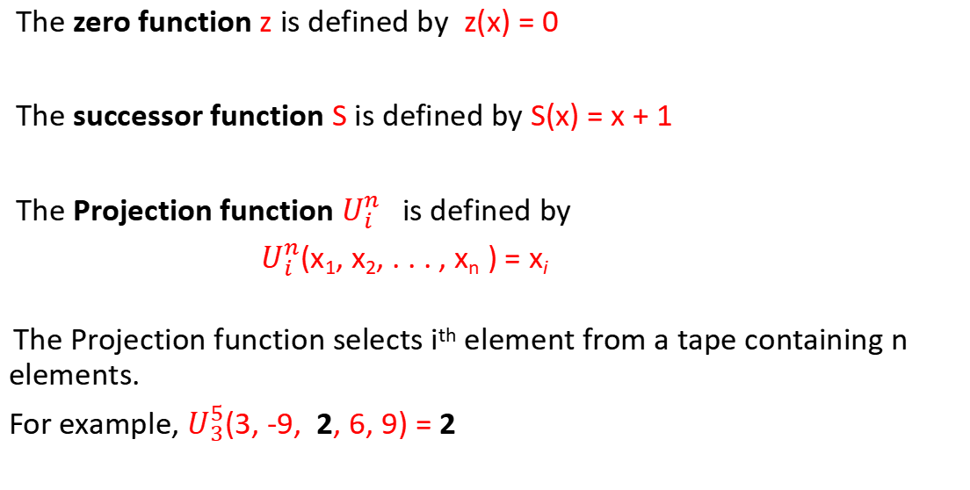
The zero function z is defined by z(x) = 0
The successor function S is defined by S(x) = x + 1
The Projection function $U_{i}^{n}$is defined by
$U_{i}^{n}$(x₁, x₂, . . . , x_{n} ) = x_{i}
The Projection function selects i^{th} element from a tape containing n elements.
For example, $U_{3}^{5}$(3, -9, 2, 6, 9) = 2

Slide 70
5. Composition
If f₁, f₂, . . . , f_{k} are partial functions of n variables, and g is a partial function of k variables, then the composition of g with f₁, f₂, . . . , f_{k} is a partial function of n variables defined by
g(f₁(x₁, x₂, . . . , x_{n}), f₂(x₁, x₂, . . . , x_{n}), . . . , f_{k}(x₁, x₂, . . . , x_{n}) )
For example:
If f₁(x, y) = x + y , f₂(x, y) = 3x , f₃(x, y) = xy and g(x, y, z) = x + y + 2z be functions over N, then
g(f₁(x, y), f₂(x, y), f₃(x, y)) = ( (x + y) + (3x) + 2(xy)) = (x + y + 3x + 2xy)
= (4x + y + 2xy)
If the composition g with f₁, f₂ and f₃ is by a function h, then
h(x, y, z) = 4x + y + 2xy

Slide 71
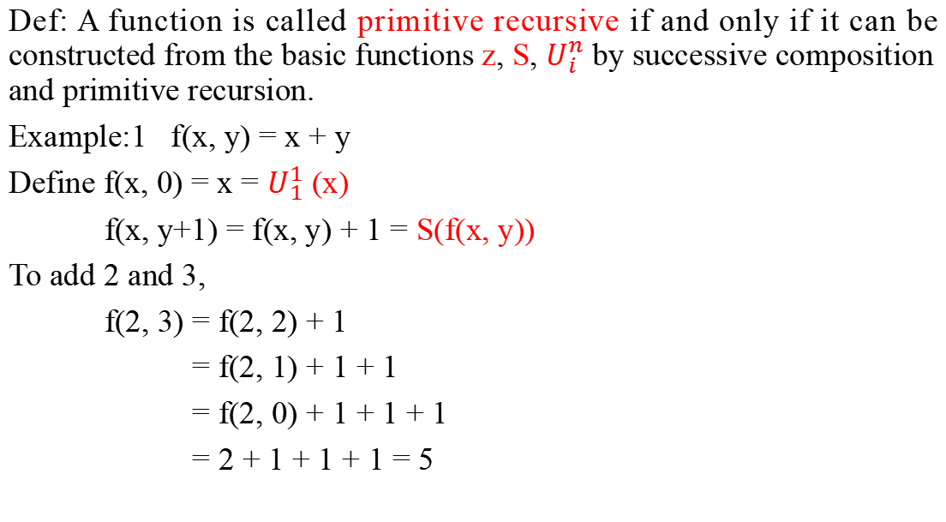
Def: A function is called primitive recursive if and only if it can be constructed from the basic functions z, S, $U_{i}^{n}$ by successive composition and primitive recursion.
Example:1 f(x, y) = x + y
Define f(x, 0) = x = $U_{1}^{1}$ (x)
f(x, y+1) = f(x, y) + 1 = S(f(x, y))
To add 2 and 3,
f(2, 3) = f(2, 2) + 1
= f(2, 1) + 1 + 1
= f(2, 0) + 1 + 1 + 1
= 2 + 1 + 1 + 1 = 5

Slide 72
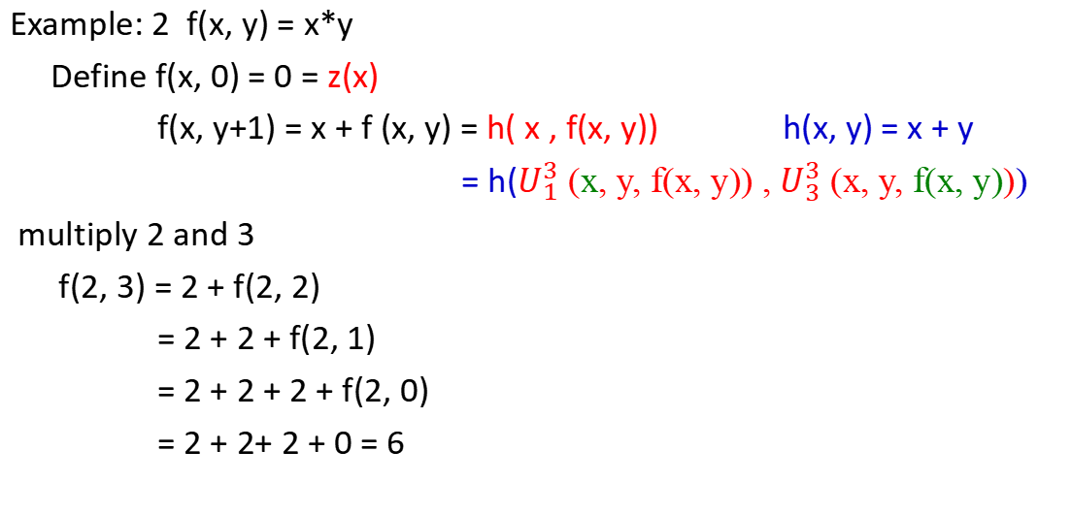
Example: 2 f(x, y) = x*y
Define f(x, 0) = 0 = z(x)
f(x, y+1) = x + f (x, y) = h( x , f(x, y)) h(x, y) = x + y
= h($U_{1}^{3}$ (x, y, f(x, y)) , $U_{3}^{3}$ (x, y, f(x, y)))
multiply 2 and 3
f(2, 3) = 2 + f(2, 2)
= 2 + 2 + f(2, 1)
= 2 + 2 + 2 + f(2, 0)
= 2 + 2+ 2 + 0 = 6

Slide 73
Example:3
f(x, y) = x – y if x ≥ y
= 0 if x < y
Now, we define the predecessor function
pred(0) = 0
pred(y + 1) = y
And from it, the subtraction function
subtr(x, 0) = x
subtr(x, y+1) = pred(subtr(x, y))

Slide 74
To prove that 5 – 3 = 2
subtr(5, 3) = pred(subtr(5, 2))
= pred(pred(subtr(5, 1)))
= pred(pred(pred(subtr(5, 0))))
= pred(pred(pred(5)))
= pred(pred(4))
= pred(3)
= 2

Slide 75
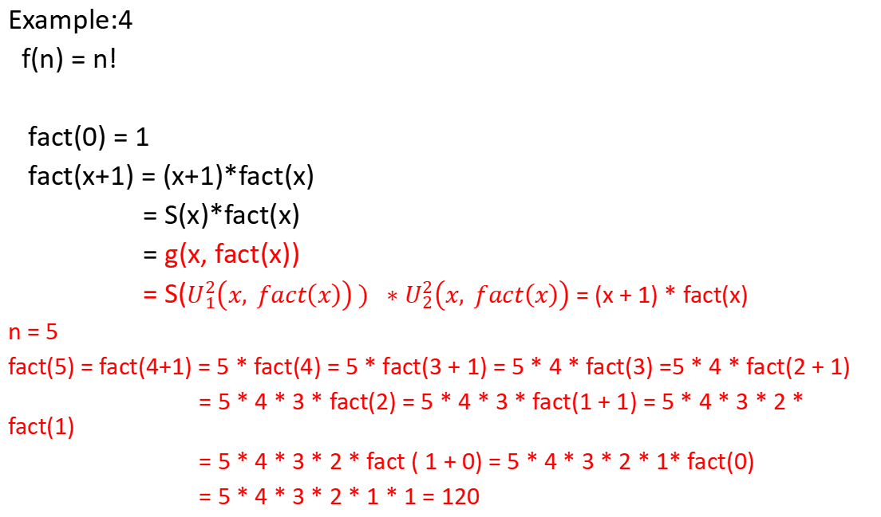
Example:4
f(n) = n!
fact(0) = 1
fact(x+1) = (x+1)*fact(x)
= S(x)*fact(x)
= g(x, fact(x))
= S($U_{1}^{2}\left(x, fact\left(x\right)\right) ) ∗$ $U_{2}^{2}\left(x, fact\left(x\right)\right)$ = (x + 1) * fact(x)
n = 5
fact(5) = fact(4+1) = 5 * fact(4) = 5 * fact(3 + 1) = 5 * 4 * fact(3) =5 * 4 * fact(2 + 1)
= 5 * 4 * 3 * fact(2) = 5 * 4 * 3 * fact(1 + 1) = 5 * 4 * 3 * 2 * fact(1)
= 5 * 4 * 3 * 2 * fact ( 1 + 0) = 5 * 4 * 3 * 2 * 1* fact(0)
= 5 * 4 * 3 * 2 * 1 * 1 = 120

Slide 76
Church-Turing Thesis
Alonzo Church (1903-1995) Lambda Calculus (λ – Calculus)
Emil Post (1897-1954) Post System
Kurt Godel (1906-1978) The incompleteness theorem (Godel number)
Alan Turing (1912-1954) Turing Machine

Slide 77
In 1936, Church created a method for defining functions called the lambda calculus (λ-calculus).
Within λ-calculus, he defined an encoding of the natural numbers called the Church numerals.
A function on the natural numbers is called λ-computable if the corresponding function on the Church numerals can be represented by a term of the λ-calculus (which is equivalent to using general recursive functions).
In the same 1936, before learning of Church's work, Alan Turing (Turing arrived at Princeton in 1936 and Alonzo Church was Turing's PhD Advisor) created a theoretical model for machines, now called Turing machines, that could carry out calculations from inputs by manipulating symbols on a tape.

Slide 78
Given a suitable encoding of the natural numbers as sequences of symbols, a function on the natural numbers is called Turing computable if some Turing machine computes the corresponding function on encoded natural numbers.
In computability theory, the Church–Turing thesis is a hypothesis ("thesis") about the nature of computable functions. In simple terms, the Church–Turing thesis states that a function on the natural numbers is computable in an informal sense (i.e., computable by a human being using a pencil-and-paper method, ignoring resource limitations) if and only if it is computable by a Turing machine.

Slide 79
Post Correspondence Problem (PCP)
Def: An instance of a Post Correspondence Problem (PCP) consists of two lists,
A = w₁ , w₂ , w₃ , . . . , w_{k}
B = x₁ , x₂ , x₃ , . . . , x_{k} of strings over Σ.
This instance of PCP has a unique solution if there is any sequence of integers
i₁ , i₂ , i₃ , . . . , i_{m} with m ≥ 1
1≤ i_{j} ≤ m
such that
w_{i1}w_{i2} w_{i3} . . . w_{im} = x_{i1} x_{i2} x_{i3} . . . x_{im}

Slide 80
Example:1
List A List B
1) 1 111
2) 10111 10
3) 10 0
(2) w 10111 (3) w 101111110
x 10 x 101111110
(1) w 101111
x 10111 w = x
(1) w 1011111 solution: 2 1 1 3
x 10111111 2 1 1 3 2 1 1 3 2 1 1 3 2 1 1 3 . . .

Slide 81
Example:2
List A List B
1) 10 101
2) 011 11
3) 101 011
(1) w 10 (3) w 10101101
x 101 x 101011011
(1) w 1010
x 101101
(3) w 10101 This problem has no solution.
x 101011

Slide 82
Example:3
List A List B
1) bbab a
2) ab abbb
3) baa aa
4) b bbb
(2) w ab (3) w abbbabbbaa
x abbb x abbbabbbaa
(1) w abbbab
x abbba w = x
(4) w abbbabb solution: 2 1 4 3
x abbbabbb 2 1 4 3 2 1 4 3 2 1 4 3 2 1 4 3 . . .

Slide 83
Example:4
List A List B
1) aab aba
2) bb bba
3) aaaa b
(2) w bb (3) w bbaaaa
x bba x bbab
(1) w bbaab
x bbaaba This problem has no solution.

Slide 84
Given an instance of PCP does it have a solution?
This problem is undecidable.
To prove this we need to define a modified PCP.

