Slide 1


BCSE304L - Theory of Computation
Dr. R. Arumuga Arun,
Cabin : PRP 315(A&B)-19,
Mailid : arumugaarun.r@vit.ac.in.
Winter-Semester 2023-2024
SCOPE
1

Slide 2

Module 7 – Recursive and Recursively Enumerable Languages
Recursive and Recursively Enumerable Languages, Language that is not Recursively Enumerable (RE) – computable functions – Chomsky Hierarchy – Undecidable problems -Post’s Correspondence Problem
Topic: Recursive and Recursively Enumerable Languages, Language that is not Recursively Enumerable (RE)
5

Slide 3
Decidable Vs undecidable languages
Decidable Language | Undecidable Language
A language is decidable iff there is a TM, M such that M accepts every string in Language, L and rejects the string that is not in L | A language is undecidable if there is no algorithm and we cannot predict whether the input is accepted by TM or not. [no algorithm, no solution to the problem]
Ex: The string over alphabet {a, b} that has equal number of a’s and b’s. The string over alphabet {0, 1} that begins with 01. | Ex: For any TM, with any given string, w, does the TM, M halt for the input string, w? Membership problem.

Slide 4
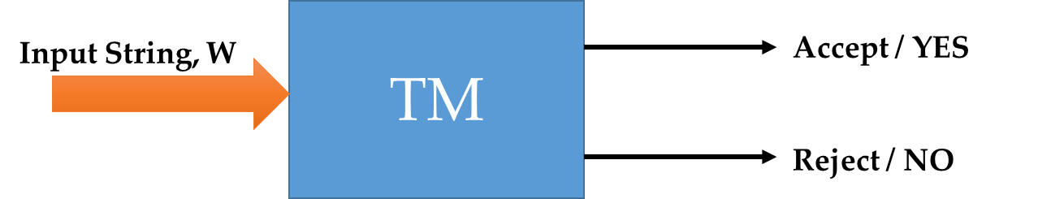
Recursive language
A language is recursive language if there exists a TM, M such that the TM accepts the strings that are in language, L and reject those strings that are not in the language, L
If the string ‘w’ is in L, then M accepts and TM halts. If ‘w’ is not in the language, L then M halts without entering the accepting state

Slide 5
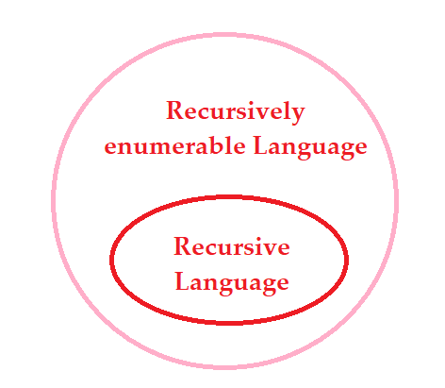
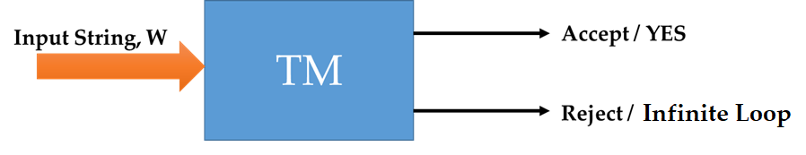
Recursively Enumerable (RE) language
A language is recursive enumerable language if there exists a TM, M that accepts the strings that are in language, L and reject those strings that are not in the language, L and it may cause the TM to enter into infinite loop.

Slide 6
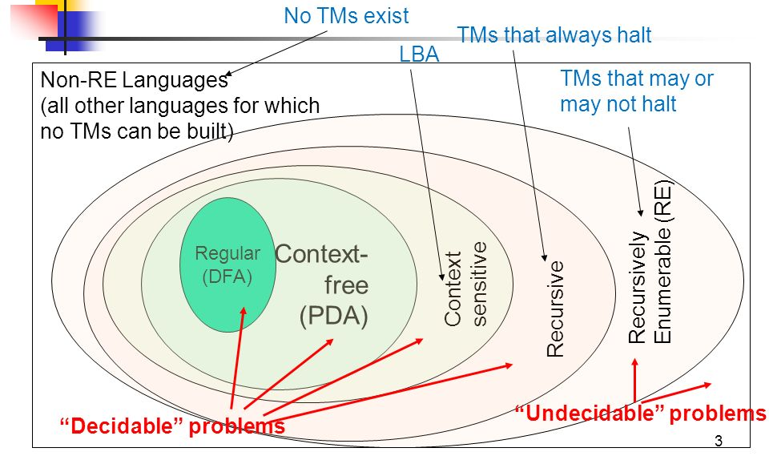
Representation

Slide 7
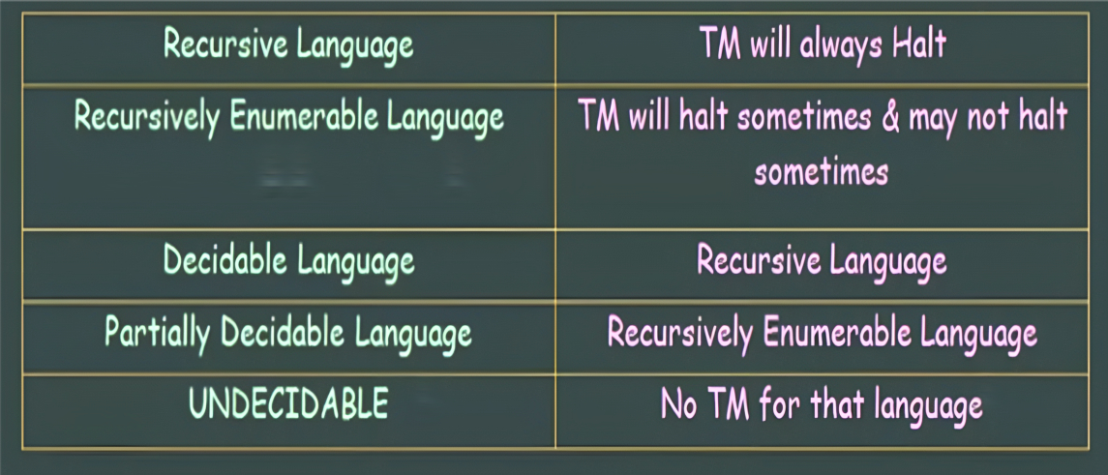
Summary

Slide 8
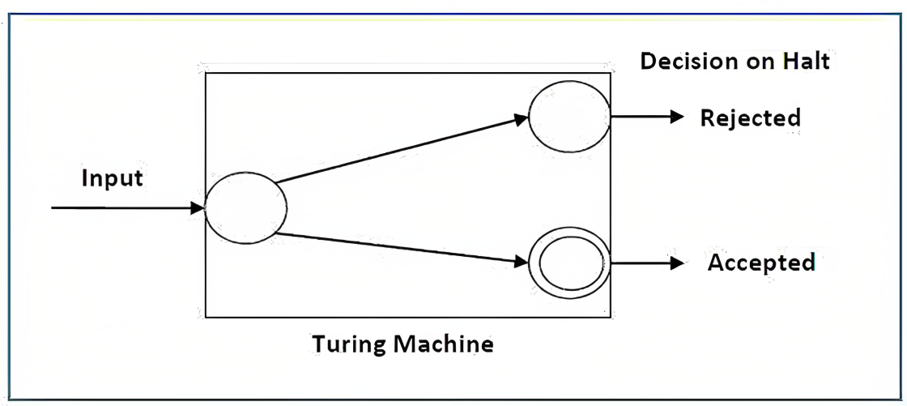
Decidable Problem
For a decidable language, for each input string, the TM halts either at the accept or the reject state.

Slide 9
Example 1
Find out whether the following problem is decidable or not −
Is a number ‘m’ prime?
Solution
Prime numbers = {2, 3, 5, 7, 11, 13, …………..}
Divide the number ‘m’ by all the numbers between ‘2’ and ‘√m’ starting from ‘2’.
If any of these numbers produce a remainder zero, then it goes to the “Rejected state”, otherwise it goes to the “Accepted state”. So, here the answer could be made by ‘Yes’ or ‘No’.
Hence, it is a decidable problem.

Slide 10
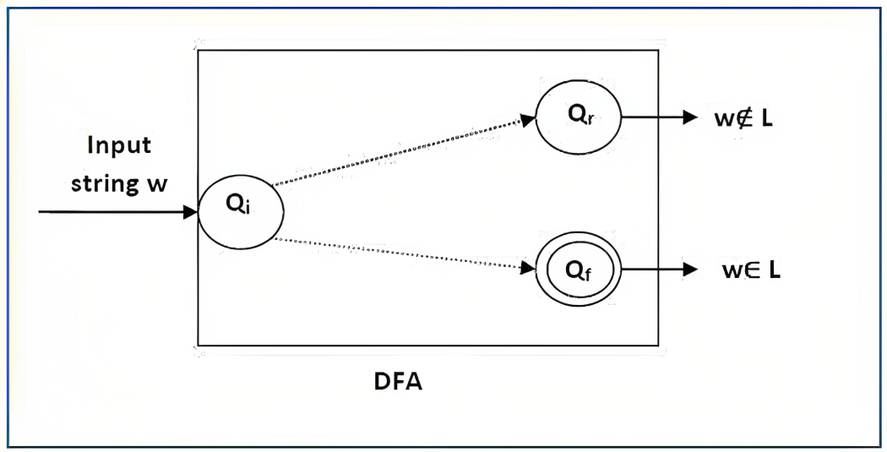
Example 2
Given a regular language L and string w, how can we check if w ∈ L?
Solution
Take the DFA that accepts L and check if w is accepted

Slide 11
Language
If a language L is decidable, then its complement L' is also decidable.
If A is decidable by some TM M, the enumerator operates by generating the strings in lexicographic order, testing each in turn for membership in A using M, and printing the string if it is in A

Slide 12
Undecidable Languages
For an undecidable language, there is no Turing Machine which accepts the language and makes a decision for every input string w (TM can make decision for some input string though).
A decision problem P is called “undecidable” if the language L of all yes instances to P is not decidable.
Undecidable languages are not recursive languages, but sometimes, they may be recursively enumerable languages.

Slide 13
Example
The halting problem of Turing machine
The Post correspondence problem
The undecidability of the string is determined with the help of Post Correspondence Problem (PCP)

Slide 14
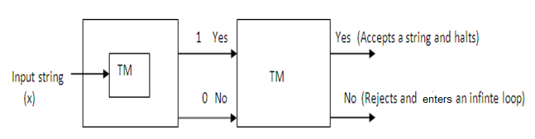
Theorem1
Statement: Every recursive language is Recursively enumerable.
T(RL) U(REL)
If T is TM recognizing T(RL) then we can get a TM, U that accepts the language L by modifying T so that when the output is 0 it may halt or into an infinite loop.

Slide 15
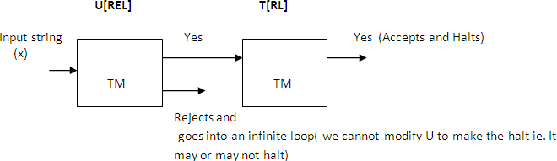
Theorem 2
Statement: Every REL is not recursive.

Slide 16
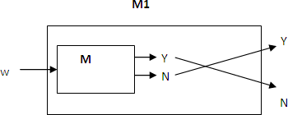
Theorem 3
Statement: The complement of a RL is recursive (or) If L is recursive, so is L′.
Let L be a Recursive Language and M be the TM that halts on all inputs and accepts L.
Construct M1 for L′.
M accepts and halts for Yes, then M1 rejects and halts.
M rejects and halts for N, then M1 accepts and halts.

Slide 17
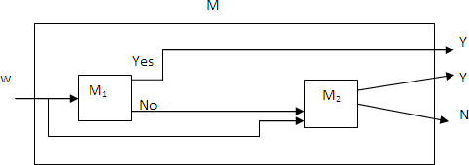
Theorem: Union of two recursive languages is recursive
Let L1 and L2 be the Recursive languages accepted by TMs M1 and M2.
Construct M:
It first simulates M1, If Yes then M accepts.
If M1 rejects, then M simulates M2 and accepts if and only if M2 accepts.
M accepts L1UL2.

Slide 18
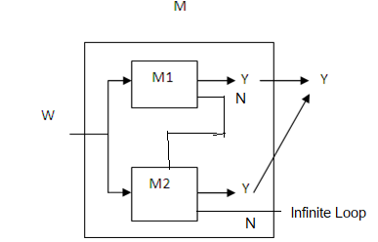
Theorem: Union of two Recursively Enumerable Languages is REL.
Let L1 and L2 be the Recursive Enumerable languages accepted by TMs M1 and M2.
M simultaneously simulates M1 and M2.
If either accepts, then M accepts .i.e. M accepts L1UL2.

Slide 19
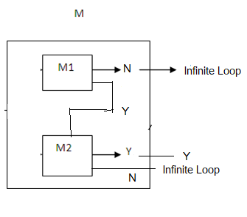
Theorem: Intersection of two recursively enumerable languages is REL.
Let L1 and L2 be the Recursive Enumerable languages accepted by TMs M1 and M2.
M halts if both M1 and M2 halts.
M will never halt if either M1 or M2 enter into infinite loop.
(i.e.)M accepts L1∩L2.

Slide 20
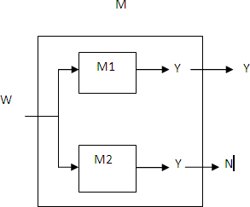
Theorem 5:
Statement: If a Language L and its complement L′ are both Recursively Enumerable, then L U L’ is recursive.

Slide 21
Theorem 5:
Statement: If a Language L and its complement L′ are both Recursively Enumerable, then L UL′ is recursive.
Let M1 and M2 be the TMs accepting L and L’ respectively.
M simultaneously simulates M1 and M2.
M1 accepts L and M2 accepts L′
If input to M is in L then M1 accepts and hence M accepts and halts. If input to M is not in L then M2 accepts and halts and hence M halts. Hence M halts on every input and so it is recursive.

Slide 22
Theorem Statements
Every recursive language is Recursively enumerable.
Every REL is not recursive
The complement of a RL is recursive (or) If L is recursive, so is L’.
Union of two recursive languages is recursive.
Union of two recursively enumerable languages is REL.
Intersection of two recursively enumerable languages is REL.
If a Language L and its complement L’ are both Recursively Enumerable, then L and hence L’ are recursive.

Slide 23
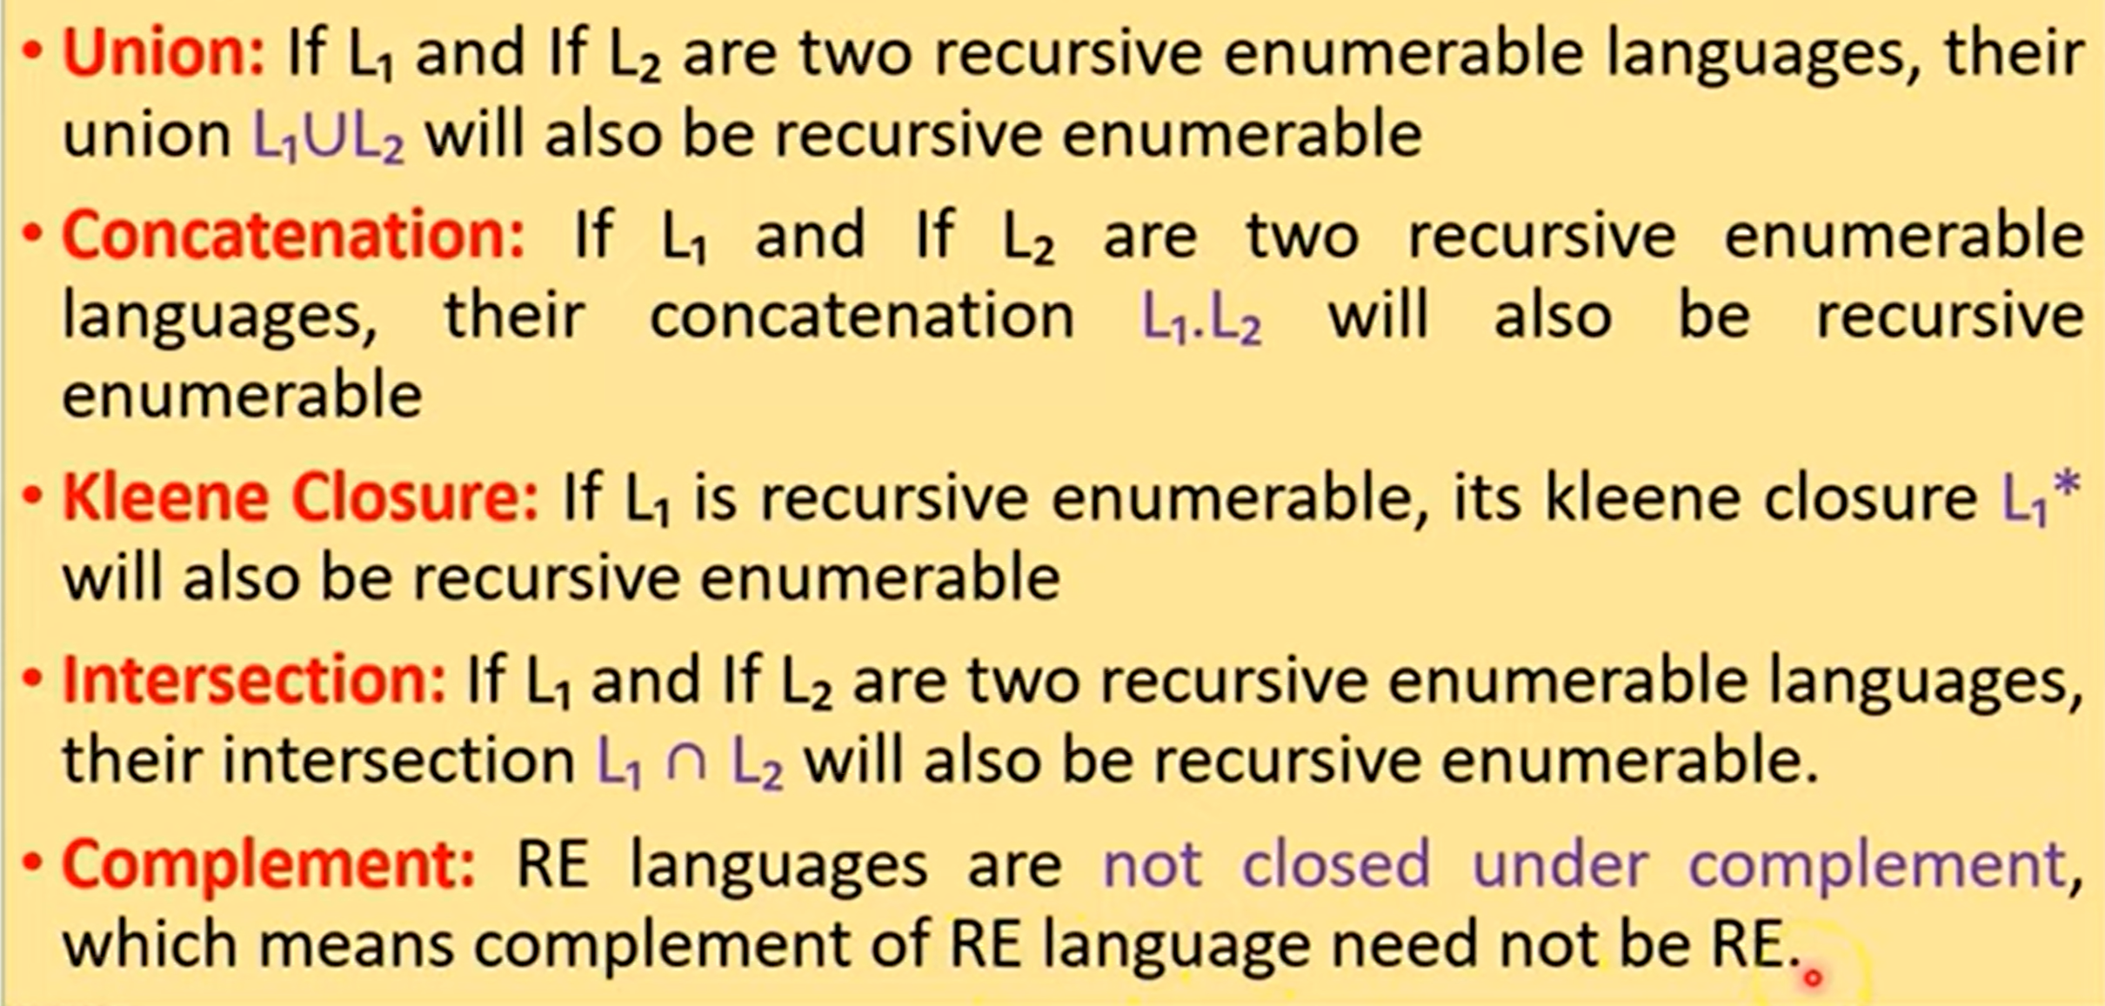
Properties of Recursive Enumerable Language (RE)

Slide 24
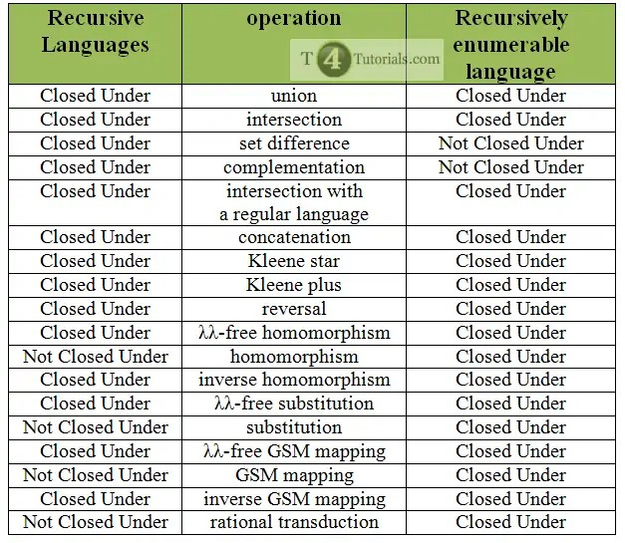
Summary of Closure properties of Recursive languages and Recursively Enumerable language

