Slide 1


BCSE304L - Theory of Computation
Dr. R. Arumuga Arun,
Cabin : PRP 315(A&B)-19,
Mailid : arumugaarun.r@vit.ac.in.
Winter-Semester 2023-2024
SCOPE
1

Slide 2

Module 7 – Recursive and Recursively Enumerable Languages
Recursive and Recursively Enumerable Languages, Language that is not Recursively Enumerable (RE) – computable functions – Chomsky Hierarchy – Undecidable problems -Post’s Correspondence Problem
Topic: Post’s Correspondence Problem, Computable functions
5

Slide 3
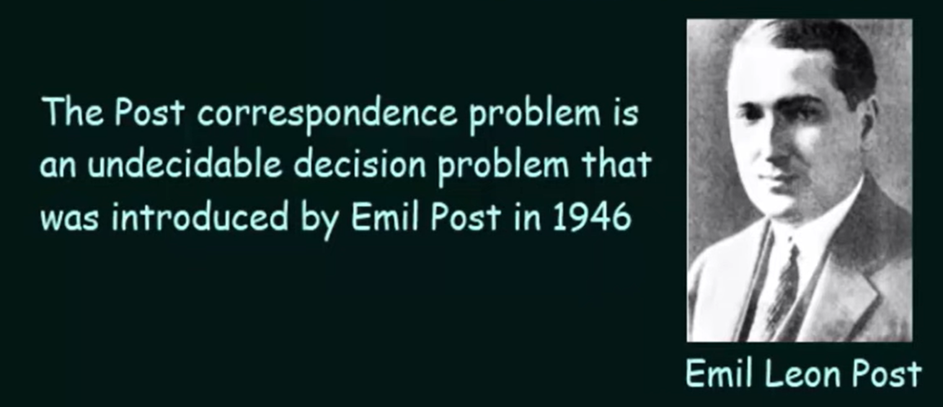
Post Correspondence Problem (PCP)
Devised by Emli Post
An abstract problem that involves string rather than TMs.
Tool for proving problems in logic or in formal language theory to be undecidable.

Slide 4
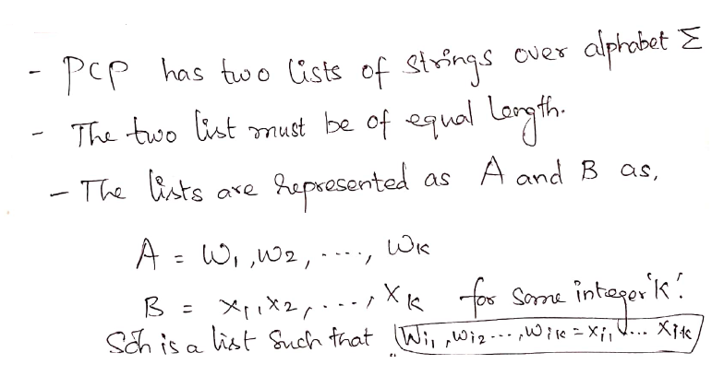
Definition

Slide 5
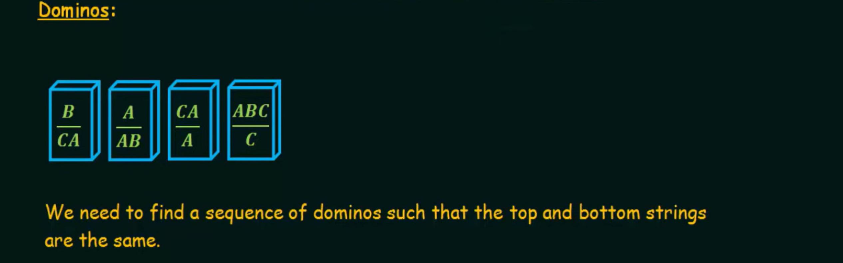
Example 1

Slide 6
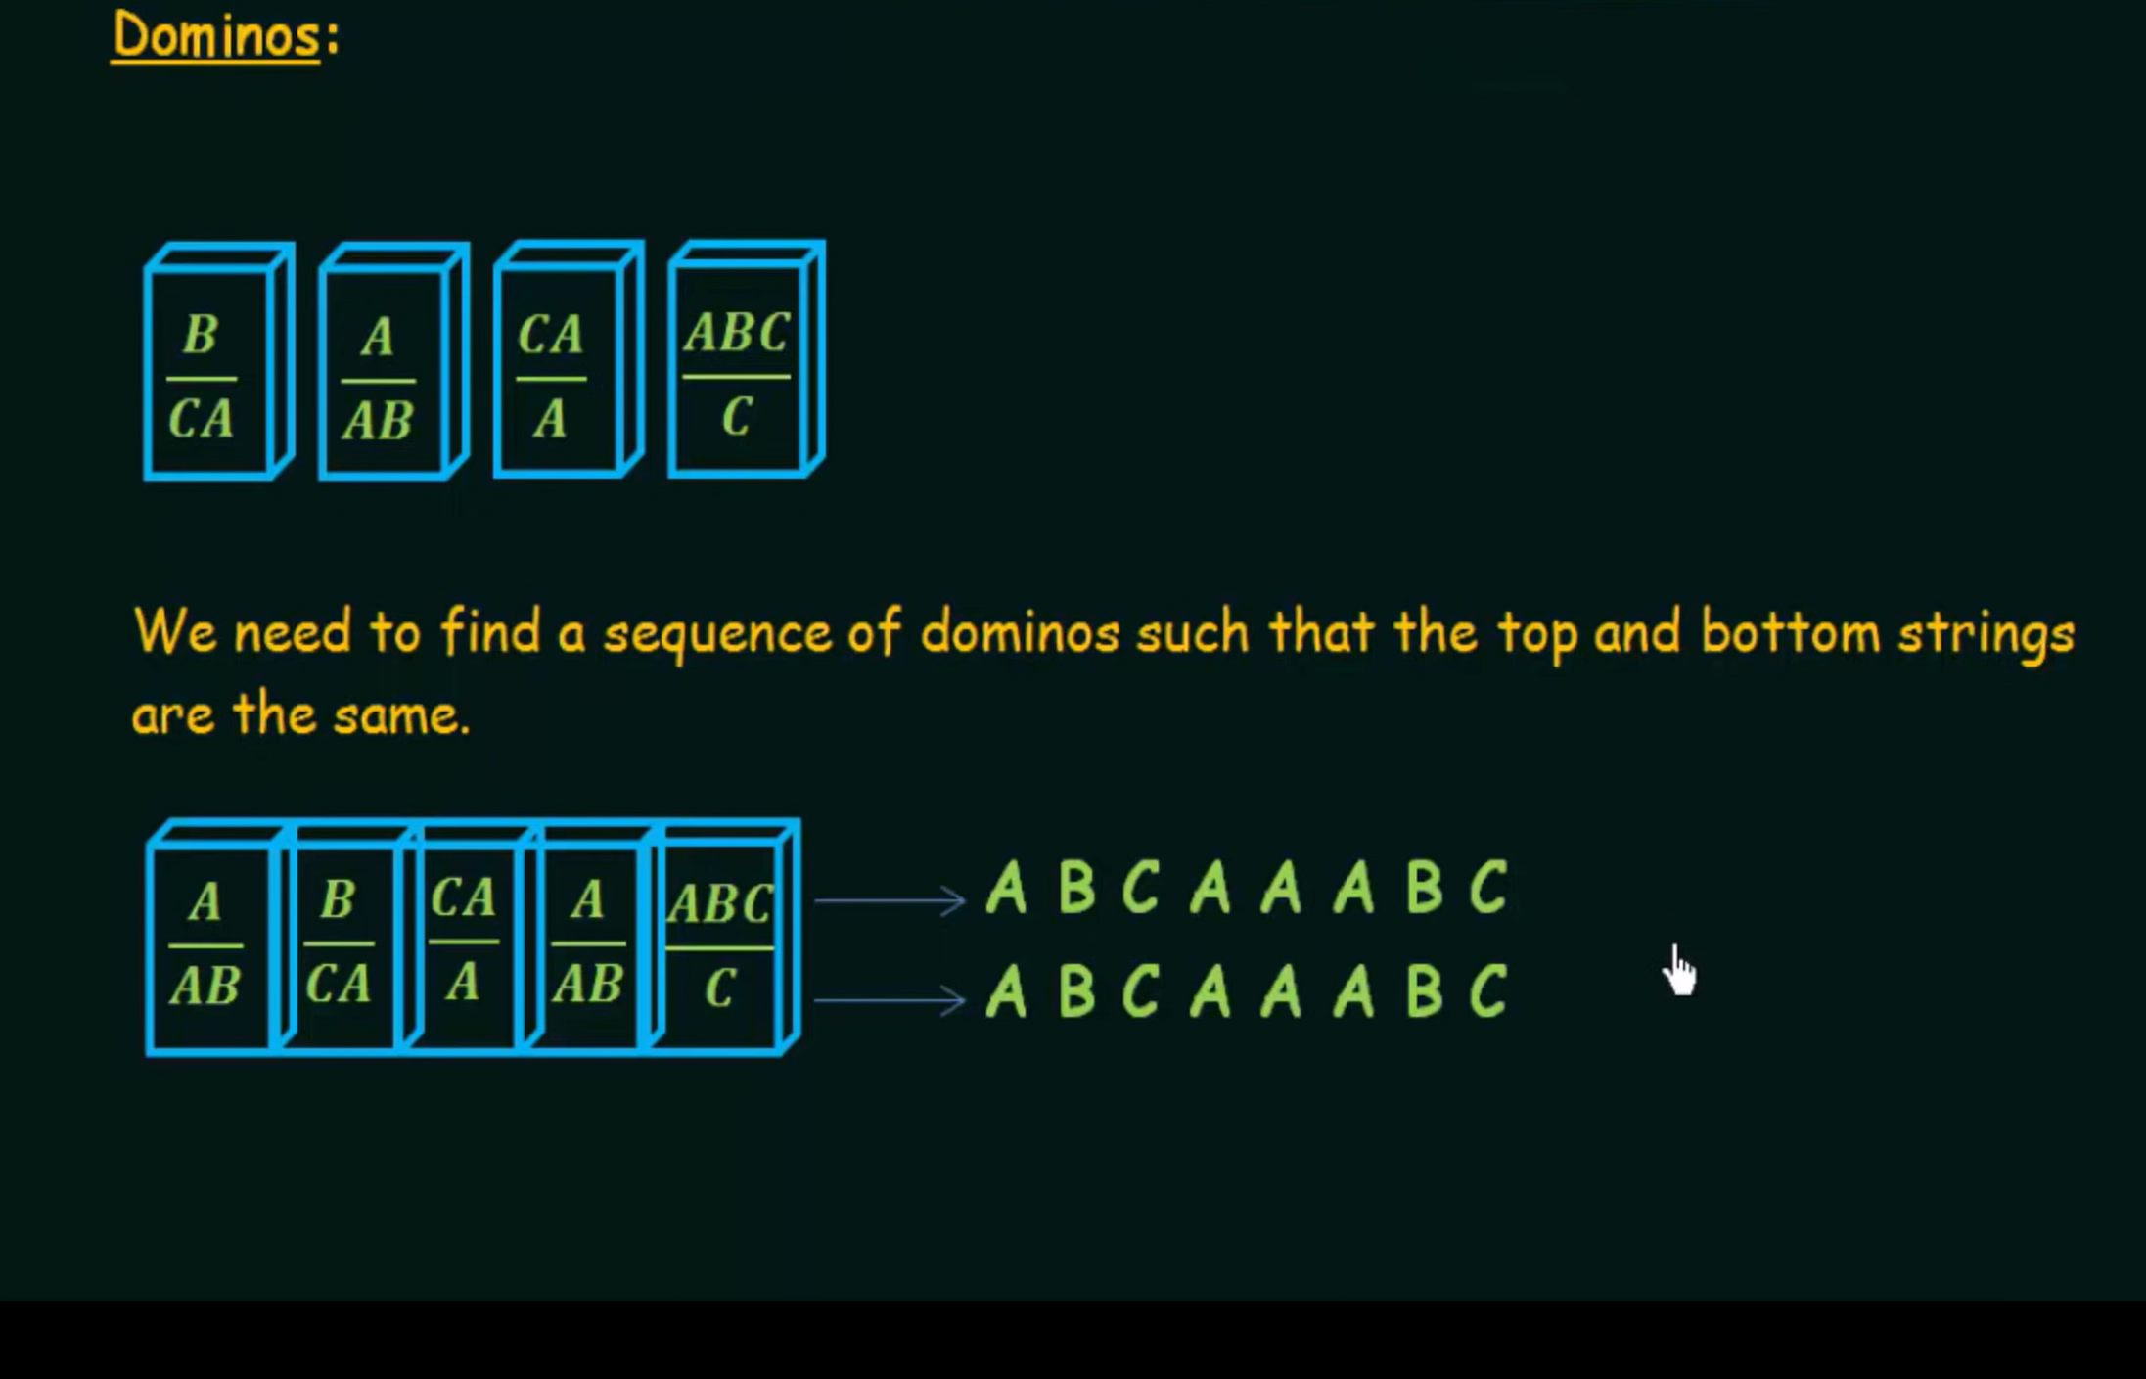
Solution
Decidable – able to find the solution

Slide 7
Example: 2
List A List B
1) 1 111
2) 10111 10
3) 10 0
(2) w 10111
x 10
(1) w 101111
x 10111
(1) w 1011111
x 10111111
Decidable – able to find the solution
(3) w 101111110
x 101111110
w = x
solution: 2 1 1 3
2 1 1 3 2 1 1 3 2 1 1 3 2 1 1 3

Slide 8
Example: 3
List A List B
1) bbab a
2) ab abbb
3) baa aa
4) b bbb
(2) w ab
x abbb
(1) w abbbab
x abbba
(4) w abbbabb
x abbbabbb
Decidable – able to find the solution
(3) w abbbabbbaa
x abbbabbbaa
w = x
solution: 2 1 4 3
2 1 4 3 2 1 4 3 2 1 4 3

Slide 9
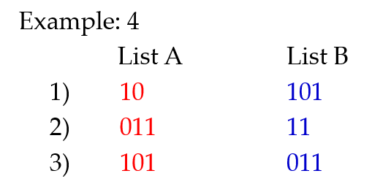

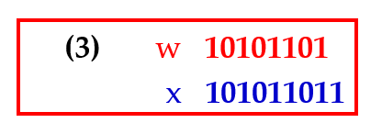
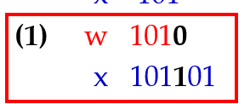


Slide 10
Example: 4
List A List B
1) 10 101
2) 011 11
3) 101 011
(1) w 10 (3) w 10101101
x 101 x 101011011
(1) w 1010
x 101101
(3) w 10101 This problem has no solution.
x 101011
Undecidable – not able to find the solution

Slide 11
Example: 5
List A List B
1) aab aba
2) bb bba
3) aaaa b
(2) w bb (3) w bbaaaa
x bba x bbab
(1) w bbaab
x bbaaba This problem has no solution.
(1) w bbaabaab
x bbaabaaba
Undecidable – not able to find the solution

Slide 12
Computable Functions
A recursive function is defined in terms of itself.
The recursive definition of factorial is
n! = n * (n-1)! for n ≥1
2. The recursive definition of the exponential x^{n} is defined as
x^{n} = x * x^{n-1} for n ≥1
A recursive function can be generalized by defining it in addition to in terms of itself, possibly in terms of some other functions.
Such generalization defines primitive recursion.
Turing machine is viewed as a mathematical model of partial recursive function.

Slide 13
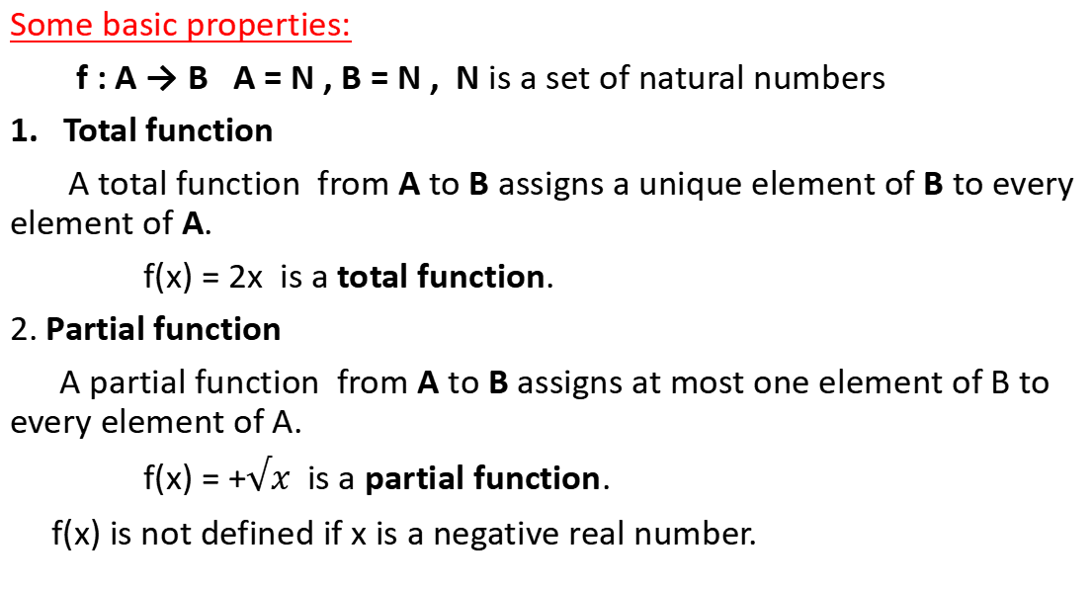
Some basic properties:
f : A → B A = N , B = N , N is a set of natural numbers
Total function
A total function from A to B assigns a unique element of B to every element of A.
f(x) = 2x is a total function.
2. Partial function
A partial function from A to B assigns at most one element of B to every element of A.
f(x) = +$√x$ is a partial function.
f(x) is not defined if x is a negative real number.

Slide 14
3. Function of k-variables
A function of k-variables is represented as f(x₁, x₂, . . . , x_{k}).
f(x₁, x₂) = x₁+2x₂ is a function of two variables.
4. Primitive recursive function
Some initial functions are taken as primitive recursive functions. These initial functions are:
a) Zero function
b) Successor function
c) Projection function
A function derived from combination / composition of primitive recursive functions is primitive recursive.

Slide 15
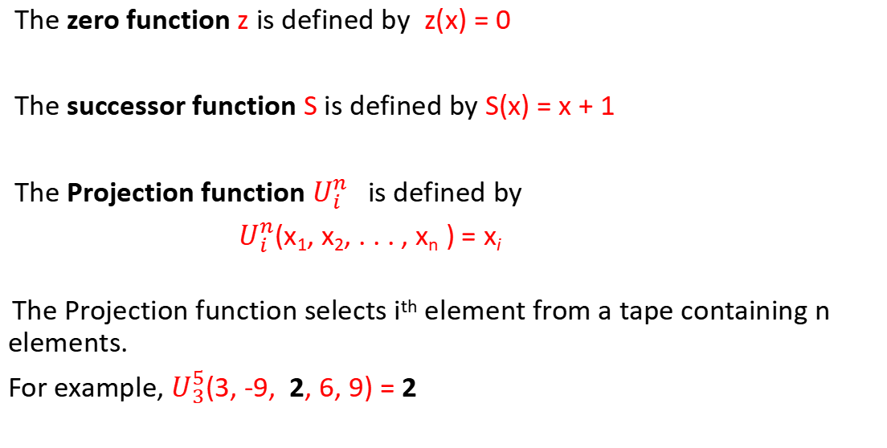
The zero function z is defined by z(x) = 0
The successor function S is defined by S(x) = x + 1
The Projection function $U_{i}^{n}$is defined by
$U_{i}^{n}$(x₁, x₂, . . . , x_{n} ) = x_{i}
The Projection function selects i^{th} element from a tape containing n elements.
For example, $U_{3}^{5}$(3, -9, 2, 6, 9) = 2

Slide 16
5. Composition
If f₁, f₂, . . . , f_{k} are partial functions of n variables, and g is a partial function of k variables, then the composition of g with f₁, f₂, . . . , f_{k} is a partial function of n variables defined by
g(f₁(x₁, x₂, . . . , x_{n}), f₂(x₁, x₂, . . . , x_{n}), . . . , f_{k}(x₁, x₂, . . . , x_{n}) )
For example:
If f₁(x, y) = x + y , f₂(x, y) = 3x , f₃(x, y) = xy and g(x, y, z) = x + y + 2z be functions over N, then
g(f₁(x, y), f₂(x, y), f₃(x, y)) = ( (x + y) + (3x) + 2(xy)) = (x + y + 3x + 2xy)
= (4x + y + 2xy)
If the composition g with f₁, f₂ and f₃ is by a function h, then
h(x, y, z) = 4x + y + 2xy

Slide 17
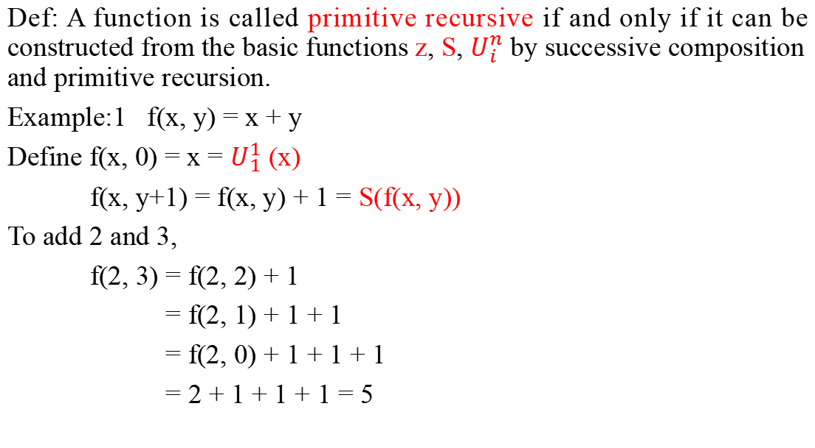
Def: A function is called primitive recursive if and only if it can be constructed from the basic functions z, S, $U_{i}^{n}$ by successive composition and primitive recursion.
Example:1 f(x, y) = x + y
Define f(x, 0) = x = $U_{1}^{1}$ (x)
f(x, y+1) = f(x, y) + 1 = S(f(x, y))
To add 2 and 3,
f(2, 3) = f(2, 2) + 1
= f(2, 1) + 1 + 1
= f(2, 0) + 1 + 1 + 1
= 2 + 1 + 1 + 1 = 5

Slide 18
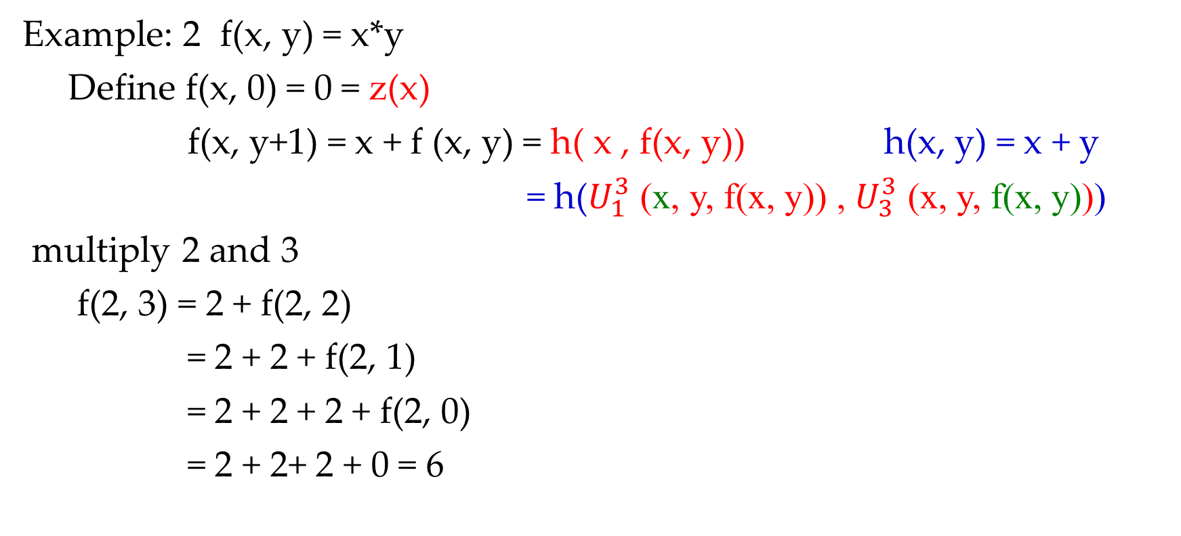
Example: 2 f(x, y) = x*y
Define f(x, 0) = 0 = z(x)
f(x, y+1) = x + f (x, y) = h( x , f(x, y)) h(x, y) = x + y
= h($U_{1}^{3}$ (x, y, f(x, y)) , $U_{3}^{3}$ (x, y, f(x, y)))
multiply 2 and 3
f(2, 3) = 2 + f(2, 2)
= 2 + 2 + f(2, 1)
= 2 + 2 + 2 + f(2, 0)
= 2 + 2+ 2 + 0 = 6

Slide 19
Example:3
f(x, y) = x – y if x ≥ y
= 0 if x < y
Now, we define the predecessor function
pred(0) = 0
pred(y + 1) = y
And from it, the subtraction function
subtr(x, 0) = x
subtr(x, y+1) = pred(subtr(x, y))

Slide 20
To prove that 5 – 3 = 2
subtr(5, 3) = pred(subtr(5, 2))
= pred(pred(subtr(5, 1)))
= pred(pred(pred(subtr(5, 0))))
= pred(pred(pred(5)))
= pred(pred(4))
= pred(3)
= 2

Slide 21
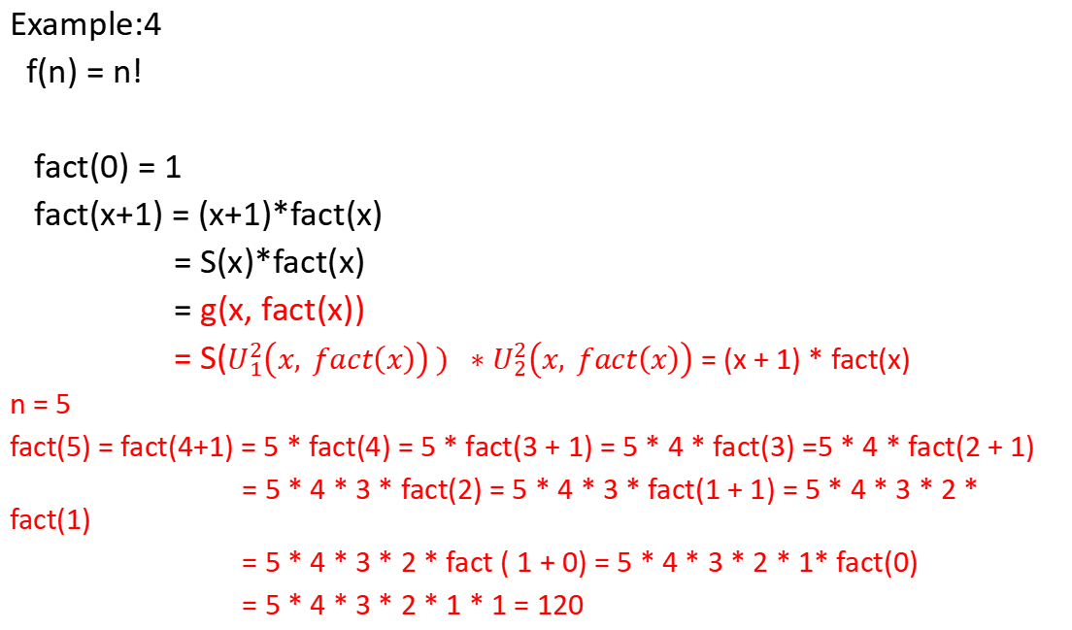
Example:4
f(n) = n!
fact(0) = 1
fact(x+1) = (x+1)*fact(x)
= S(x)*fact(x)
= g(x, fact(x))
= S($U_{1}^{2}\left(x, fact\left(x\right)\right) ) ∗$ $U_{2}^{2}\left(x, fact\left(x\right)\right)$ = (x + 1) * fact(x)
n = 5
fact(5) = fact(4+1) = 5 * fact(4) = 5 * fact(3 + 1) = 5 * 4 * fact(3) =5 * 4 * fact(2 + 1)
= 5 * 4 * 3 * fact(2) = 5 * 4 * 3 * fact(1 + 1) = 5 * 4 * 3 * 2 * fact(1)
= 5 * 4 * 3 * 2 * fact ( 1 + 0) = 5 * 4 * 3 * 2 * 1* fact(0)
= 5 * 4 * 3 * 2 * 1 * 1 = 120

