Slide 1
Samsung Innovation Campus

Slide 2
Student Performance Analysis
Harshit Srivastava(Team Leader)
Divya Bhakt
Chirag Kumar Jain
Guided By: Satish Kumar Dhiwar Sir

Slide 3
Student Performance Analysis
INTRODUCTION
Student Performance Analysis is a critical area of research that seeks to understand the factors influencing academic achievement. By examining various attributes such as student’s study hours, absence rate, career aspiration, study hours and individual characteristics, we can gain valuable insights into how students learn and succeed.
By exploring these aspects, this project aims to provide valuable insights into student performance and offer potential strategies for enhancing educational outcomes.
Student Performance Analysis
Notes:
Note:

Slide 4
Student Performance Analysis
PROBLEM STATEMENT
Understanding the factors influencing student’s performance which is crucial for developing effective educational strategies and interventions with the help of data-driven approach.
DESCRIPTION
To address the problem statement and gain insights into student performance, we employed a variety of visualization techniques to explore the relationships between different factors. Which can help the stakeholders to follow the data-driven decision in making educational policies.
Student Performance Analysis

Slide 5
Student Performance Analysis
TECHNOLOGY USED
Programming Language: Python
Data Manipulation: Pandas
Data Visualization: Matplotlib, Seaborn and Plotly
Student Performance Analysis

Slide 6
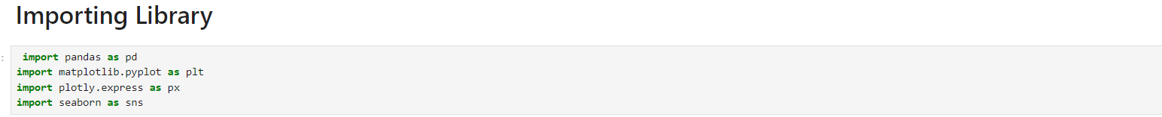
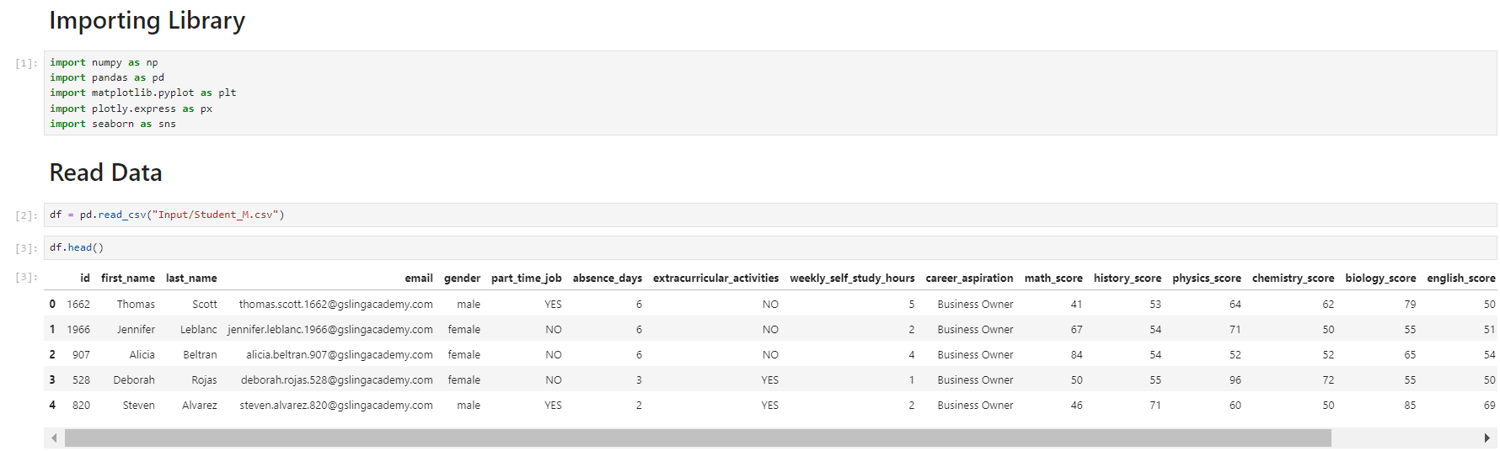
Student Performance Analysis
Student Performance Analysis

Slide 7
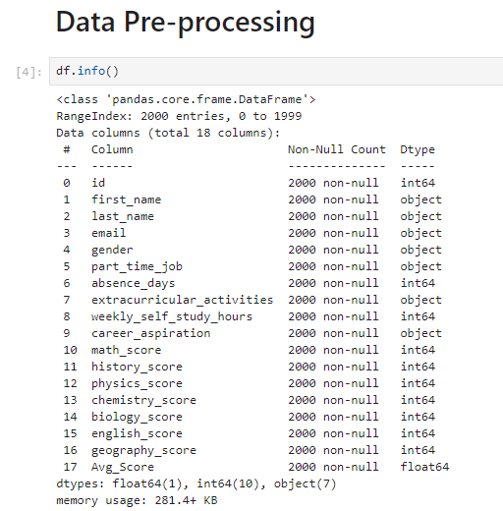
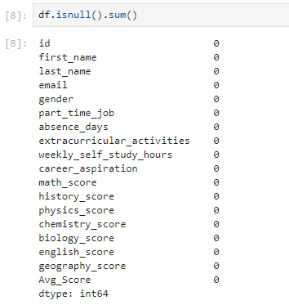
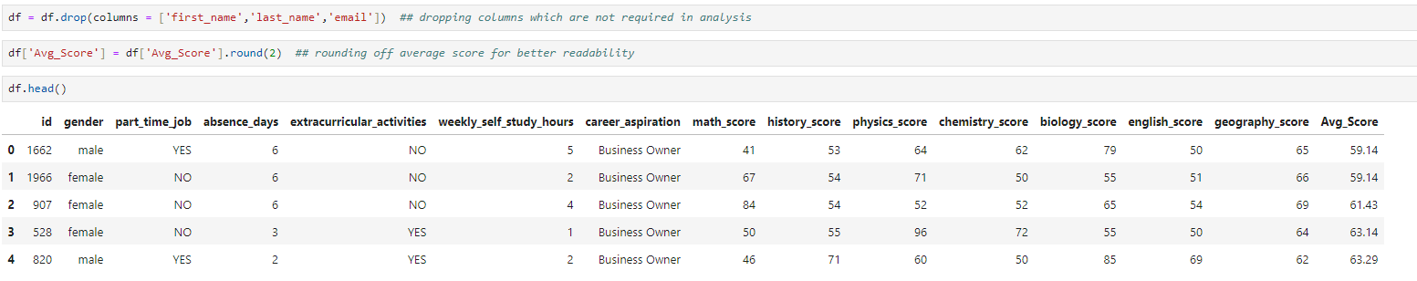
Student Performance Analysis

Slide 8

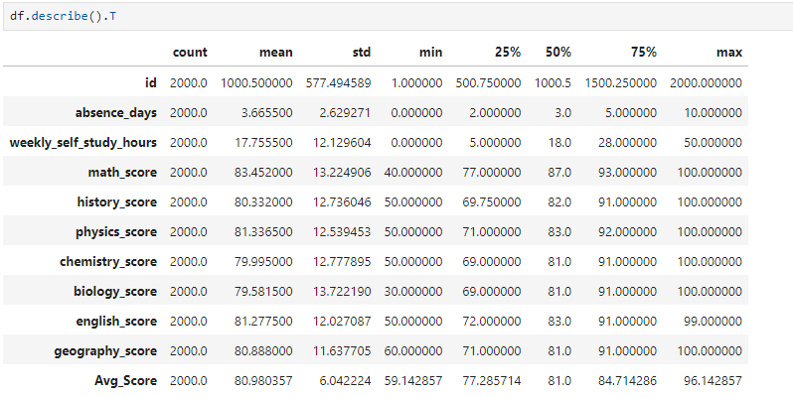
Student Performance Analysis
Student Performance Analysis

Slide 9
DATA VISUALIZATION
Student Performance Analysis
Student Performance Analysis

Slide 10
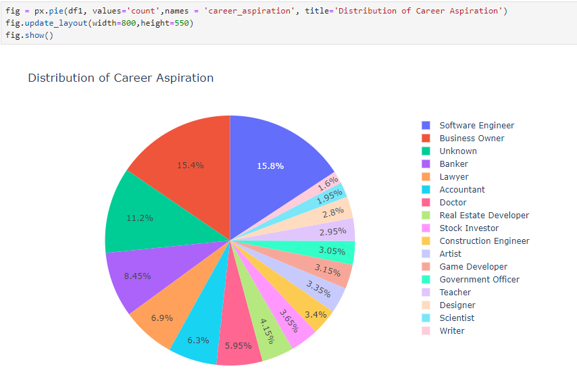
Student Performance Analysis
Student Performance Analysis

Slide 11
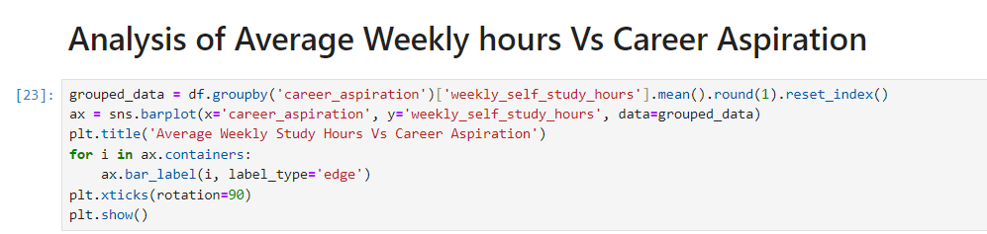
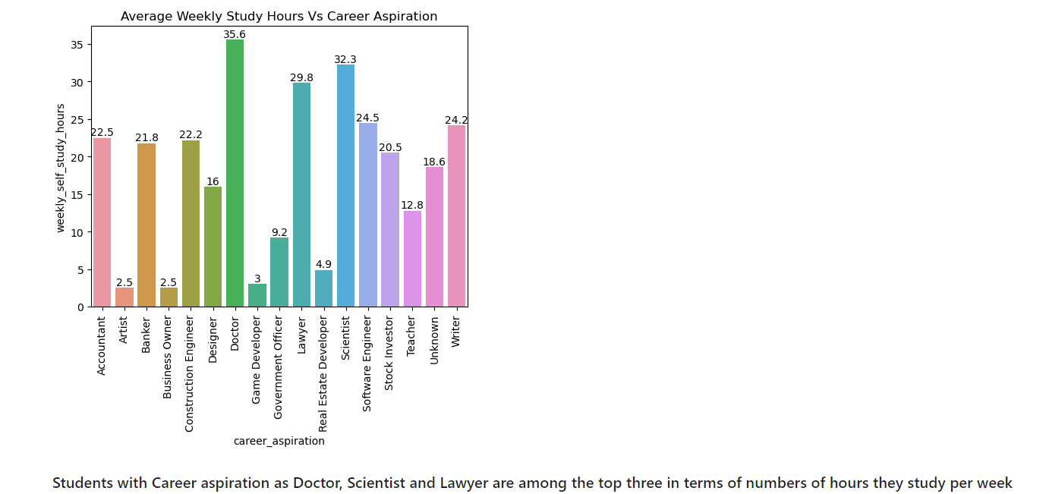
Student Performance Analysis
Student Performance Analysis

Slide 12
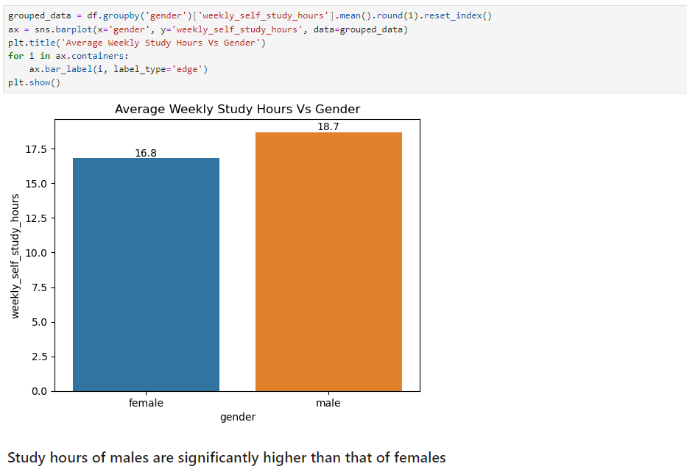
Student Performance Analysis
Student Performance Analysis

Slide 13
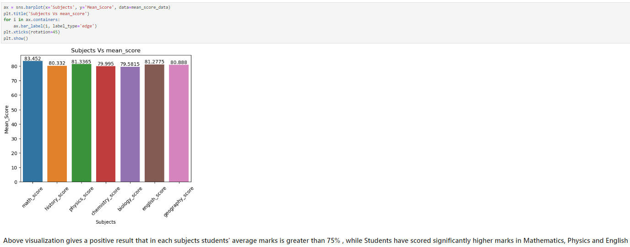
Student Performance Analysis
Student Performance Analysis

Slide 14
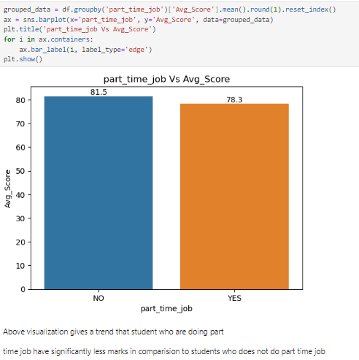
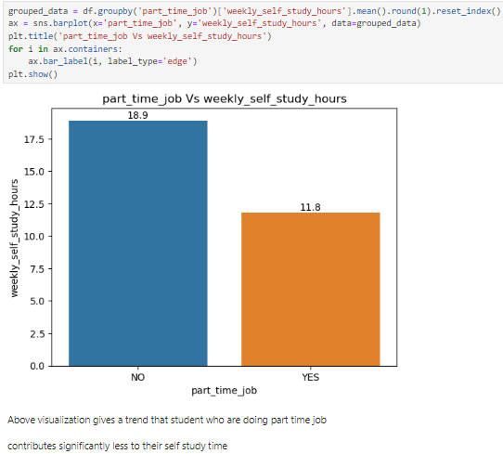
Student Performance Analysis
Student Performance Analysis

Slide 15
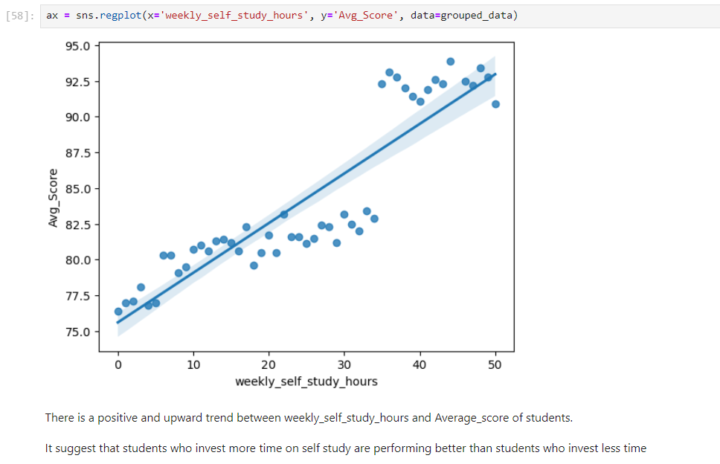
Student Performance Analysis
Student Performance Analysis

Slide 16
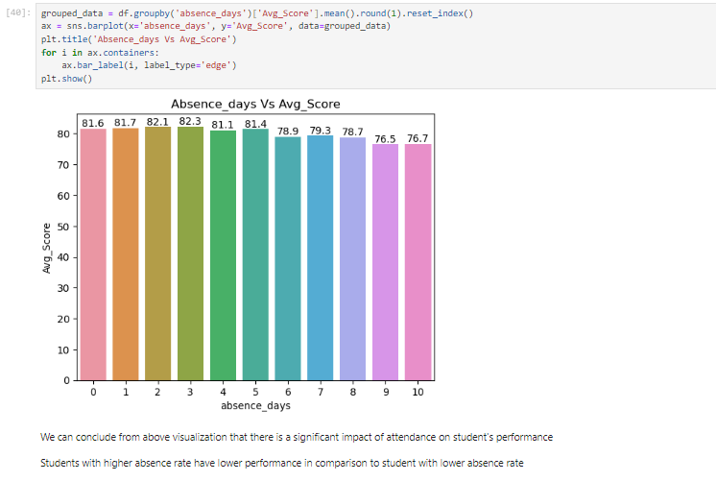
Student Performance Analysis
Student Performance Analysis

Slide 17
Student Performance Analysis
FUTURE SCOPE
While this project has provided valuable insights into student performance, there are several areas for future exploration:
Longitudinal Studies: Conducting longitudinal studies to track student performance over time can provide a deeper understanding of the impact of various factors on academic outcomes.
Comparative Analysis: Comparing student performance across different schools, regions, or countries can identify best practices and areas for improvement.
Teacher Impact: Analysing the impact of teacher characteristics, qualifications, and teaching styles on student outcomes.
Technology Integration: Exploring the role of technology in education and its impact on student learning and engagement.
Machine Learning: Applying machine learning algorithms to predict student performance and identify at-risk students.
Student Performance Analysis

Slide 18
Student Performance Analysis
CONCLUSION
Key Findings:
Self-Study and Performance: Students who invest more time in self-study tend to achieve higher average scores.
Absence and Performance: Students with frequent absences generally have lower average scores compared to regular students.
Part-Time Jobs and Self-Study: Students engaged in part-time jobs may allocate less time to self-study.
Data –Driven Suggestions:
Encourage Self-Study: Promote the importance of self-study among students, providing resources, guidance, and opportunities for independent learning.
Address Absenteeism: Implement strategies to reduce absenteeism, such as counselling, mentoring, or academic support programs for struggling students.
Balance Part-Time Jobs: Advise students on managing their time effectively to balance part-time work with academic commitments. Consider providing guidance on selecting part-time jobs that align with their academic goals.
Personalized Support: Offer personalized academic support, tutoring, or mentoring programs to students who may need extra assistance.
Student Performance Analysis

Slide 19
References:
Student Performance Analysis
1. Dataset: Kaggle https://www.kaggle.com/
2. Python official documentation: https://docs.python.org/3/
3. Matplotlib official documentation: https://matplotlib.org/stable/index.html
4. Seaborn official documentation: https://seaborn.pydata.org/
5. Plotly official documentation: https://plotly.com/python/
6. Pandas official documentation: https://pandas.pydata.org/
Student Performance Analysis

