Slide 1


SMART INDIA HACKATHON 2024
Problem Statement ID –1600
Problem Statement Title-Virtual Voice
Assistant Sara for the Handicap and Blind People to Make Them Use of Desktop
Theme-Innovation (Ministry of Education Innovation Cell)
PS Category- Software
Team ID-
Team Name- HealthByte Innovaters

Slide 2
VOICE ASSISTANT SARA
HealthByte
Innovaters
Key Features:-
What is SARA?
Voice Activated Control
Text to Speech Functionality
Task Automation
Multilingual Input
Speech Feedback
Desktop Navigation
1
Sara is a highly interactive, voice-controlled virtual assistant tailored for individuals with visual impairments or physical disabilities, allowing them to navigate and use a desktop environment with ease.
2
3
4
5
6

Slide 3
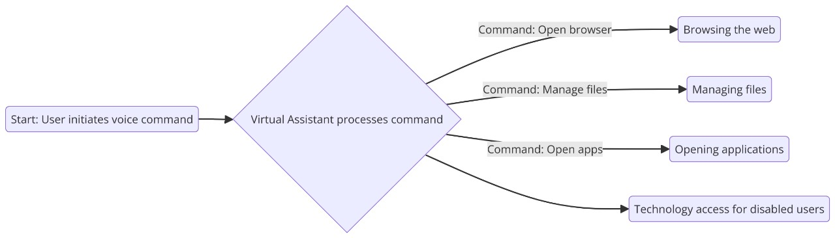
TECHNICAL APPROACH
HealthByte
Innovaters
Text-to-Speech (TTS) Engine
Process Management and Multithreading
Speech Recognition
Natural Language Understanding

Slide 4
FEASIBILITY AND VIABILITY
HealthByte
Innovaters
Fail Safe **
Multi Voice Recognition
Machine Learning Algorithms
Multilingual Response
Software Integration
End to End Personalization and Encryption
Complete Internet Navigation
Future innovations on if anything goes wrong
FUTURE OUTLOOKS

Slide 5
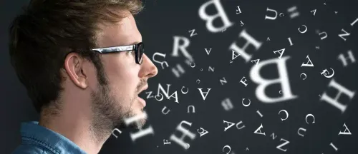
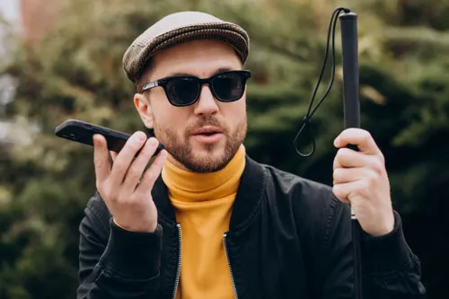
IMPACT AND BENEFITS
HealthByte
Innovaters
Impact of SARA
Empowerment of the Visually Impaired and Disabled
Enhanced Productivity
Digital Inclusion
Improved Quality of Life
Benefits of SARA
Accessibility Technology Easily and Independently
Remote work Enabled
Paperless Interaction

Slide 6
RESEARCH AND REFERENCES
HealthByte
Innovaters
Shresth Agarwal, Sukrit Tiwari, Vikas Tiwari, Sachin Yadav “ Voice Assistant For Physically Challenged Individuals: Enhancing Accessibility And Independence ” International Journal of Engineering Applied Sciences and Technology, 2023.
S. K. Sooraj, E. Sundaravel, Babu Shreesh and K. Sireesha, "Iot smart home assistant for physically challenged and elderly people", International Conference on Smart Electronics and Communication (ICOSEC), 2020.
Mullapudi Harshasri, Manyam Durga Bhavani and Misra Ravikanth, "Voice Based Email for Blind” International Journal of Innovative Research", Computer Science & Technology (IJIRCST) ISSN, 2021.
Akshay Sharma, Kirit Kaur, Savit Gautam and Others “Enhanced Virtual Assistant” International Journal of Engineering Applied Sciences and Technology 2023
Edriss Eisa Babikir Adam, "Deep Learning based NLP Techniques In Text to Speech Synthesis for Communication Recognition", Journal of Soft Computing Paradigm (JSCP), 2020.
Thakur, Amrita Pujan, Budhathoki, Sarmila Upreti, Shirish Shrestha and Subarna Shakya, "Real Time Sign Language Recognition and Speech Generation", Journal of Innovative Image Processing, 2020.
Sakshi Bajpai and D. Radha, "Smart phone as a controlling device for smart home using speech recognition", International Conference on Communication and Signal Processing (ICCSP), 2019.

