Slide 1


Car Rental System –Java OOPs Frontend Project
This presentation explains developing a car rental system using Java OOP concepts, which is created by the team named : Syntax Symphony
1.) Harshit Pandey (24SCSE1011227) {Leader}
2.) Shivam (24SCSE1010158)
3.)Shivanshu Mishra (24SCSE1010828)
4.) Sachin Poddar (24SCSE1010047)
B.Tech CSE – Section 13, Semester II
(2024 -2025)
Galgotias University
Note : Learn how classes, inheritance, polymorphism, and interfaces drive the design…!!
MADE BY Harshit
Notes:
1

Slide 2

What is OOP?
Object-Oriented Programming
Core Principles
Encapsulation
Organizes code as interacting objects representing real entities.
Inheritance
Polymorphism
Abstraction
Presentation Focus
Applying these principles to build a car rental system.
MADE BY Harshit
Notes:
2

Slide 3
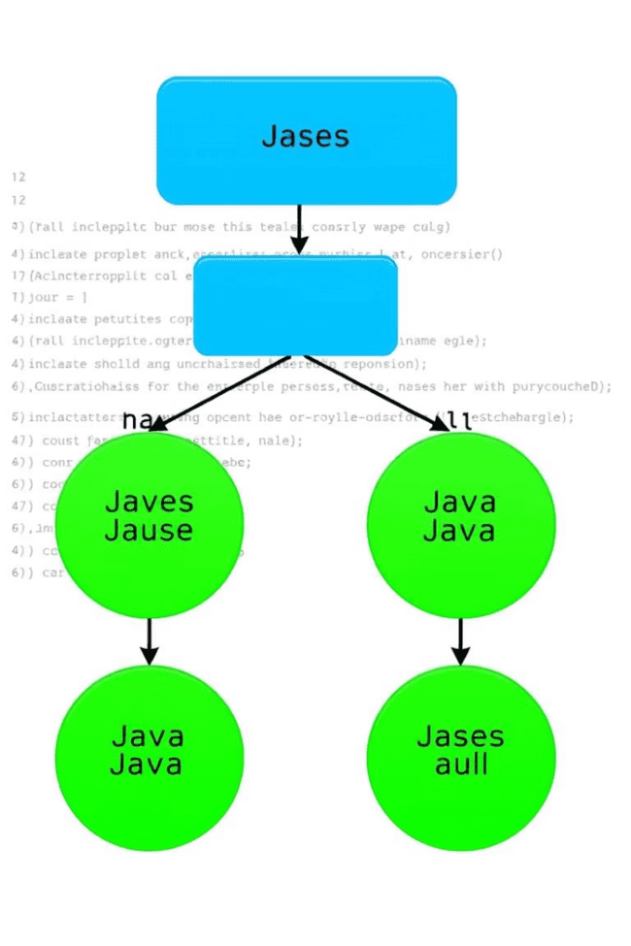
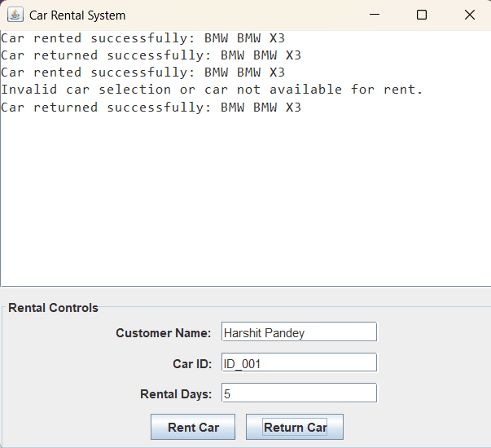

Project Overview
A GUI - based
Application for
Renting cars ,
Built using java
Objects and classes
Simulates real-world car rental operations:
Car selection → input (Name , Car id )→Booking
confirmination.
Key Features
JDK Version 24
IntelliJ IDEA
Desktop application
MADE BY Harshit
Notes:
3

Slide 4
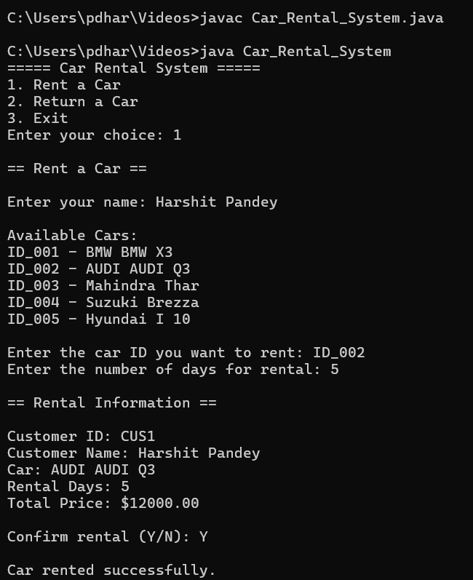
Encapsulation: Protecting Data
Definition
Combines data and methods into a single unit, hiding internals.
Data Hiding
Use private modifiers to guard sensitive fields inside classes.
Java Example
private String licensePlate; accessed via getLicensePlate() (Not Included)
MADE BY Harshit
Notes:
4

Slide 5
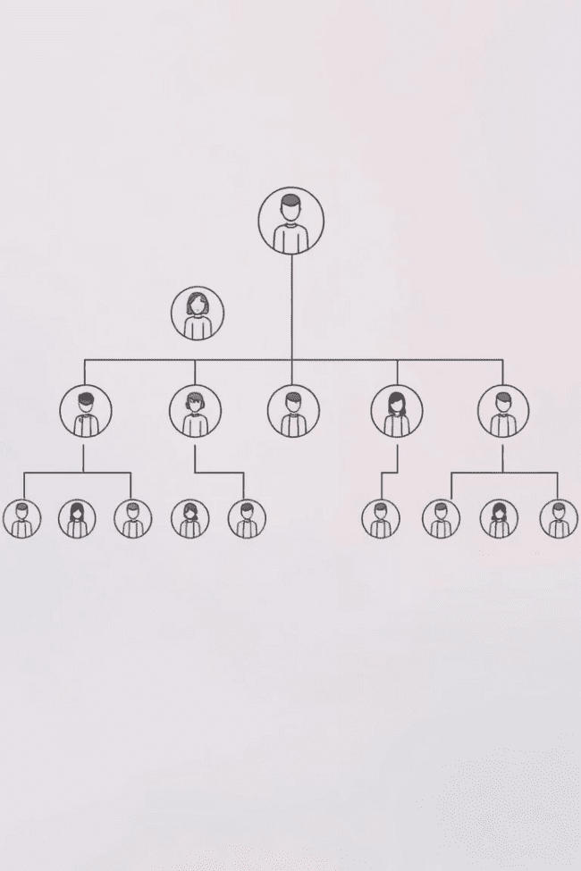



Inheritance: Reusability and Hierarchy
Superclasses & Subclasses
Subclasses inherit attributes and methods from superclasses.
Code Reuse
Reduces duplication by extending existing functionality.
Java Example
class ElectricCar extends Car { int batteryCapacity; }
MADE BY Harshit
Notes:
5

Slide 6



Polymorphism: Many Forms
Interface Implementation
2
Multiple classes can implement the same interface.
Method Overriding
1
Same method name, different behaviors in subclasses.
Benefits
3
Supports flexible and interchangeable objects.
MADE BY Harshit
Notes:
6

Slide 7
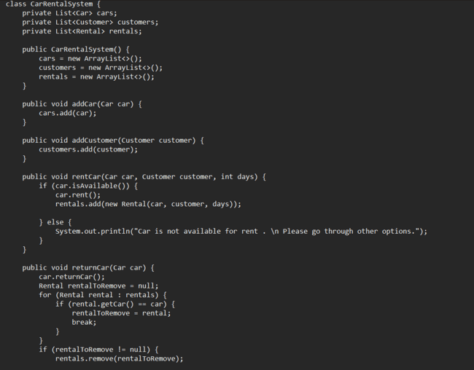
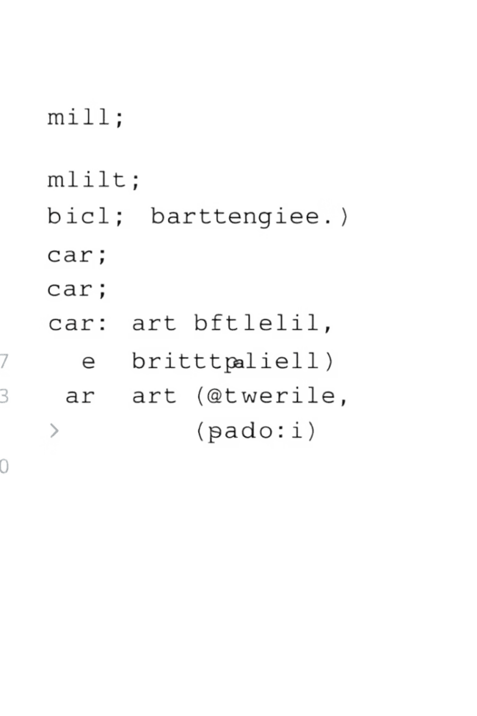
Polymorphism: Example Method Overriding
Base Class
Subclass Override
Effect
class Car { public String getDescription() { return "Generic car"; } }
Method behavior varies by object at runtime.
class ElectricCar extends Car { @Override public String getDescription() { return "Electric car"; } }
MADE BY Harshit
Notes:
7

Slide 8

Interfaces: Defining Contracts
What is an Interface?
Purpose
A contract specifying methods classes must implement.
Enables loose coupling and system flexibility.
Java Example
interface Rentable { boolean isAvailable(); double calculateRentalCost(int days); }
MADE BY Harshit
Notes:
8

Slide 9
Car Rental System: Putting It All Together
Key Classes
Relationships
OOP Benefits
Car
Customer rents Car; Rental generates Payment records; Confirmation Appears
Promotes maintainability and scalability for system growth.
Customer
Rental
Car Rental System
Future Scope
The car rental system can be enhanced with AI-driven dynamic pricing, real-time vehicle tracking, and predictive maintenance. Integration with electric and autonomous vehicles, mobile apps with voice assistance, and seamless digital payments will elevate user experience. Expanding to a shared mobility platform can also promote sustainability and cater to smart city initiatives.
MADE BY Harshit
Notes:
9

Slide 10
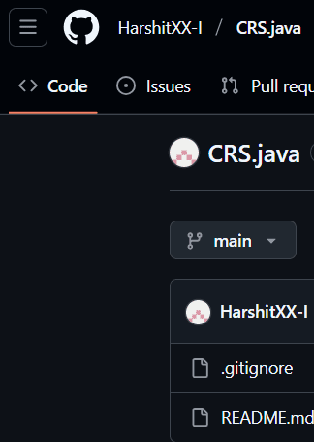
GitHub Repository
Code Is structured and publically readable .
README.md with setup instructions,
The content is as per the guidelines .
Link : https://github.com/HarshitXX-I/CRS.java
MADE BY Harshit
Notes:
10

