Slide 1


Slide 2
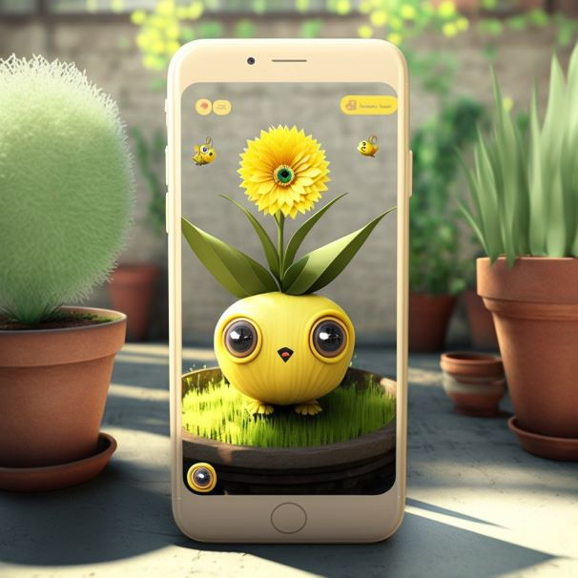
About our product
Our product, Ilagro is a water tracker and reminder app which uses AR Lens to detect and showcase activities.
Unlike other such apps available on app marketplaces like Google Play Store and App Store, Ilagro offers a unique solution by incorporating AR technology within the app, giving users an interesting and interactive experience, personalised to their needs.
Our first and most basic version of this app includes a pet plant which can be customised to one’s preferences. It will get watered only when the AR Lens detects the user drinking water in real time which can be detected by our AI algorithm.
Users will get comprehensive reports with graphical and diagrammatic representations of their water intake. Various alerts throughout the day will be sent to users.
This product aims to evolve into a health and fitness application with us introducing more, new, exciting and interactive characters.
It is a fresh and new concept which has the potential to transform the health and fitness application market.

Slide 3
Some more information
Our application Ilagrow is going to be available on play store and app store.
TAM: Our targeted audience includes all the people in the world with access to AR peripherals and internet. As per recent data, by 2024 there will be an estimated 1.7 billion mobile augmented reality (AR) user devices worldwide, as a rise of 1.5 billion from the 200 million was seen in 2015. In 2022, there will be an estimated 1.1 billion mobile AR user devices worldwide.
SAM: Ilagrow, our app comes under the health and fitness domain.Fitness enthusiasts, elderly people,health conscious people,people with a busy schedule and people with medical ailments are the users who will derive the maximum benefit from our app.
SOM: Ilagrow, is primarily going to be an activity tracker (drinking water) app.Current competitors include established apps like Aloe Bud,Plant Nanny,Aqua Alert,My Water Balance.

Slide 4
Industrial requirements
This being a part of the software sector industry following will be our requirements:
Data Centres at multiple places to collect, store and analyse the water intake of our users.
We will be using augmented reality technology where our app codes will be designed in a 3d program that will use GPS to fix our plant position at certain places in the work area or living area by our user.
We will be using an AI algorithm for object recognition which will help our AR Lenses to detect and secure the water intake by the user. The AI will be able to detect the volume of water intake with the help of lenses without the user’s hassle to input the water intake.
(We will modify the algorithm build for calculation of apples volume and weight and use it for calculating volume of water intake by our users.)

Slide 5
What will we provide?
We will provide a weekly health chart with a daily water calculator which will input daily water intake approximately the amount of water you must drink each day to avoid dehydration. Remember, this is only an estimate. The actual amount one needs depends on many factors like exercise, illness and fluid content in dietary intake. Pregnant and breastfeeding women need to drink additional fluids to stay hydrated.
With the help of the data collected, our plant will be showcasing emotion and behaviour based on the water intake of the user.
For example:
At the time of water intake → happy, grateful, energetic etc.
If the user is not following the commands and not following the routine, the plant will be emoting according.
After 14 days of proper water intake by our users the plant will get stored in a personalised garden , users will be able to collect various pet-plant and grow them from seed to plant.
After planting 6 pet-plants which will be taking a minimum of 12 weeks to grow, we will plant a sapling for our users and give them the location of the area planted, along with the user name.

Slide 6
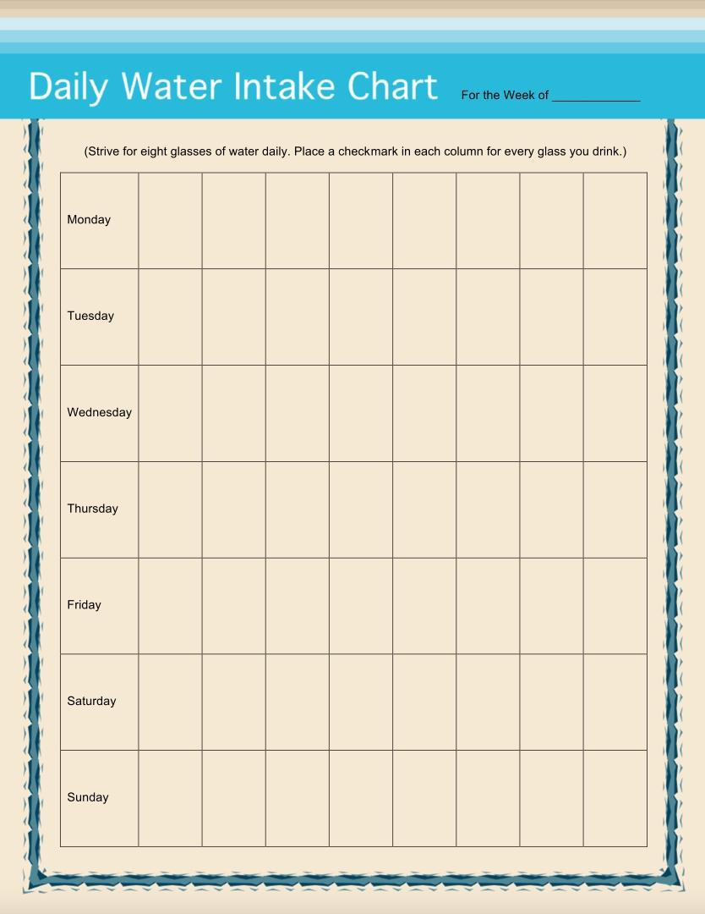
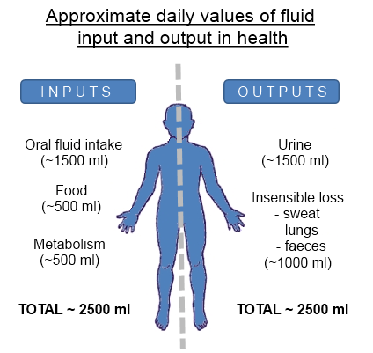

Slide 7

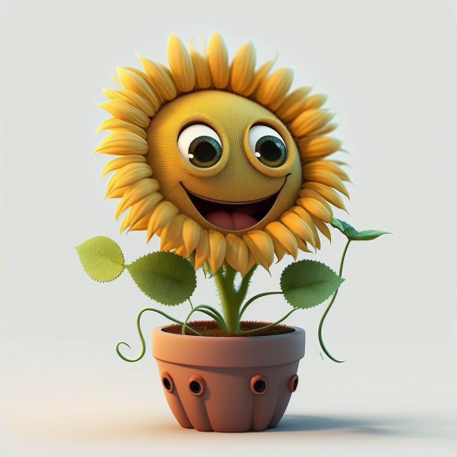

Slide 8
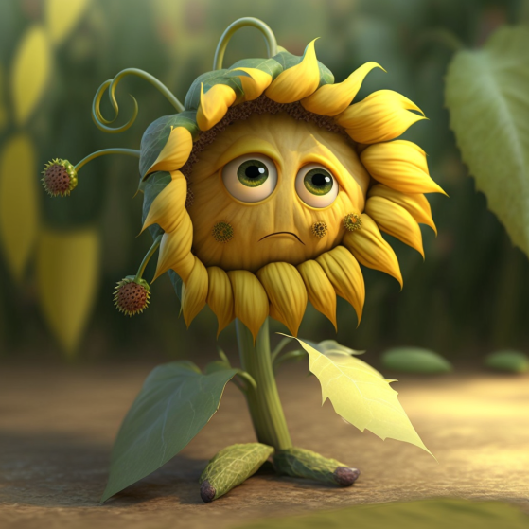
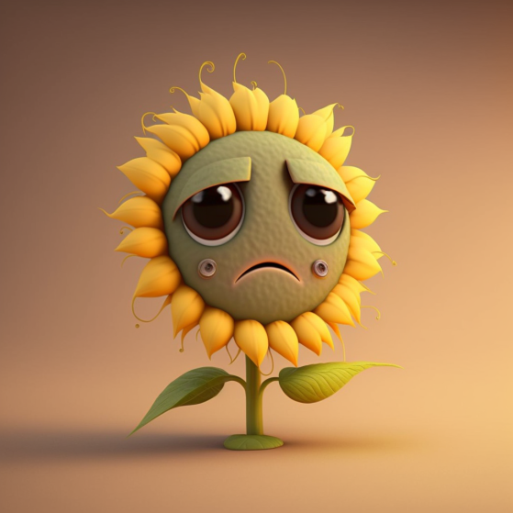

Slide 9
Our technology - Augmented Reality
For our product, ILAGROW we are using AR (Augmented Reality).
The primary benefit of AR is that it manages to blend digital and three-dimensional (3D) components with an individual's perception of the real world. AR delivers visual elements, sound and other sensory information to the user through a device like a smartphone or glasses. This information is overlaid onto the device to create an interwoven experience where digital information alters the user's perception of the real world.
AR devices of the future will provide personalised, accessible and well-designed experiences. In the coming years, these new AR glasses will become an alternative to the smartphone.
Boeing Computer Services Research employee Thomas Caudell coined the term augmented reality in 1990 to describe how the head-mounted displays that electricians use when assembling complicated wiring harnesses worked.
Our app will be focusing on the healthcare and fitness sector.
It is already being used in healthcare sector for various purposes. It offers a new approach for treatments and education in medicine. AR aids in surgery planning and patient treatment and helps explain complex medical situations to patients and their relatives.
Augmented Reality is coming to the fitness industry as well. It will start to appear in more traditional fitness technology, while AR smart glasses and headsets will bridge the gap between gaming and traditional fitness activities.

Slide 10
Roadmap for the future
Our first goal will be to launch Ilagrow in playstore and appstore by the end of first quarter of 2030..
Users will get free access to 5 seeds.A seed will take 2 weeks to grow into a full grown plant.Users will be able to create a garden of their plants.
In order to get access to a greater variety of seeds(seeds will be divided into categories:legend,epic,rare and common) users will have to subscribe to our app or make in-app purchases which will contribute to our revenue.
On growing six plants,we will plant a real plant on behalf of the user, which will help our earth become a greener place.
We aim to become profitable by the end of the fourth quarter of 2030.
By the end of the third quarter of 2030, we aim on becoming the number 1 application available in the health and fitness segment.

Slide 11
Roadmap for the future
By the end of the fourth quarter of 2031, we plan on expanding the utility of our app.We will venture into the fitness domain by introducing an AR dog,who will encourage and motivate you to stick to your fitness goals in addition to reminding you to drink water at regular intervals.
The AR dog will accompany you on your walks and jogs, will bark when you stop for too long and will give you side-eyes if you don’t drink water.
Now, our in-app purchases range will also include a range of dog breeds.In addition to this, users will also be able to customise their dog’s appearance.
From the beginning of the first quarter,we plan on introducing special limited monthly edition themes.For example in a Harry Potter themed edition we will be introducing Dobby.When the user will drink water, Dobby will say Master gave Dobby water,Dobby is free.
This is our roadmap for the first two years after launching our app, Ilagrow.

Slide 12
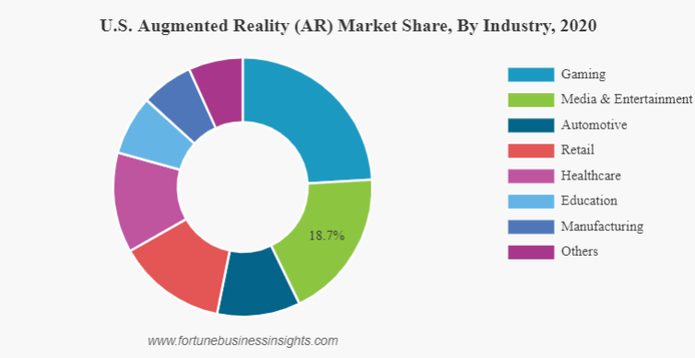
Projected sales and Customer Pipelines
The AR market is projected to grow from USD 6.12 billion in 2021 to USD 97.76 billion in 2028 at a CAGR of 48.6% in the 2021-2028 period.
The augmented reality market is expected to reach over 97 billion USD by 2028, bringing with it a major change in the way we interact with the world and tech.
Healthcare industry is witnessing rising adoption of immersive technologies to support healthcare workers. Because of the increasing availability, accessibility, and affordability of AR devices, it has boosted its adoption across the industry and patients.

Slide 13
Stakeholders
App developers
Graphic designers
AI engineers
AR developers
Finance team
Government

Slide 14
Market entry
As our app, Ilagrow requires only an AR lens and access to the internet, it does not have any geographic constraint. Ilagrow will be a global product.
As our business is a B2C app our main target will be to make consumers aware that our application exists.Hence, we will focus on marketing (social media marketing, advertisements).
As the Gen-Z generation is becoming more health conscious,these will be our target audience.Our marketing strategy will be to create a hype about our app, make it a way of their daily life, such that everyone feels tempted to use it

Slide 15
Key dependencies
AR technology to be available at much nominal cost than it is today.
AR wearable to have a long battery as the existing ones such as Oculus and Microsoft Hololens have battery life of just 2 to 3 hrs, so we depend on battery span of the device, as it will help our app to run and engage for long period of time, leading to better data collection of our users and producing better health graphs and result of our users.

Slide 16
Go to Market
Positioning
We will position Ilagrow as an water drinking reminder application which will give the users an immersive and interactive AR experience, our USP.
Product
Ilagrow is a water tracker and reminder app. Ilagrow offers a unique solution by incorporating AR technology within the app, giving users an interesting and interactive experience, personalised to their needs.
Price
Our application is available free of cost on appstore and playstore.
It includes in-app purchases based on a marketplace model.Users can trade their plants in our marketplace in Ilacoins (100 ilacoins=120 rupees).Different categories of plants will have different pricings with common being the cheapest(0-20 Ilacoins) and legendary coins being the most expensive(300 ilacoins).
We also provide a subscription model wherein a monthly subscription costs 150 rupees.To the subscribers we will provide 3 plants every month with an algorithm in place to ensure that they do not end up with 3 common plants.
Promotion
We will follow an advertisement heavy approach as it will help us reach out to a larger audience.Social media promotion will also be a dominant strategy that we make use of as our target audience has a large presence on social media.
Placement
Our product will be placed in the appstore and playstore.

Slide 17
Affordability and Funding
Affordability
At this current stage, our product is not affordable and cannot penetrate immediately in the market as Augmented Reality lenses (Hololens 2, Microsoft Oculus Quest 2) is a relatively new technology and is expensive(prices start from approximately $350).
But our product is not made for the present, it is meant for the future.In the next 50 years we foresee AR integrating into the daily lives of the people as it becomes affordable.We see AR becoming an omnipresent concept.Hence our product will be used on a mass scale as it depends on AR lenses.Hence our customer base will manifold.
Funding
Our expenses will be on marketing and AI developers,designers,office rent and salaries to employees.
We will be raising funds in a pre-money round from investors in order to cover our expenses for app development and marketing.We will raise approximately 200,000 dollars for meeting our needs.

Slide 18
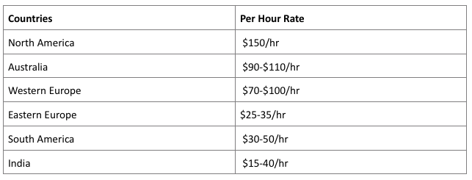
Financials - Proposed fundings
Assuming the growth and affordability of AR technology in the coming years, Visual odometry/SLAM-based AR apps
Graphic designers-3680.32 dollars per year
AI scientists- In India the average cost of AI App developer is 15 USD per hour.- 31200 dollars per year.
App development- Indian mobile app developer average salary is $4k / year
AR app development cost- 52000 dollars per year

Slide 19
Capital and Revenue
The initial capital will be required to employ AR developers, AI developers, app developers and graphic designers to make the application.
Our team would employ 10 to 12 Graphic Designers whose cost will come to around 40k USD per year, 4 AI scientists costing us around 125k USD per year, 2 to 3 App developers costing us around 12k USD per year and 6 to 7 AR developers whose cost will come to roughly 370k USD per year. The total cost will come to around 500k to 750k per year. After the app launch, 5k USD monthly will be allocated for marketing and advertisement.
The revenue generated will be in the form of monthly subscription plans which we have kept at 5 USD per month. Our starting aim is to target 100k people out of which we estimate 25k to be recurring customers who would buy the subscription each month, 50k as one time users and 25k more than one time users, who we estimate to renew their subscriptions 4 times a year on an average. If we go by these figures, our forecasted revenue will be around 2.25 M USD. We would also have in app purchases. It is important to keep in mind that these are rough estimates and can change according to conditions in the future when the app launches.

Slide 20
Challenges
Creating and developing technology is time consuming and will require high amount of capital needs to be given in making our AI accurate in calculating water consumption by our user.
AR/VR devices create novel issues for user privacy due to the scope, scale, and sensitivity of the information we will be collecting .
Technology being relatively new , government policies on data tracking and data protection is still a space to be explored and can be a issue for fund raising in the future, to avoid any potential funding gap due to government policies we will develop our product in lines with the government policies.

Slide 21
References
https://www.grandviewresearch.com/industry-analysis/mobile-application-market
https://www.alliedmarketresearch.com/fitness-app-market-A07465
https://doi.org/10.1155/2020/5053407)
https://www.fortunebusinessinsights.com/augmented-reality-ar-market-102553
https://makeanapplike.com/artificial-intelligence-app-development-cost/
https://www.ambitionbox.com/profile/graphic-designer-salary
https://www.businessofapps.com/app-developers/research/ios-android-developer-salary/
https://www.businessofapps.com/insights/how-much-does-cost-make-ar-app/
https://www.digitaltrends.com/mobile/ar-glasses-replace-smartphones-future-how/
https://itif.org/publications/2021/03/04/balancing-user-privacy-and-innovation-augmented-and-virtual-reality/)

Slide 22


