Slide 1
Secure data hiding in images using steganography
CAPSTONE PROJECT
Presented By: Harshita
Student Name : Harshita
College Name & Department : Dr. Akhilesh Das Gupta Institute of Professional Studies, ECE Department

Slide 2
OUTLINE
Problem Statement
Technology used
Wow factor
End users
Result
Conclusion
Git-hub Link
Future scope

Slide 3
Problem Statement
Development of robust steganographic system to securely embed sensitive data within digital images, ensuring high imperceptibility and resistance against steganalysis. The system must minimize visual distortion while maximizing data capacity, provide secure method for hidden text extraction.

Slide 4
Technology used
Key Technologies and Techniques: Least Significant Bit (LSB) Insertion, Discrete Cosine Transform (DCT), Encryption, Steganalysis.
Libraries and Platforms: Python
cv2
String
os

Slide 5
Wow factors
A unique data hiding project would excel in robustness against detection, maximize hidden data capacity without visual distortion and integrate strong encryption with advanced steganographic techniques. It might also feature adaptive security, cross- platform usability, metadata hiding, resilience to image manipulation and creating a system that’s both secure and practical.

Slide 6
End users
Individuals
Organizations : military, businesses, health care providers
Cybersecurity professionals

Slide 7
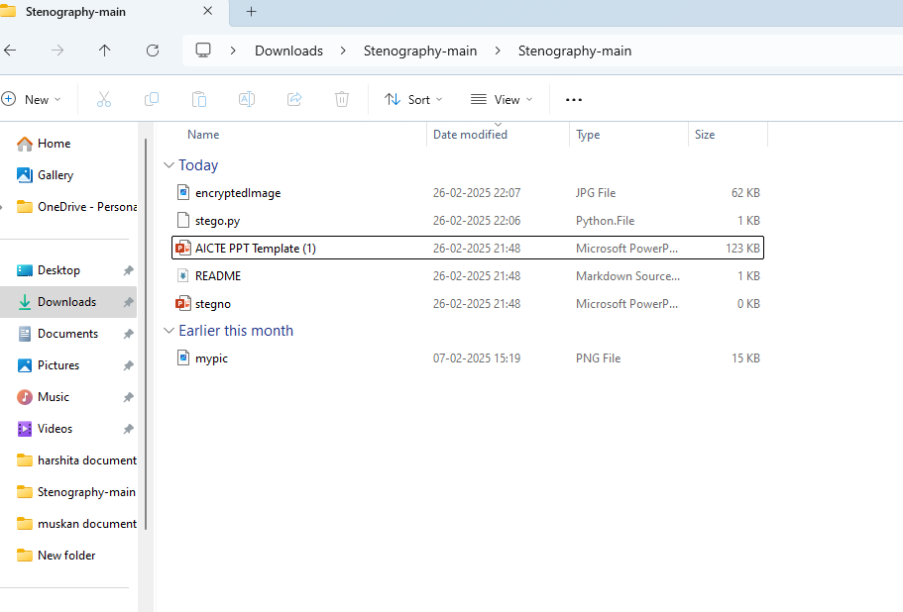
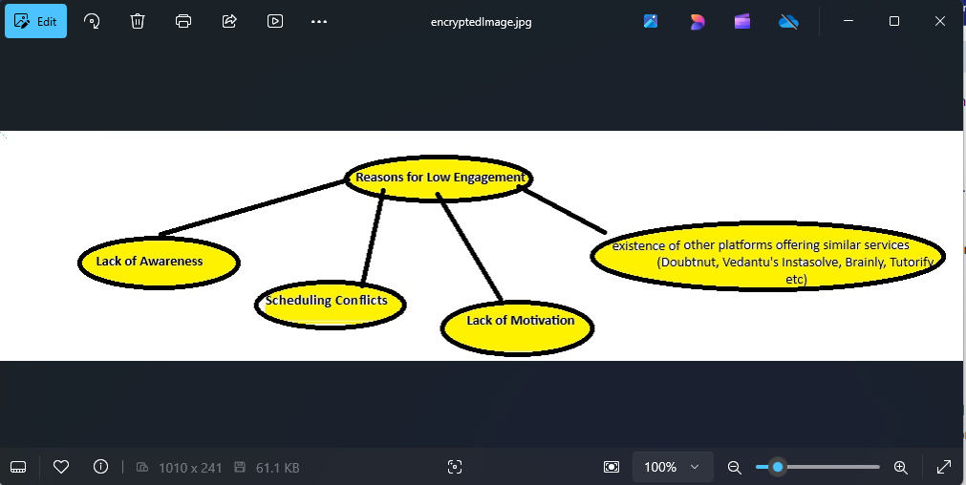
Results

Slide 8
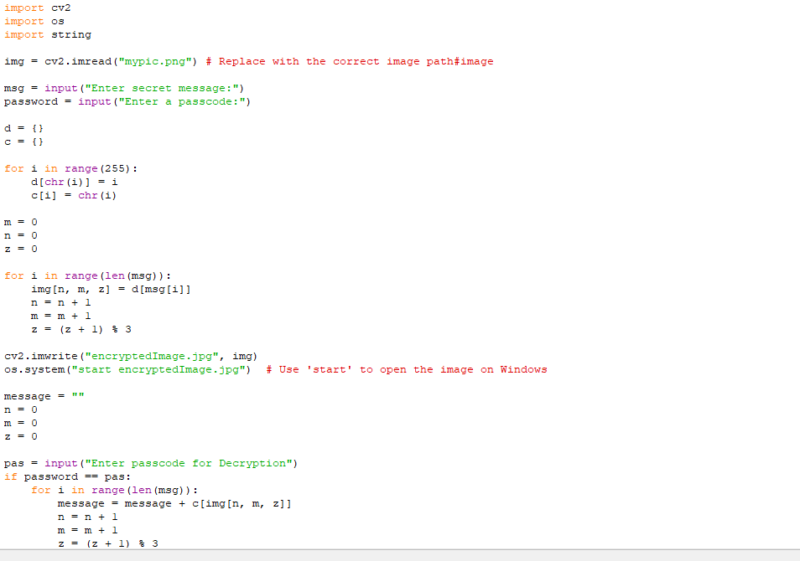

Slide 9
Conclusion
In conclusion , project focused on secure data hiding within images using steganography offers a valuable tool for data protection and for secret communication. It protects data from hacker

Slide 10
GitHub Link
https://github.com/Harshita-Negi-03/stegnography.git

Slide 11
THANK YOU

