Slide 1

ECE597
Special Problems
AUDIO PROCESSING THROUGH T/F ALGORITHMS IMPLEMENTED ON ZEDBOARD
Project by:
Harshita Ravi Shankar
Srinivasa Virinchi Palakodety
Hardik Sheladiya

Slide 2
INTRODUCTION
A normal human hearing range is 20Hz to 20kHz and the signals which produce these audible vibrations are audio signals.
Audio signals are information rich nonstationary signals that play an important role in our day-to-day communication, perception of environment, and entertainment.
Time and frequency alone are inadequate to analyze signals due to their non-stationary nature. Hence, joint time-frequency (TF) approach more efficiently process these signals.
Here we have processed audio signal using Short Time Fourier Transform, Split Spectrum Processing and Hilbert Transform and compared the results

Slide 3

Short Time Fourier Transform
It is a Fourier related transform that is used to determine the frequency and phase content of small equal segments of a signal with change in time.
An intuitive solution to the idea of a joint time-frequency analysis is to cut our function f(t) into pieces through the application of a window w(t)—and then take the Fourier transform of each piece.
The STFT is defined as

Slide 4
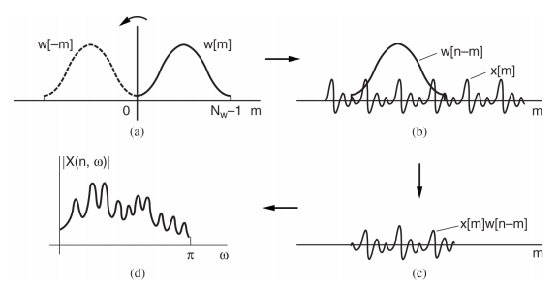
Implementation of STFT
Audio file converted from .mp3 to .txt file using Matlab
Read required number of values from text file
Generate Hamming window function
Multiply the input signal with the window function and find FFT of the windowed segment
Slide window and repeat the above step till the end
Compute execution time and display the execution time and STFT result

Slide 5
Applications of STFT
STFT has applications is all fields and known as the Multi-purpose Transform
Used as a filter bank in audio processing
Used in the analysis of music for equalization and tuning audio effects
Used to detect short local signals of human brain previously undetected
It makes the signal synthesize the noise well and performs additive synthesis for noise analysis

Slide 6
Split Spectrum Processing
Split Spectrum Processing also called as SSP, is a signal processing method to improve the signal-to-noise ratio (SNR) of radar ultrasonic signals.
Instead of transmitting at different frequencies, it works by receiving the echo and splits the frequency spectrum of the incoming signal.
It divides the frequency band which contains the flaw into smaller frequency bands.

Slide 7
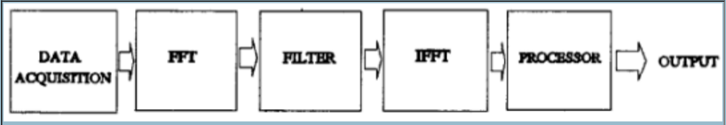
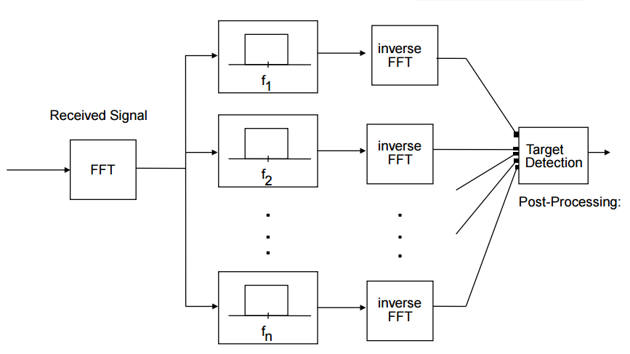
Block Diagram

Slide 8
Applications of SSP
Non-destructive testing
Multiple target detection
Flaw detection
Medical applications
Industrial applications

Slide 9
HILBERT TRANSFORM
Fourier, Laplace, and z-transforms change from the time-domain representation of a signal to the frequency-domain representation of the signal
The resulting two signals are equivalent representations of the same signal in terms of time or frequency
In contrast, The Hilbert transform does not involve a change of domain, unlike many other transforms

Slide 10
HILBERT TRANSFORM
Strictly speaking, the Hilbert transform is not a transform in this sense
First, the result of a Hilbert transform is not equivalent to the original signal, rather it is a completely different signal
Second, the Hilbert transform does not involve a domain change, i.e., the Hilbert transform of a signal x(t) is another signal denoted by in the same domain (i.e.,time domain)

Slide 11
HILBERT TRANSFORM
The Hilbert transform of a signal x(t) is a signal whose frequency components lag the frequency components of x(t) by 90°
has exactly the same frequency components present in x(t) with the same amplitude–except there is a 90° phase delay
The Hilbert transform of x(t) = Acos(2πf₀t + θ) is Acos(2πf₀t + θ - 90°) = Asin(2πf₀t + θ)

Slide 12
HILBERT TRANSFORM
Obviously performing the Hilbert transform on a signal is equivalent to a 90° phase shift in all its frequency components
Therefore, the only change that the Hilbert transform performs on a signal is changing its phase
The amplitude of the frequency components of the signal do not change by performing the Hilbert-transform
On the other hand, since performing the Hilbert transform changes cosines into sines, the Hilbert transform of a signal x(t) is orthogonal to x(t)
Also, since the Hilbert transform introduces a 90° phase shift, carrying it out twice causes a 180° phase shift, which can cause a sign reversal of the original signal

Slide 13
PROPERTIES OF HILBERT TRANSFORM
Evenness and Oddness
The Hilbert transform of an even signal is odd, and the Hilbert transform of an odd signal is even
Sign Reversal
Applying the Hilbert-transform operation to a signal twice causes a sign reversal of the signal, i.e.,
Energy
The energy content of a signal is equal to the energy content of its Hilbert transform
Orthogonality
The signal x(t) and its Hilbert transform are orthogonal

Slide 14
Conclusion
Comparing STFT, SSP, and Hilbert Transform
The STFT Software execution time is 3.626msec and Hardware execution time is 4.276msec
The SSP Software execution time is 1.113msec and Hardware execution time is 1.761msec
The Hilbert Transform Software execution time is 4.656msec and Hardware execution time is 5.285msec

