Slide 1
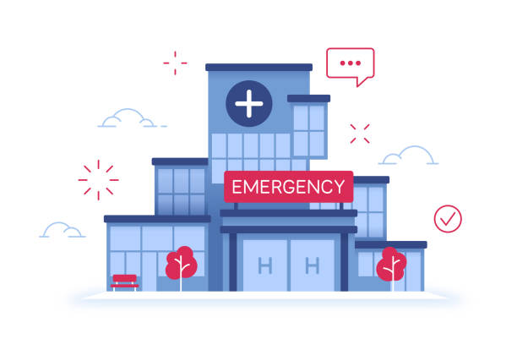
Hospital Emergency Room Dashboard
Monthly View
Consolidated View
Patient Details
Presented by [Harshita Sharma]

Slide 2
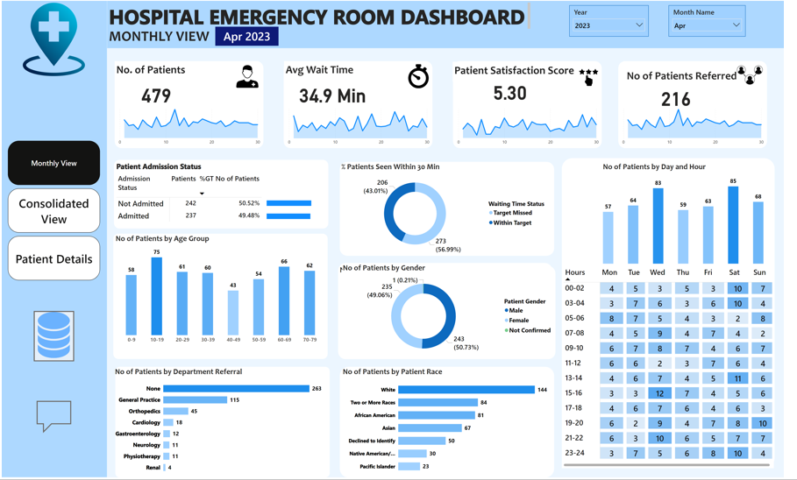

Slide 3

Introduction
Objective of the Dashboard:
- Provide insights into emergency room operations.
- Track patient volume, wait times, and satisfaction scores.
- Monitor admission status, gender, age group, and referral departments.

Slide 4
Key Metrics Overview
Highlighted KPIs:
✅ Number of Patients:
Measure the total number of patients visiting the ER daily.
✅ Average Wait Time:
Calculate the average time patients wait before being attended to by a medical professional.
✅ Patient Satisfaction Score:
Analyze the average satisfaction score of patients on a daily basis to evaluate the quality of service provided.
✅ Number of Patients Referred:
Count the number of patients referred to specific departments from the ER each day.

Slide 5
BUSINESS REQUIREMENTS
Dashboard 1: Monthly View
Objective: Monitor key metrics and trends on a month-by-month basis to identify patterns and areas for improvement.
Charts to Develop:
Patient Admission Status: Track admitted vs. non-admitted patients.
Patient Age Distribution: Group patients by 10-year age intervals.
Department Referrals: Analyze referral trends across different departments.
Timeliness: Measure the percentage of patients seen within 30 minutes.
Gender Analysis: Visualize patient distribution by gender.
Racial Demographics: Analyze patient data by race.
Time Analysis: Assess patient volume by day and hour.

Slide 6
BUSINESS REQUIREMENTS
Dashboard 2: Consolidated View
Objective: Provide a holistic summary of hospital performance for a selected date range.
Charts to Develop:
Similar metrics as the Monthly View,

Slide 7
BUSINESS REQUIREMENTS
Dashboard 3: Patient Details
Objective: Offer granular insights into patient-level data to enable detailed analysis and troubleshooting.
Charts to Develop: A grid displaying essential fields:
Patient ID
Patient Full Name
Gender
Age
Admission Date
Patient Race
Wait Time
Department Referral
Admission Status

Slide 8
Patient Admission Status
Breakdown:
- Not Admitted: 242 (50.52%)
- Admitted: 237 (49.48%)
Shows the proportion of patients who were admitted versus those who weren’t.

Slide 9
Patient Demographics
Age Group Distribution:
- Highest: 10-19 years (75 patients)
- Lowest: 40-49 years (43 patients)
Gender Breakdown:
- Male: 49.06%
- Female: 50.73%
Helps in resource allocation and targeted healthcare services.

Slide 10
Patient Flow Analysis
% of Patients Seen Within 30 Minutes:
- Within Target: 273 (56.99%)
- Missed Target: 206 (43.01%)
No. of Patients by Day & Hour:
- Peak Days: Wednesday & Friday (83-85 patients)
- Peak Hours: 14:00 - 16:00
Helps manage staff shifts and resource planning.

Slide 11
Department Referral Analysis
Referrals by Department:
- General Practice: 115 referrals
- Orthopedics, Cardiology, Gastroenterology, Neurology, Physiotherapy, Renal follow next.
Helps in identifying high-demand departments.

Slide 12
Patient Race Demographics
Race Breakdown:
- White: 144 patients
- Two or More Races: 84 patients
- African American: 81 patients
- Asian: 67 patients
Analyze patient data by race

Slide 13

Target Audience
Hospital Administrators & Management
Emergency Room (ER) Staff & Supervisors
Healthcare Quality & Performance Analysts
Department Heads (Orthopedics, Cardiology, etc
Hospital Financial & Planning
Public Health Officials

Slide 14

Interactive Features & Filters
Slicers Used:
✅ Year & Month Selection
✅ Page Navigation (Monthly View, Patient Details, Consolidated View)
✅ Filters for Patient ID, Department, Admission Status, etc.
✅Date range selection
Enables dynamic data exploration.

Slide 15
Insights & Recommendations
Key Takeaways:
✅ Improve wait time efficiency by allocating more resources during peak hours.
✅ Enhance patient satisfaction by improving within-target waiting time percentages.
✅ Focus on high-referral departments like General Practice & Orthopedics.
✅ Prepare for high patient volume on Wednesdays & Fridays.

Slide 16
Conclusion
Next Steps:
- Add predictive analytics to forecast peak hours.
- Implement real-time tracking for patient flow.
- Optimize staff scheduling based on patient load.
🙏 Thank You!

