Slide 1
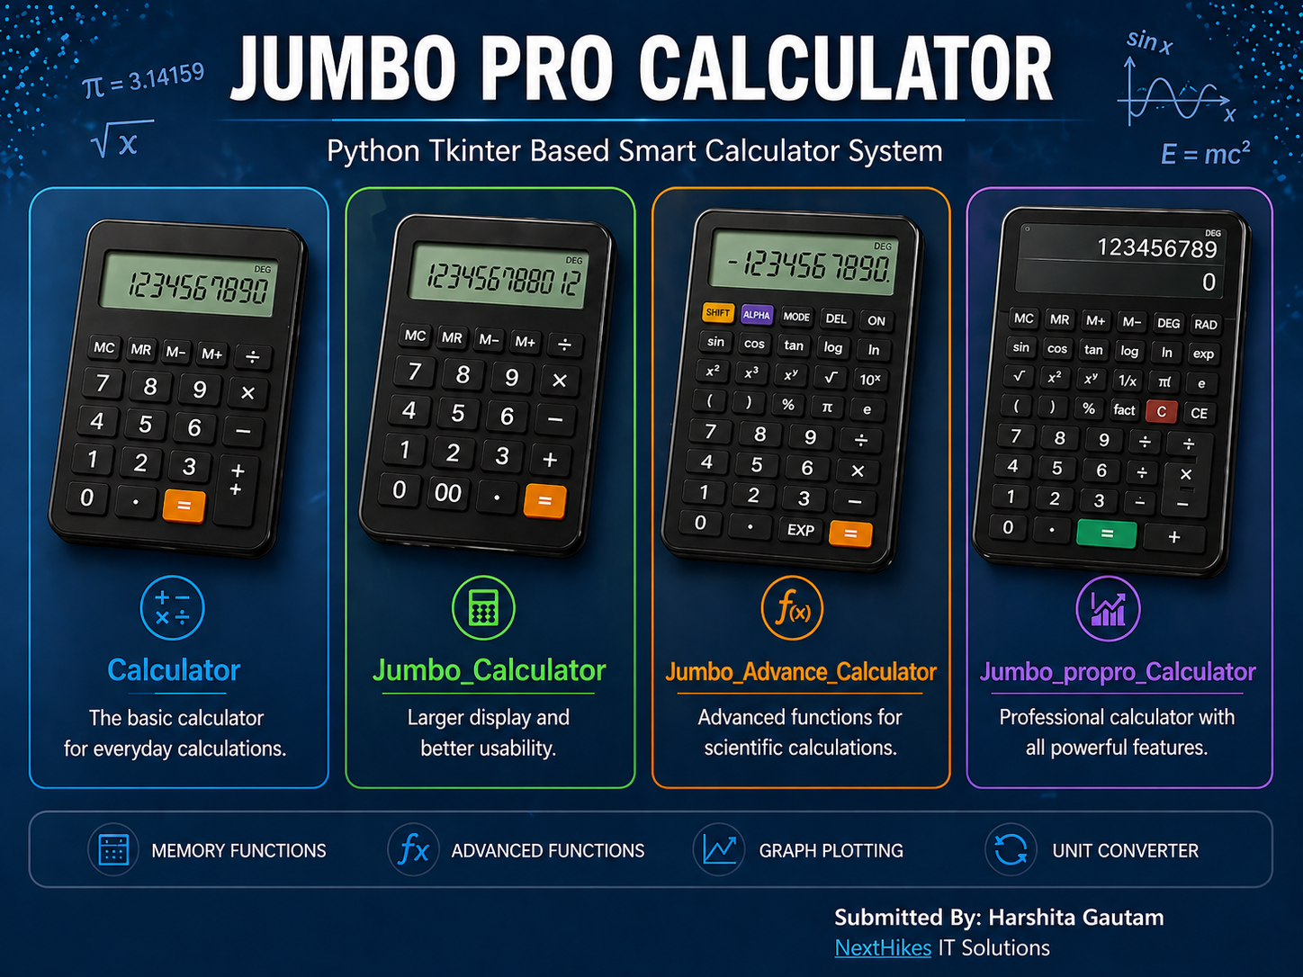


Slide 2
INTRODUCTION
In this project, a GUI-based calculator is developed using Python and Tkinter to perform various mathematical operations.
The application includes basic, scientific, and advanced functionalities such as trigonometric calculations, graph plotting, and unit conversion.
The goal is to build a user-friendly and efficient application.

Slide 3
OBJECTIVE
Create a GUI-based calculator using Python and Tkinter.
To perform basic, scientific, advanced and propro mathematical operations
Create a user-friendly and interactive interface.
Add advanced features like graph and converter
To gain practical knowledge of application development.
To understand the implementation of real-world projects using Python.

Slide 4
TECHNOLOGIES USED
• Python – Programming language used for development. • Tkinter – GUI library for designing the interface. • Matplotlib – Used for graph plotting functionality. • Math Library – For performing scientific calculations. • Visual Studio Code – Code editor used for development • GitHub – For code version control and project submission.
🐍 Python 🖥️ Tkinter (GUI) 📊 Matplotlib (Graph)
➗ Math Library 💻 Visual Studio Code 🔗 GitHub

Slide 5
INSTALLATIONS & SETUIP
• Python must be installed on the system • Required libraries: Tkinter (for GUI), Matplotlib (for graph) • Install libraries using pip if not available • Use VS Code or any IDE to run the project • Download or clone the project from GitHub repository • Execute the Python file to launch the application

Slide 6
FEATURES
This slide shows the core features of the calculator including basic operations, memory functions, and user-friendly interface.
Basic Arithmetic Operations (+, −, ×, ÷, %)
Interactive Button-Based Input System
Clear (C) and Backspace (CE) Functionality
Memory Operations (MC, MR, M+, M−)
Support for Mathematical Constants (π, e)
User-Friendly and Responsive GUI Design

Slide 7
ADVANCED FEATURES
This slide highlights advanced functionalities such as scientific calculations, graph plotting, unit conversion, and angle mode selection.
Scientific Functions (sin, cos, tan, log, ln, exp)
Advanced Mathematical Operations (√, x², x³, xʸ, factorial, |x|, 1/x)
Graph Plotting Functionality 📊
Unit Conversion Feature 🌡️
DEG and RAD Mode for Angle Calculations.
Modern Dark Theme Interface for Better User Experience.

Slide 8
WORKINGS
The project is divided into four versions: Basic, Jumbo, Advanced, and propro Calculator.
Each version increases in complexity and functionality
The Basic Calculator performs simple arithmetic operations.
The Jumbo Calculator includes scientific and additional mathematical functions
The Jumbo Advanced Calculator introduces features like graph plotting and history
The Jumbo Propro Calculator integrates all features including memory, converter, and mode selection.
The application works on an event-driven approach where the user interacts with the system through buttons. When a user presses a button, the corresponding value is displayed dynamically on the screen. The entered expression is processed using Python logic and evaluated using built-in and math functions. The result is displayed instantly, and proper error handling ensures smooth execution. Additionally, features like graph plotting and unit conversion are handled through separate modules to enhance functionality and user experience.

Slide 9
FILES USED
🔹 Python Source Files
calculator.py → This file contains the basic calculator implementation. → It performs simple arithmetic operations like addition, subtraction, multiplication, and division. → Designed as the foundation of the project.
Jumbo_Calculator.py → This file includes an improved version of the calculator. → Added extra functions such as percentage, square root, reciprocal (1/x), and π. → Enhanced user interface for better usability.
Jumbo_Advanced_Calculator.py → This file implements advanced scientific features. → Includes trigonometric functions (sin, cos, tan), logarithmic functions (log, ln), and exponential calculations. → Also integrates graph plotting and unit converter tools.
Jumbo_propro_Calculator.py → This is the final and most advanced version of the calculator. → Combines all features including memory functions, power operations, factorial, and DEG/RAD modes. → Provides a complete professional calculator system with optimized UI.
→ Also integrates graph plotting and unit converter tools.

Slide 10
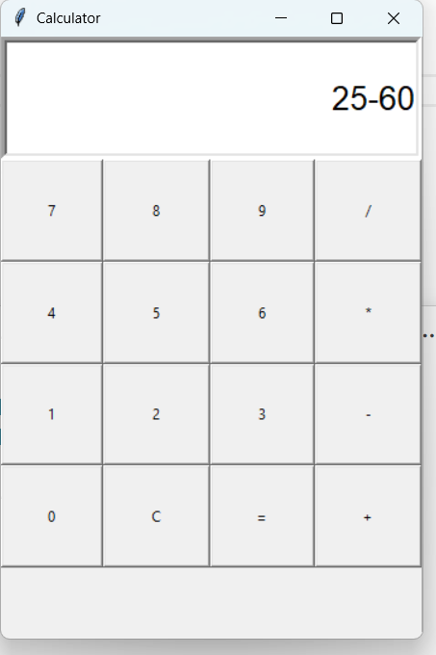
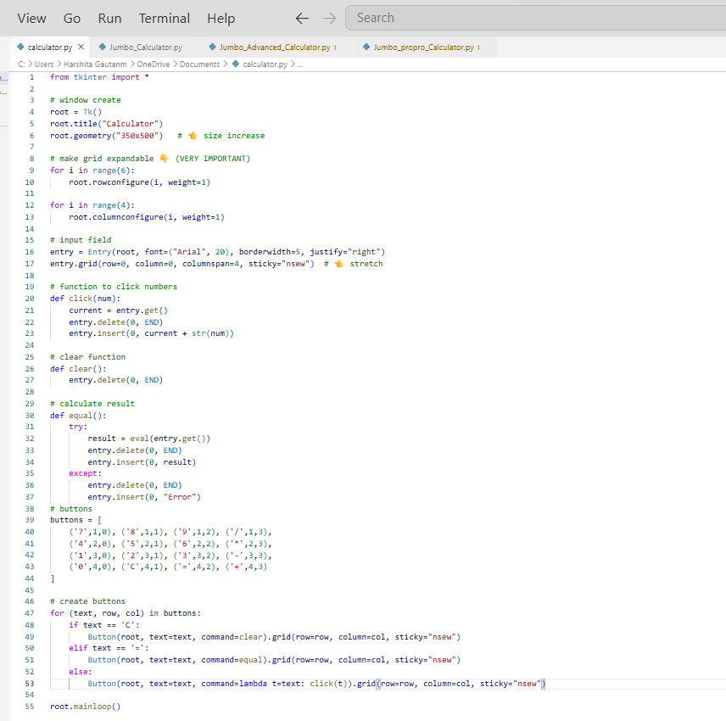
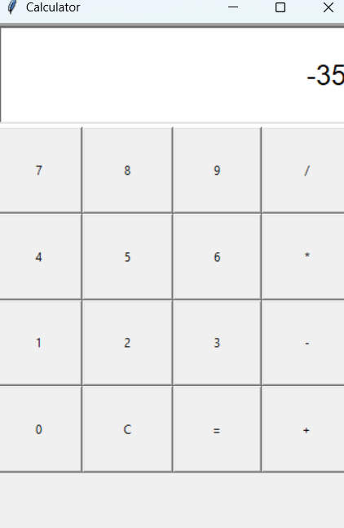
CODING +OUTPUTS
calculator.py

Slide 11
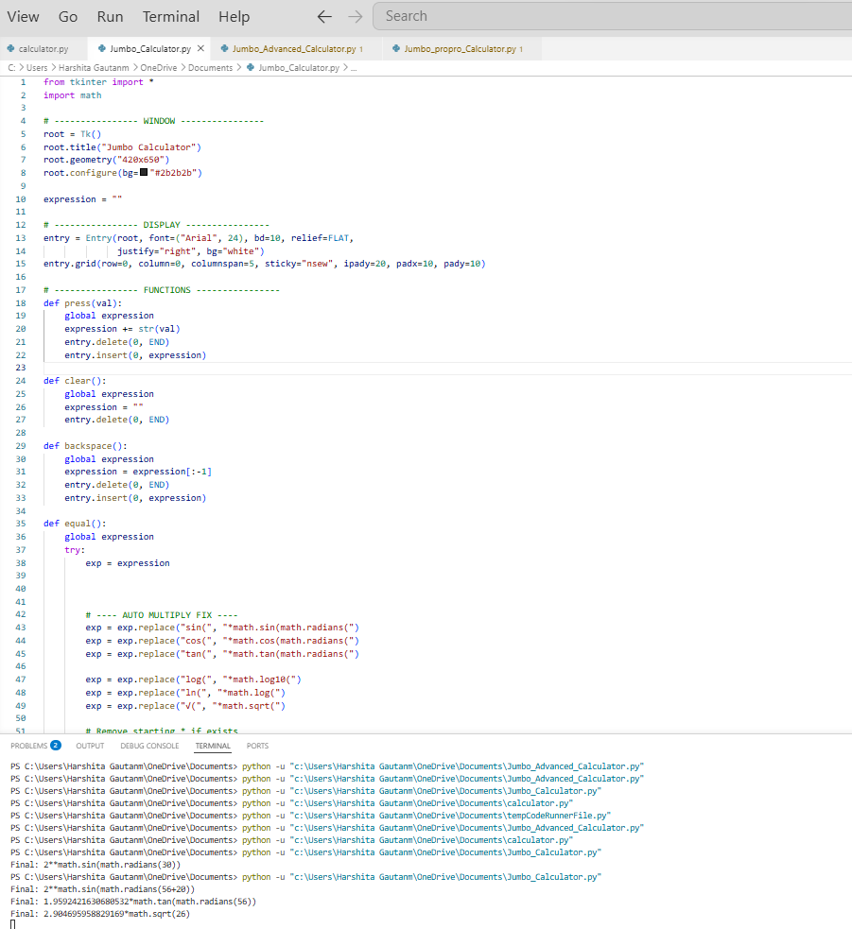
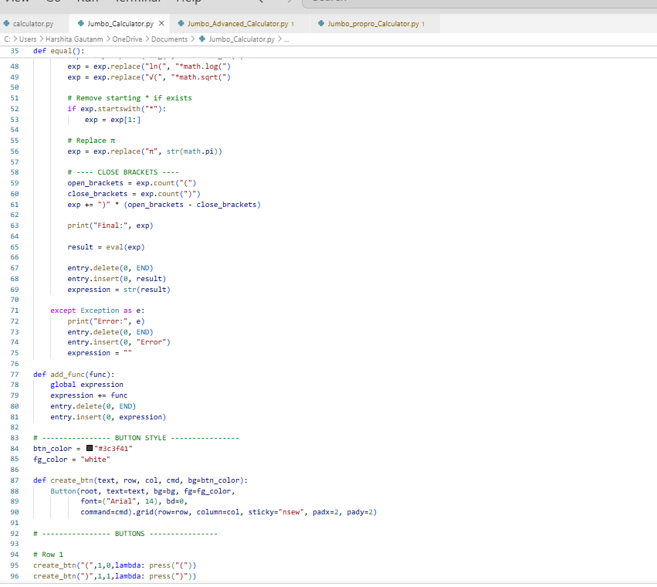
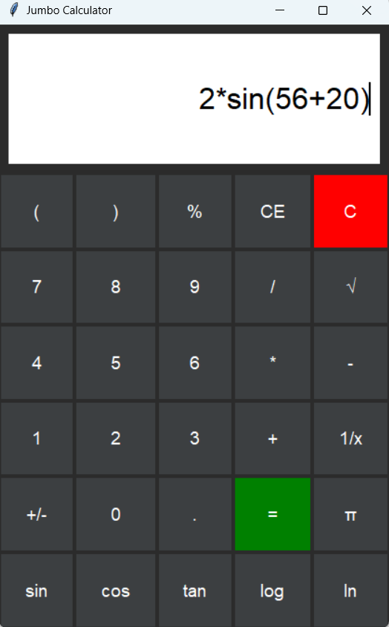
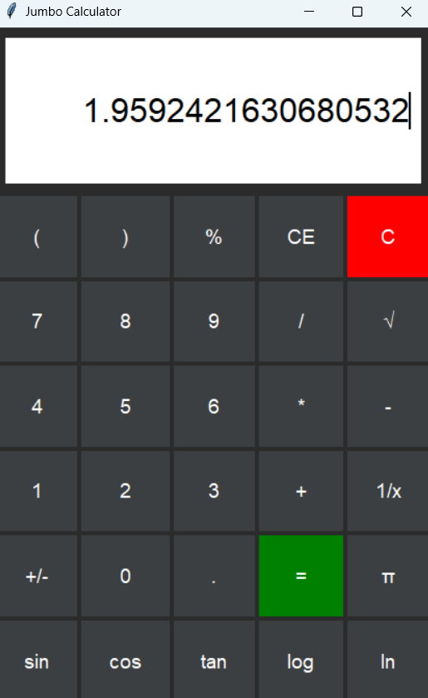
CODING+OUTPUTS
Jumbo_Calculator.py

Slide 12
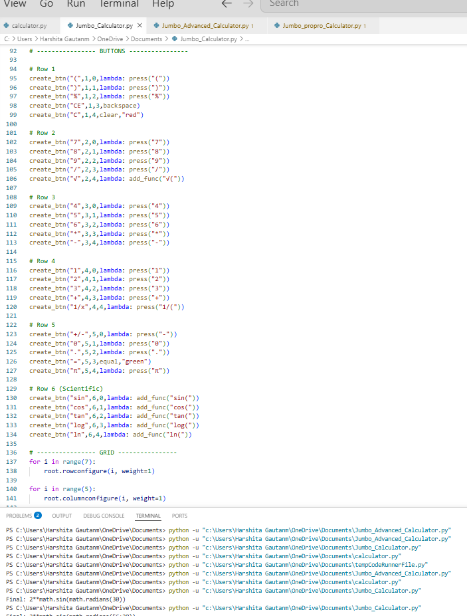
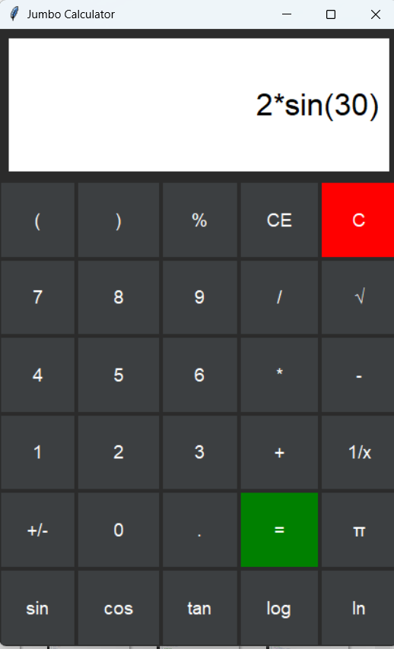
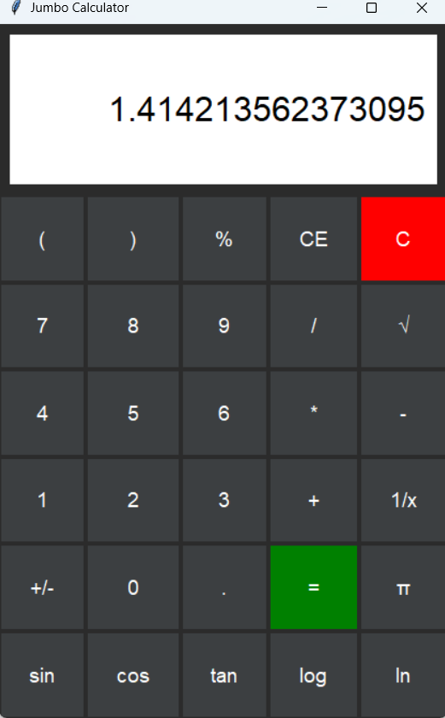
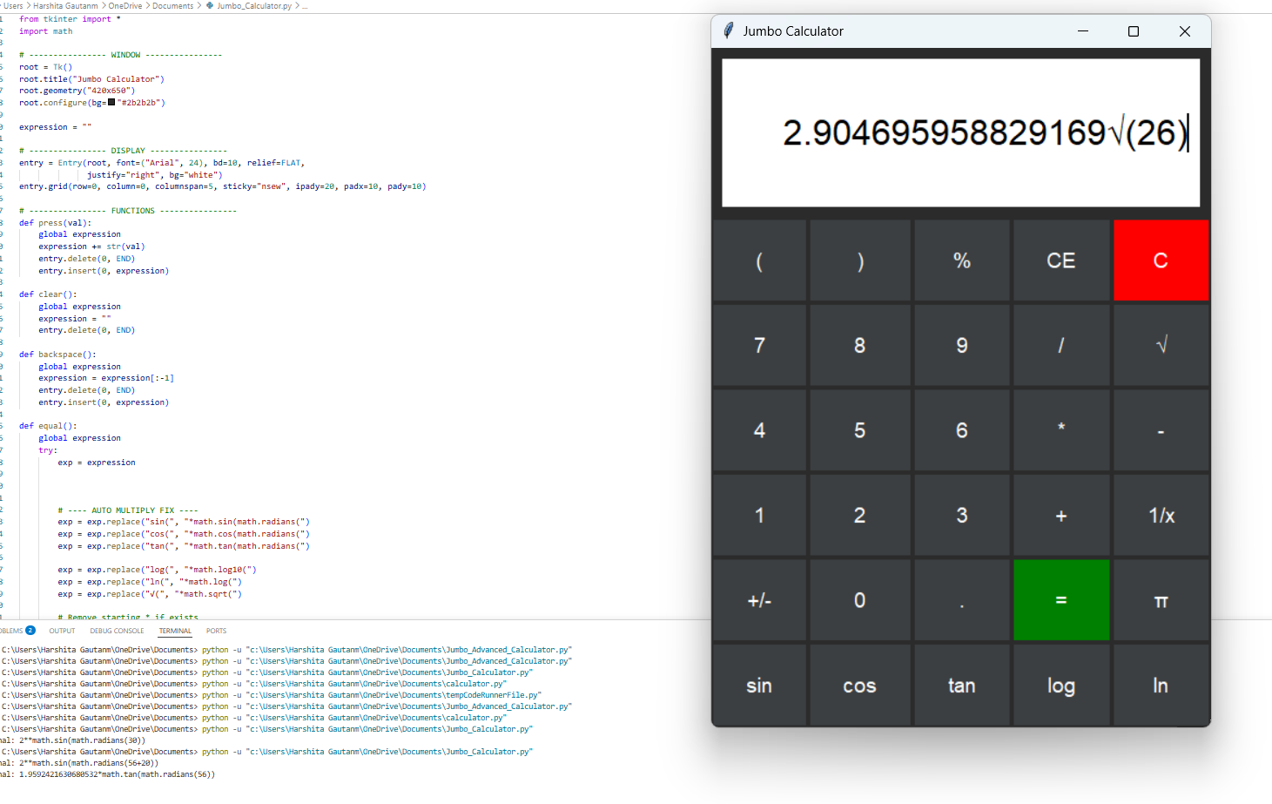
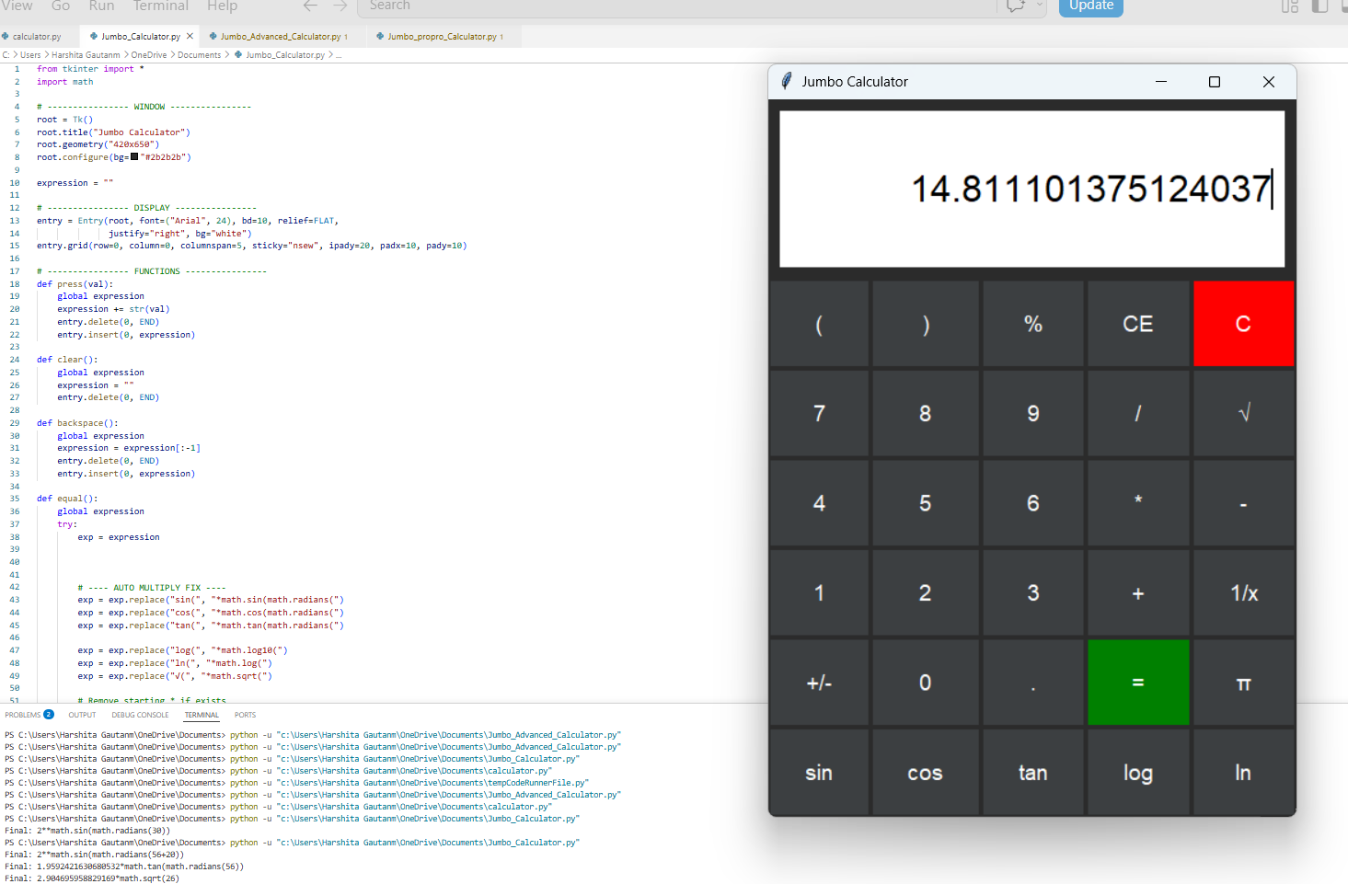
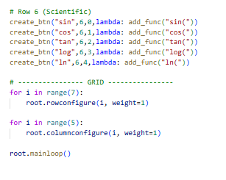

Slide 13
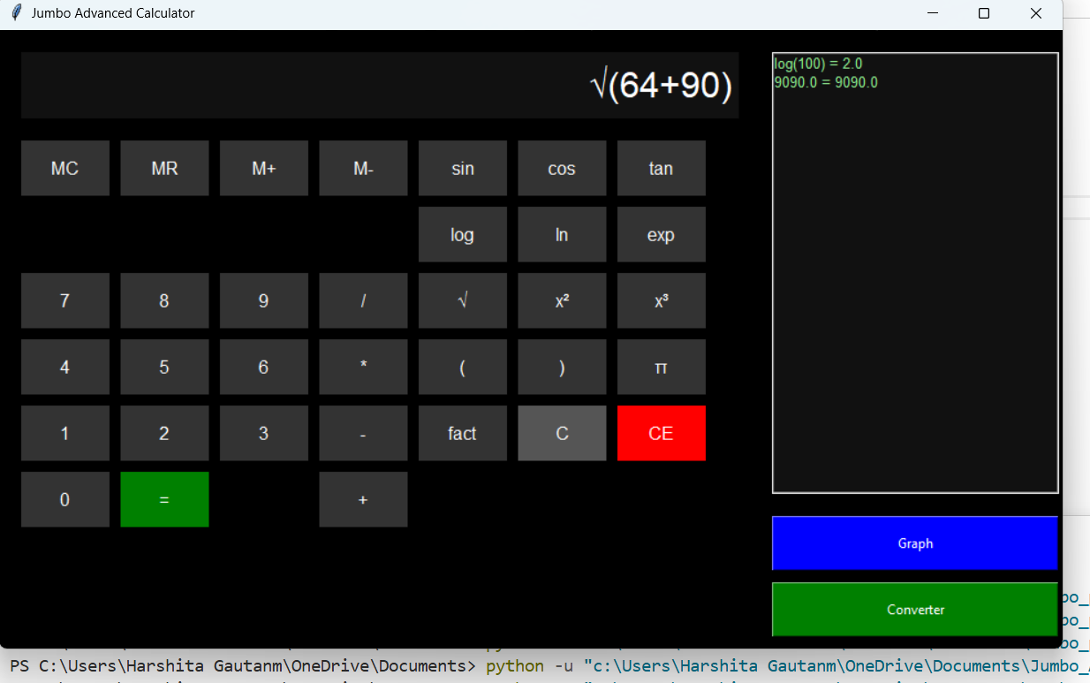
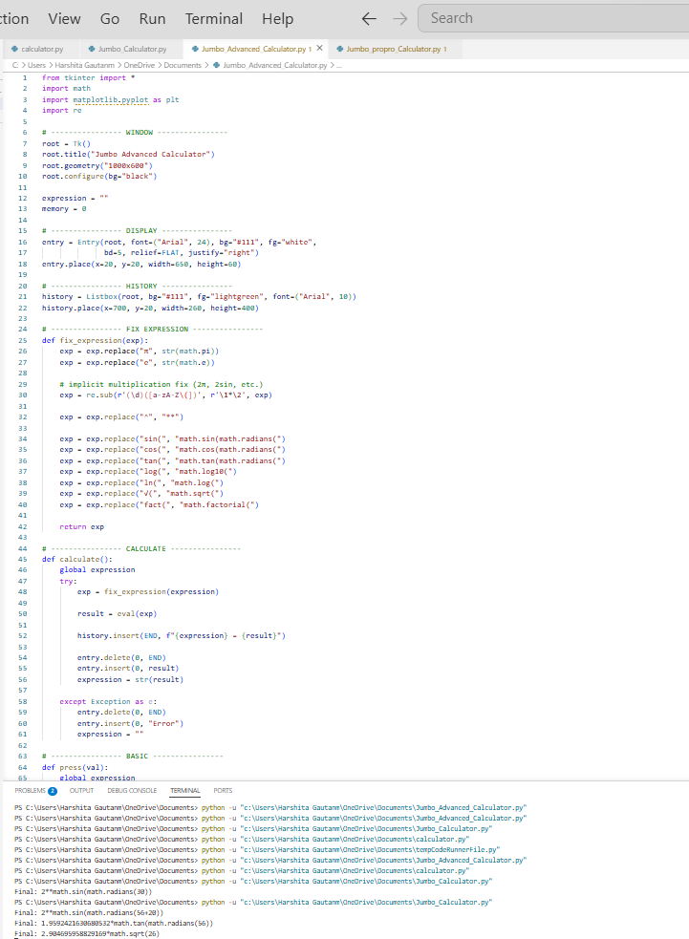
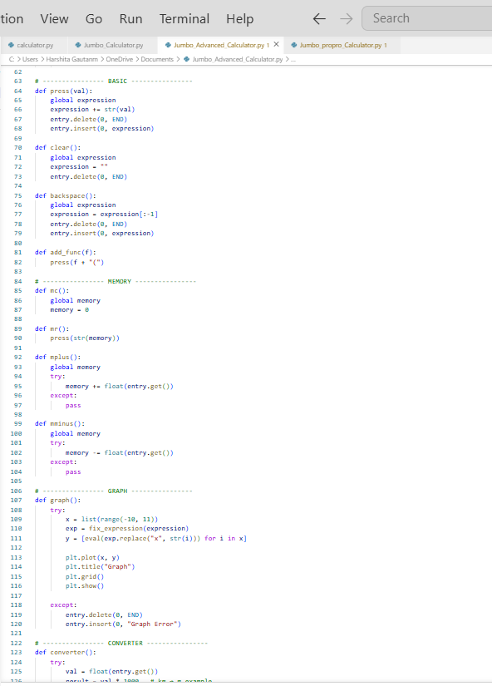
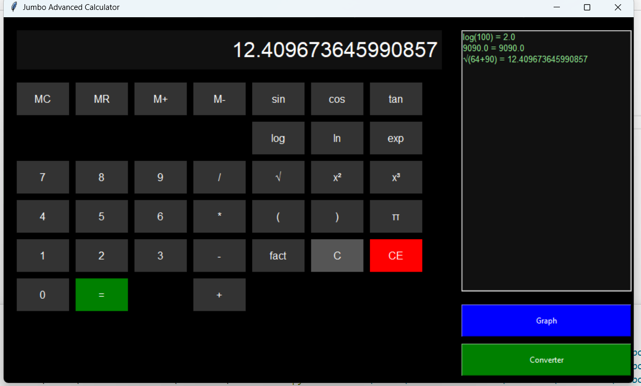
CODING+OUTPUTS
Jumbo_Advanced_Calculator.py

Slide 14
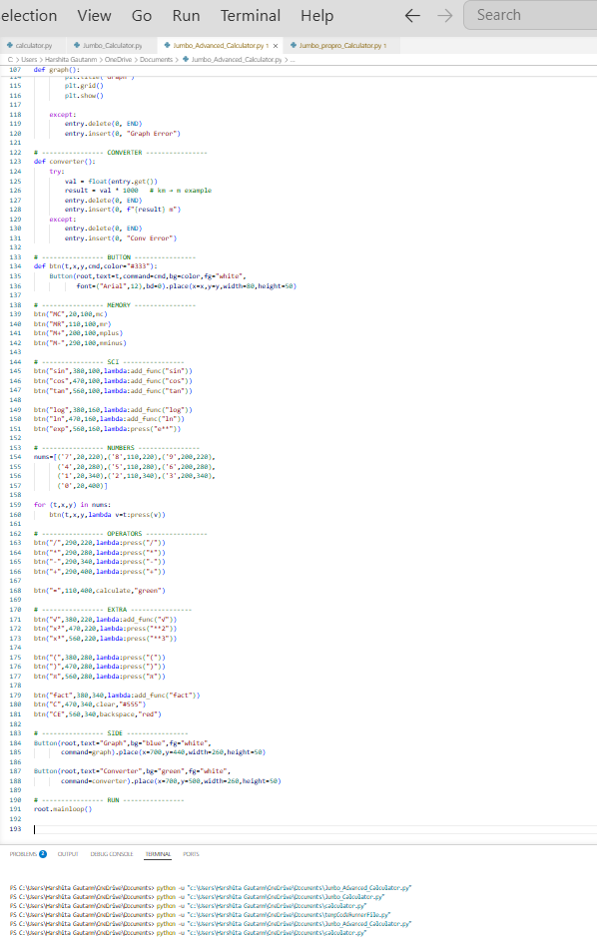
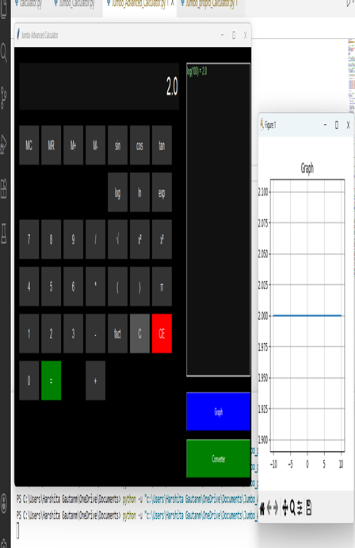
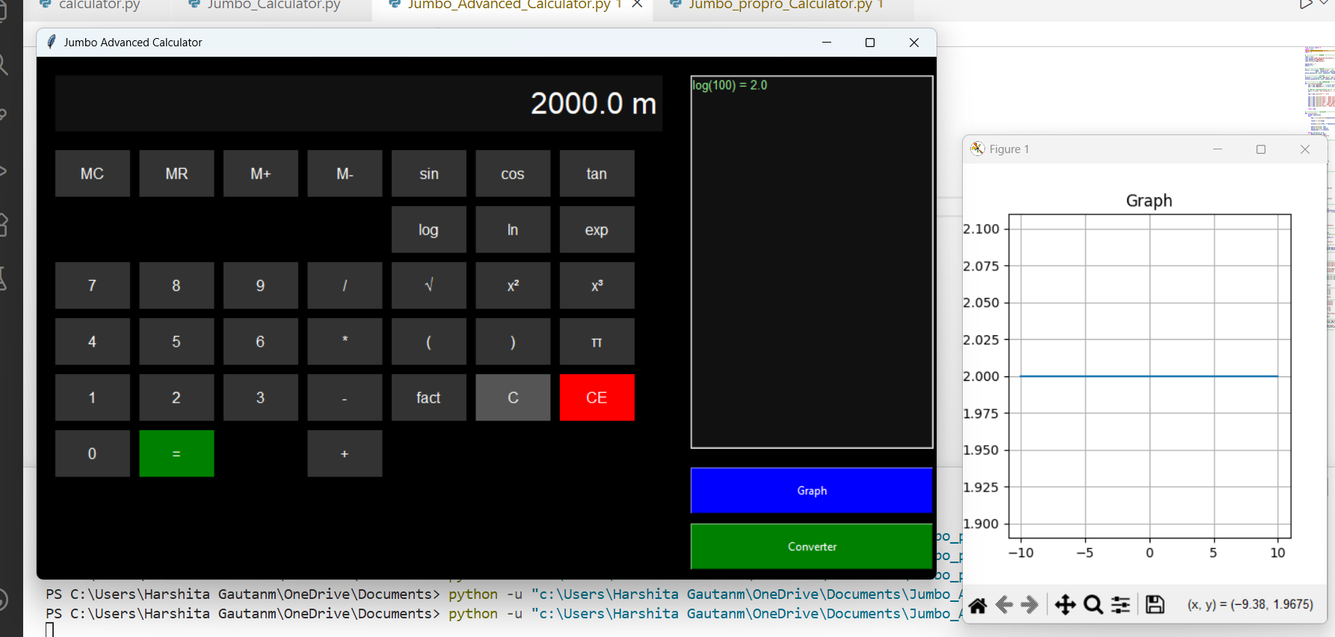

Slide 15
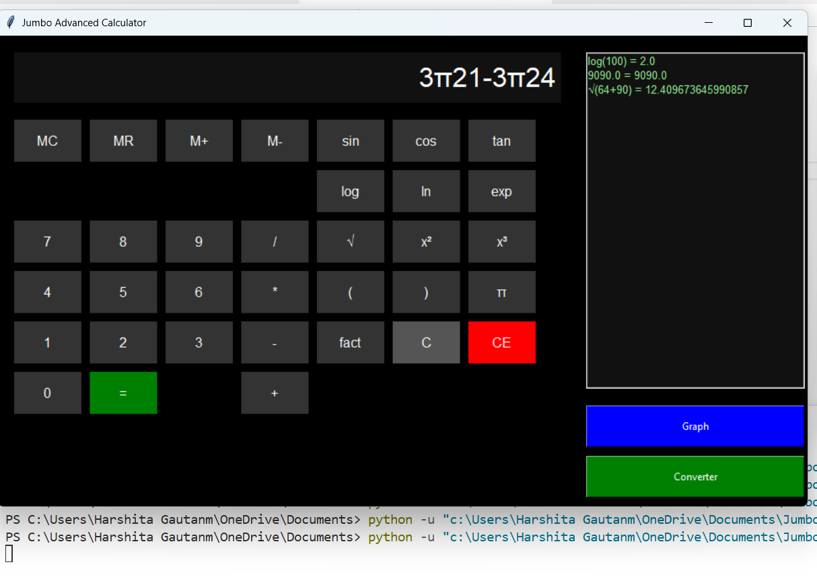
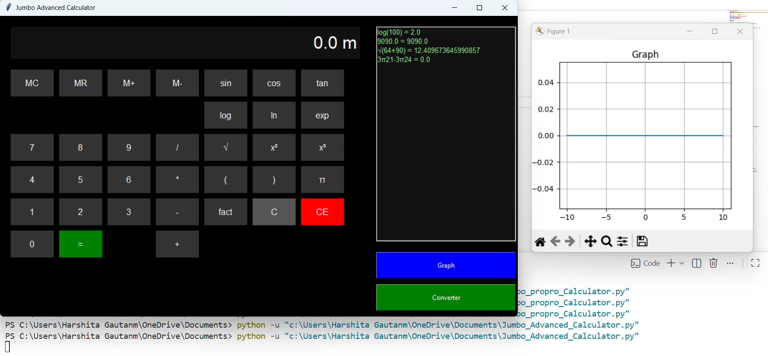

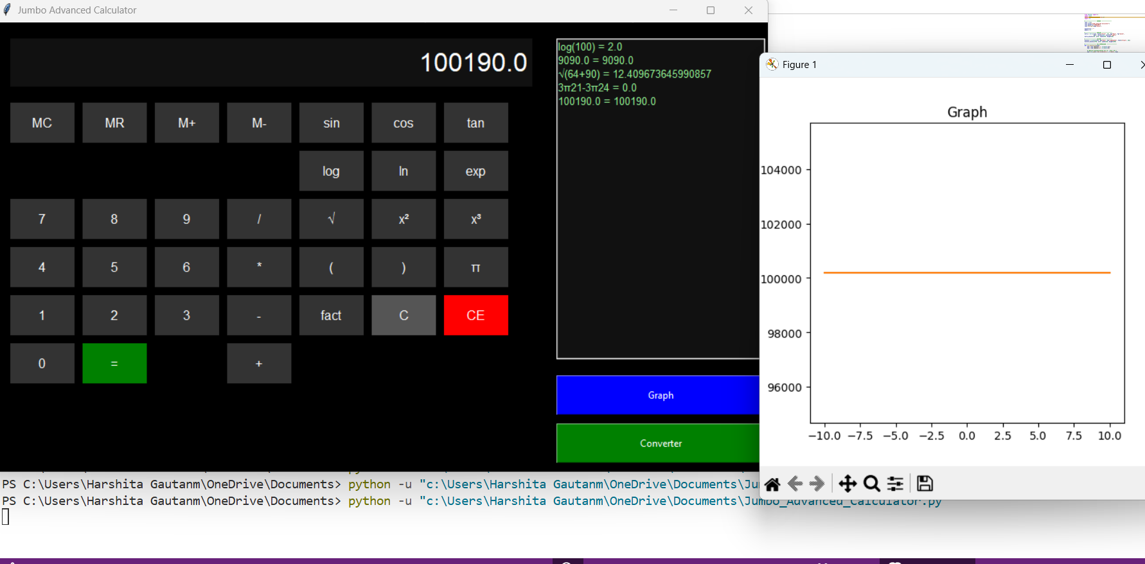
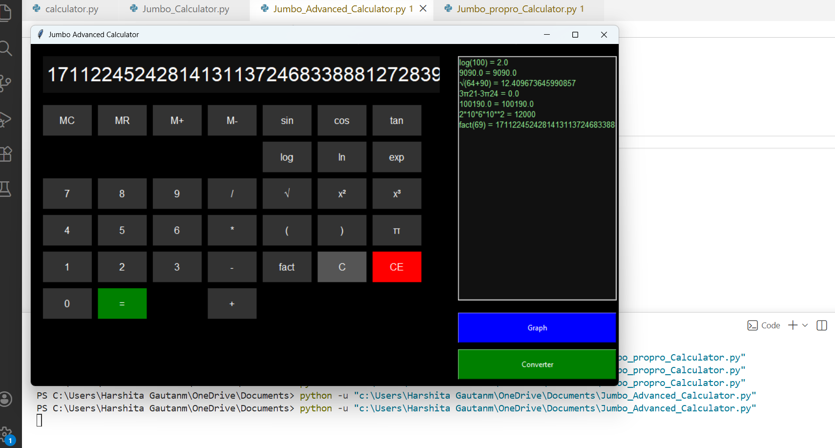
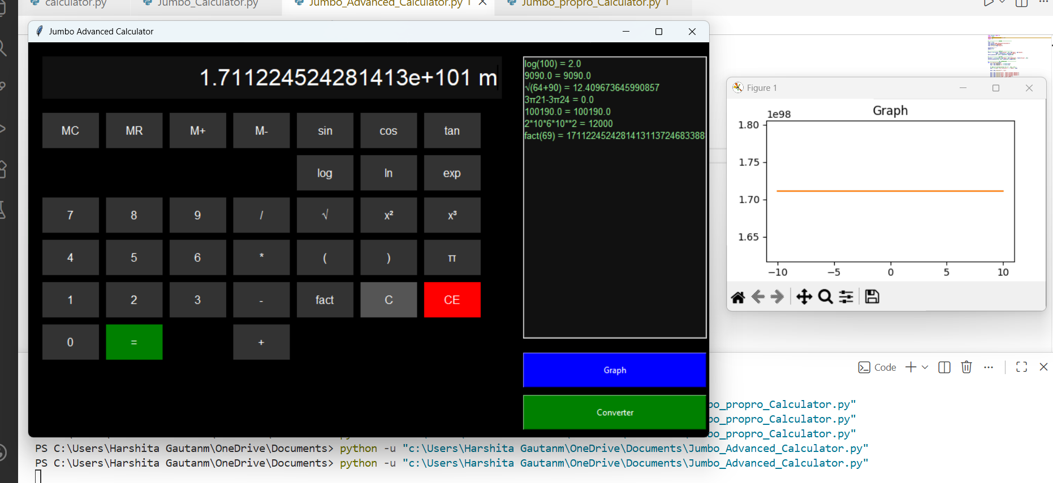

Slide 16
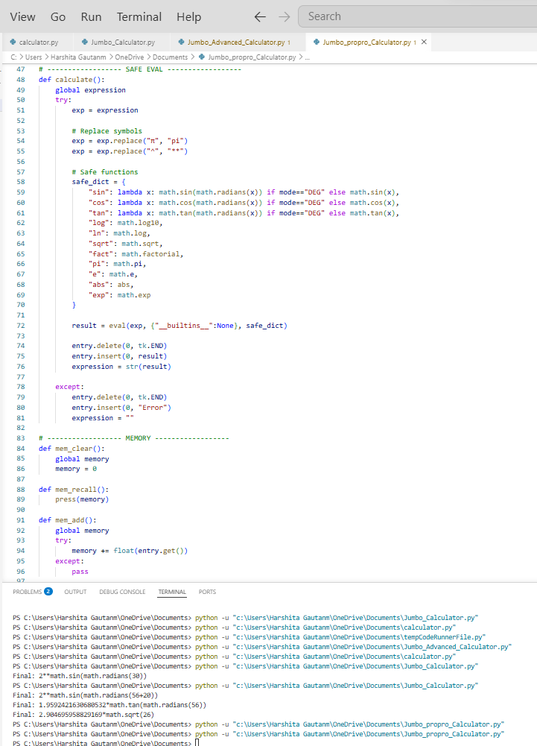
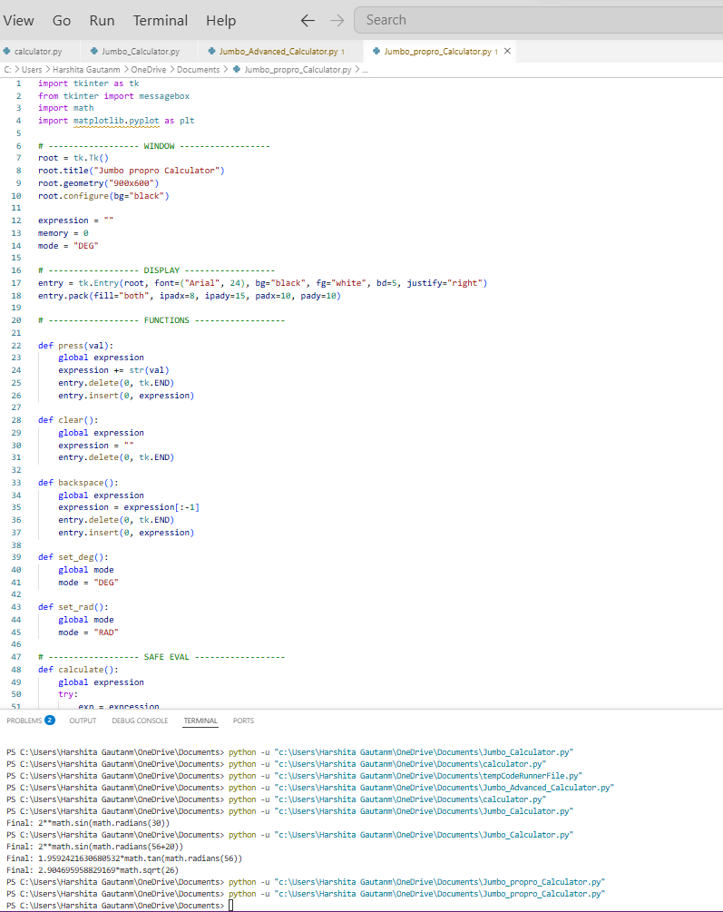
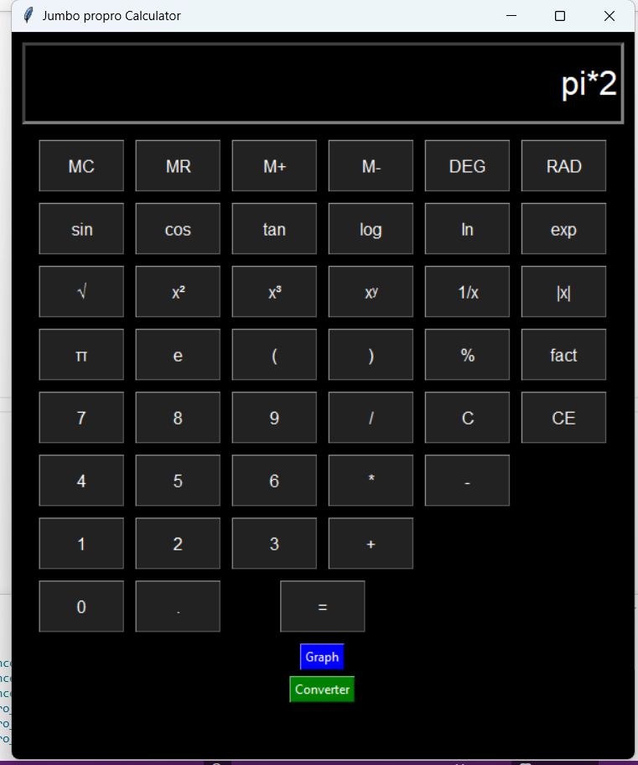
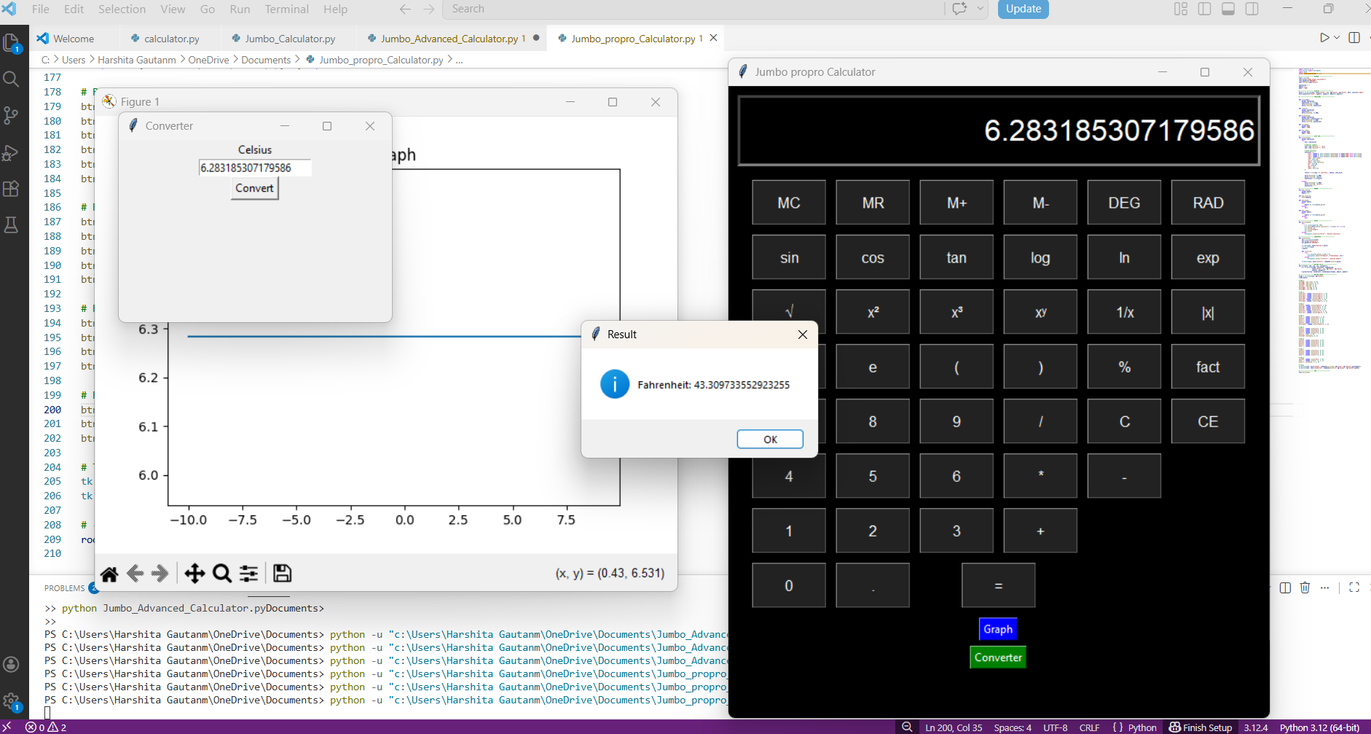
CODING+OUTPUT
Jumbo_propro_Calculator.py

Slide 17
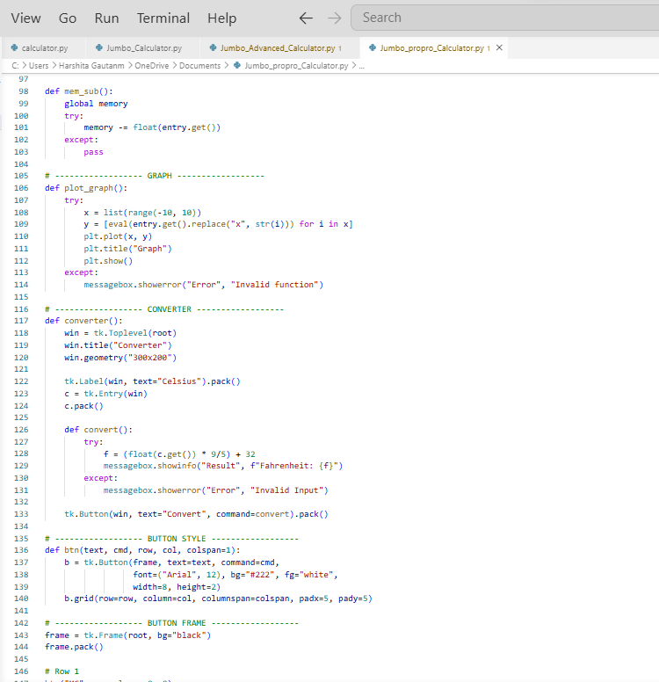
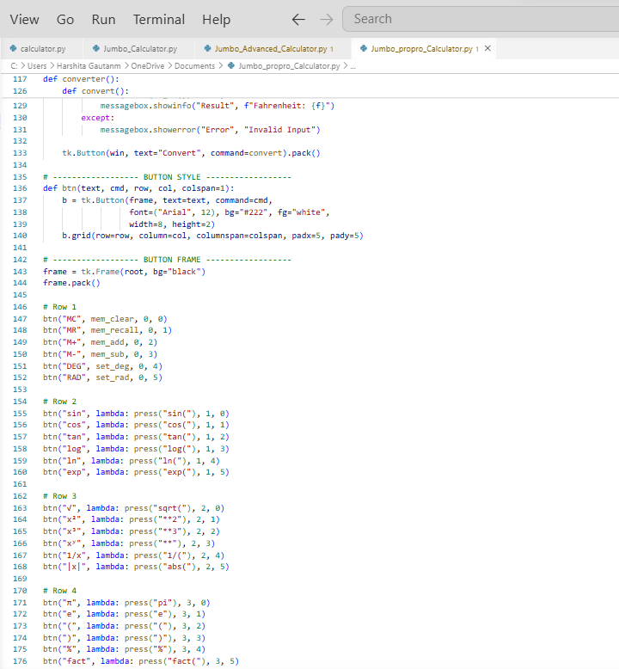
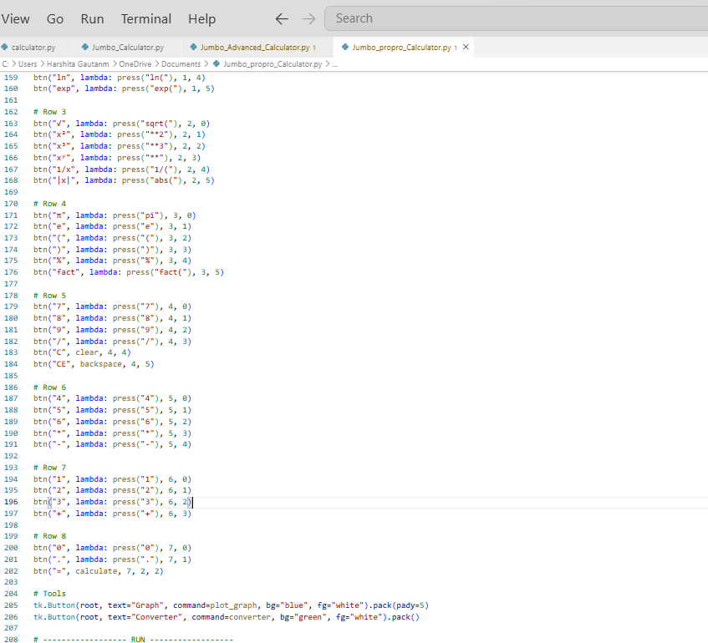

Slide 18
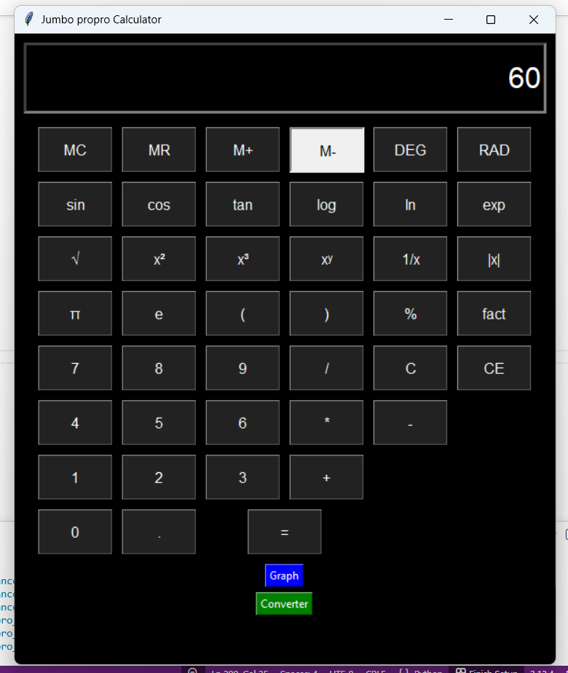
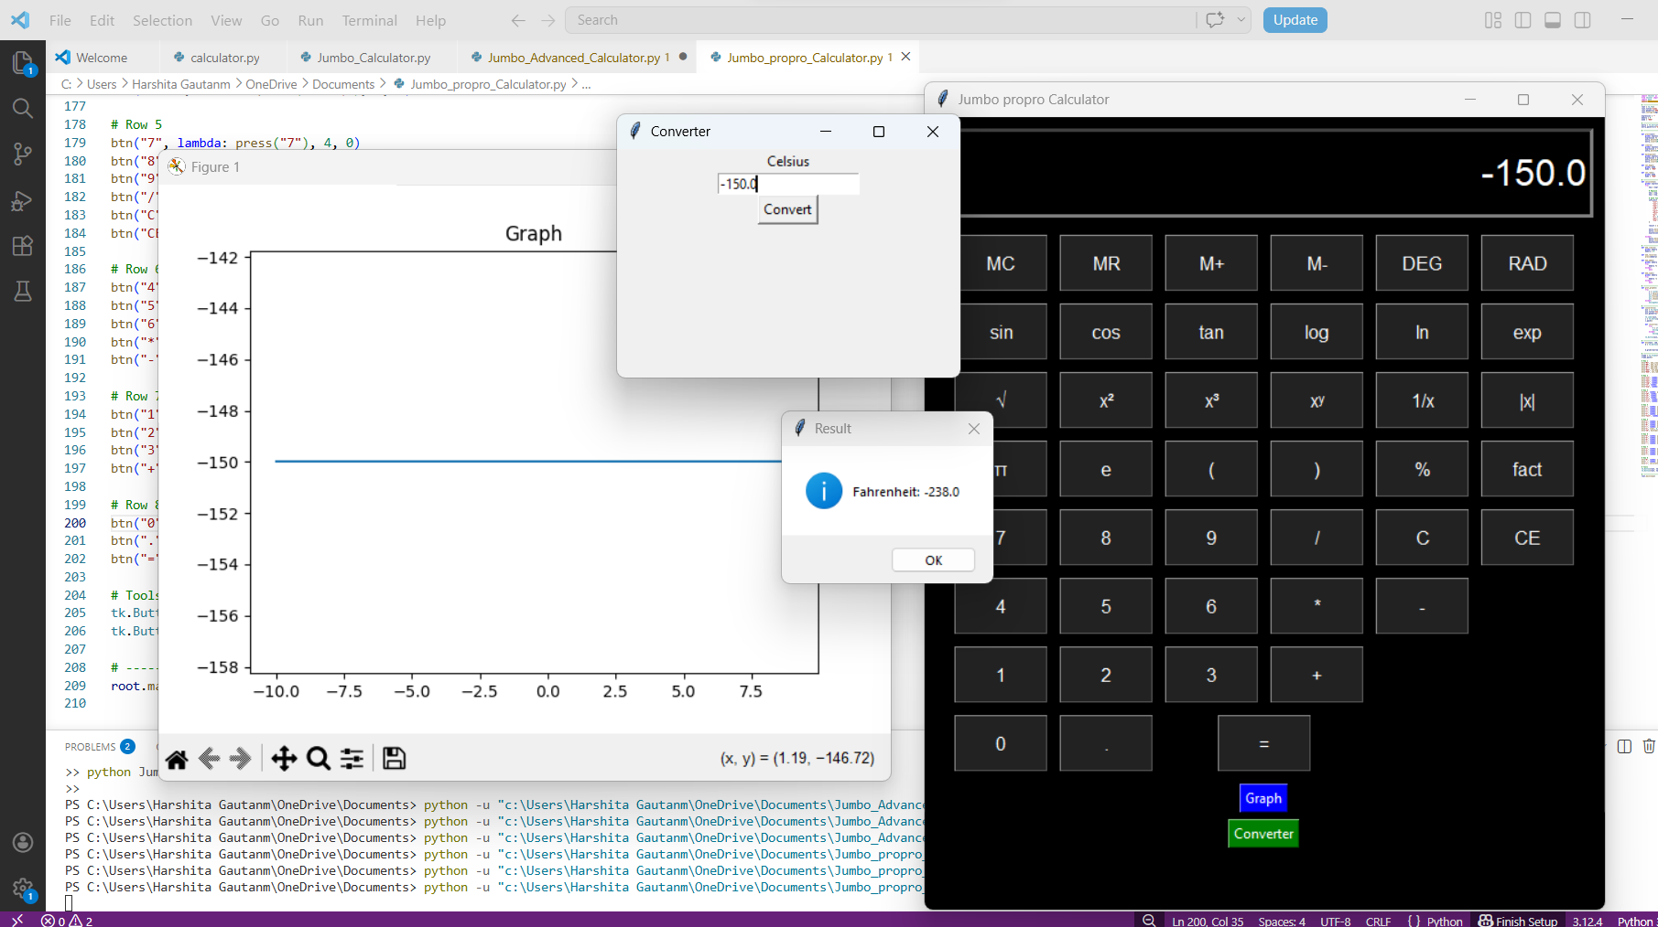
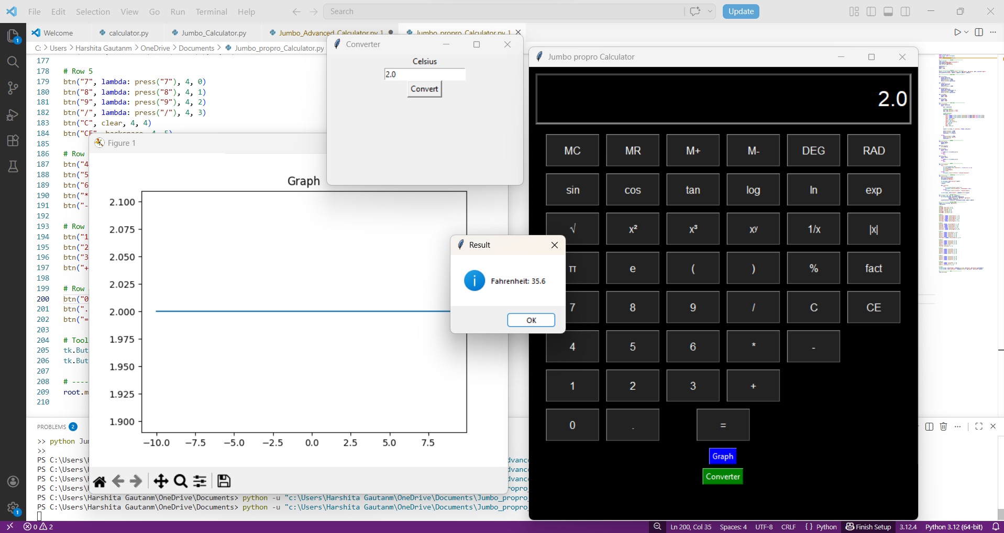
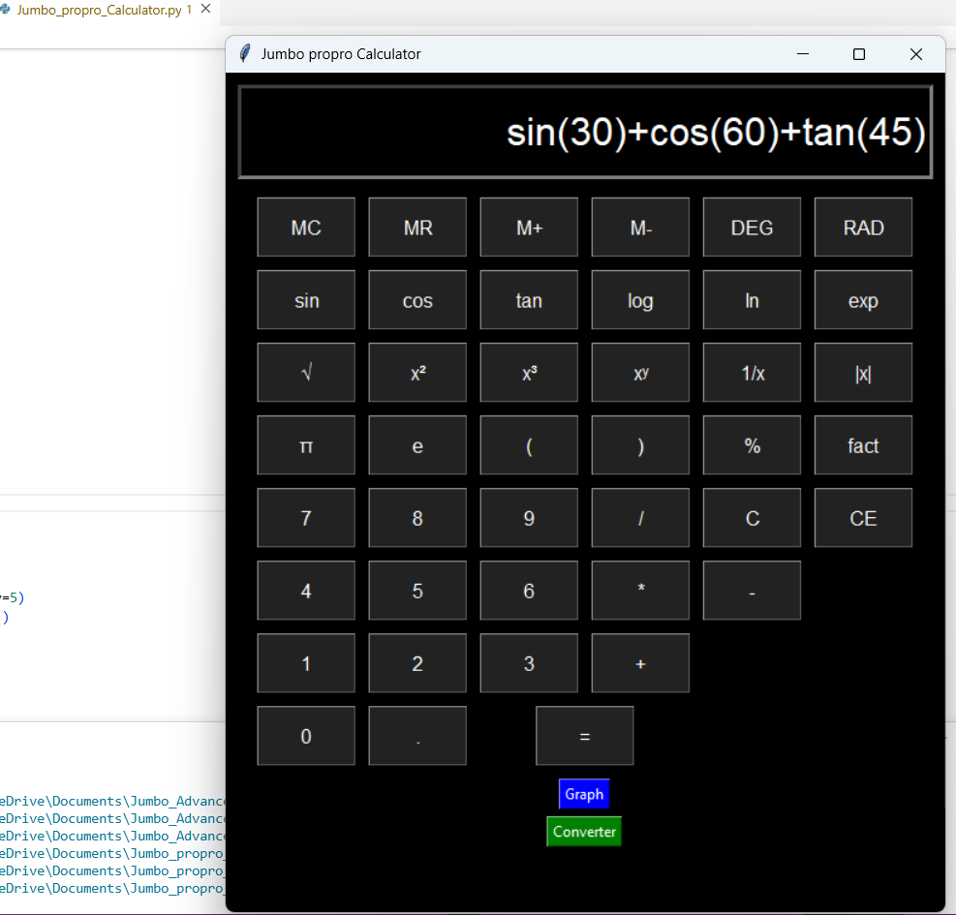

Slide 19
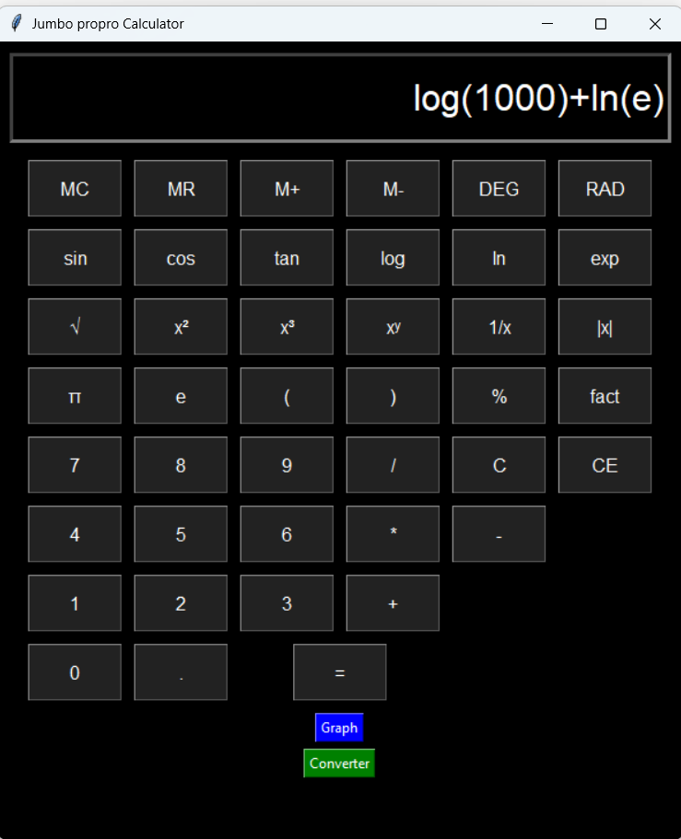
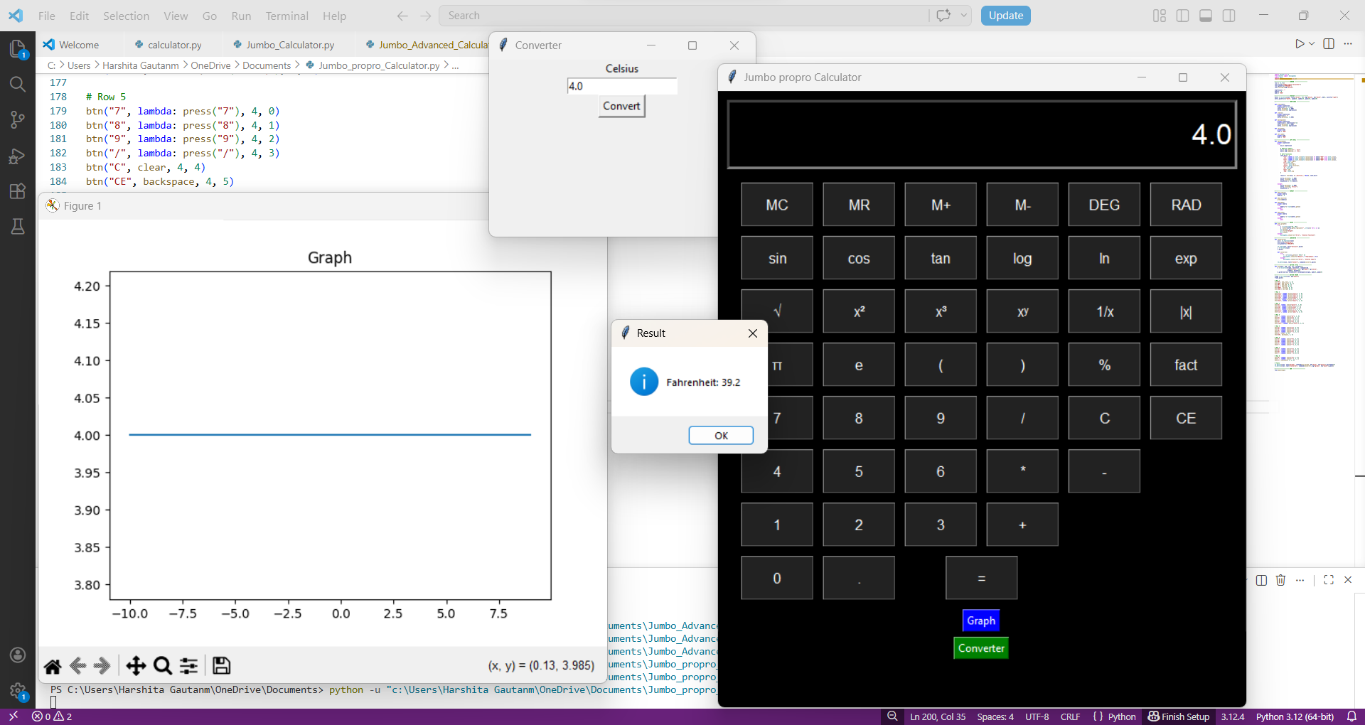
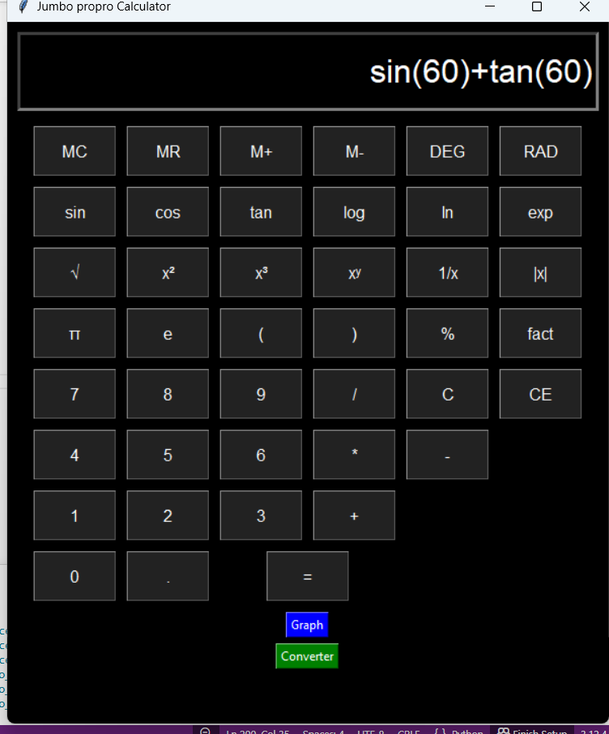
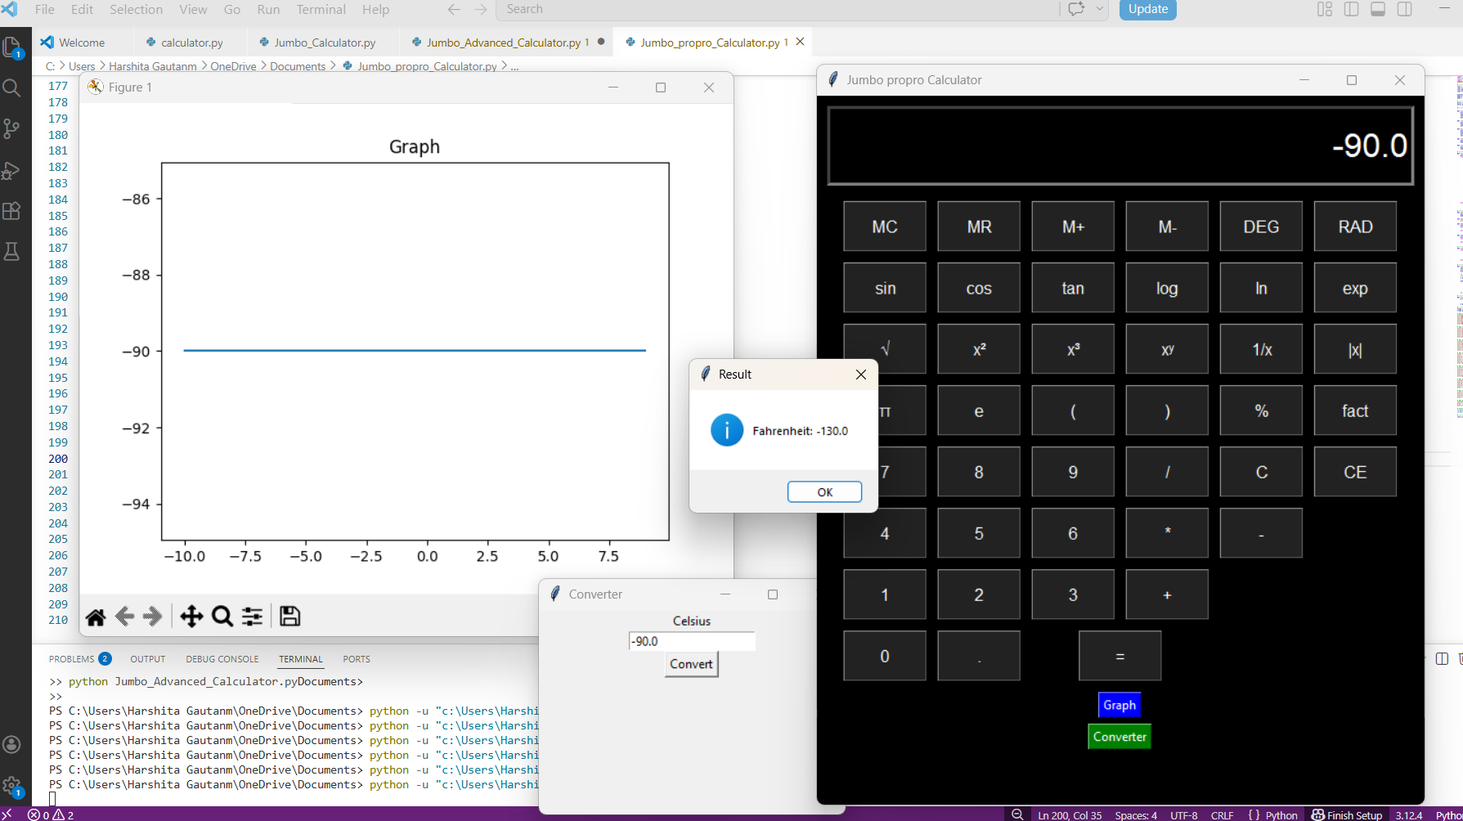
MORE OUTPUTS

Slide 20
Conclusion
I have Successfully developed a multi-level calculator system using Python, consisting of Basic, Jumbo, Advanced, and Pro versions, each with increasing functionality. The project integrates various features such as scientific functions, memory operations, graph plotting, and unit conversion. A user-friendly graphical interface is designed using Tkinter, making the application efficient and suitable for real-world use.

Slide 21
RECOMMENDATIONS
Future ImprovementS
Improve UI with modern themes and animations.
Add history save/export feature .
Optimize performance for large calculations .
System Enhancements
Convert desktop app into web/mobile application .
Add voice input support .
Implement AI-based smart suggestions for calculations .
User Experience Improvements.
More customizable layout options .
Dark/Light mode toggle ..
Better error handling and user guidance

Slide 22
BIBLOGRAPHY
https://www.geeksforgeeks.org/python/python-simple-gui-calculator-using-tkinter/
https://matplotlib.org/stable/users/index.html

Slide 23


