Slide 1
Analysis of Poverty in India
Harshitha S
Harshita R
K Likhitha
Hamsa A

Slide 2
INTRODUCTION
India is a developing nation. Although its economy is growing, poverty is still a major challenge. However, poverty is on the decline in India.
Poverty is the state of not having enough material possessions or income for a person basic need. Poverty may include social, economic, and political elements. Absolute poverty is the complete lack of the means necessary to meet basic personal needs, such as food, clothing, and shelter.

Slide 3
PROBLEM STATEMENT
In this project we have implemented machine learning algorithms to make a detailed analysis on poverty and other factors that lead to poverty in India. We have used various visualization techniques like scatter plot to get a pictorial view of our data. We have considered data sets which includes state, population, poverty line, unemployment rate, literacy rate, crime rate and malnutrition of India.

Slide 4
IMPLEMENTATION
Collection of required datasets.
Importing all libraries and modules.
Reading csv files.
Processing the data .
Data visualization using scatter plot.
Applying regression techniques on the data set to find the data model. (Linear Regression and Random Forest techniques).

Slide 5
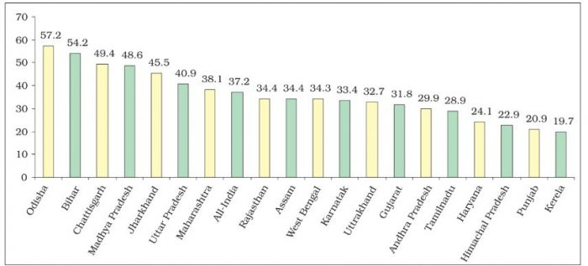
Population in Indian States

Slide 6
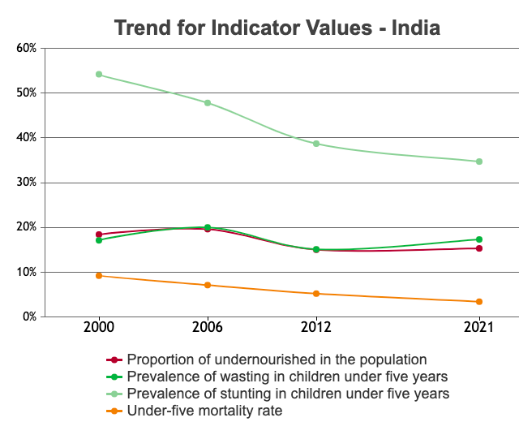

Slide 7
CONCLUSION
India's economy is growing briskly, but many Indians are being left behind. The democratic promise of inclusive growth is not being met. If the facts of want amid plenty are relatively clear, why this may be so and what can be done about it are controversial issues. One somewhat sanguine view of India's current developmental trajectory takes comfort in the fact that the Indian economy finally opened up to the world in the early 1990s and grew rapidly as a result. Since poverty and destitution in India are age-old problems, this view might continue, the new growth finally offers the possibility of incorporating the poor into a productive economy.

