Slide 1
Recommendation Systems for Personalized Content Discovery
Dataset: Netflix Prize Dataset • 100M+ ratings • 480K users • 17,770 movies
Models: Item-Based Collaborative Filtering • SVD (Matrix Factorization)
Subset: 50,000 users from combined_data_1.txt | Split: User-wise 80/20
Name: Harshita Gupta
Enrollment no: 23113065
B. Tech Civil Engg.
Machine Learning | Recommender Systems | Matrix Factorization | Collaborative Filtering

Slide 2
PROBLEM OVERVIEW
THE CHALLENGE
100M+
Every day, billions of users interact with recommendation engines that shape what they watch, listen to, and buy.
The Netflix Prize was a landmark ML competition to improve movie recommendation accuracy - its dataset remains a benchmark for the field.
Our goal: build an intelligent engine that learns user preferences and generates meaningful, personalized recommendations.
Total Ratings
480K
Unique Users
17,770
Movies
⚠ Subset used: 50,000 randomly sampled users from combined_data_1.txt (~24M ratings) – done due to Colab RAM constraints

Slide 3
APPROACH & METHODOLOGY
01
Data Loading & Cleaning
02
EDA
03
Train-Test Split
Parsed 24M ratings from combined_data_1.txt. Validated rating range (1-5), dates (1999-2005), nulls and duplicates. Applied iterative filtering: min 10 ratings per user and per movie.
Analysed rating distributions, user/movie activity power laws, sparsity (~97%), time trends and rating bias. Identified key business insights to guide model design.
User-wise 80/20 random split (seed 42). Every user appears in both train and test. Zero data leakage confirmed. Relevance threshold: rating ≥ 3.5 (as per PS).
04
Model 1: Item-Based CF
05
Model 2: SVD (Matrix Factorization)
06
Evaluation
Cosine similarity between movie vectors. Weighted average of top-20 similar movies the user has rated. Falls back to global mean for cold-start.
Scikit-Surprise SVD with explicit user/item bias. Hyperparameter tuned via GridSearchCV (2-fold CV). Learns latent factors capturing hidden preferences.
Mandatory: RMSE (rating accuracy) and MAP@10 (ranking quality). Additional: MAE, within-0.5-star %, per-rating error breakdown.

Slide 4
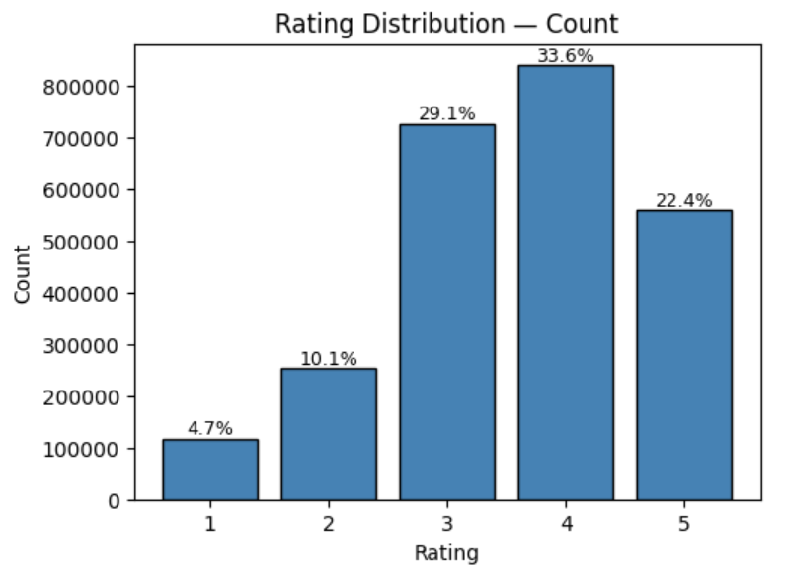
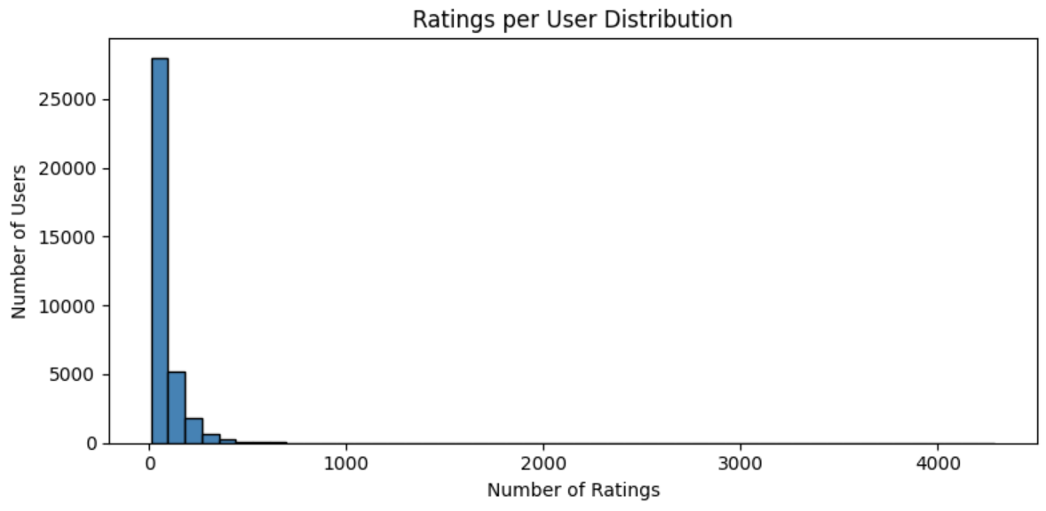
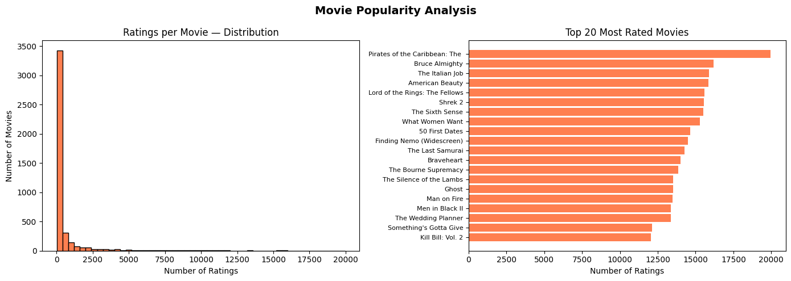
KEY INSIGHTS: EXPLORATORY DATA ANALYSIS
Rating Distribution & User Activity Distribution
Positivity Bias
~60% of ratings are 4-5 stars. Users rate movies they chose to watch — selection bias. Justifies the PS relevance threshold of ≥ 3.5.
User Activity Distribution
Top 10% of users contribute the majority of all ratings. Most users have sparse histories, making cold-start a real challenge.
Movie Popularity Distribution
Movie Popularity Distribution
Blockbusters dominate; most movies are niche with few ratings. Long-tail distribution makes recommendation systems essential.
Rating Bias
Significant user-level bias: some users consistently rate high (lenient), others low (harsh). SVD's explicit bias terms directly address this.

Slide 5
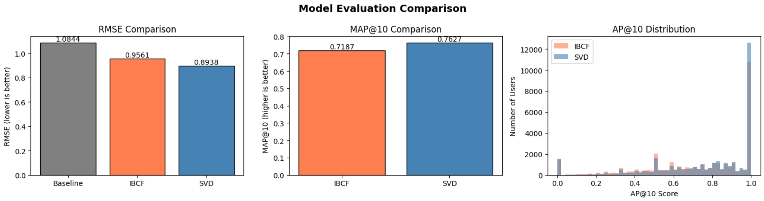
EXPERIMENTAL RESULTS
Model Performance Comparison
📊 Model Comparison Chart
Metric | Baseline (Global Mean) | Item-Based CF | SVD ★ Best
RMSE | 1.0844 | 0.9561 | 0.8938
MAE | 0.9086 | 0.7456 | 0.7019
MAP@10 | N/A | 0.7187 | 0.7627
Within ±0.5 stars | N/A | 41.8% | ~43.9%
[ INSERT CHART ]
RMSE & MAP@10 Bar Comparison
(Baseline vs Item-Based CF vs SVD)
From Step 16, Cell 205 — plt.subplots(1,3) figure
SVD Configuration
Latent Factors: Best from GridSearchCV (125)
Regularization: Best from GridSearchCV (0.02/0.05)
Epochs: Best from GridSearchCV (20)
CV Strategy: 2-fold GridSearchCV | Random seed 42
Learning Rate: 0.005

Slide 6
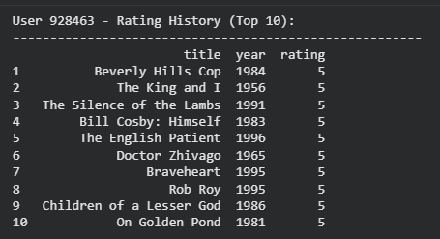
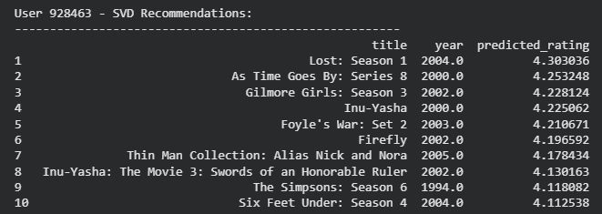
RECOMMENDATION EXAMPLES
👤 User History (Top Rated - Train Set)
🎬 Top-10 Recommendations (SVD)
✅ Success Case
❌ Failure Case
Popular movies with many ratings → strong item similarity signals. Active users with rich history → accurate neighbourhood. Predictions within ±0.5 stars. (Replace with a specific example from your notebook output — Step 14/Cell 165)
Niche movies with sparse ratings → weak or no similarity signal → fallback to global mean. Users with unique tastes poorly served. Error ≥ 2 stars. (Replace with a specific example from Step 14/Cell 167)

Slide 7
MODEL COMPARISON
Model 1
Model 2 ★ Winner
Item-Based Collaborative Filtering
SVD — Matrix Factorization
STRENGTHS
STRENGTHS
+ Intuitive: finds movies similar to what you liked
+ Explicit user & item bias terms
+ Interpretable: similarity scores are transparent
+ Captures latent factors (genres, themes)
+ No training phase: computes on demand
+ Better generalisation on sparse data
LIMITATIONS
+ Industry-standard for large-scale systems
− No user bias correction (harsh vs lenient raters)
LIMITATIONS
− Struggles with sparse / niche movies
− Black-box: harder to explain recommendations
− Popularity bias: favours blockbusters
− Requires retraining as new data arrives
− Cannot capture latent preferences
− Cold-start for unseen users / movies

Slide 8
KEY TAKEAWAYS & FUTURE IMPROVEMENTS
SVD Wins on Both Metrics
Power Laws Drive Design
SVD outperforms Item-Based CF on both RMSE (rating accuracy) and MAP@10 (ranking quality). Bias modelling and latent factor decomposition are key advantages.
User/movie power-law distributions confirm that sparsity handling is essential. Min-10 filtering and user-wise splits are justified by the data.
Relevance Threshold = 3.5 ★
Limitations & Next Steps
~60% of ratings are ≥ 4 stars. The PS threshold of 3.5 cleanly separates genuine positives from neutral/negative interactions.
Cold-start for new users/movies remains unsolved. Future work: hybrid models incorporating content metadata, neural collaborative filtering (NCF), explainability layer.

