Slide 1






WELCOME TO
BOOK
BRIDGERS
HARSHITA BAGWE-16014023024
OMSING PAWAR-16014023036
TY EXCP

Slide 2

PROBLEM STATEMENT
STUDENTS OFTEN STRUGGLE TO ACCESS REQUIRED BOOKS ON TIME, AFFECTING THEIR LEARNING. LIBRARIES HAVE RESOURCES BUT LIMITED DISCOVERABILITY, WHILE MANY USEFUL BOOKS REMAIN IDLE WITH DONORS. A COMMUNITY DRIVEN PLATFORM IS NEEDED TO BRIDGE STUDENTS, LIBRARIES, AND DONORS FOR EASIER BOOK ACCESS.

Slide 3




PROJECT OBJECTIVE
BRIDGING STUDENTS, LIBRARIES, AND DONORS TO MAKE BOOKS ACCESSIBLE FOR EVERYONE
BOOKBRIDGERS CONTRIBUTES TO
SDG 4 — QUALITY EDUCATION
SDG 10 — REDUCED INEQUALITIES
SDG 11 — SUSTAINABLE CITIES AND COMMUNITIES
SDG 12 — RESPONSIBLE CONSUMPTION AND PRODUCTION

Slide 4
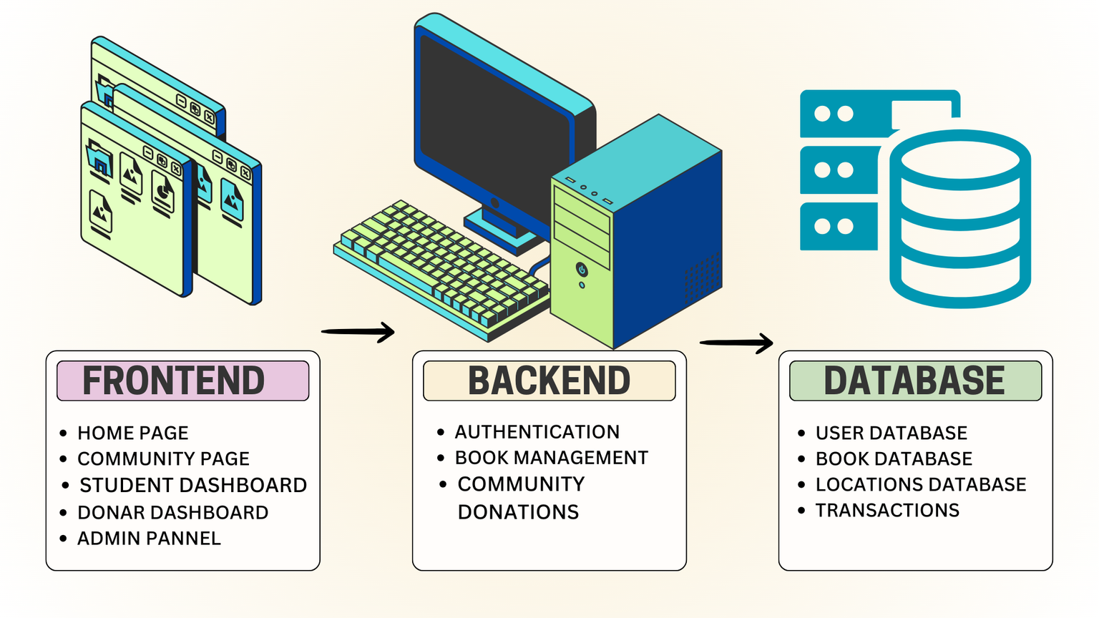

SYSTEM ARCHITECTURE
TECHNOLOGIES USED:
FRONTEND:HTML,CSS,JAVASCRIPT,BOOTSTRAP
BACKEND:NODEJS
DATABASE:MONGODB COMMUNITY SERVER

Slide 5
PAGES AND DATABASE
ARCHITECTURE
FRONTEND PAGES:
DATABASES:
PUBLIC PAGES
HOME.JS - LANDING PAGE WITH PROJECT OVERVIEW
LOGIN.JS - USER AUTHENTICATION PAGE
SIGNUP.JS - USER REGISTRATION PAGE
COMMUNITY.JS - COMMUNITY FEATURES AND INFORMATION
ROLE-BASED PAGES
STUDENT.JS - STUDENT DASHBOARD (APPROVED BOOKS, BORROWING HISTORY)
DONOR.JS - DONOR DASHBOARD (BOOK DONATIONS, DROP-OFF SCHEDULING)
ADMIN.JS - ADMIN DASHBOARD (REQUEST MANAGEMENT, SYSTEM OVERSIGHT)
ADMINLOGIN.JS - ADMIN-SPECIFIC LOGIN PAGE
FEATURE PAGES
LIBRARY.JS - BOOK BROWSING AND SEARCH
PARTNERLIBRARIES.JS - INTERACTIVE MAP WITH LIBRARY LOCATIONS AND APPOINTMENTS
USERS COLLECTION - COMPLETE USER PROFILE WITH LOCATION AND COORDINATES
BOOKS COLLECTION - BOOK DETAILS WITH STATUS TRACKING AND OWNERSHIP
REQUESTS COLLECTION - BORROWING WORKFLOW WITH APPROVAL TRACKING
PARTNERLIBRARIES COLLECTION - LIBRARY INFORMATION WITH GEOSPATIAL DATA
APPOINTMENTS COLLECTION - SCHEDULING SYSTEM WITH BOOK ASSOCIATIONS
DATABASE FEATURES HIGHLIGHTED:
GEOSPATIAL INDEXING - 2DSPHERE INDEX FOR LOCATION-BASED QUERIES
PASSWORD SECURITY - AUTOMATIC BCRYPT HASHING
DATA VALIDATION - MONGOOSE SCHEMA VALIDATION
REFERENTIAL INTEGRITY - OBJECTID REFERENCES BETWEEN COLLECTIONS
PERFORMANCE OPTIMIZATION - STRATEGIC INDEXES FOR EFFICIENT QUERIES
KEY DATABASE RELATIONSHIPS:
USERS ↔ BOOKS: DONOR OWNERSHIP AND CURRENT BORROWER TRACKING
USERS ↔ REQUESTS: STUDENT REQUESTS AND ADMIN APPROVALS
USERS ↔ APPOINTMENTS: USER APPOINTMENT SCHEDULING
BOOKS ↔ REQUESTS: BOOK BORROWING WORKFLOW
PARTNERLIBRARIES ↔ APPOINTMENTS: LIBRARY APPOINTMENT MANAGEMENT

Slide 6
BACKEND ARCHITECTURE
BACKEND API ENDPOINTS:
APPOINTMENTS ROUTES (/API/APPOINTMENTS)
POST /API/APPOINTMENTS - CREATE APPOINTMENT
GET /API/APPOINTMENTS/MY-APPOINTMENTS - GET USER'S APPOINTMENTS
PUT /API/APPOINTMENTS/:ID/CANCEL - CANCEL APPOINTMENT
GET /API/APPOINTMENTS/LIBRARY/:LIBRARYID - GET LIBRARY APPOINTMENTS
GET /API/APPOINTMENTS/LIBRARY/:LIBRARYID/AVAILABLE-SLOTS - GET AVAILABLE TIME SLOTS
PUT /API/APPOINTMENTS/:ID/STATUS - UPDATE APPOINTMENT STATUS (ADMIN ONLY)
PARTNER LIBRARIES ROUTES (/API/PARTNER-LIBRARIES)
GET /API/PARTNER-LIBRARIES - GET ALL LIBRARIES (PUBLIC)
GET /API/PARTNER-LIBRARIES/NEAREST - FIND NEAREST LIBRARIES (PUBLIC)
GET /API/PARTNER-LIBRARIES/:ID - GET SPECIFIC LIBRARY (PUBLIC)
GET /API/PARTNER-LIBRARIES/USER/NEARBY - GET LIBRARIES FOR USER
POST /API/PARTNER-LIBRARIES - CREATE LIBRARY
PUT /API/PARTNER-LIBRARIES/:ID - UPDATE LIBRARY
DELETE /API/PARTNER-LIBRARIES/:ID - DELETE LIBRARY (ADMIN ONLY)
ADMIN ROUTES (/API/ADMIN)
GET /API/ADMIN/STATS - GET SYSTEM STATISTICS (ADMIN ONLY)
GET /API/ADMIN/PENDING-REQUESTS - GET PENDING REQUESTS (ADMIN ONLY)
GET /API/ADMIN/BOOKS - GET ALL BOOKS (ADMIN ONLY)
GET /API/ADMIN/USERS - GET ALL USERS (ADMIN ONLY)
PUT /API/ADMIN/REQUESTS/:ID - UPDATE REQUEST (ADMIN ONLY)
AUTHENTICATION ROUTES (/API/AUTH)
POST /API/AUTH/REGISTER - USER REGISTRATION
POST /API/AUTH/LOGIN - USER LOGIN
GET /API/AUTH/ME - GET CURRENT USER PROFILE
BOOKS ROUTES (/API/BOOKS)
GET /API/BOOKS - GET ALL BOOKS
POST /API/BOOKS - CREATE NEW BOOK (DONOR/ADMIN ONLY)
GET /API/BOOKS/:ID - GET SPECIFIC BOOK
PUT /API/BOOKS/:ID - UPDATE BOOK (DONOR/ADMIN ONLY)
DELETE /API/BOOKS/:ID - DELETE BOOK (ADMIN ONLY)
USERS ROUTES (/API/USERS)
GET /API/USERS - GET ALL USERS (ADMIN ONLY)
GET /API/USERS/:ID - GET SPECIFIC USER (ADMIN ONLY)
PUT /API/USERS/:ID - UPDATE USER (ADMIN ONLY)
DELETE /API/USERS/:ID - DELETE USER (ADMIN ONLY)
REQUESTS ROUTES (/API/REQUESTS)
GET /API/REQUESTS - GET ALL REQUESTS
POST /API/REQUESTS - CREATE BORROWING REQUEST (STUDENT ONLY)
GET /API/REQUESTS/USER/:USERID - GET USER'S REQUESTS
PUT /API/REQUESTS/:ID/STATUS - UPDATE REQUEST STATUS (ADMIN ONLY)
PUT /API/REQUESTS/:ID/RETURN - RETURN BOOK (STUDENT ONLY)

Slide 7

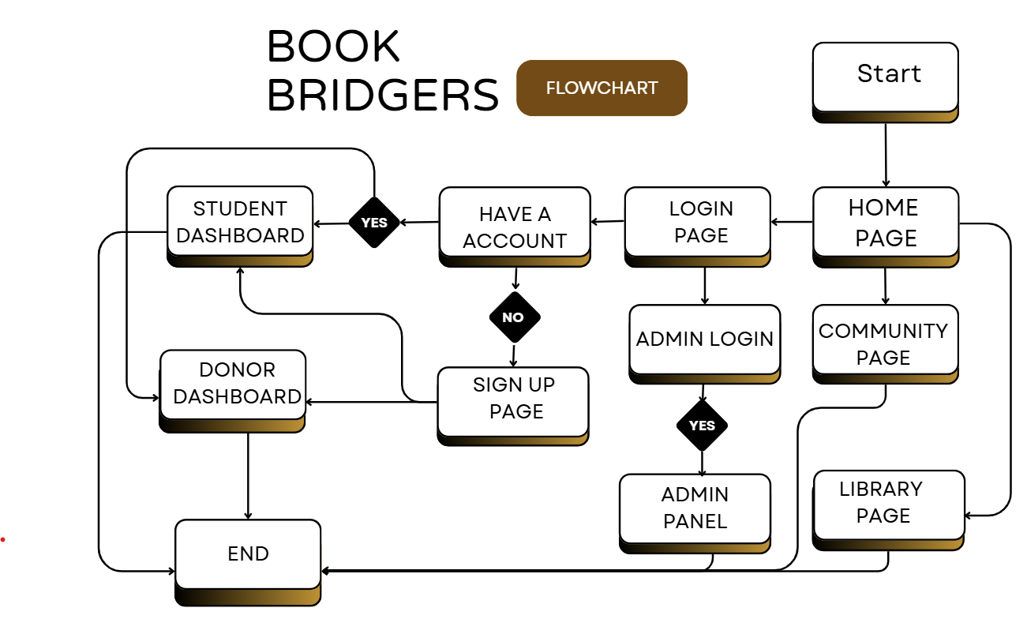


FLOWCHART

Slide 8
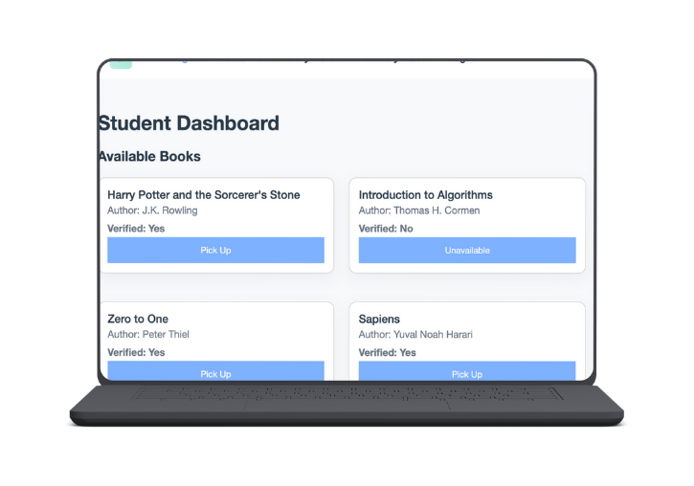
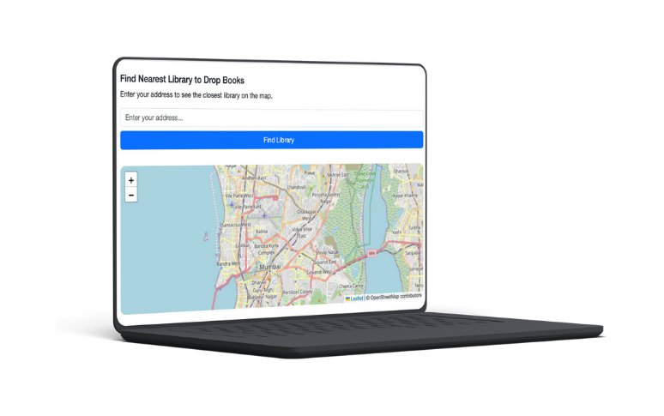
FEATURES
ROLE-BASED DASHBOARDS:
Student Dashboard (Search, Request, Wishlist).
Admin Panel (Manage Listings, Approve Requests).
Donor Dashboard (Donate, Track Contributions).
COMMUNITY PAGE:
Forums for discussion, book clubs, and recommendations.
“Contribute” button linking to donations/QR for funding drives.
BOOK SEARCH & TRACKING:
Search by title, author, or category.
Track availability and request status.
SECURE LOGIN/SIGNUP:
Encrypted authentication with hashed passwords.
DONATION MANAGEMENT:
Donors can log book donations or financial contributions.
PICKUP/DROPOFF LOCATION:
Gives nearest pickup and drop location based on your location.

Slide 9
RESULT
THE COMPLETE VERSION OF BOOKBRIDGERS HAS BEEN SUCCESSFULLY DEVELOPED USING HTML, BOOTSTRAP, AND CSS TO DESIGN A RESPONSIVE AND USER-FRIENDLY FRONTEND.
COMPLETELY FUNCTIONAL BACKEND WITH 7 ROUTE FILES WITH 25+ API ENDPOINTS.

Slide 10

CONCLUSION
BookBridgers has successfully evolved from concept to a fully functional library management system. The project has achieved complete implementation with:
Fully Integrated Full-Stack Architecture - Seamless connection between React frontend and Node.js backend
Comprehensive Role-Based Authentication - Complete JWT-based security system for Students, Donors, and Admins
Database Connectivity - MongoDB integration with 5 optimized collections and geospatial indexingAdvanced Feature Implementation - Interactive maps, appointment scheduling, and real-time request management

Slide 11



REFERENCES
HTTPS://WWW.IRJET.NET/ARCHIVES/V8/I2/IRJET-V8I2337.PDF
HTTPS://WWW.SCRIBD.COM/DOCUMENT/633412415/BOOK-DONATION-SYSTEM
HTTPS://PROJECTRABBIT.IN/SINGLE-PROJECT-DETAILS/ONLINE-BOOK-DONATION-PLATFORM

Slide 12
THANK
YOU

