Slide 1
Docker, Kubernetes
Bachelor of Engineering- Computer Science & Engineering
Cloud Computing (CC)
(23CS009)
Department of Computer Science & Engineering
Chitkara University Institute of Engineering and Technology, Chitkara University, Punjab, India

Slide 2
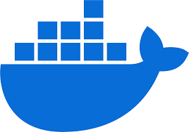
Docker
Docker is an open platform for developing, shipping, and running applications along with their dependencies(code, os, runtime, web framework, and version are dependencies). Docker enables you to isolate your applications from your infrastructure so you can deliver software quickly.
With Docker, you can manage your infrastructure in the same ways you manage your applications.
Docker is an open-source platform that makes it easy to create containers and container-based apps.
Docker is written in the Go language. It uses a technology called namespaces to provide the isolated workspace called the container.
When you run a container, Docker creates a set of namespaces for that container. These namespaces provide a layer of isolation.
Each container runs in a separate namespace and its access is limited to that namespace.

Slide 3
Docker Cont’d
Docker is a containerization platform for developing, packaging, shipping and running applications.
It provide consistent environment for developing, testing, deployment and is compatible with any platform that support docker.
It provides the ability to run an application in an isolated environment called Container.
Container: It is an executable, lightweight package that contains everything needed to run an application (with all the necessary dependencies and configurations). It can be easily shared.
Example: Docker is like renting a room in a shared apartment, where everyone shares the kitchen and electricity but still has their own space.
Image: Containers are created from images, which are templates that include the application code and dependencies.
Docker engine: Core of Docker, which creates and runs containers on host operating systems directly without guest os.
Docker hub: repository where developer can share ,pull, rebuilt container image.

Slide 4
Docker Cont’d
Container
Docker File
Docker Image
Simple text file with instructions to build an image
Container
Single file with all the dep. And lib. necessary to run the program
Image instances

Slide 5
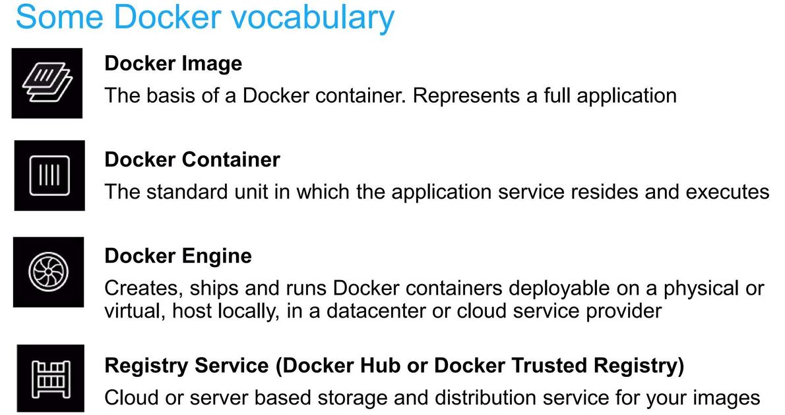
Docker Cont’d

Slide 6
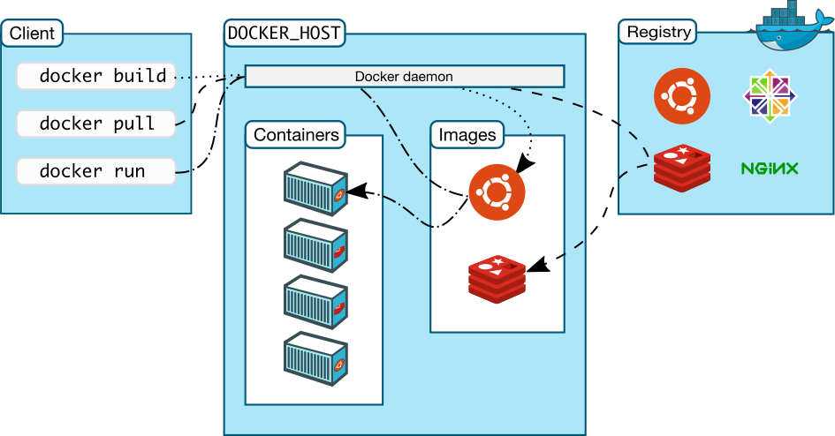
Docker Architecture
Docker uses a client-server architecture, which involves the 3 main components that are Docker Client, Docker Host, and Docker Registry. The Docker client and daemon can run on the same system, or we can connect a Docker client to a remote Docker daemon. The Docker client and daemon communicate using a REST API, over a network interface. The Docker daemon (dockerd) listens for Docker API requests and manages Docker objects such as images, containers, networks, and volumes.

Slide 7
Docker Architecture
Docker daemon: The Docker daemon (dockerd) listens for Docker API requests and manages Docker objects such as images, containers, networks, and volumes.
Docker client: The Docker client (docker) is the primary way that many Docker users interact with Docker. When you use commands such as docker run, the client sends these commands to dockerd, which runs them. The docker command uses the Docker API.
Docker registries: A Docker registry stores Docker images. Docker Hub is a public registry that anyone can use, and by default Docker looks for images on Docker Hub.
When you use the Docker run or pull command, Docker pulls the required images from your configured registry. When you use the docker push commands, Docker pushes your image to your configured registry.

Slide 8
Docker vs. Virtual Machine
Virtual Machines are like physical hardware, turning one server into many servers. It uses technology called hypervisor which allows multiple VMs to run on a single machine.
Each VM has a full copy of an operating system, the application, necessary binaries and libraries. VMs are bulky in nature.
They have a full OS with its own memory management installed with the associated overhead of virtual device drivers. Hence, we can look at it an independent full-fledge house where we don't share any resources.
Docker Containers isolate application environments from one another, and only share the underlying OS kernel.
Docker containers are executed with the Docker engine rather than the hypervisor. Containers are therefore smaller than Virtual Machines and enable faster start up with better performance, less isolation and greater compatibility possible due to sharing of the host's kernel.
Hence, it looks very similar to the housing society homes where we share resources of the society.

Slide 9
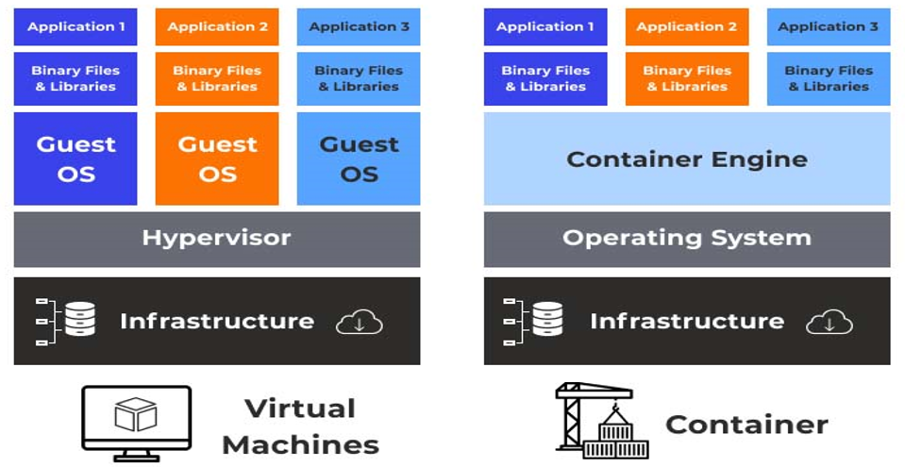
Docker vs. Virtual Machine

Slide 10
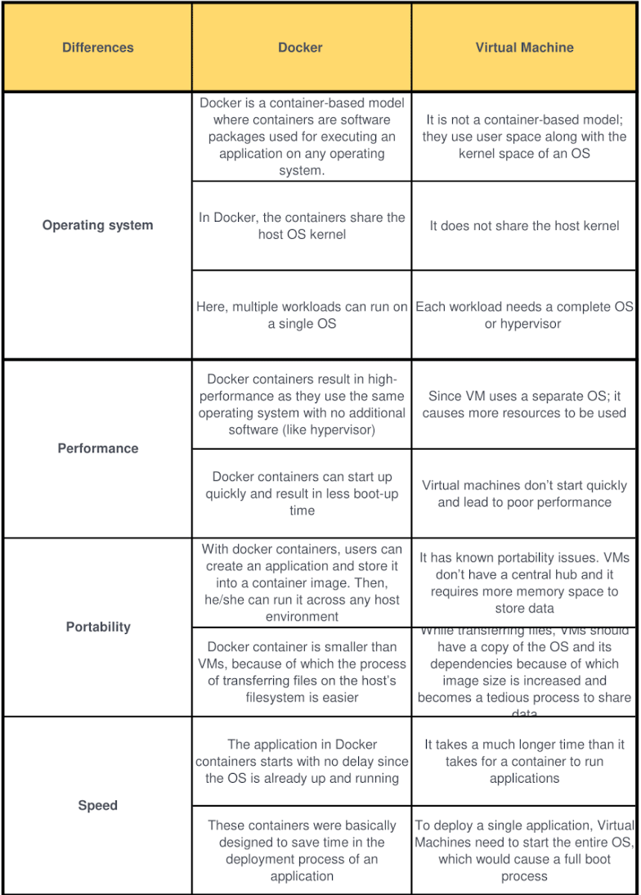
Docker vs. Virtual Machine

Slide 11
Kubernetes (K8s)
It is a container orchestration platform that automates the deployment, scaling, and management of containerized applications.
Kubernetes is an open-source container management tool that automates container deployment, scaling & load balancing.
Google developed an internal system called ‘borg’ (later named Omega) to deploy and manage thousands of google applications and services on their cluster. Later in 2014, google introduced Kubernetes an open-source platform written in ‘Go lang’ and later managed by CNCF (Cloud Native Computing Foundation).

Slide 12
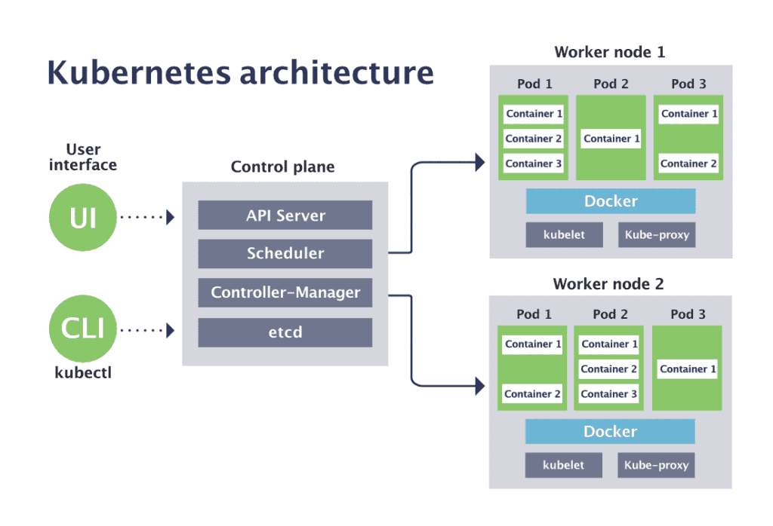
Kubernetes Architecture

Slide 13
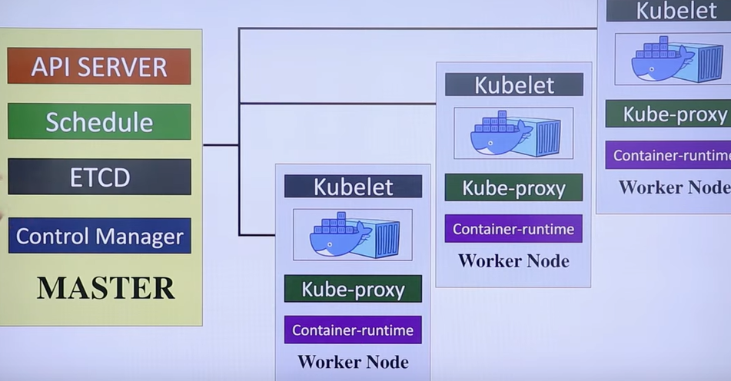
Kubernetes Architecture Cont’d

Slide 14
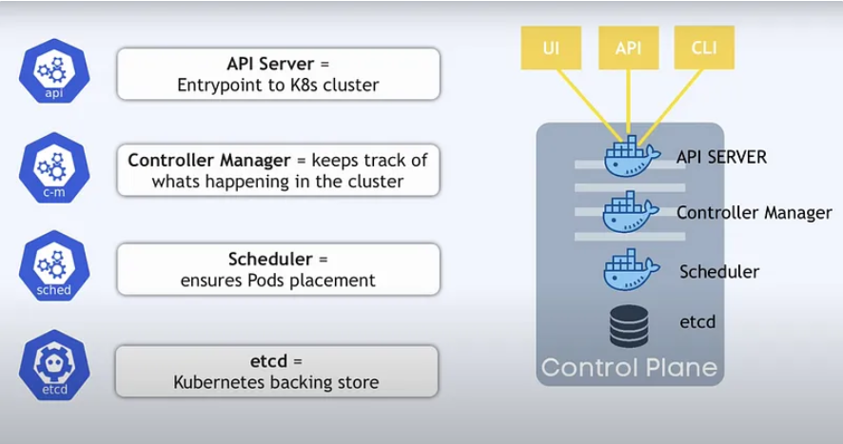
Kubernetes Architecture Cont’d

Slide 15
Kubernetes Architecture Cont’d
Pod
A Pod is the smallest and simplest unit in Kubernetes.
It consists one or more containers, storage, and a network identity into a single unit.
Node
A node is a physical or virtual machine in the Kubernetes cluster that runs pods.
Cluster
A collection of nodes running containerized apps under Kubernetes management is known as a cluster.

Slide 16
Kubernetes Architecture Cont’d
Master Node
The master node keeps the cluster in the appropriate condition by coordinating with the other nodes and managing the cluster’s state.
The scheduler, controller manager, and API server are some of the parts that make up the master node.
API server
The API server is the front end of the Kubernetes control plane. Clients can communicate with the Kubernetes system thanks to the exposed Kubernetes API.
Etcd
The state of the Kubernetes cluster, including the desired state of the applications and the cluster’s configuration, is stored in etcd, a distributed key-value store.
Controller Manager
The controller manager is in charge of making sure the cluster reaches the desired condition. Numerous controllers are included, such as the replication controller, which ensures that the appropriate number of pod replicas are always active.
Scheduler
The scheduler schedules a pod’s execution on a cluster node according to resource limits and other factors.

Slide 17
Kubernetes Architecture Cont’d
Worker Node
Worker nodes run containerized applications and maintain communication with the master node. Each node consists of the following components:
Pod:
Kubelet:
It is like an agent that ensures containers are running in a pod as expected.
Listens to Kubernetes master (eg- Pod creation request).
Send success/Fail reports to master.
Managing the containers and pods operating on each node in the cluster is done by a component known as the kubelet. To ensure the operating pods are in the desired state, the kubelet communicates with the API server.
Container Runtime:
The underlying software (e.g., Docker, containerd) that runs containers.
Kubernetes can handle the containers operating on the nodes using a variety of container runtimes, including Docker or Container.

Slide 18
Kubernetes Architecture Cont’d
Worker Node
Kube-proxy
Assign IP to each pod.
It is required to assign IP addresses to Pods (dynamic)
Kube-proxy runs on each node & this makes sure that each pod will get its unique IP Address.

Slide 19
Advantages
Scalability: Kubernetes enables businesses to scale up their application up or down fast in response to demand, ensuring that they have adequate resources to deal with traffic surges and aren’t paying for resources that aren’t being used, also.
Resilience: Kubernetes has features already built to handle failures, such as automatic container restarts and node replacement.
Portability: Kubernetes simplifies moving applications between cloud providers or on-premises data centres by offering a standard API for deploying and managing containers across various environments.
Automation: Kubernetes automates various container deployment and management operations, including load balancing, service discovery, and rolling updates.

Slide 20
Key Points
Pod is the smallest unit in Kubernetes.
POD is a group of one or more containers that are deployed together on the same host.
A cluster is a group of nodes.
A cluster has at least one worker node and a master node.
In Kubernetes, the control unit is the POD, not the containers.
Consist of one or more tightly coupled containers.
POD runs on a node, which is controlled by the master.
Kubernetes only knows about PODs (Does not know about individual containers).
Cannot start containers without a POD.

Slide 21
Thank You

