Slide 1
CareerPath Finder
Team Details:
Harshita : 2310990601
Moorvi Garg : 2310990659
Faculty Coordinator: Dr.Kirandeep Singh
Chitkara University Institute of Engineering and Technology,
Chitkara University, Punjab

Slide 2
Table of Contents
Introduction
Technologies Used
EJS
Backend
Project flow
Key Features
Project Highlight

Slide 3
Introduction
Project Overview:
CareerPath Finder is a platform that helps users navigate their careers with AI-powered suggestions, quiz-based guidance, job listings, and interview prep resources. It offers resume uploads, career guides, mentorship booking, and daily motivational quotes. Built with a Node.js backend, it ensures security and efficiency

Slide 4
Technologies Used-
Template Engine: EJS
Backend: Node.js, Express.js
Data Storage: JSON files

Slide 5
Template Engine
EJS(Embedded JavaScript):
EJS (Embedded JavaScript) files come under the templating engines category and are used in server-side rendering (SSR). EJS is commonly used with Node.js and Express.js to dynamically generate HTML content.
Technically, EJS files are part of the view layer in the MVC (Model-View-Controller) architecture, often categorized under frontend templating but rendered on the server side.

Slide 6
Backend -
Server Setup:
http module: Creates a server to handle incoming requests.
fs module: Reads and writes data to a User.json file.
qs module: Parses form data sent in POST requests.
Request Handling:
GET Request: Fetches data from the User.json file and sends it as a response (for displaying all student data).
POST Request: Receives form data, stores it in User.json, and responds with a success page.
Data Storage:
Data is stored in a JSON file (User.json), where each new registration is appended.

Slide 7
Backend Development & Dependency Management
Modules: Reusable JavaScript files in Node.js that help organize code efficiently.
npm: Node Package Manager, used to install and manage dependencies.
Static Pages: Pre-rendered web pages (HTML, CSS, JS) served without server-side processing.
Exception Handling: Managing errors in a program to prevent crashes and ensure smooth execution.
Frameworks & Express.js
Node.js: A JavaScript runtime that allows running JavaScript outside the browser, mainly used for backend development.
Express.js: A minimal and flexible Node.js web framework that simplifies handling requests, routing, and middleware in web applications
Middleware & Error Handling
Middleware in Express.js processes requests before reaching endpoints, while error handling manages and responds to application errors gracefully.
.

Slide 8
Project Flow -
User Registration & Authentication
Profile Setup & Resume Upload
Job Listings & Career Resources
Motivational Quotes & Daily Updates
Dark Mode & User Preferences

Slide 9
Key Features
Responsive Design
User-Friendly Interface
Clear and Organized Content Layout
Interactive Data Display
Success Confirmation
Error Handling
Data Storage Integration
Backend Processing
Integrated Resource Links.

Slide 10
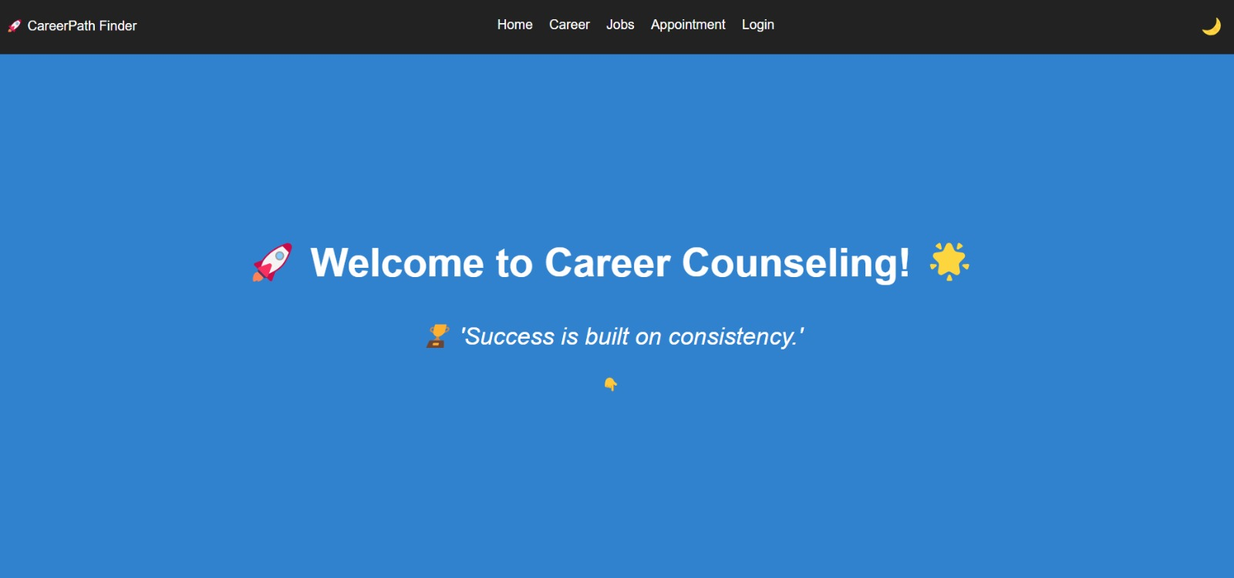
PROJECT HIGHLIGHTS -

Slide 11
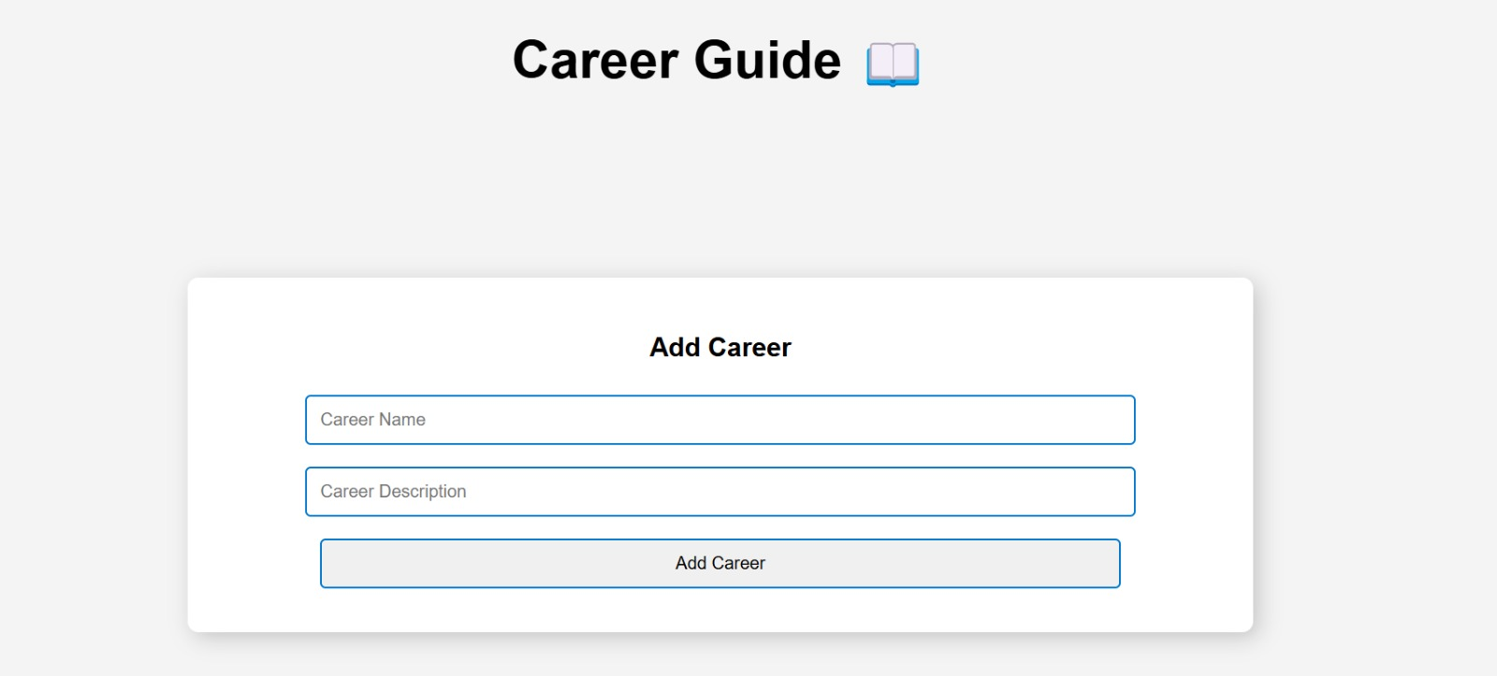

Slide 12
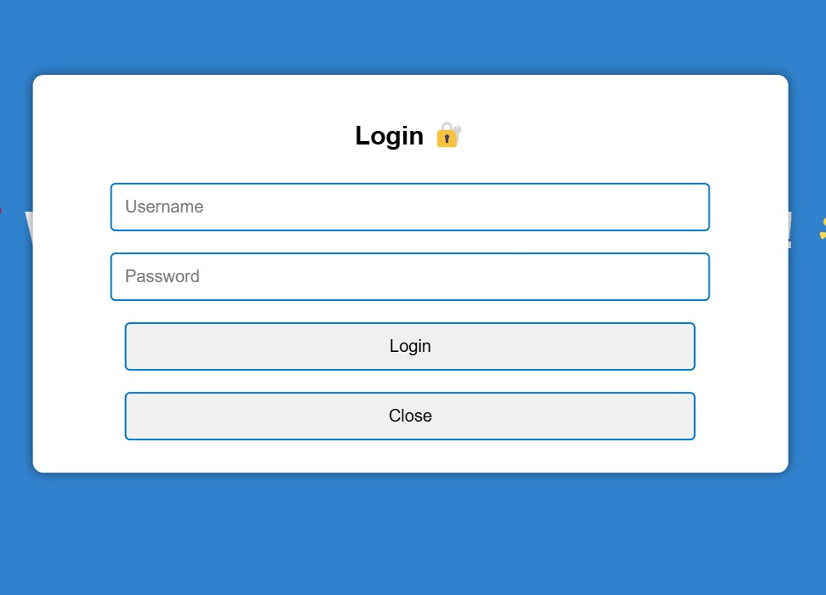

Slide 13


