Slide 1
Introduction to LVM concepts
It provides a higher level view of the disk storage on the computer system than the traditional view of the disks.
It is a more flexible approach to managing disk storage space.
It provides logical volume management for the Ubuntu 20.04
it allows for the collection of multiple physical hard drives and partitions into a single volume.
It is placed between the file system and disk partition

Slide 2
What is LVM?
LVM stands for Logical Volume Management.
LVM created in Ubuntu 20.04 version.
It is better for monitoring and disk management on your computer
LVM is a software tool to manage large pool of storage devices.
With LVM, a hard drive or set of hard drives is allocated to one or more physical volumes.

Slide 3
Cont(…)
Why Use LVM ?
For the easier management of physical storage devices.
Allows file systems to be easily resized as needed.
With traditional storage, three 1 TB disks are handled individually.
With LVM, those same three disks are considered to be 3 TB of aggregated storage capacity.

Slide 4
Cont(…)
Basic Terms of LVM
Physical Volume(PV)
A partition or a disk derived initialized to be used by LV
Physical Extent (PE)
a small uniform segment of a disk. PVs are split into PEs
Volume Group(VG)
it is a storage pool made of one or more PVs
Logical Extent(LE)
every PE associated with LE, and those PE are combined into LV
Logical Volume (LV)
it is a apart of VG and made of LEs.

Slide 5
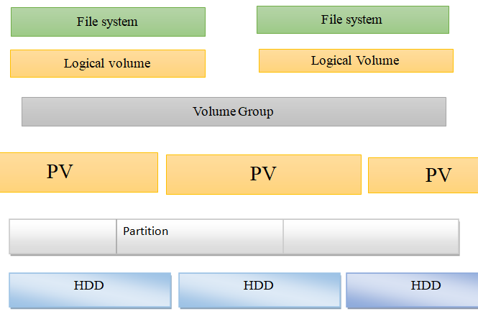
Cont(…)
LVM Structure
LVM enables the combining of multiple individual hard drives and/or disk partitions into a single volume group.
That volume group can then be subdivided into logical volumes or used as a single large volume.
Regular file systems, such as ext3 or ext4, can then be created on a logical volume

Slide 6
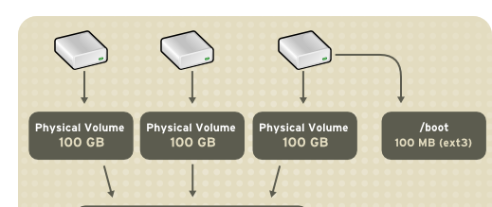
Cont(…)
The physical volumes are combined into volumes group, with the exception of the /boot partition.
The /boot partition cannot be on a logical volume group because the boot loader cannot read it.
Volume Group (VG)

Slide 7
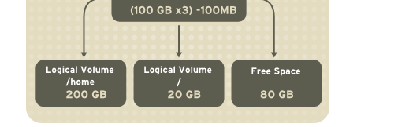
Cont(…)
The volume groups can be divided into logical volumes.
When partitions reach their full capacity, free space from the volume group can be added to the logical volume to increase the size of the partition.
Volume Group (VG)

Slide 8
Cont(…)
Advantages of using logical volume management (LVM)
For the easier management of physical storage devices.
Allows file systems to be easily resized as needed.
With traditional storage, three 1 TB disks are handled individually.
With LVM, those same three disks are considered to be 3 TB of aggregated storage capacity.
It is used to increases the availability of your data.
Increased abstraction and control.

Slide 9
Cont(…)
Disadvantages using logical volume management (LVM)
It adds another layer to the storage system.
While the overhead of LVM is usually small, any decrease in performance can be critical on busy systems.

Slide 10
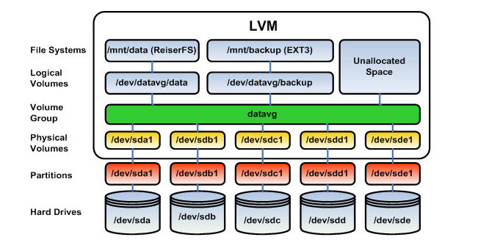
LVM System Layer
LVM is a very cool volume management tool.
It can be used for a variety of tasks.

Slide 11
Cont(…)
LVM Layer 1: Physical Volumes
The bottom layer
Consists of disks and partition.
LVM Layer 2: Volume Groups
Create using physical volumes
Consist of one or more physical volumes
LVM Layer 3: Logical Volumes
Created from the space within volume groups
Can hold arbitrary file systems.

Slide 12
Cont(…)
LVM Commands
How to create a LVM in Ubuntu 20.04 Version , these are the below steps to be followed.
Select or identify the correct disks to be used for LVM.
Create a Physical Volumes (PV) on the disk.
Create the Volume Group(VG) on the Physical Volumes
Create Logical Volumes(LV) on the Volume Group
Create a file system for the logical volumes

Slide 13
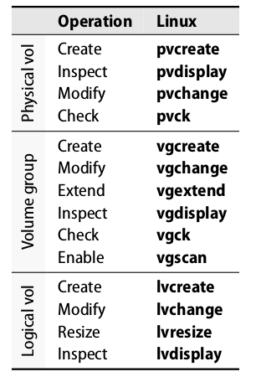
Cont(…)

Slide 14
Cont(…)
Designate Physical Volumes
PV are disks or partitions that are available to LVM as potential storage capacity.
To implement LVM, first designate a drive as a Physical Volume.
Physical volume (Pv) commands
pvcreate: create a physical volume from sda1
Pvdisplay: display detailed information of physical volume
pvscan: scan a disk on the physical volume and verify Pv status
Pvs : provides (PV) information in a configurable form
Pvremove: e.g pvermove /dev/sda1 remove a given PV.

Slide 15
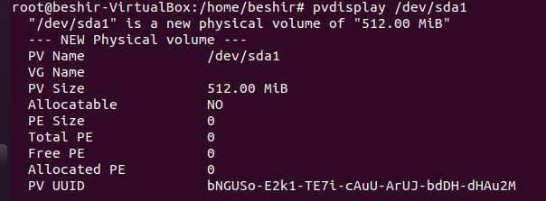
Cont(…)
Creating a Physical Volumes from hard drive
Syntax : pvcreate [ physical volume name]
pvcreate /dev/sda1
Displaying the physical volume
Pvdisplay:

Slide 16
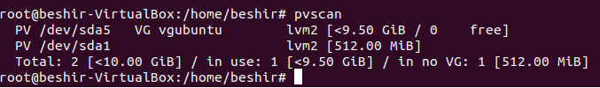
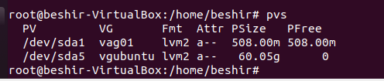

Cont(…)
The pvscan command
The pvs command.
pvremove

Slide 17
Cont(…)
Create Volume Group (VG) on the Physical Volumes
VGs are a pool of storage that consists of one or more pvs.
Volume Group (Vg) commands
vgcreate: create a volume group from one or more drives
vgdisplay: display details on the volume group
vgremove: remove the volume group e.g vgremove vg1
Vgdisplay –v vg_name: To view the specific VG information
Vgextend : add the new pv to the vg e.g vgextend vg1 /dev/sda1
Vgreduce: remove the vg from the pv e.g vgremove vg1 /dev/sda1

Slide 18
Cont(…)
syntax: vgcreate [volume group name] [physical volume name]
vgcreate vag01 /dev/sda1: create a volume group from one drives

Slide 19
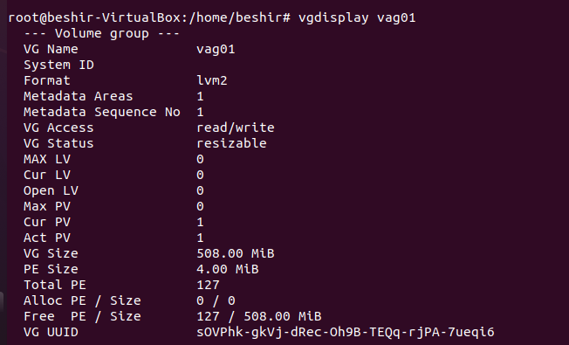
Cont(…)
vgdisplay vg1: Display details on a volume group

Slide 20
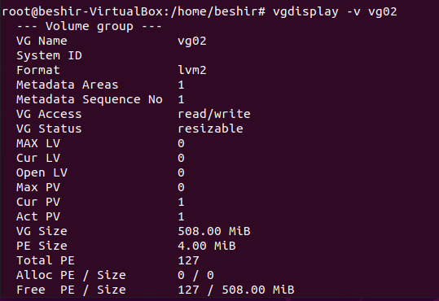
Cont(…)
Vgdisplay –v vg_name: To view the specific volume group information

Slide 21

Cont(…)
vgremove commands: e.g vgremove vg_name

Slide 22
Cont(…)
Creating the Logical Volumes
The VG can be subdivided into one or more (LVs).
The VG has a total capacity, and then some part of that capacity is allocated to a Logical Volume.
The lvcreate command carves storage capacity from a VG.
There are a few options to be aware of.
option description
-n name of Lv example
-L size of the logical volume

Slide 23
Cont(…)
Logical volume (LV) commands
lvcreate: create the logical volume on the volume group
Lvdisplay: provides details information about LV.
Lvscan : shows the logical volume
Lvrename: rename the logical volume
Lvextend: Add space to an LV
e.g lvextend -L 20M /dev/mynew_vg/vol01
Lvremove: remove the logical volume from the VG.
example: lvremove /dev/vg02/lv03

Slide 24
Cont(…)
The syntax for the lvcreate command is as follows:
Lvcreate -n [ logical volume name ] -L [ logical volume size] [ name of the volume group where the lv to be created it].
Here is the command to create a 20M Logical Volume named lv02 carved from the vag01 Volume Group:
Lvcreate -n lv01 –L 20M vag01

Slide 25
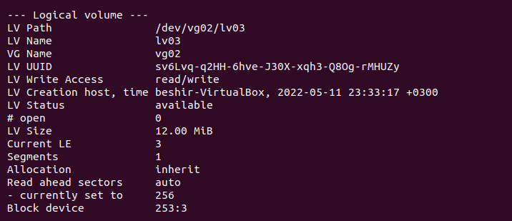
Cont(…)
You can use the lvdisplay command to see the Logical Volume's configuration.

Slide 26
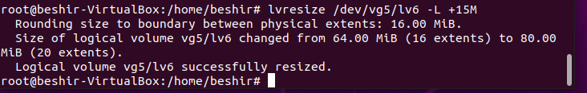
Cont(…)
Lvremove: remove the logical volume from the VG.
example lvremove /dev/vg02/lv03
Lvrename: rename the logical volume
Lvresize

Slide 27
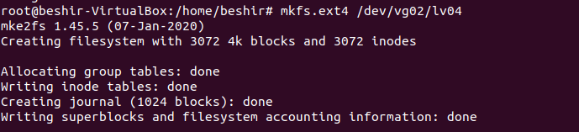

Cont(…)
Create file system for the logical volumes.
Lets create a file system, so the LV will be ready to use.
Syntax: file_name /dev/vg_name/lv_name
Once file system is created, mount the Logical volumes and start using the volume.

Slide 28
LVM Components
Linux file system is basically inflexible
It is difficult to modify partitions on a running system
LVM provides a virtual pool of memory space
Called a volume group
From which logical volumes can be generated if needed
LVM lets you resize the physical media during operation
Physical volumes are combined to a super unit
Referred to the volume group

Slide 29
LVM Features
You can combine several hard disks or partitions
You can enlarge a logical volume when free space is exhausted
You can add hard disks to the volume group in a running system
You can add logical volumes in a running system

