Slide 1
Nykaa Marketing Campaign Performance Analysis
Business insights, funnel performance, customer segments, channel efficiency and marketing strategy
Data Analytics Portfolio Project

Slide 2
1. Business Problem & Objective
Business problem
Nykaa invests across campaign types, channels, audiences and languages, but campaign performance varies considerably. The objective is to identify what is associated with successful campaigns, where users drop off, and where marketing resources can be allocated more efficiently.
Business objective
Evaluate the effectiveness and profitability of Nykaa's marketing campaigns, understand where users drop off in the conversion funnel, identify high-performing customer segments and channels, and provide actionable recommendations to improve campaign ROI and conversions.
Decision focus
Where should Nykaa increase investment, where should it optimize, and which campaign patterns should become benchmarks?
2

Slide 3
2. KPIs & Analytical Framework
Revenue
Core marketing performance measure
Spend
Core marketing performance measure
ROI
Core marketing performance measure
Conversions
Core marketing performance measure
CPA
Core marketing performance measure
CTR
Core marketing performance measure
Conversion Rate
Core marketing performance measure
Funnel framework
Impressions → Clicks → Leads → Conversions → Revenue / profitability outcome
Nykaa Marketing Campaign Analysis
3

Slide 4
3. Campaign Performance — What Worked?
Highest ROI
Social Media and Paid Ads
Highest conversion rate
Influencer and Social Media
Highest revenue
Influencer, Social Media and Paid Ads
Highest spend
Paid Ads and Influencer campaigns
Watch-out
Email had relatively low ROI despite high spend and low revenue at the campaign-type level.
Takeaway
Strong performance is concentrated in Social Media, Paid Ads and Influencer, but spend efficiency still needs to be evaluated campaign by campaign.
Nykaa Marketing Campaign Analysis
4

Slide 5
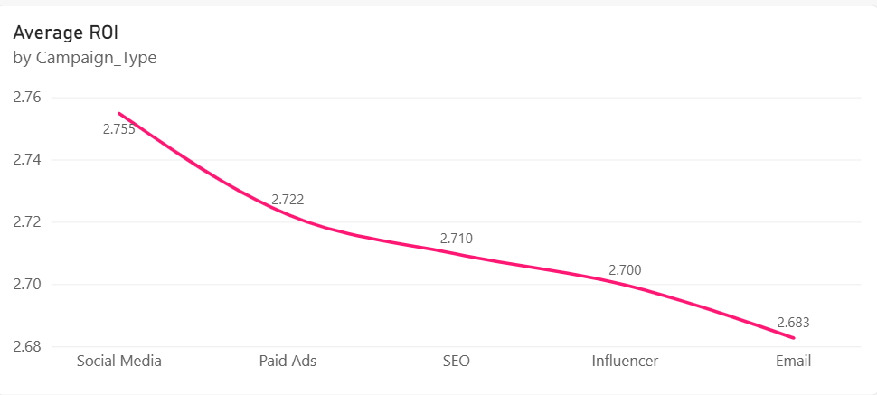
Average ROI per Campaign Type

Slide 6
4. Top vs Bottom Campaigns
Top 10 ROI campaigns
• Mainly Paid Ads, followed by Influencer
• Target audiences: mainly Premium Shoppers and Youth
• Duration: 20–30 days
• Engagement Score: 24–30
• Channels: mainly Facebook and WhatsApp
• Conversion Rate: around 5.5%
Bottom 10 ROI campaigns
• Negative ROI
• Campaign types: Social Media, Paid Ads and Email
• Low revenue
• Engagement Score: 2–6
• Target audiences: mainly Tier 2 City Customers and Premium Shoppers
• Channels: mainly Google and YouTube
• Conversion Rate: around 0.2%
Implication
High-performing campaigns combine stronger engagement and conversion efficiency; weak campaigns should be reviewed before additional spend.
Nykaa Marketing Campaign Analysis
5

Slide 7
5. Funnel Analysis — Where Are Users Dropping Off?
Impressions | 100%
Clicks | 8.5% of impressions
Leads | >40% of clicks
Conversions | >55% of leads
Key finding
The biggest opportunity is the awareness-to-click stage. Later funnel stages are comparatively stronger.
Nykaa Marketing Campaign Analysis
6

Slide 8
6. CTR, Engagement & Conversion
CTR → Conversion
Correlation = 0.714, indicating a strong positive relationship. Higher CTR generally coincides with higher Conversion Rate.
Engagement → Conversion
Higher Engagement Score is associated with higher Conversion Rate. Campaigns around 25–30 engagement generally reached about 5–7% conversion.
What this means
Better creatives and messaging can help win the click, but the goal should be qualified engagement and conversion—not clicks or engagement alone.
Caution
These are associations; they do not prove that increasing CTR or engagement alone causes conversion to increase.
Nykaa Marketing Campaign Analysis
7

Slide 9
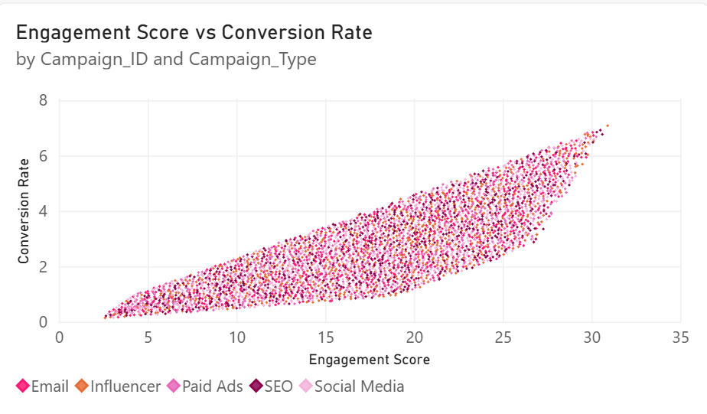

Slide 10
7. Customer & Audience Segmentation
Most valuable segments
Working Women and Premium Shoppers showed the highest ROI, Conversion Rate and Engagement. Working Women also generated the highest revenue.
Tier 2 City Customers
Showed high engagement and Conversion Rate, suggesting potential value even if they were not the top ROI segment.
Youth
Showed lower ROI, Conversion Rate, Engagement and revenue generation.
Strategy
Prioritize Working Women and Premium Shoppers for efficient growth, while diagnosing the creative, offer and targeting issues behind weaker Youth performance.
Nykaa Marketing Campaign Analysis
8

Slide 11
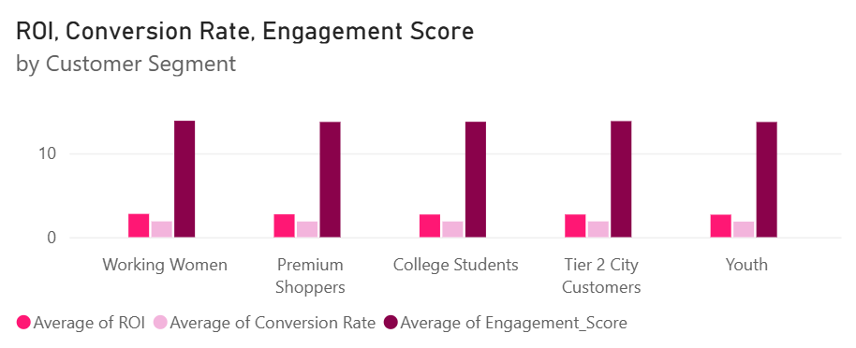

Slide 12
8. Language & Channel Performance
Language
Hindi had the highest ROI, Conversion Rate, Revenue generation and CTR. English had the lowest Engagement Score, Conversion Rate and Revenue generation.
Channel associations
Instagram showed the highest ROI, Conversion Rate and Engagement. Instagram also generated the highest revenue, followed by YouTube and Google.
Channel watch-outs
Facebook had low ROI and the least revenue generation despite the most spend. WhatsApp showed the lowest ROI and Engagement.
Usage context
Google, WhatsApp and YouTube were the most used channels. Multi-channel campaigns were associated with higher ROI and revenue.
Caution
Because campaigns can use multiple channels, channel-level results should be treated as associations rather than isolated channel causality.
Nykaa Marketing Campaign Analysis
9

Slide 13
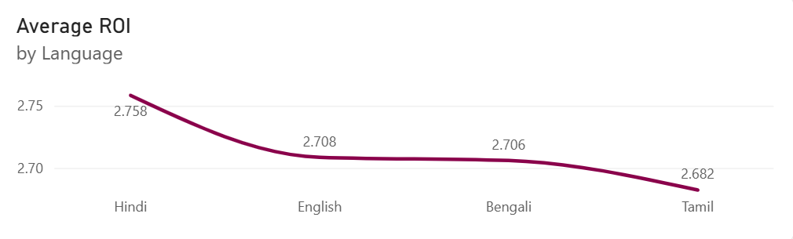
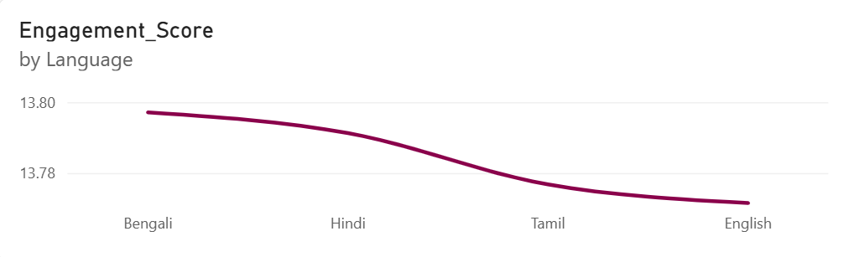

Slide 14
9. Spend Efficiency
Key observation
Higher spend did not consistently translate into higher revenue. Spend and ROI showed a clear negative relationship in the observed campaign data.
Efficient zone
Campaigns below roughly ₹175K spend tended to show higher ROI. Some campaigns around ₹50K–₹70K achieved ROI above 40–70.
Decision rule
Scale campaigns that combine strong ROI, conversion efficiency and engagement; optimize mixed performers; review or discontinue persistent negative-ROI campaigns.
Important
Do not interpret the negative spend–ROI relationship as proof that reducing spend causes higher ROI; ROI mathematically depends on spend.
Nykaa Marketing Campaign Analysis
10

Slide 15
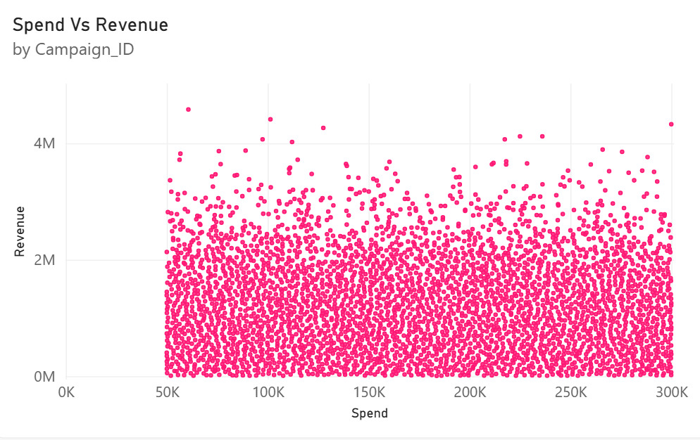

Slide 16
10. Strategic Recommendations
Scale efficient campaigns
Prioritize campaigns with strong ROI, conversion efficiency and engagement; use the top-performing Paid Ads, Influencer and Social Media patterns as benchmarks.
Fix the top funnel gap
Improve creatives, offers, messaging and audience targeting to increase the 8.5% impressions-to-click stage.
Optimize spend
Do not increase budgets simply to chase conversions. Reallocate spend toward campaigns that generate stronger returns relative to investment.
Review weak campaigns
Audit negative-ROI and very-low-conversion campaigns before continuing spend. Test new creative, audience or channel combinations before scaling.
Prioritize valuable segments
Use Working Women and Premium Shoppers as priority segments while investigating why Youth campaigns underperform.
Use channel insights carefully
Test more investment in Instagram-led strategies and review Facebook/WhatsApp efficiency, but avoid attributing campaign revenue to one channel when campaigns use multiple channels.
Localize language
Use Hindi creative/messaging as a strong benchmark and investigate why English campaigns underperform in engagement and conversion.
Build an experimentation framework
For future A/B tests, compare controlled variants such as creative, language or audience while holding other major factors constant.
Nykaa Marketing Campaign Analysis
11

Slide 17
11. Recommended Marketing Decision Framework
SCALE
High ROI
High conversion efficiency
Strong engagement
Strong revenue relative to spend
→ Increase budget gradually and monitor efficiency
OPTIMIZE
Good engagement but weak conversion
High revenue but weak ROI
High CTR but weak downstream conversion
→ Test creative, targeting, offer or landing experience
REVIEW
Negative ROI
Very low conversion
Low engagement
Low revenue
→ Pause/rework after checking business context
Core principle
Allocate budget based on efficiency and quality of outcomes, not spend volume alone.
Nykaa Marketing Campaign Analysis
12

Slide 18
12. Executive Conclusion
• Social Media, Paid Ads and Influencer campaigns were the strongest overall campaign-type performers, while Email showed weaker returns.
• The biggest funnel opportunity is converting impressions into clicks; later funnel stages perform comparatively better.
• CTR and Engagement Score are positively associated with Conversion Rate, reinforcing the importance of strong, relevant campaign content.
• Working Women and Premium Shoppers are the strongest customer segments in the analysis; Youth performance needs further diagnosis.
• Hindi campaigns outperformed English on the key reported metrics.
• Instagram was the strongest associated channel, while Facebook and WhatsApp showed efficiency concerns in the reported analysis.
• The clearest strategic message is to scale efficient campaigns, improve the top-of-funnel experience, and reallocate spend based on ROI and conversion efficiency.
Nykaa Marketing Campaign Analysis
13

Slide 19
13. Limitations & Next Steps
Limitations
• The analysis is observational; correlations and group comparisons do not establish causation.
• Channel-level results can be affected by multi-channel campaigns, so a campaign's revenue should not be assigned entirely to one channel.
• The provided analysis uses summary findings rather than raw campaign-level data for every comparison.
• No true A/B test or randomized control/treatment design is available in the supplied analysis.
• Thresholds such as 'high' and 'low' should be explicitly defined when operationalizing campaigns for action.
Next steps
• Build the Power BI dashboard around KPI, funnel, segment, channel and spend views.
• Add campaign-level drill-down and clear high/low performance thresholds.
• Test language, creative, audience and channel combinations using controlled experiments.
• Track incremental revenue/profit and customer quality, not only clicks and conversions.
• Monitor performance over time to separate persistent patterns from short-term variation.
Final message
The analysis should guide where to investigate and invest; future controlled experiments should validate which actions actually cause improvement.
Nykaa Marketing Campaign Analysis
14

