Slide 1
ACCEL AI INNOVATE PARIS · FUTURE FOUNDERS · 22 OCT 2026
FDIR Copilot
93%
50%
70 s
An AI flight controller that finds the root cause of small-satellite anomalies, and learns from every incident.
root-cause accuracy vs 32% limit-check
of faults never alarm on a classic console
median detection vs 450 s
WHO IT'S FOR
Learning from memory: 76% → 100% accuracy as closed incidents accumulate.
NewSpace start-ups and university CubeSat teams: 2 to 5 operators flying many spacecraft, with no 24/7 flight-controller bench.
HOW THE AGENT WORKS
THE PROBLEM
Telemetry downlink → Aiven PostgreSQL
① Detect: orbit-aware residuals (eclipse ephemeris)
② Isolate: backtrack a system-dynamics causal graph
③ Recall: kNN over incident memory in Aiven PostgreSQL
④ Fuse evidence ⑤ Recommend recovery + briefing
Operator closes incident → memory → next pass is smarter
Consoles alarm on limit violations: symptoms (battery temperature), not causes (a degrading solar array). Half of faults never cross a limit at all.
WHY NOW
Thousands of small-sat launches a year, flat ops headcount, and agents that can reason over telemetry plus a causal model of the vehicle.
ROUTE TO FIRST USERS
POINT OF DIFFERENCE
Free tier for CubeSat teams (YAMCS / OpenMCT / CCSDS importers) → paid pilots with 3 NewSpace operators, per spacecraft per month → SmallSat Conference, LibreCube, launch brokers.
Built on aerospace systems engineering (FDIR, FMEA, system dynamics). It explains why, with a traceable causal chain, and runs on Aiven Runtime.
FDIR Copilot · Paras Adlakha & Harshita Adlakha · Accel AI Innovate Paris 2026
01

Slide 2
THE PROBLEM
Consoles alarm on symptoms. Operators need causes.
Small-sat ops teams lose hours per anomaly on manual telemetry forensics.
A DEGRADING SOLAR ARRAY, AS THE CONSOLE SEES IT
49.7%
sa_current ↓
+160 s
root cause, masked in eclipse
of injected faults never cross a single hard limit. A limit-check console stays silent while the spacecraft drifts toward safe mode.
bus_voltage ↓
+450 s
in limits
batt_soc ↓
+800 s
in limits
32%
batt_voltage ↓
+2990 s
in limits
root-cause accuracy when you blame the subsystem of the first alarm, which is what a limit-check console effectively does.
batt_temp ↑
+4250 s
first thing an operator notices
FDIR Copilot · Paras Adlakha & Harshita Adlakha · Accel AI Innovate Paris 2026
02

Slide 3
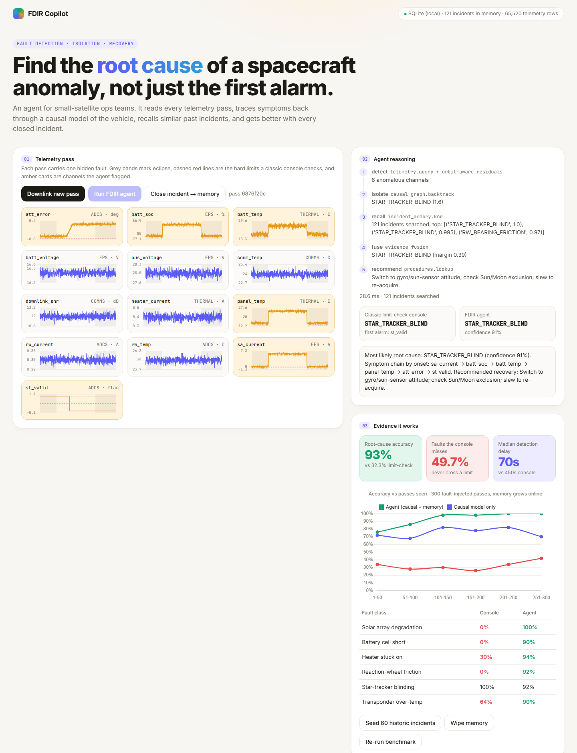
THE SOLUTION
A 5-step agent that reasons like a flight controller
Deterministic, traceable core. The LLM only writes the human briefing.
01
02
03
04
05
Detect
Isolate
Recall
Fuse
Recommend
Orbit-aware residuals, eclipse-conditioned baselines, persistence filter
Backtrack the spacecraft's causal graph: root, sign, precedence, coverage
kNN over closed incidents stored in Aiven PostgreSQL
Combine causal and memory evidence; confidence from the margin
Recovery procedure and operator briefing; full trace logged
FDIR Copilot · Paras Adlakha & Harshita Adlakha · Accel AI Innovate Paris 2026
03

Slide 4
DATA AT THE CORE
Aiven PostgreSQL: the agent's memory
Without the stored telemetry, ephemeris grounding and incident memory, the agent cannot diagnose anything.
Downlink
telemetry
FDIR agent
agent_runs
incidents
13 channels · 10 s
9,360 rows / pass
Aiven PostgreSQL
passes · telemetry
detect → isolate →
recall → fuse → recommend
Aiven PostgreSQL
audit trail + latency
Aiven PostgreSQL
long-term memory
↺ Operator closes the incident → confirmed root cause written to incidents → the next pass is diagnosed with more memory
Data | Where it lives | Role
Telemetry passes | Aiven PostgreSQL · passes, telemetry | Raw evidence queried on every run
Orbit ephemeris | Derived per pass (eclipse / sunlit) | Grounds baselines; 0 A solar current in eclipse is nominal
Causal model | Gains + transport delays (system dynamics) | Separates causes from symptoms
Incident memory | Aiven PostgreSQL · incidents | kNN recall; grows with every closed incident
Agent run log | Aiven PostgreSQL · agent_runs | Audit trail for flight-safety review
FDIR Copilot · Paras Adlakha & Harshita Adlakha · Accel AI Innovate Paris 2026
04

Slide 5
EVIDENCE IT WORKS
Root-cause accuracy: 93% vs 32%
300 fault-injected passes · 6 fault classes · random onset, severity and orbit phase · memory starts empty
49.7%
70 s
4 ms
76→100%
faults the console never alarms; the agent flags them
median detection delay vs 450 s for the console
median compute per diagnosis
agent accuracy as incident memory fills
FDIR Copilot · Paras Adlakha & Harshita Adlakha · Accel AI Innovate Paris 2026
05

Slide 6
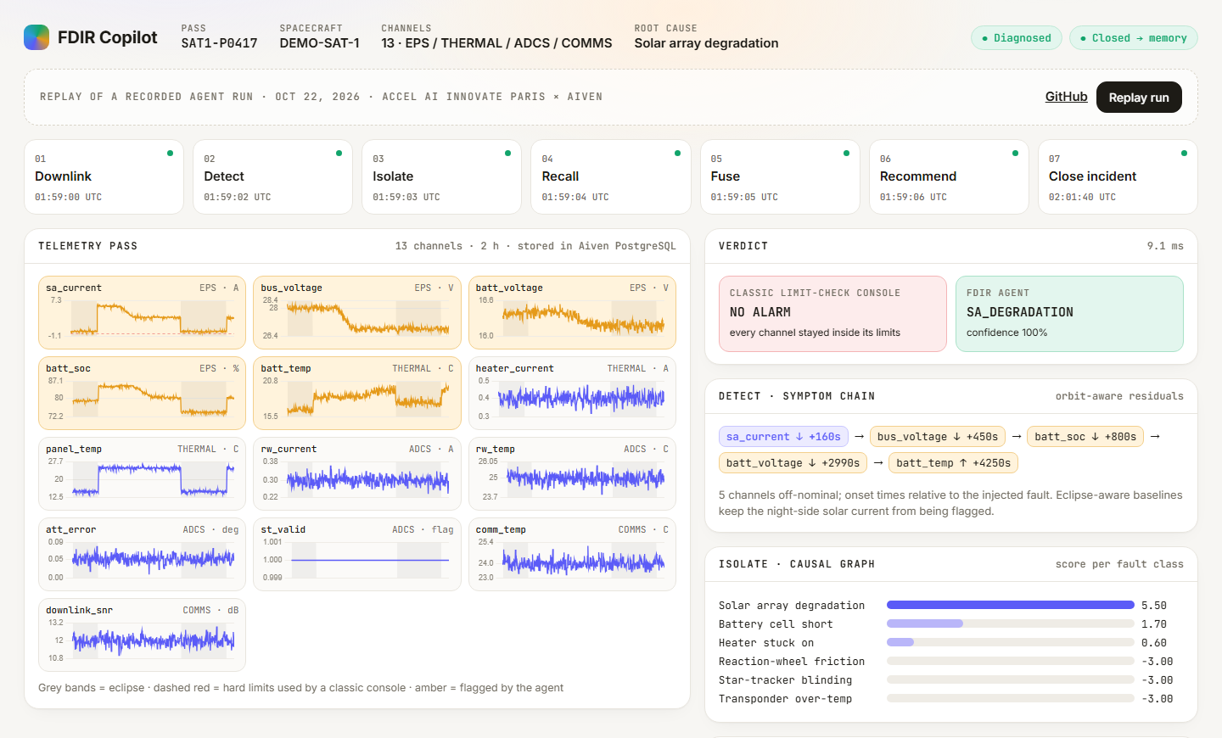
PRODUCT DEMO
Live app on Aiven Runtime, plus a public replay
The console stays silent; the agent names the root cause, cites its memory and gives the recovery procedure.
REPLAY (GITHUB PAGES)
parasadlakha.github.io/fdir-copilot
SOURCE CODE
github.com/ParasAdlakha/fdir-copilot
DATA LAYER
Aiven for PostgreSQL
DEPLOYMENT
Aiven Runtime · Dockerfile · port 8080
FDIR Copilot · Paras Adlakha & Harshita Adlakha · Accel AI Innovate Paris 2026
06

Slide 7
GO-TO-MARKET · ROADMAP · TEAM
From CubeSat teams to NewSpace fleets
ROUTE TO FIRST USERS
ROADMAP
TEAM
• Free tier for university CubeSat teams
• Open-source importers: YAMCS, OpenMCT, CCSDS
• Paid pilots with 3 seed-stage NewSpace operators
• Priced per spacecraft per month
• SmallSat Conference, LibreCube, launch brokers
• Validate on NASA SMAP / MSL telemetry
• Learn causal gains and delays from fleet data
• Streaming via Aiven for Apache Kafka
• Long-horizon trends in Aiven for ClickHouse
• Fleet memory: satellite A pre-warns satellite B
• Paras Adlakha: aerospace, systems engineering, system dynamics
• Harshita Adlakha: co-builder
• Built in one day at the hackathon
BUILT AT ACCEL AI INNOVATE PARIS · FUTURE FOUNDERS · 22 OCTOBER 2026
Partners: Aiven · Lovable · Hackathon Hub · Iterate
FDIR Copilot · Paras Adlakha & Harshita Adlakha · Accel AI Innovate Paris 2026
07

