Slide 1
Statistical Semantic Classification of Crisis Information
Prashant Khare, Miriam Fernandez, Harith Alani
Knowledge Media Institute, The Open University, UK
{prashant.khare, miriam.fernandez, h.alani} @open.ac.uk

Slide 2

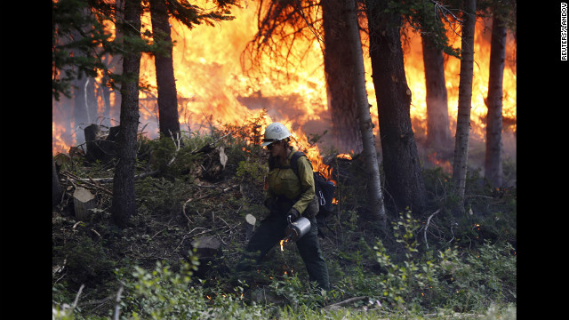
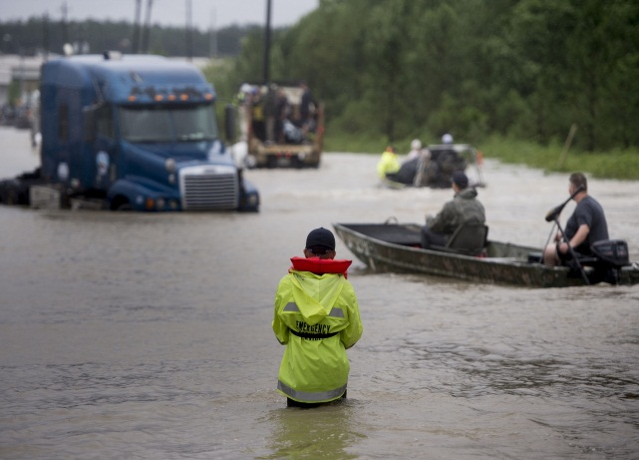
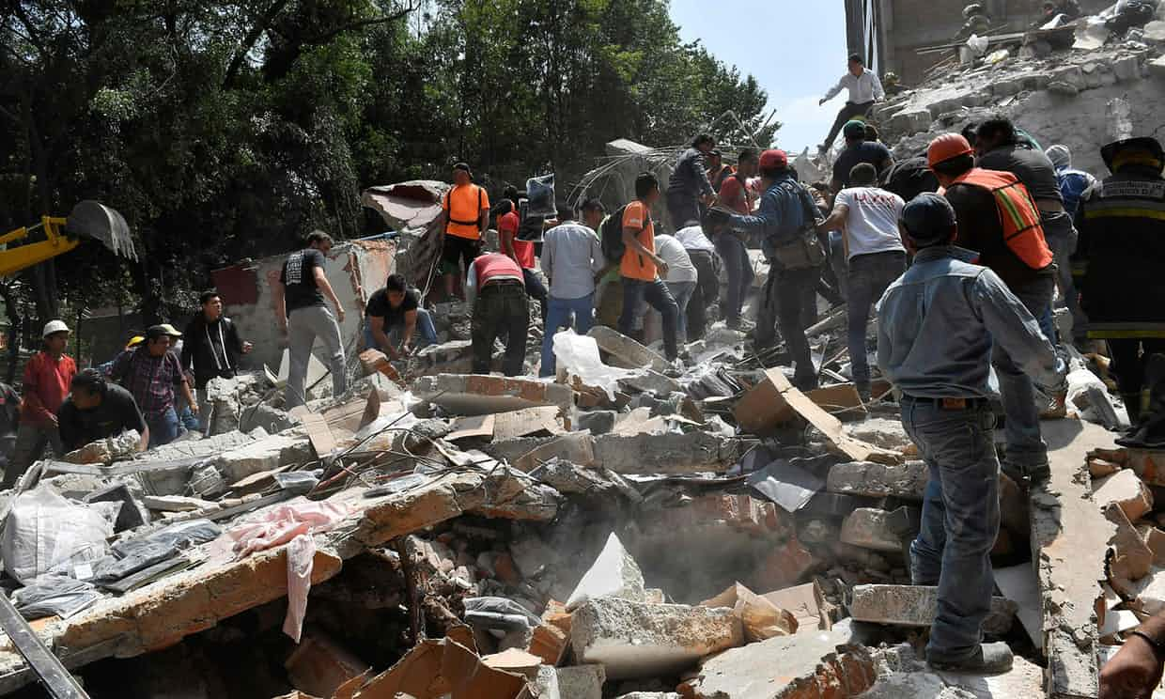
Motivation
People of NSW, be careful because there's fires spreading! Stay safe everyone!
Floods
CRISIS
Wildfire
Hundreds of volunteers in Mexico tried to unearth children they hoped were still alive beneath a school's ruins
Two trucks and one car in the water after a road collapse at Hwy 287 and Dillon. #cowx #boulderflood
Earthquake

Slide 3
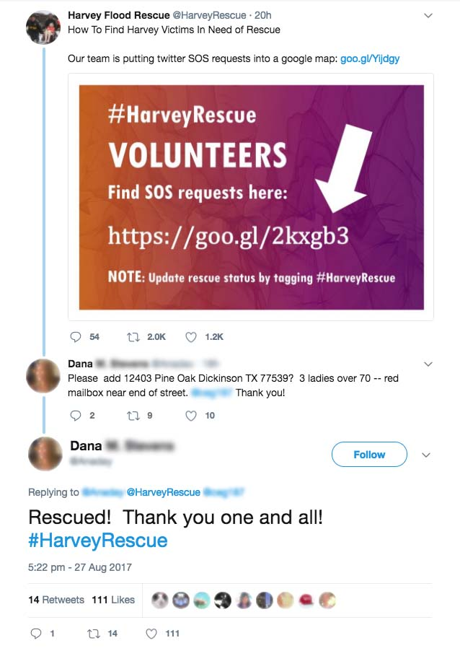
Motivation
Challenges
A flood of data gets generated. For e.g.- On an average over a million tweets got generated during Hurricane Harvey 2017.
500% increase in the tweets bandwidth during 2011 Japan earthquake.
Almost impossible to manually absorb and process the sheer volume.
In addition, the characteristics of social media posts such as short length, colloquialism, syntactic issues pose additional challenges of processing the data.

Slide 4
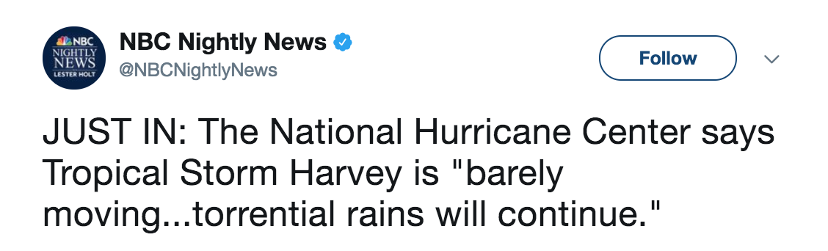
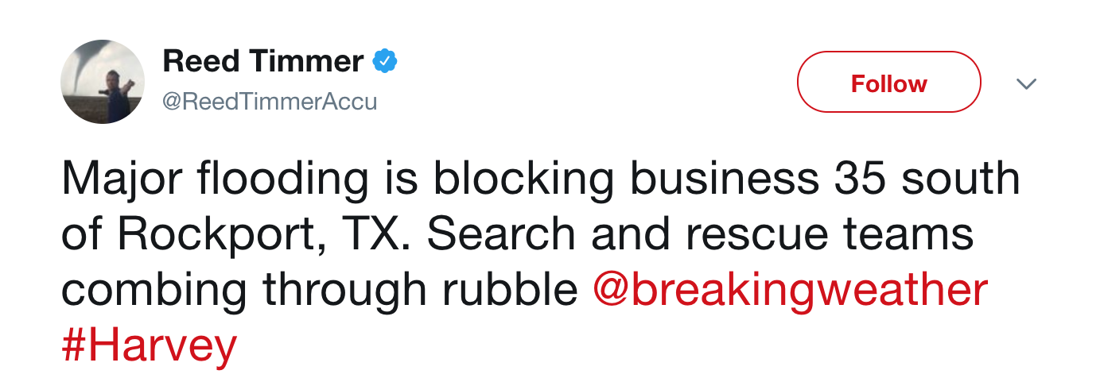
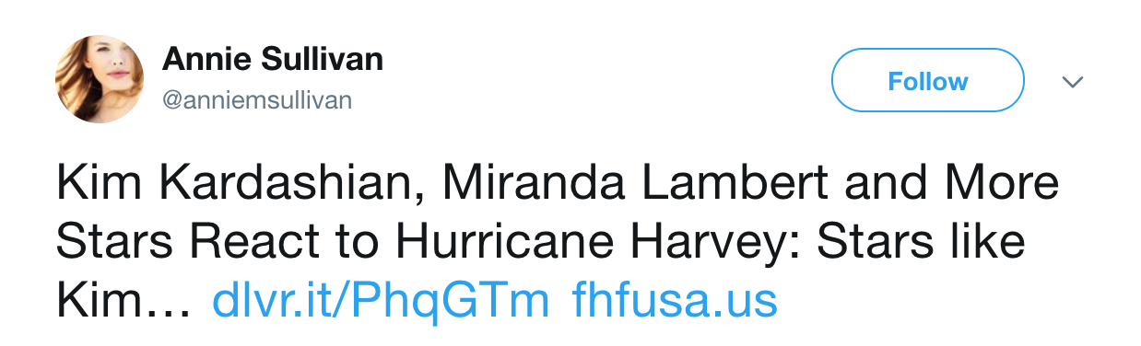
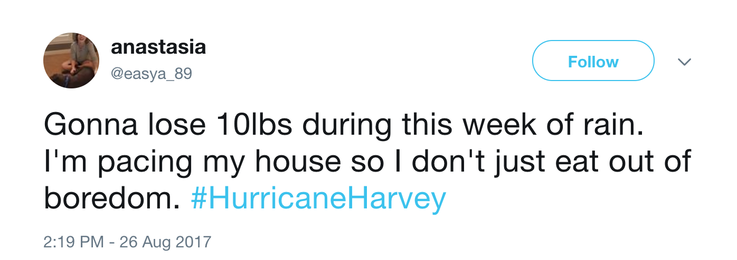
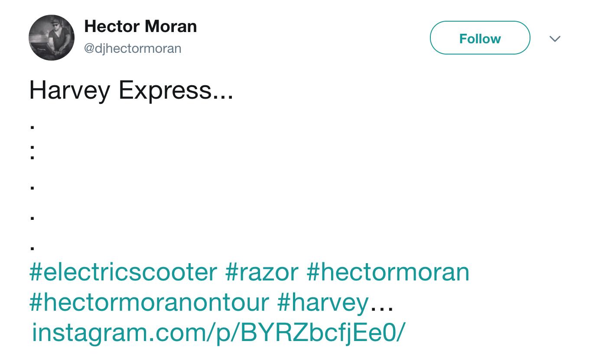
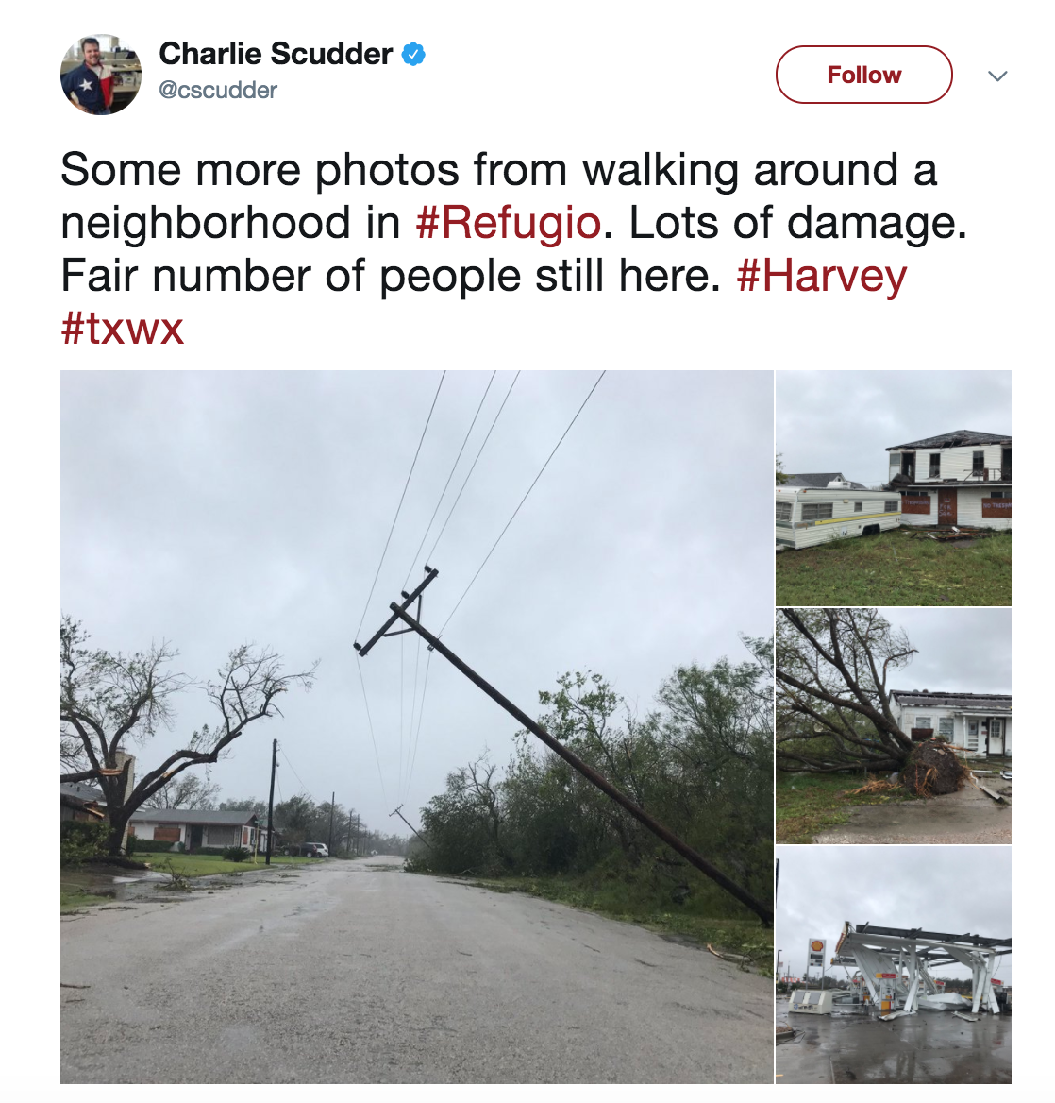
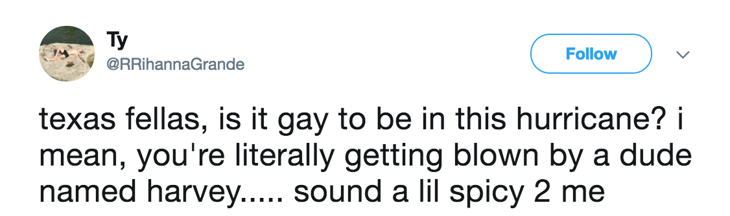
Motivation
Relevant and Non-Relevant

Slide 5
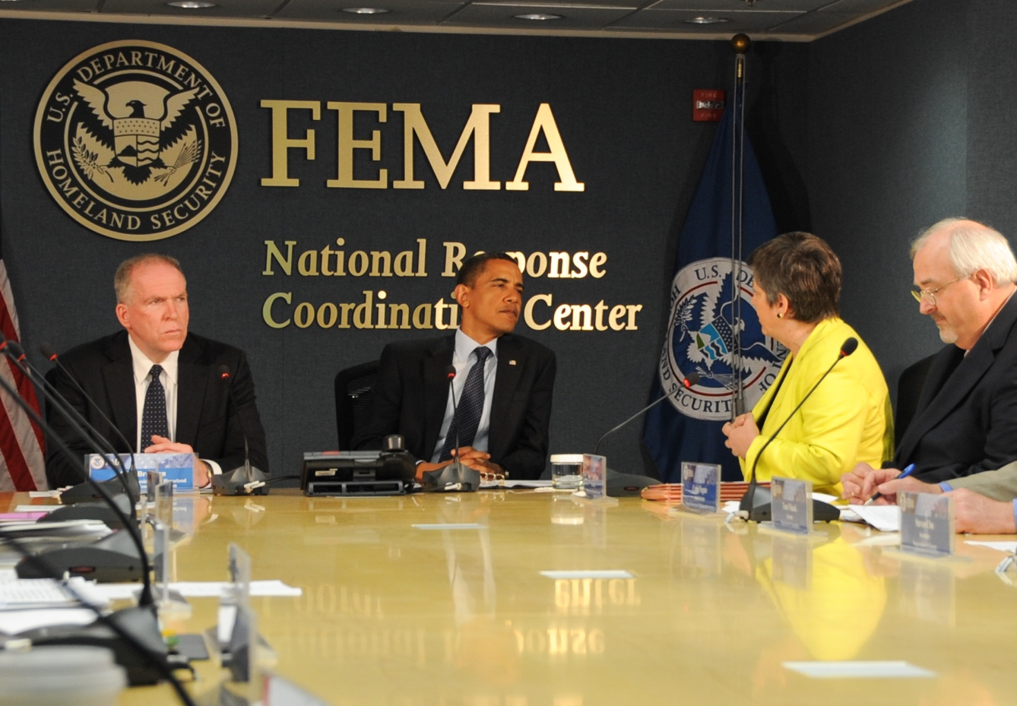
Motivation
FEMA launched an initiative to use public social media data for situational awareness purpose¹.
1: https://www.dhs.gov/sites/default/files/publications/privacy-pia-FEMA-OUSM-April2016.pdf
Image source – fema.gov

Slide 6
Previous Efforts - Identifying Crisis Related Information
ML Classification Methods:
Supervised Approaches: Often making use of n-grams, linguistic features, and/or statistical features of tweets.
Unsupervised Approaches: Keyword processing and clustering.
Semantic Models:
Representation of the information emerging from Crisis Events, providing faceted search of crisis related information.

Slide 7
Hypothesis and Aim
Hypothesis:
Semantics can establish a consistency within crisis relevant information and enhance the discriminative power of classifiers.
Complement the previous approaches by investigating the impact of semantic features in ML classification along with statistical features.

Slide 8
Method
Collect Data from CrisisLex.org- collection of Crisis oriented tweets.
Extract Statistical Features.
Semantic Enrichment of tweets via annotation using Babelfy API.
Expand the semantics by incorporating hypernyms through BabelNet.
Filter out the less informative and abstract features (using a hypernym hierarchy).
Classify using SVM classification method.

Slide 9
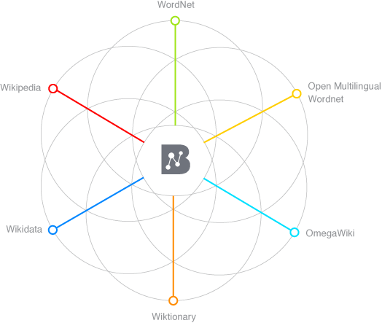
Semantic Enrichment of Tweets
Lets us consider this Tweet from Colorado Wildfire 2012:
#HighParkFire
burn area map
as of
Monday night 10 p.m.
http://t.co/1guBTcXX
Annotated Tokens
Semantically enriched (augmented hypernyms)
burn
Burn destroy
area
area region map representation
map
Monday weekday
day_of_the_week night period
Monday
night
Image source: http://babelnet.org/about

Slide 10
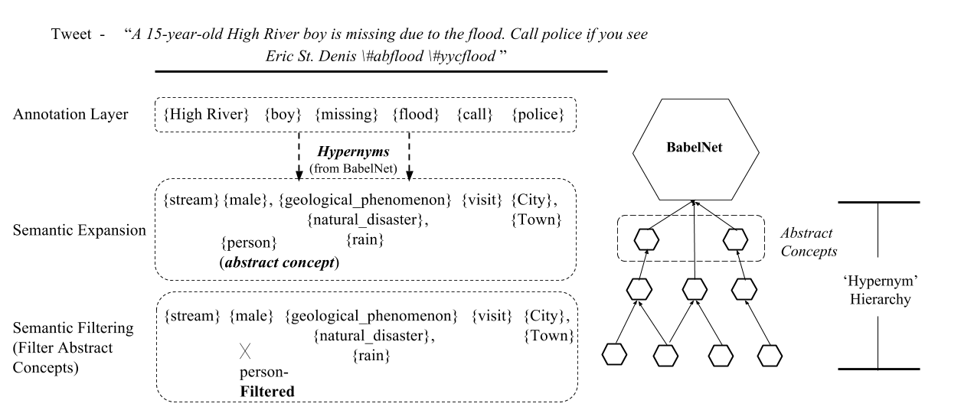
Semantic Features: Annotations, Expansion, & Filtering

Slide 11
Semantic Features: Annotations, Expansion, & Filtering
BabelNet:
Extracted 4 million relations by iteratively querying for hypernyms.
Using Directed-graph and betweenness centrality – ‘Entity’ (SynSet ID ‘bn:00031027n’) was found to be most abstract concept.
Using shortest path – Maximum depth of nodes found to be 21.
Using Information Gain, most of the informative concepts were between the depth 3 and 7.

Slide 12
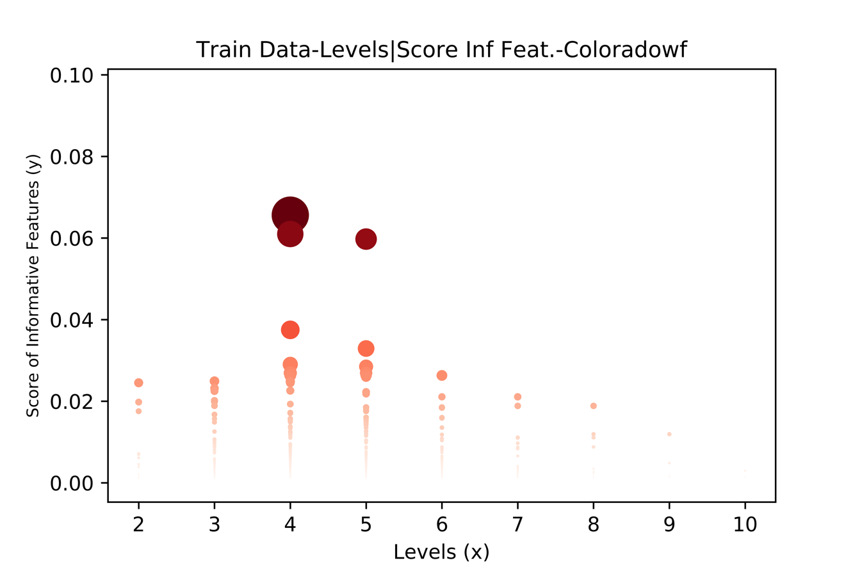
Semantic Features: Annotations, Expansion, & Filtering
Features plotted against Levels/Information Gain – Training Data for Colorado Wildfire Test case

Slide 13
Data
CrisisLexT26 (3206 tweets – 1667 related, 1539 not related)
9 Events- predominantly in English
Event | Positive Samples | Negative Samples | Total
West Texas Explosion (WT) | 111 | 89 | 200
Colorado Wildfire (CW) | 247 | 247 | 494
Colorado Floods (CF) | 89 | 75 | 164
Queensland Floods (QF) | 320 | 281 | 601
Singapore Haze (SH) | 80 | 67 | 147
Savar Building Crash (SB) | 361 | 339 | 600
Australia Bushfire (AB) | 250 | 250 | 500
LA Airport Shooting (LA) | 130 | 120 | 250
Boston Bombing (BB) | 79 | 71 | 150

Slide 14
Features
Statistical Features (SF)
Number of Nouns, Verbs, Pronouns
Tweet Length
Number of Words, Hashtags
Readability -Gunning Fox Index using average sentence length (ASL) and percentage of complex words (PCW) : 0.4*(ASL + PCW)
Unigrams
Semantic Features (SemF)
Semantic Annotation Features (SemAF)
Semantic Expansion Features (SemEF)
Semantic Filtering Features (SemFF)

Slide 15
Experiment
Classifier – Support Vector Machine with Linear Kernel
Designed two type of experiments:
Crisis Classification Model (train and test on all 9 crisis events)
Create following classifier models
SF
SF + SemAF
SF + SemAF + SemEF
SF +SemFF (statistical features and filtered semantic annotations, along with hypernyms)
Cross Crisis Classification (train on 8 crisis events and test on 9th crisis event)
Statistical Features (SF), Semantic Annotation Features (SemAF), Semantic Expansion Features (SemEF), Semantic Filtering Features (SemFF)

Slide 16
Experiment
Crisis Classification (10- fold cross validation)
Features | F | F_{mean} (10 iteration) | Std. Dev. σ (10 iteration) | ∆F /F
SF (Baseline) | 0.865 | 0.872 | 0.017 | -
SF + SemAF | 0.870 | 0.877 | 0.017 | 0.0057
SF + SemAF + SemEF | 0.868 | 0.873 | 0.017 | 0.0011
SF + SemFF | 0.864 | 0.873 | 0.018 | 0.0011
Statistical Features (SF), Semantic Annotation Features (SemAF), Semantic Expansion Features (SemEF), Semantic Filtering Features (SemFF)

Slide 17
Experiment
Cross-Crisis Classification
 | SF | SF + SemAF |  | SF + SemAF + SemEF |  | SF + SemFF
Test | F | F | ∆F /F (%) | F | ∆F /F (%) | F | ∆F /F (%)
Event
West Texas Explosion | 0.804 | 0.808 | 0.5 | 0.812 | 1.0 | 0.823 | 2.4
Colorado Wild Fire | 0.638 | 0.617 | -3.3 | 0.714 | 11.9 | 0.71 | 11.3
Colorado Flood | 0.774 | 0.793 | 2.5 | 0.787 | 1.7 | 0.793 | 2.5
Australia Bush Fire | 0.774 | 0.777 | 0.4 | 0.798 | 3.1 | 0.788 | 1.8
Boston Bombing | 0.702 | 0.693 | -1.3 | 0.732 | 4.3 | 0.759 | 8.1
LA Airport Shooting | 0.808 | 0.776 | -4.0 | 0.775 | -4.1 | 0.787 | -2.6
Queensland Flood | 0.694 | 0.695 | 0.1 | 0.69 | -0.6 | 0.691 | -0.4
Savar Building Collapse | 0.58 | 0.636 | 9.7 | 0.561 | -3.3 | 0.565 | -2.6
Singapore Haze | 0.548 | 0.669 | 3.2 | 0.67 | 3.4 | 0.662 | 2.2
Avg. Change |  |  | 0.9% |  | 1.94% |  | 2.51%
Statistical Features (SF), Semantic Annotation Features (SemAF), Semantic Expansion Features (SemEF), Semantic Filtering Features (SemFF)

Slide 18
Results and Observations
Number of Hashtags, Nouns, and Pronouns are most relevant features among Statistical features – based on Information Gain of the features.
Apart from Statistical features, Semantic expansion reflected concepts such as ‘Happening’ and ‘Event’ (which are hypernym of concepts ‘Incident’, ‘Fire’, ‘Crisis’, ‘Disaster’, and ‘Death’ in BabelNet) among Top 10 attributes.

Slide 19
Results and Observations
Post A –“RT @LarimerCounty: #HighParkFire burn area map as of Monday night 10 p.m.”
Misclassified in SF but correctly classified in SF+SemAF. ‘Burn’ did not occur in training data but annotation ‘Fire’ did.
Post B –“Colorado wildfires their worst in a decade http://t.co/RtfLmfds”
Misclassifed in SF+SemAF but correctly classified in SF+SemAF+SemEF. ‘Fire’, a high IG feature, is hypernym of original annotation ‘wildfire’ which was not a ranked feature in training data.
Post C – “RT @RedCross: Thanks to generosity of volunteer blood donors there is currently enough blood on the shelves to meet demand.#BostonMarathon”
Misclassified in SF+SemAF+SemEF but correctly classified in SF+SemFF. ‘Thanks’ and ‘Meet’ expanded to very low discriminative and abstract features as ‘Virtue’ and ‘Desire’. Excluding them raised the discriminative power of more informative concepts such as ‘Volunteer’ and ‘Benefactor’ (hypernym of ‘donor’).

Slide 20
Take Away
Potential in mixing the statistical and semantic features for classification.
Most noteworthy improvement is achieved when hybrid model is used to classify an entirely new data.
Semantic expansion can also result in noise.
Filtering can help in addressing the noise.
In future, we should expand the data to more crisis events (currently 5 types of events) and sample size of each event.

Slide 21
Questions!

