Slide 1
Agenda
08:00 PST | 1 hr 50 mins | Part I - Review of CSKGs
 | 15 min | Introduction to commonsense knowledge (slides) - Pedro
 | 25 min | Review of top-down commonsense knowledge graphs (slides) - Mayank
 | 70 min | Review of bottom-up commonsense knowledge graphs (slides+demo) - Mayank, Filip, Pedro
 | 10 min | Break
10:00 PST | 45 min | Part II - Integration and analysis
 | 35 min | Consolidating commonsense graphs (slides) - Filip
 | 10 min | Consolidating commonsense graphs (demo) - Pedro
 | 10 min | Break
10:55 PST | 1 hr 05 mins | Part III - Downstream use of CSKGs
 | 50 min | Answering questions with CSKGs (slides+demo) - Filip
 | 15 min | Wrap-up (slides) - Mayank

Slide 2
Consolidating Commonsense Knowledge Graphs
Filip Ilievski

Slide 3
Commonsense Knowledge Sources
•ConceptNet
–Information about everyday objects, actions, states and relationships among them, extensive links to WordNet
–Incomplete coverage, “related-to” accounts for 75% of statements

Slide 4
Commonsense Knowledge Sources
•ConceptNet
–Information about everyday objects, actions, states and relationships among them, extensive links to WordNet
–Incomplete coverage, “related-to” accounts for 75% of statements
•ATOMIC
–Pre- and post-states for events and their participants, physical and mental aspects covered
–Only 25% of nodes have links to ConceptNet, difficult to combine with other resources

Slide 5
Commonsense Knowledge Sources
•ConceptNet
–Information about everyday objects, actions, states and relationships among them, extensive links to WordNet
–Incomplete coverage, “related-to” accounts for 75% of statements
•ATOMIC
–Pre- and post-states for events and their participants, physical and mental aspects covered
–Only 25% of nodes have links to ConceptNet, difficult to combine with other resources
•WordNet
–Meanings of words & relationships to other words, high coverage, many resources have links to WordNet, example sentences
–No description of the properties of objects or roles in verbs, only is-a and part-of relations

Slide 6
Commonsense Knowledge Sources
•ConceptNet
–Information about everyday objects, actions, states and relationships among them, extensive links to WordNet
–Incomplete coverage, “related-to” accounts for 75% of statements
•ATOMIC
–Pre- and post-states for events and their participants, physical and mental aspects covered
–Only 25% of nodes have links to ConceptNet, difficult to combine with other resources
•WordNet
–Meanings of words & relationships to other words, high coverage, many resources have links to WordNet, example sentences
–No description of the properties of objects or roles in verbs, only is-a and part-of relations
•VerbNet, FrameNet
–Defines participants/roles for a large number of situations/frames, links to verbs, syntactic forms and example sentences
–No semantic typing of roles, many roles are very abstract (e.g., Agent), lacks info about state changes, or pre-post conditions

Slide 7
Commonsense Knowledge Sources
•ConceptNet
–Information about everyday objects, actions, states and relationships among them, extensive links to WordNet
–Incomplete coverage, “related-to” accounts for 75% of statements
•ATOMIC
–Pre- and post-states for events and their participants, physical and mental aspects covered
–Only 25% of nodes have links to ConceptNet, difficult to combine with other resources
•WordNet
–Meanings of words & relationships to other words, high coverage, many resources have links to WordNet, example sentences
–No description of the properties of objects or roles in verbs, only is-a and part-of relations
•VerbNet, FrameNet
–Defines participants/roles for a large number of situations/frames, links to verbs, syntactic forms and example sentences
–No semantic typing of roles, many roles are very abstract (e.g., Agent), lacks info about state changes, or pre-post conditions
•Visual Genome
–“Visual” commonsense, many possible attributes, relationships/actions among objects, linked to WordNet, many edges for a KG
–No abstraction mechanism to understand prevalence of relations

Slide 8
Commonsense Knowledge Sources
•ConceptNet
–Information about everyday objects, actions, states and relationships among them, extensive links to WordNet
–Incomplete coverage, “related-to” accounts for 75% of statements
•ATOMIC
–Pre- and post-states for events and their participants, physical and mental aspects covered
–Only 25% of nodes have links to ConceptNet, difficult to combine with other resources
•WordNet
–Meanings of words & relationships to other words, high coverage, many resources have links to WordNet, example sentences
–No description of the properties of objects or roles in verbs, only is-a and part-of relations
•VerbNet, FrameNet
–Defines participants/roles for a large number of situations/frames, links to verbs, syntactic forms and example sentences
–No semantic typing of roles, many roles are very abstract (e.g., Agent), lacks info about state changes, or pre-post conditions
•Visual Genome
–“Visual” commonsense, many possible attributes, relationships/actions among objects, linked to WordNet, many edges for a KG
–No abstraction mechanism to understand prevalence of relations
•Wikidata
–Comprehensive descriptions of objects, both specific (named entities) and generic (nouns)
–Sparse information about events and states, much knowledge is on instance-level and abstraction is non-trivial

Slide 9
Consolidation Hypothesis
Integrating multiple knowledge sources in CSKG is beneficial for downstream reasoning tasks.

Slide 10
On stage, a woman takes a seat at the piano. She
sits on a bench as her sister plays with the doll.
smiles with someone as the music plays.
is in the crowd, watching the dancers.
nervously sets her fingers on the keys.

Slide 11
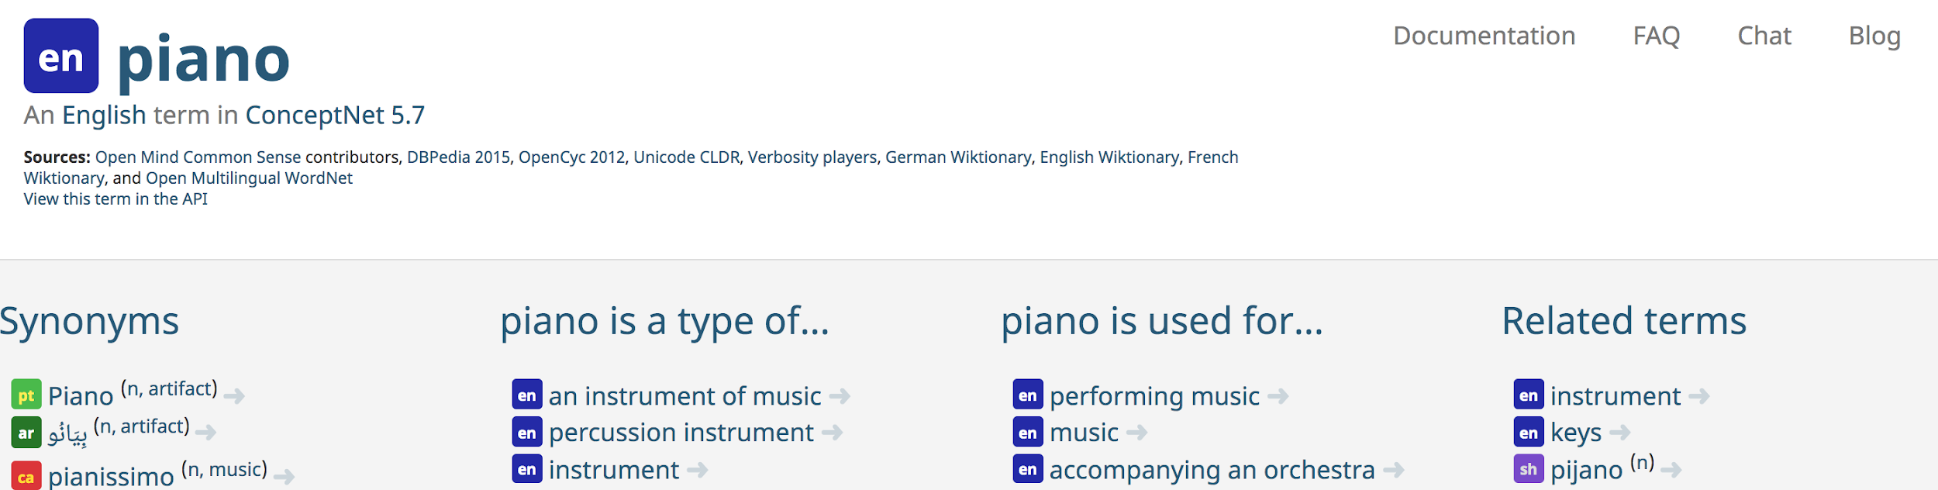
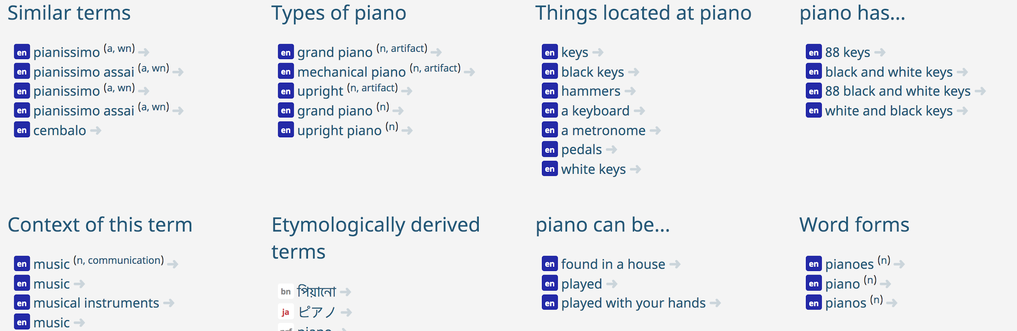
ConceptNet: pianos have keys, are used to perform music
On stage, a woman takes a seat at the piano. She
sits on a bench as her sister plays with the doll.
smiles with someone as the music plays.
is in the crowd, watching the dancers.
nervously sets her fingers on the keys.

Slide 12
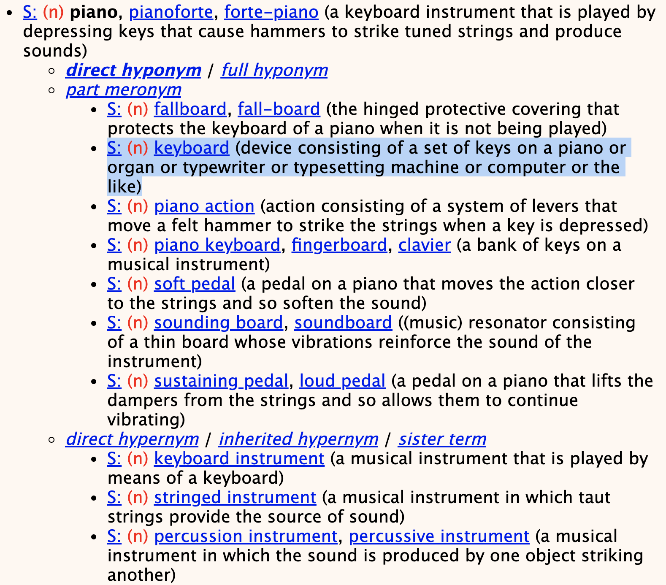
ConceptNet: pianos have keys, are used to perform music
WordNet: pianos are played by pressing keys
On stage, a woman takes a seat at the piano. She
sits on a bench as her sister plays with the doll.
smiles with someone as the music plays.
is in the crowd, watching the dancers.
nervously sets her fingers on the keys.

Slide 13
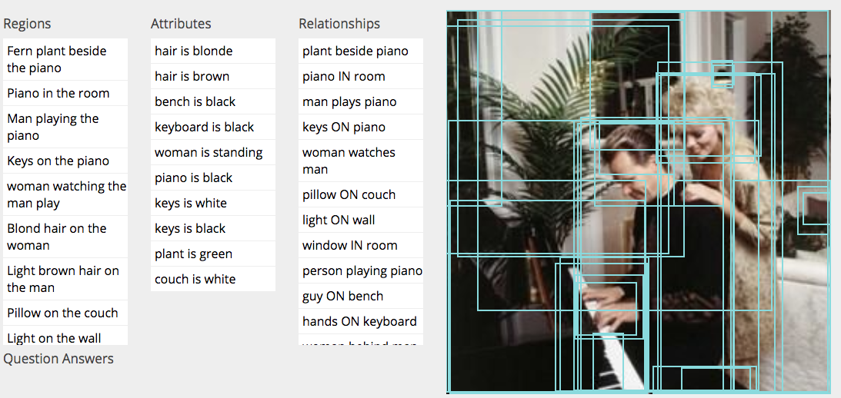
ConceptNet: pianos have keys, are used to perform music
WordNet: pianos are played by pressing keys
On stage, a woman takes a seat at the piano. She
sits on a bench as her sister plays with the doll.
smiles with someone as the music plays.
is in the crowd, watching the dancers.
nervously sets her fingers on the keys.
Visual Genome: person can play a piano while sitting, his hands are on the keyboard

Slide 14
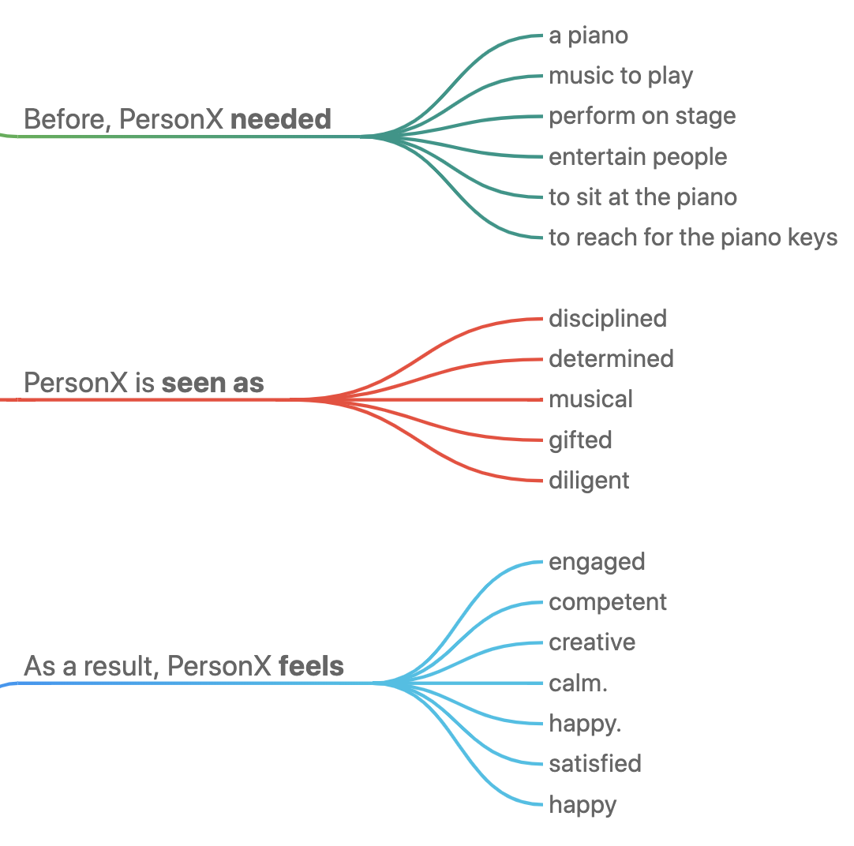
ConceptNet: pianos have keys, are used to perform music
WordNet: pianos are played by pressing keys
ATOMIC: to play piano, a person needs to sit at it, on stage and reach for the keys; feelings
On stage, a woman takes a seat at the piano. She
sits on a bench as her sister plays with the doll.
smiles with someone as the music plays.
is in the crowd, watching the dancers.
nervously sets her fingers on the keys.
Visual Genome: person can play a piano while sitting, his hands are on the keyboard

Slide 15
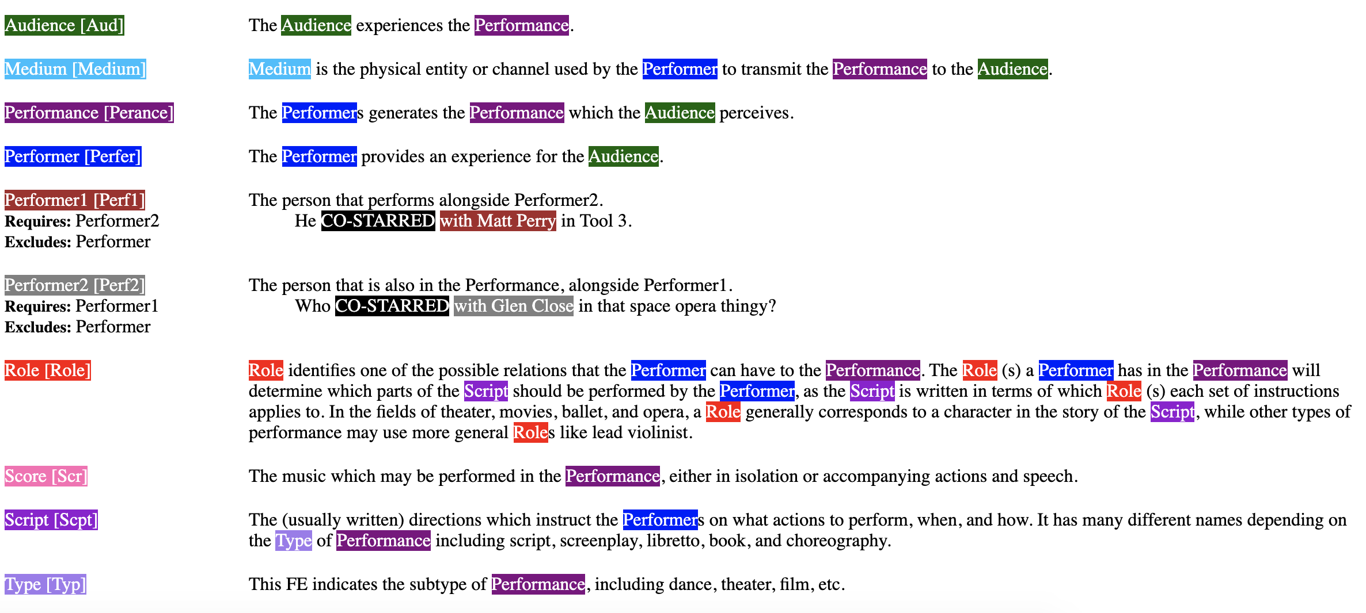
ConceptNet: pianos have keys, are used to perform music
WordNet: pianos are played by pressing keys
ATOMIC: to play piano, a person needs to sit at it, on stage and reach for the keys; feelings
On stage, a woman takes a seat at the piano. She
sits on a bench as her sister plays with the doll.
smiles with someone as the music plays.
is in the crowd, watching the dancers.
nervously sets her fingers on the keys.
FrameNet: performer entertains audience
Visual Genome: person can play a piano while sitting, his hands are on the keyboard

Slide 16
Challenge: Modeling of relations
ConceptNet
/r/HasProperty
Web Child
-
ability#n#1
age#n#1
appearance#n#1
beauty#n#1
color#n#1
disposition#n#4
emotion#n#1
feeling#n#1
length#n#1
manner#n#1
motion#n#4
personality#n#1
physical_property#n#1
quality#n#1
sensitivity#n#2
shape#n#2
size#n#1
sound#n#1
state#n#2
strength#n#1
structure#n#2
sustainability#n#1
tactile_property#n#1
taste_property#n#1
temperature#n#1
trait#n#1
weight#n#1

Slide 17
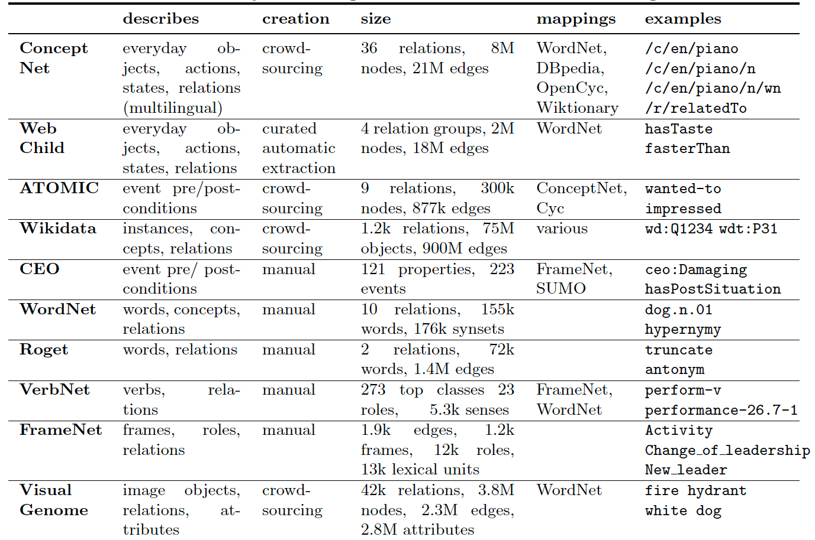
Challenge: Knowledge granularity

Slide 18
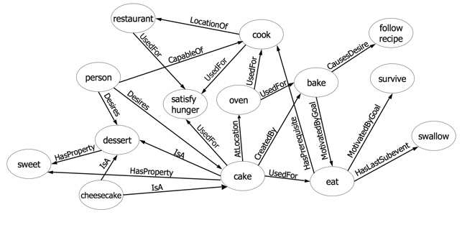
Challenge: Imprecise descriptions
IsA

Slide 19
Challenge: Different creation methods and quality

Slide 20
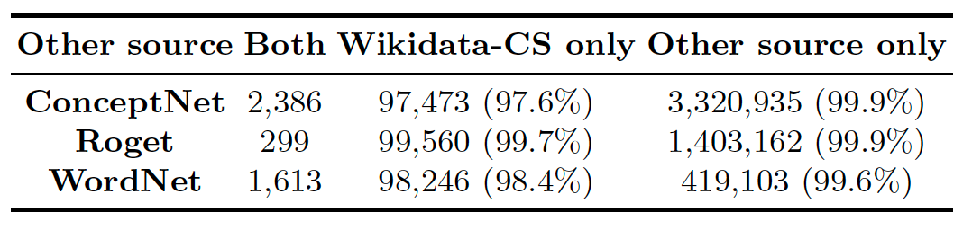
Challenge: Sparse overlap
and mappings

Slide 21
Principles for a modular and useful CSKG
P1. Embrace heterogeneity of nodes objects, classes, words, actions, frames, states

Slide 22
Principles for a modular and useful CSKG
P1. Embrace heterogeneity of nodes objects, classes, words, actions, frames, states P2. Reuse edge types across resources /r/HasProperty from ConceptNet applicable for attributes in Visual Genome

Slide 23
Principles for a modular and useful CSKG
P1. Embrace heterogeneity of nodes objects, classes, words, actions, frames, states P2. Reuse edge types across resources /r/HasProperty from ConceptNet applicable for attributes in Visual Genome P3. Leverage external links many sources map to WordNet

Slide 24
Principles for a modular and useful CSKG
P1. Embrace heterogeneity of nodes objects, classes, words, actions, frames, states P2. Reuse edge types across resources /r/HasProperty from ConceptNet applicable for attributes in Visual Genome P3. Leverage external links many sources map to WordNet P4. Generate high-quality probabilistic links many facts not explicitly stated

Slide 25
Principles for a modular and useful CSKG
P1. Embrace heterogeneity of nodes objects, classes, words, actions, frames, states P2. Reuse edge types across resources /r/HasProperty from ConceptNet applicable for attributes in Visual Genome P3. Leverage external links many sources map to WordNet P4. Generate high-quality probabilistic links many facts not explicitly stated P5. Enable access to labels text labels and aliases are the key, in particular for NLP use cases

Slide 26
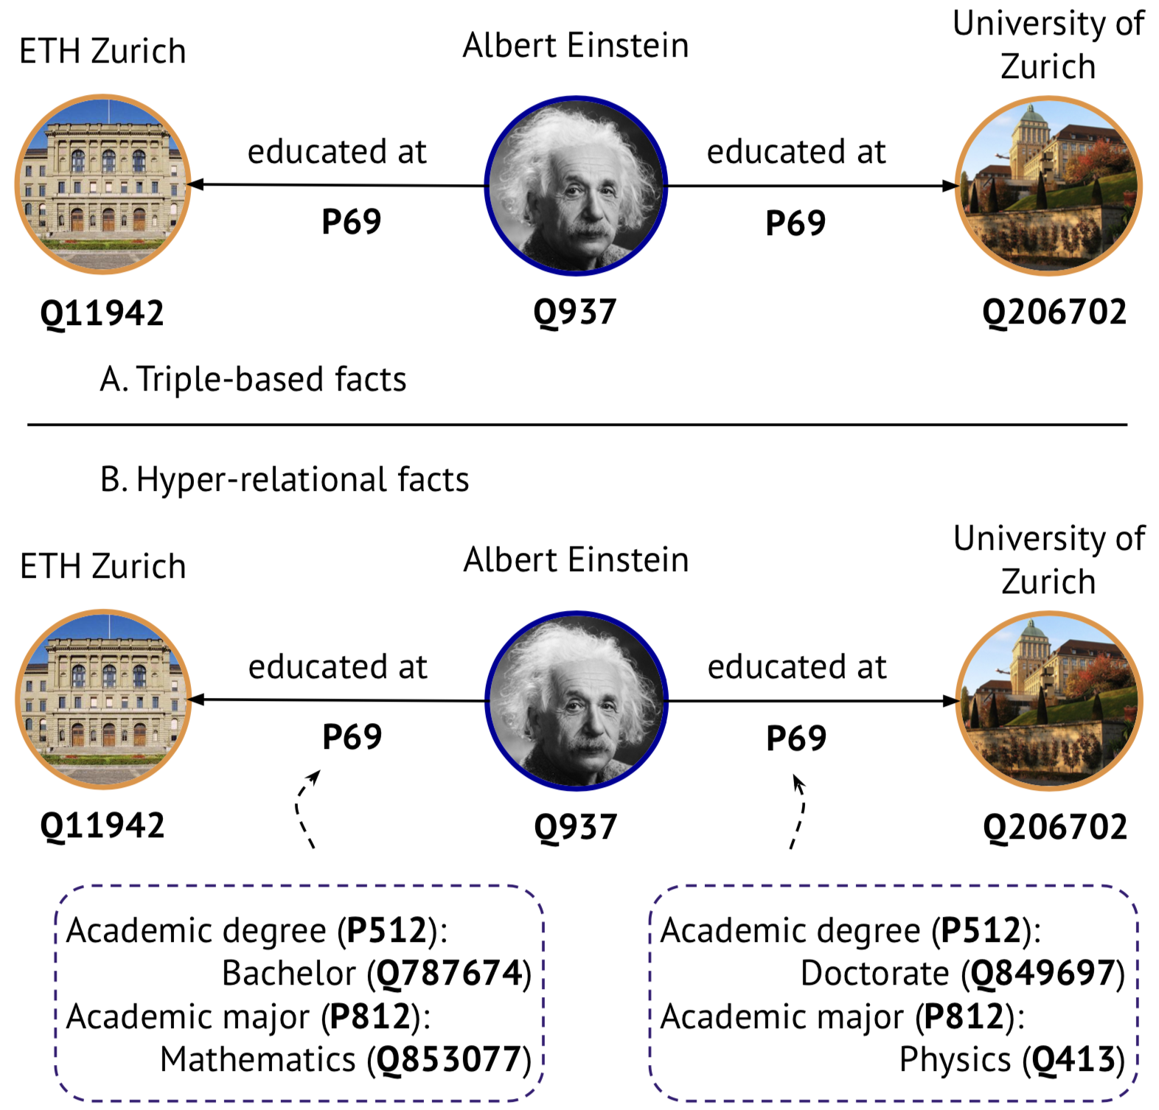
Hyper-relational graph
Image by: Michael Galkin et al. (2020)

Slide 27
Hyper-relational graph in tabular format
How: KGTK format Row = Fact + Qualifiers
Main Why: Tool integration Pandas, PyTorchBigGraph, Graph-tool, …

Slide 28
primary edges
id | node1 | relation | node2
/c/en/angel_hair/n-/r/RelatedTo-/c/en/spaghetti-0000 | /c/en/angel_hair/n | /r/RelatedTo | /c/en/spaghetti
/c/en/animals-/r/CapableOf-/c/en/eat_spaghetti-0000 | /c/en/animals | /r/CapableOf | /c/en/eat_spaghetti
/c/en/bavette/n/wikt/en_2-/r/RelatedTo-/c/en/spaghetti-0000 | /c/en/bavette/n/wikt/en_2 | /r/RelatedTo | /c/en/spaghetti
/c/en/bigoli/n-/r/RelatedTo-/c/en/spaghetti-0000 | /c/en/bigoli/n | /r/RelatedTo | /c/en/spaghetti
/c/en/black_hole/n-/r/SimilarTo-/c/en/spaghettification-0000 | /c/en/black_hole/n | /r/SimilarTo | /c/en/spaghettification
/c/en/bolognese_pasta_sauce/n/wn/food-/r/IsA-/c/en/pasta/n/wn/food-0000 | /c/en/bolognese_pasta_sauce/n/wn/food | /r/IsA | /c/en/pasta/n/wn/food
/c/en/bucatini/n-/r/RelatedTo-/c/en/spaghetti-0000 | /c/en/bucatini/n | /r/RelatedTo | /c/en/spaghetti
/c/en/carbonara/n/wn/food-/r/IsA-/c/en/pasta/n/wn/food-0000 | /c/en/carbonara/n/wn/food | /r/IsA | /c/en/pasta/n/wn/food
/c/en/carbonara/n-/r/RelatedTo-/c/en/spaghetti-0000 | /c/en/carbonara/n | /r/RelatedTo | /c/en/spaghetti
/c/en/cheese/n/wn/food-/r/LocatedNear-/c/en/spaghetti/n/wn/food-0000 | /c/en/cheese/n/wn/food | /r/LocatedNear | /c/en/spaghetti/n/wn/food

Slide 29
primary edges
‘lifted’ edges
id | node1 | relation | node2 | node1;label | node2;label | relation;label
/c/en/angel_hair/n-/r/RelatedTo-/c/en/spaghetti-0000 | /c/en/angel_hair/n | /r/RelatedTo | /c/en/spaghetti | angel hair | spaghetti | related to
/c/en/animals-/r/CapableOf-/c/en/eat_spaghetti-0000 | /c/en/animals | /r/CapableOf | /c/en/eat_spaghetti | animals | eat spaghetti | capable of
/c/en/bavette/n/wikt/en_2-/r/RelatedTo-/c/en/spaghetti-0000 | /c/en/bavette/n/wikt/en_2 | /r/RelatedTo | /c/en/spaghetti | bavette | spaghetti | related to
/c/en/bigoli/n-/r/RelatedTo-/c/en/spaghetti-0000 | /c/en/bigoli/n | /r/RelatedTo | /c/en/spaghetti | bigoli | spaghetti | related to
/c/en/black_hole/n-/r/SimilarTo-/c/en/spaghettification-0000 | /c/en/black_hole/n | /r/SimilarTo | /c/en/spaghettification | black hole | spaghettification | similar to
/c/en/bolognese_pasta_sauce/n/wn/food-/r/IsA-/c/en/pasta/n/wn/food-0000 | /c/en/bolognese_pasta_sauce/n/wn/food | /r/IsA | /c/en/pasta/n/wn/food | bolognese pasta sauce | pasta sauce|spaghetti sauce | is a
/c/en/bucatini/n-/r/RelatedTo-/c/en/spaghetti-0000 | /c/en/bucatini/n | /r/RelatedTo | /c/en/spaghetti | bucatini | spaghetti | related to
/c/en/carbonara/n/wn/food-/r/IsA-/c/en/pasta/n/wn/food-0000 | /c/en/carbonara/n/wn/food | /r/IsA | /c/en/pasta/n/wn/food | carbonara | pasta sauce|spaghetti sauce | is a
/c/en/carbonara/n-/r/RelatedTo-/c/en/spaghetti-0000 | /c/en/carbonara/n | /r/RelatedTo | /c/en/spaghetti | carbonara | spaghetti | related to
/c/en/cheese/n/wn/food-/r/LocatedNear-/c/en/spaghetti/n/wn/food-0000 | /c/en/cheese/n/wn/food | /r/LocatedNear | /c/en/spaghetti/n/wn/food | cheese | spaghetti | on

Slide 30
primary edges
‘lifted’ edges
qualifiers
id | node1 | relation | node2 | node1;label | node2;label | relation;label | source | sentence
/c/en/angel_hair/n-/r/RelatedTo-/c/en/spaghetti-0000 | /c/en/angel_hair/n | /r/RelatedTo | /c/en/spaghetti | angel hair | spaghetti | related to | CN
/c/en/animals-/r/CapableOf-/c/en/eat_spaghetti-0000 | /c/en/animals | /r/CapableOf | /c/en/eat_spaghetti | animals | eat spaghetti | capable of | CN | [[Animals]] can [[eat spaghetti]]
/c/en/bavette/n/wikt/en_2-/r/RelatedTo-/c/en/spaghetti-0000 | /c/en/bavette/n/wikt/en_2 | /r/RelatedTo | /c/en/spaghetti | bavette | spaghetti | related to | CN
/c/en/bigoli/n-/r/RelatedTo-/c/en/spaghetti-0000 | /c/en/bigoli/n | /r/RelatedTo | /c/en/spaghetti | bigoli | spaghetti | related to | CN
/c/en/black_hole/n-/r/SimilarTo-/c/en/spaghettification-0000 | /c/en/black_hole/n | /r/SimilarTo | /c/en/spaghettification | black hole | spaghettification | similar to | CN
/c/en/bolognese_pasta_sauce/n/wn/food-/r/IsA-/c/en/pasta/n/wn/food-0000 | /c/en/bolognese_pasta_sauce/n/wn/food | /r/IsA | /c/en/pasta/n/wn/food | bolognese pasta sauce | pasta sauce|spaghetti sauce | is a | CN|WN | [[bolognese pasta sauce]] is a type of [[spaghetti sauce]]
/c/en/bucatini/n-/r/RelatedTo-/c/en/spaghetti-0000 | /c/en/bucatini/n | /r/RelatedTo | /c/en/spaghetti | bucatini | spaghetti | related to | CN
/c/en/carbonara/n/wn/food-/r/IsA-/c/en/pasta/n/wn/food-0000 | /c/en/carbonara/n/wn/food | /r/IsA | /c/en/pasta/n/wn/food | carbonara | pasta sauce|spaghetti sauce | is a | CN|WN | [[carbonara]] is a type of [[spaghetti sauce]]
/c/en/carbonara/n-/r/RelatedTo-/c/en/spaghetti-0000 | /c/en/carbonara/n | /r/RelatedTo | /c/en/spaghetti | carbonara | spaghetti | related to | CN
/c/en/cheese/n/wn/food-/r/LocatedNear-/c/en/spaghetti/n/wn/food-0000 | /c/en/cheese/n/wn/food | /r/LocatedNear | /c/en/spaghetti/n/wn/food | cheese | spaghetti | on | VG

Slide 31
Individual sources
ATOMIC
ConceptNet
FrameNet
ROGET
WordNet
VisualGenome-KG
Wikidata-CS

Slide 32
Recap: VisualGenome-KG
Objects = WordNet senses ‘red shoe’ is the label shoe#n#1 is the node
Relationships = proximity ‘on top of’ is the label /r/LocatedNear is the relation
Attributes
(POS=v) /r/CapableOf (POS=a) mw:MayHaveProperty (POS=n) -

Slide 33
Recap: Extraction of Wikidata-CS
P1: Concepts, not entities houses have rooms Versailles Palace has 700 rooms
WD guidelines on entity capitalization
P2: Common concepts Container used for storage Noma subclass of aphthous stomatitis
Corpus frequency
P3: General-domain relations wheel is part of a car cholesterol has component cell membrane
Mapping to ConceptNet

Slide 34
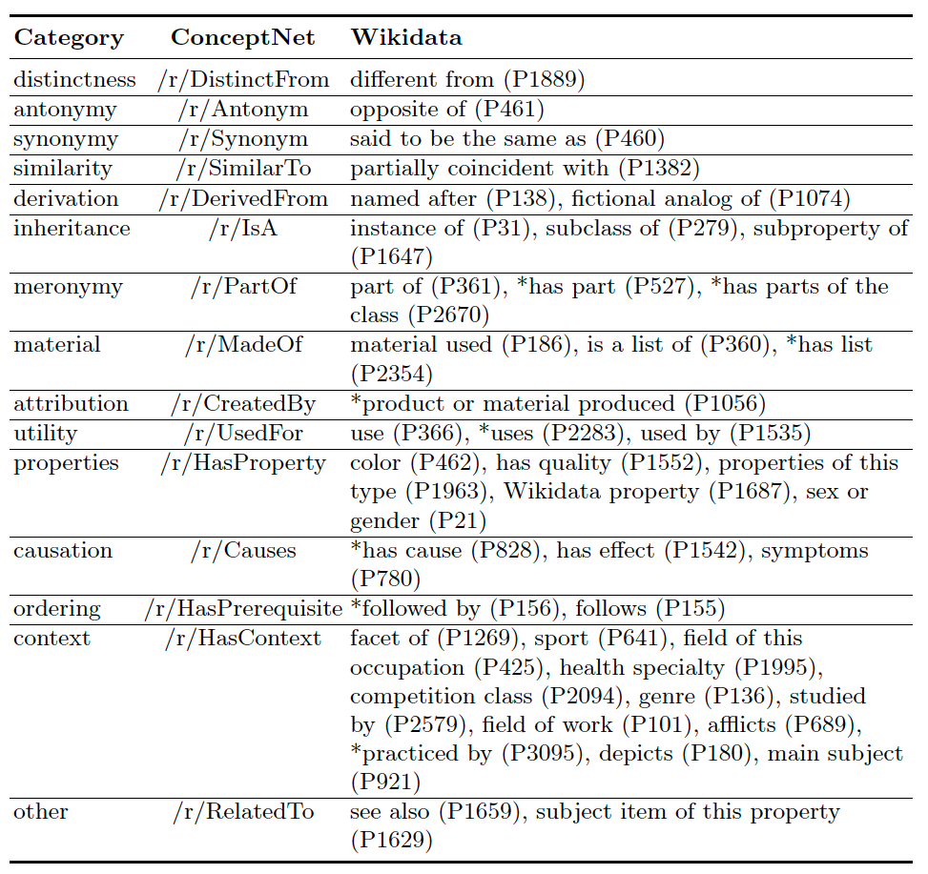
Recap: Mapping Wikidata-CS to ConceptNet

Slide 35
Overview of node mappings
Mapping from | Mapping to | Relation | Resource used
WordNet 3.0 senses | WordNet 3.1 senses | mw:SameAs | Interlingual Index (ILI)
lexical nodes in ConceptNet | lexical nodes in ATOMIC and ROGET | mw:SameAs | /
ConceptNet nodes | FrameNet LUs | mw:SameAs | Predicate matrix
ConceptNet concepts | FrameNet FEe | mw:HasInstance | rule-based system
Wikidata Qnodes | WordNet senses | mw:SameAs | XLNet-based description similarity

Slide 36
Node mapping statistics
251,517 mw:SameAs Applied to merge identical nodes
45,659 mw:HasInstance

Slide 37
From concatenated sources to CSKG
append node mappings
compute identity clusters
deduplicate identical triples

Slide 38
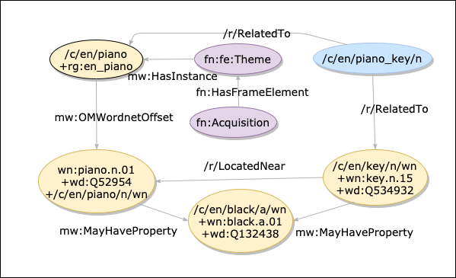
CSKG snippet

Slide 39
CSKG snippet
lexical mapping
rule-based mapping
ILI & LM-based mapping
ILI & LM-based mapping
ILI & LM-based mapping

Slide 40
CSKG statistics
#nodes | 2,160,968
#edges | 6,003,237
#relations | 81
mean degree | 5.56
std degree | 0.027

Slide 41
Integration statistics
 | AT | CN | FN | RG | WN | WD | VG | CSKG (concat) | CSKG
#nodes | 304,909 | 1787373 | 15,652 | 71,804 | 91,294 | 71,243 | 11,264 | 2,344,938 | 2,160,968
#edges | 732,723 | 3423004 | 54,109 | 1,403,955 | 111,276 | 101,771 | 2,587,623 | 6,054,261 | 6,003,237
#relations | 9 | 34 | 23 | 2 | 3 | 15 | 3 | 81 | 81
mean degree | 4.81 | 3.83 | 6.91 | 39.1 | 2.44 | 2.86 | 459.45 | 5.16 | 5.56
std degree | 0.07 | 0.02 | 0.73 | 0.34 | 0.02 | 0.05 | 35.81 | 0.02 | 0.03

Slide 42
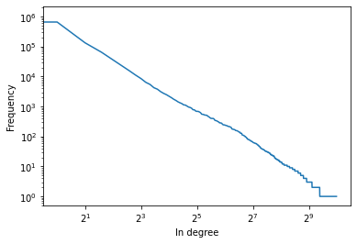
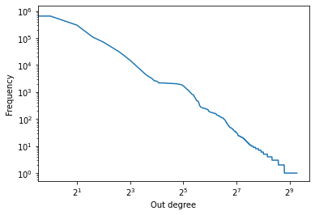
In degree
Out degree
max = 11,081
max = 6,366

Slide 43
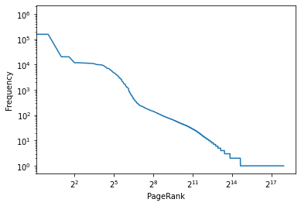
PageRank distribution
max = 0.0015

Slide 44
Top PageRank nodes
/c/en/chemical_compound/n
/c/en/change/n/wn/artifact
/c/en/natural_science/n/wn/cognition
/c/en/chromatic/a/wn
/c/en/organic_compound

Slide 45
Open challenge: Node resolution
Node label: scene
fn:lu:sensation:scene | FN
fn:lu:locale_by_event:scene | FN
fn:fe:scene | FN
Q7430735 | WD
Q67943498 | WD
Q16675888 | WD
Q1185607 | WD
Q282939 | WD
/c/en/scene/n/wn/location | CN, WN
/c/en/scene/n/wn/event | CN, WN
/c/en/scene/n/wn/cognition | CN, WN
/c/en/scene/n/wn/artifact | CN, WN
/c/en/scene/n/wn/state | CN, WN
/c/en/scene/n/opencyc/scene_dramatic | CN
/c/en/scene/n/opencyc/image_space | CN
/c/en/picture/n/wn/state | CN, WN
/c/en/scene/n | CN
/c/en/scene | CN
/c/en/scenery/n/wn/artifact | CN, WN

Slide 46
Open challenge: Ambiguity of nodes
IsA

Slide 47
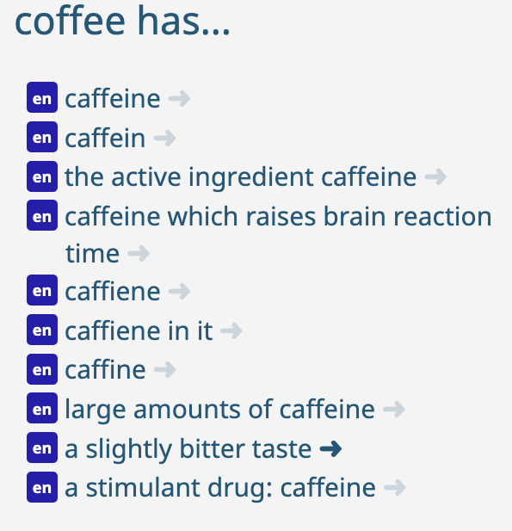
Open challenge: Variance of nodes

Slide 48
Open challenge: Relation granularity
ConceptNet
/r/HasProperty
Web Child
-
ability#n#1
age#n#1
appearance#n#1
beauty#n#1
color#n#1
disposition#n#4
emotion#n#1
feeling#n#1
length#n#1
manner#n#1
motion#n#4
personality#n#1
physical_property#n#1
quality#n#1
sensitivity#n#2
shape#n#2
size#n#1
sound#n#1
state#n#2
strength#n#1
structure#n#2
sustainability#n#1
tactile_property#n#1
taste_property#n#1
temperature#n#1
trait#n#1
weight#n#1

Slide 49
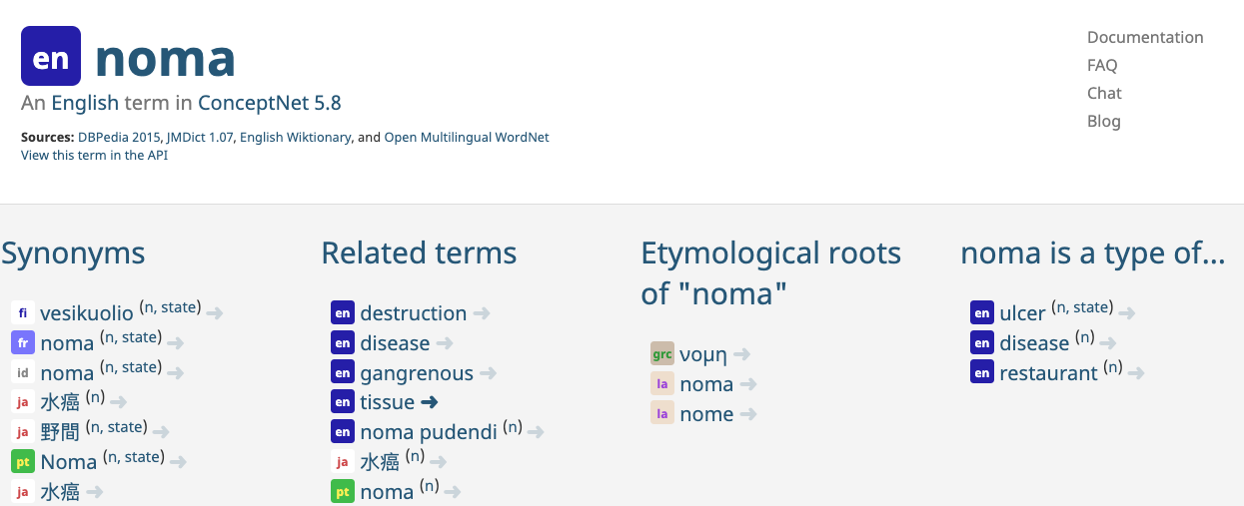
Open challenge: Knowledge filtering

Slide 50
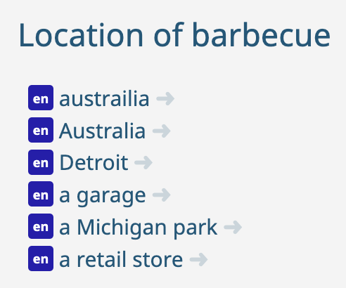
Open challenge: Missing facts

Slide 51
Agenda
08:00 PST | 1 hr 50 mins | Part I - Review of CSKGs
 | 15 min | Introduction to commonsense knowledge (slides) - Pedro
 | 25 min | Review of top-down commonsense knowledge graphs (slides) - Mayank
 | 70 min | Review of bottom-up commonsense knowledge graphs (slides+demo) - Mayank, Filip, Pedro
 | 10 min | Break
10:00 PST | 45 min | Part II - Integration and analysis
 | 35 min | Consolidating commonsense graphs (slides) - Filip
 | 10 min | Consolidating commonsense graphs (demo) - Pedro
 | 10 min | Break
10:55 PST | 1 hr 05 mins | Part III - Downstream use of CSKGs
 | 50 min | Answering questions with CSKGs (slides+demo) - Filip
 | 15 min | Wrap-up (slides) - Mayank

