Slide 1
SENTIMENT ANALYSIS OF A MOVIE REVIEW
Using machine learning
Presented by – Group 16
Harshita Chegondi - 1002115738
Rakshitha Koushika - 1002076118
Pranav Rayapati - 1002077440

Slide 2
Steps we have implemented
Extracted the Dataset
http://ai.stanford.edu/~amaas/data/sentiment
Preprocessed the data
Removed Stopwords
Removed HTML tags
Applied Stemming
Label Encoding
Implemented Models
Convolutional Neural Network
BERT Model
Evaluated the models

Slide 3

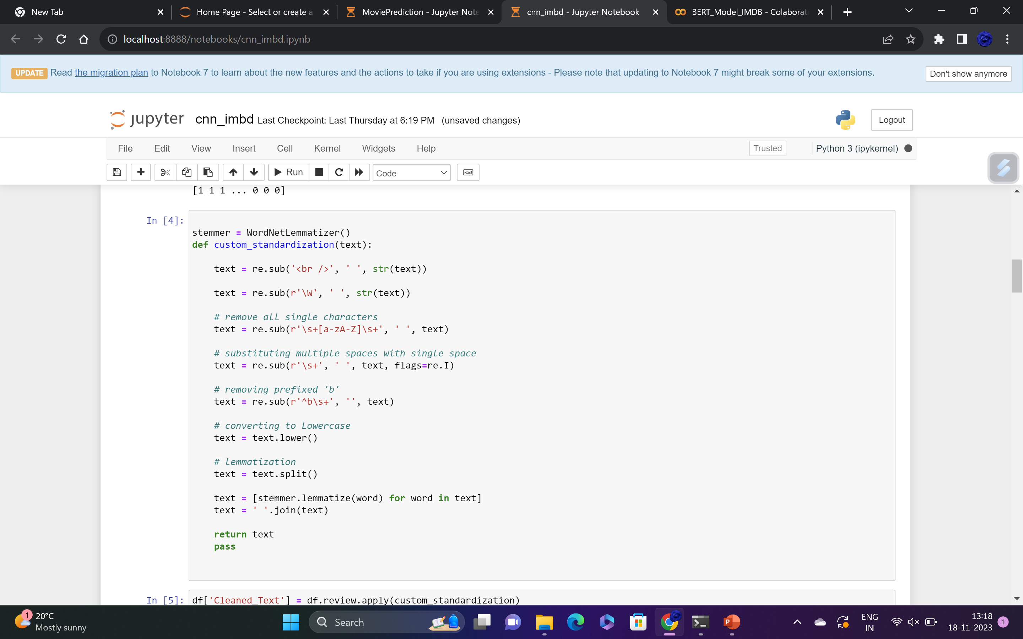
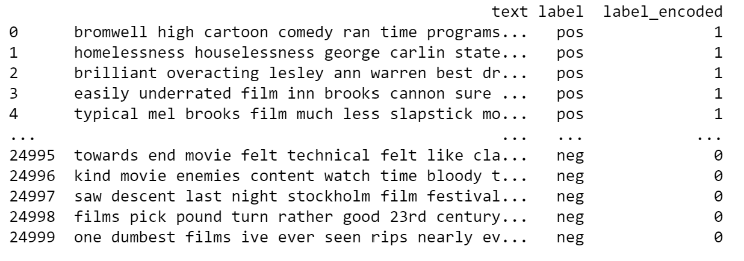
Data Pre-Processing
Here we are removing the following:
HTML Tags
Converting the text to lower case
Removing single characters
Removing stop words
Applied Lemmatization
Encoded the labels

Slide 4
ALGORITHMS
Convolutional Neural Network (CNN)
Transformer Models

Slide 5
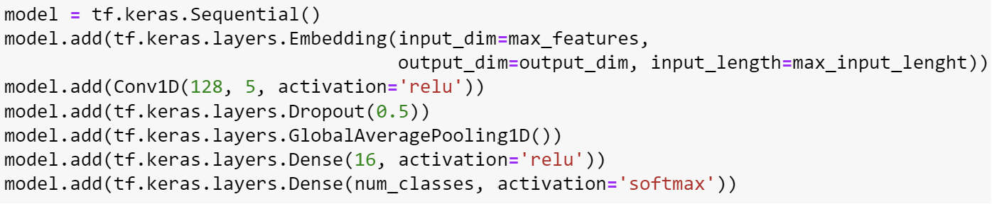
CONVOLUTIONAL NEURAL NETWORK
A Convolutional Neural Network (CNN) is a deep learning model specifically designed for processing structured grid data, such as images and, in some cases, text data treated as sequences.

Slide 6
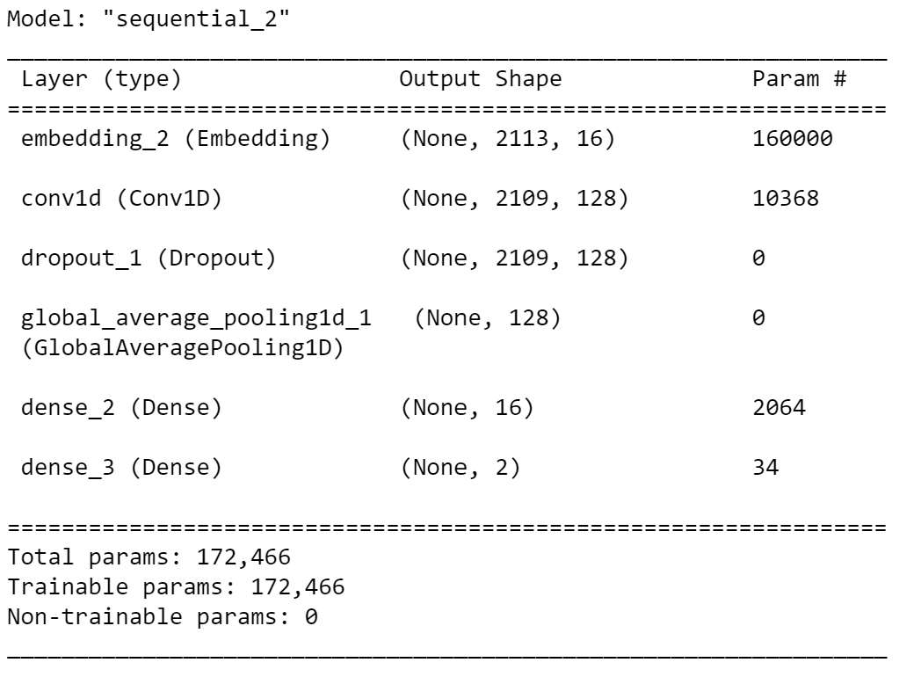
Model Summary
Embedding Layer: This layer converts word indices into dense word embeddings. It can capture semantic relationships between words.
Convolutional Layer: This convolutional layer applies 64 filters with a kernel size of 5 to capture local patterns in the text data.
Dropout Layer: Dropout layers are used for regularization by randomly setting a fraction of input units to 0 during each update, which helps prevent overfitting.
Flatten Layer: This layer flattens the 1D feature maps into a 1D vector, preparing the data for the fully connected layers.
Dense Layer 1: Applies a linear transformation to the input data.
Dense Layer 2 (Output Layer): Activation Function: Sigmoid: This is the output layer with a single unit and sigmoid activation. It's typical for binary classification tasks.

Slide 7
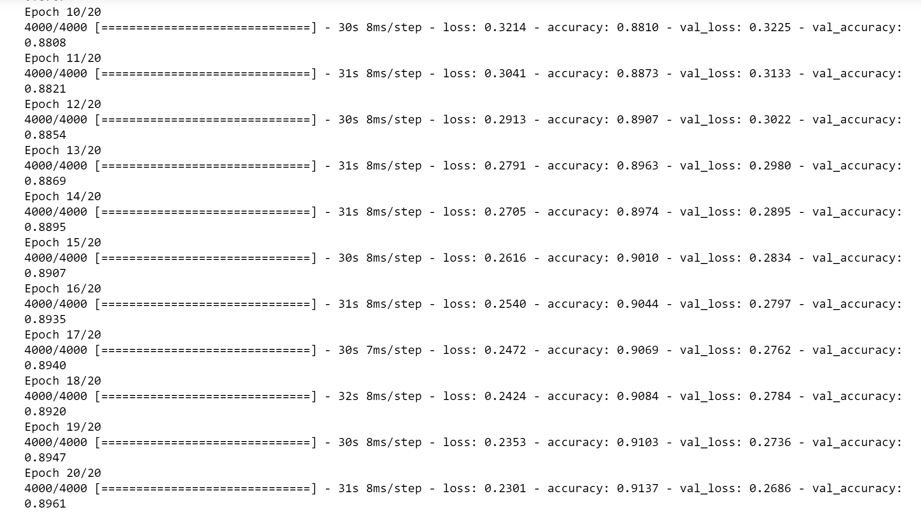
Training the Model

Slide 8
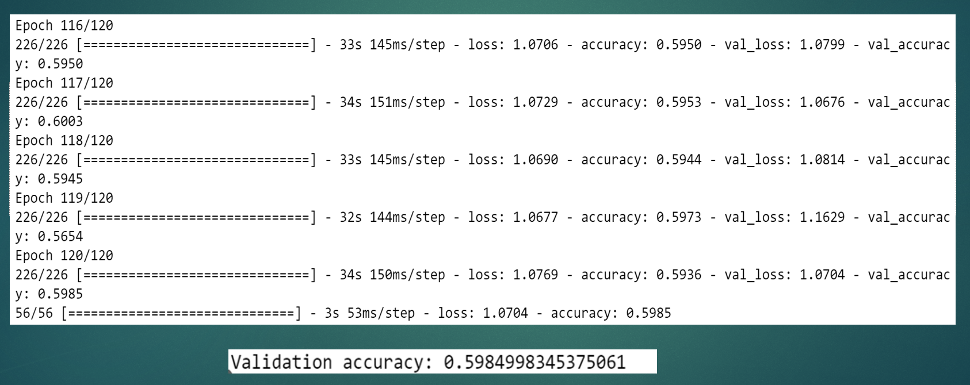
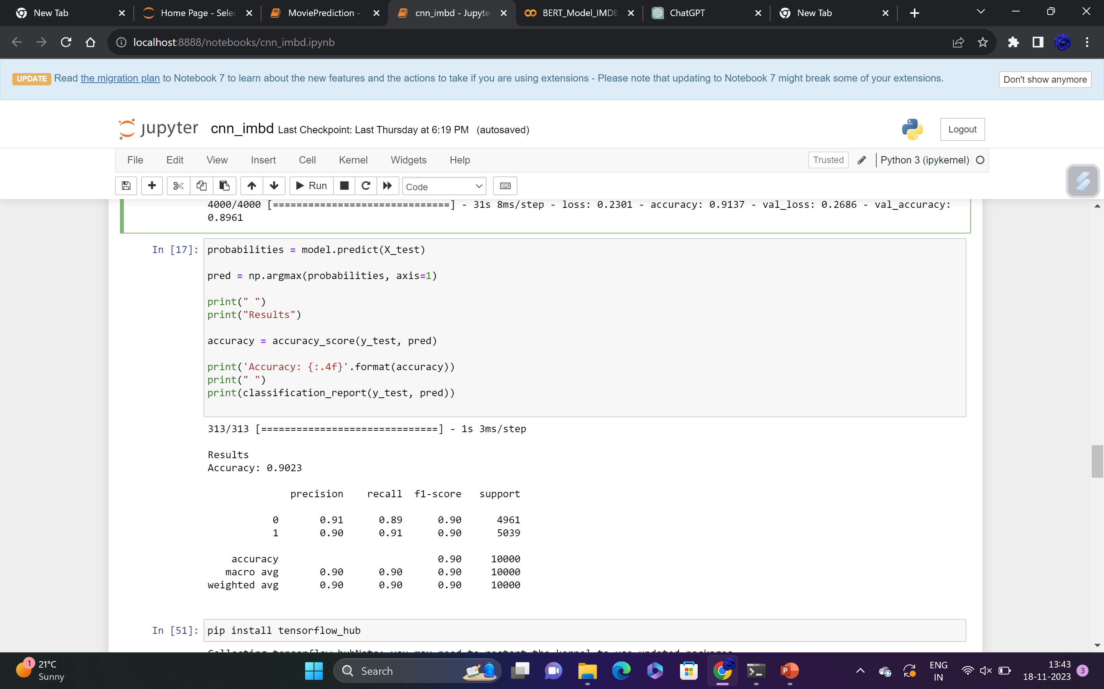
Accuracy

Slide 9
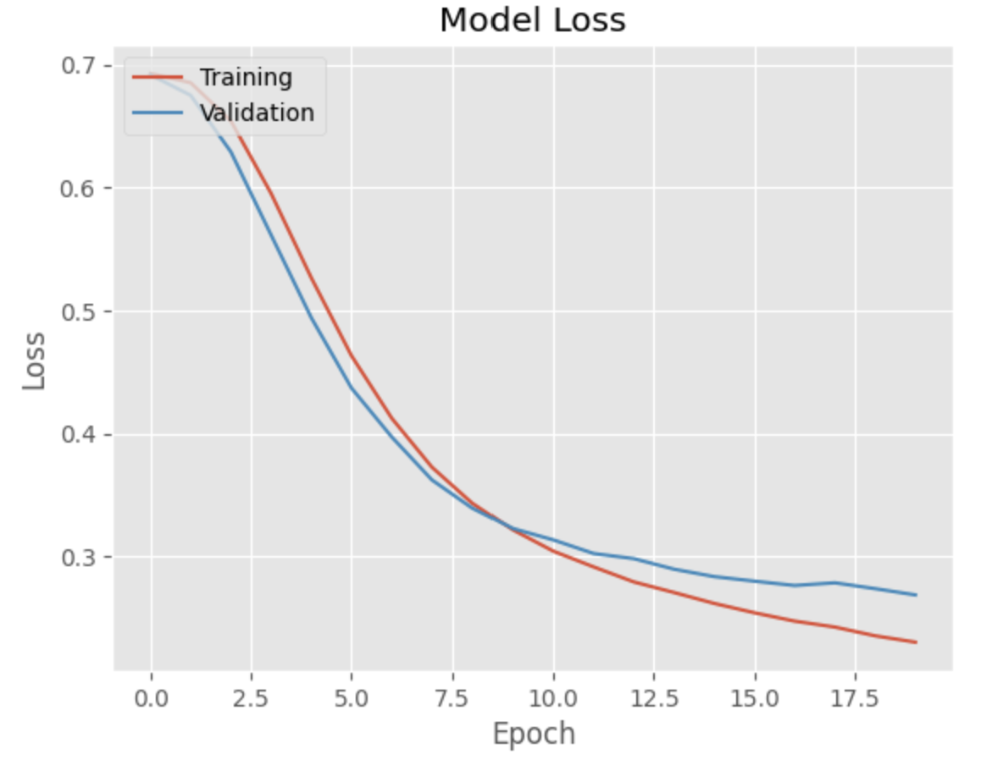
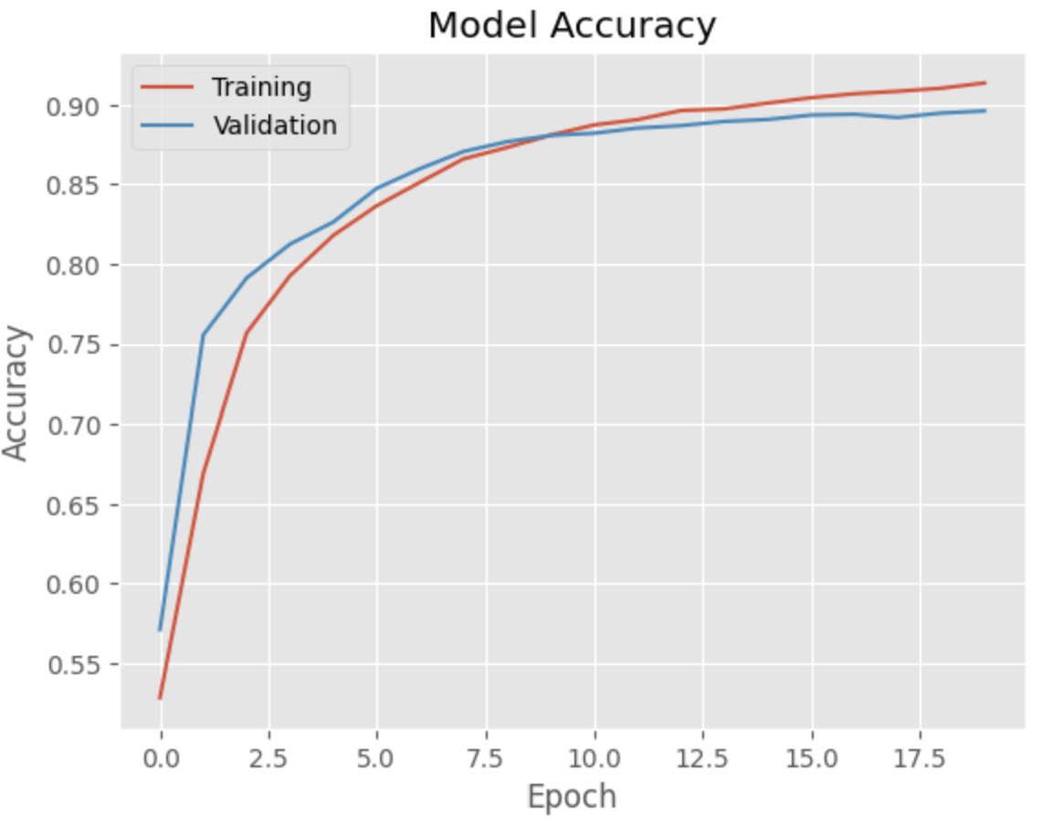
Model Graphs from CNN

Slide 10
TRANSFORMER MODEL
BERT, which stands for "Bidirectional Encoder Representations from Transformers," is a machine learning model used for natural language processing (NLP) tasks.
BERT is based on the Transformer architecture, which includes self-attention mechanisms and multiple layers of encoders.
It's a significant advancement in NLP because it can understand the context of words in a sentence by considering both the words that come before and after a particular word.
The Transformer architecture enables BERT to model long-range dependencies in text efficiently.

Slide 11
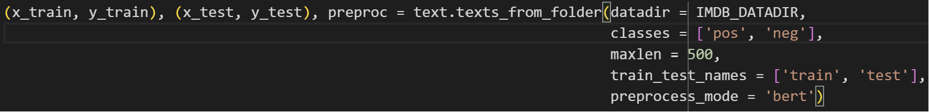
Creating Train and test data for BERT model
Here we are setting up a text classification model based on the BERT architecture, using the specified training data (x_train, y_train) and applying pre-processing steps defined by preproc. The text_classifier function likely handles the construction and training of the BERT-based model for the specific text classification.

Slide 12
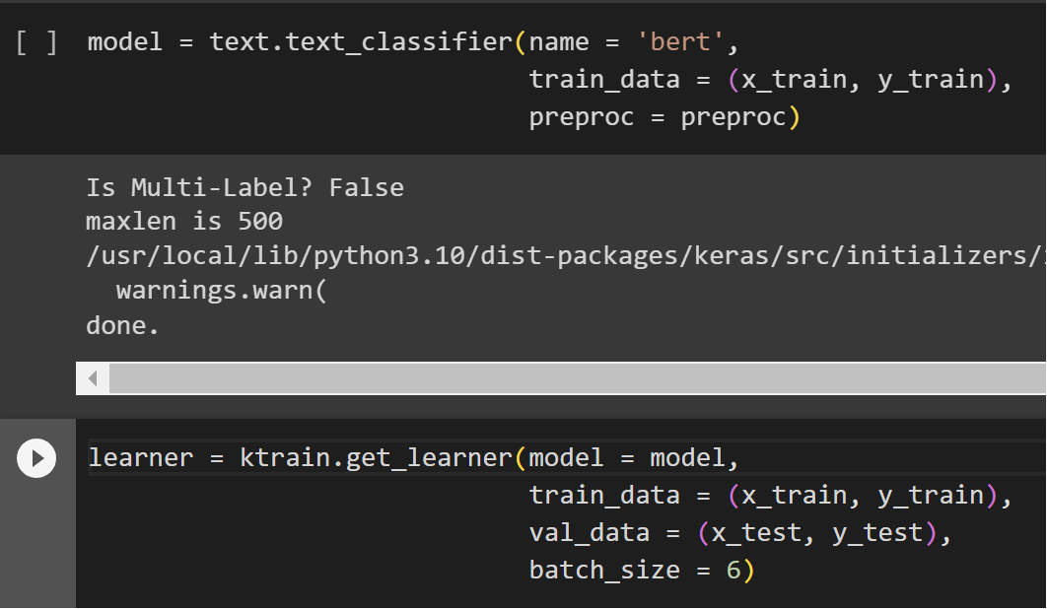
BERT MODEL
Here we train a model using a one-cycle learning rate policy for one epoch and then evaluates its performance on a validation set. The class names are specified to enhance the interpretation of evaluation results.

Slide 13
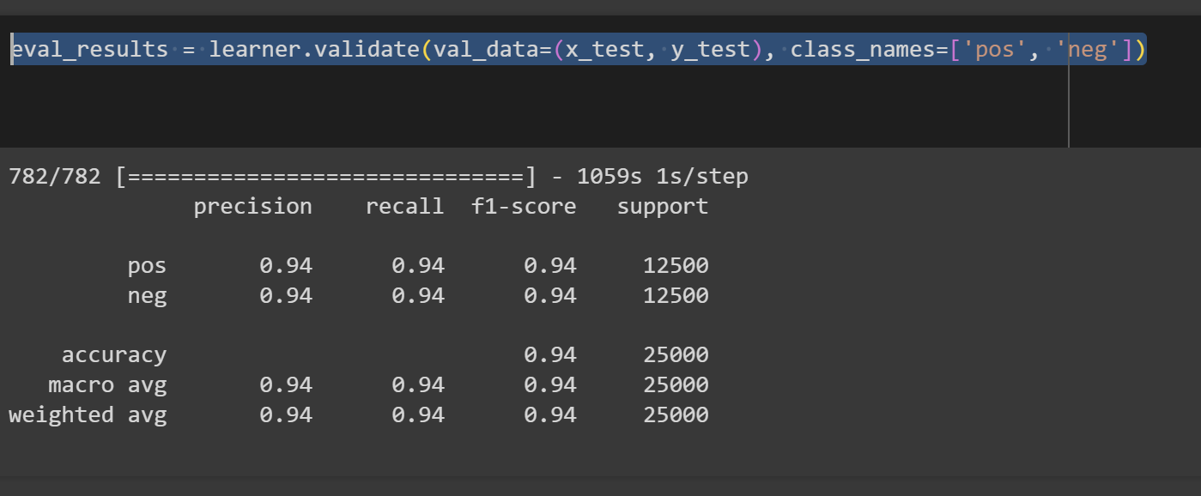
Evaluating the model
Here we are evaluating on the validation set using the validate method, and the results are stored in the eval_results variable.
eval_results includes metrics such as accuracy, loss, or other relevant metrics.

Slide 14
Accuracies for both the models
CONVOLUTIONAL NEURAL NETWORK | BERT Model
90% | 94%

Slide 15
References
A Hybrid BiLSTM-ATT Model for Improved Accuracy Sentiment Analysis - Langxue Dang, Chunyu Wang, Hongyu Han, Yan-E Hou – 2022
https://ieeexplore-ieee-org.ezproxy.uta.edu/document/10074634
Comparative Study of Algorithms for Sentiment Analysis on IMDB Movie Reviews – Neelisetty Sri Lakshmi Sai Charitha, Vellanki Rakesh, Mandadapu Varun – 2023
https://ieeexplore-ieee-org.ezproxy.uta.edu/document/10113113
Sentiment Prediction of IMDb Movie Reviews Using CNN-LSTM Approach – Mahesh Mishra, Amol Patil – 2023
https://ieeexplore-ieee-org.ezproxy.uta.edu/document/10165155
ktrain: A Lightweight Wrapper for Keras to Help Train Neural Network
https://towardsdatascience.com/ktrain-a-lightweight-wrapper-for-keras-to-help-train-neural-networks-82851ba889c
BERT Text Classification in 3 Lines of Code Using Keras
https://towardsdatascience.com/bert-text-classification-in-3-lines-of-code-using-keras-264db7e7a358

Slide 16
THANK YOU

