Slide 1

Pneumonia Detection from Chest X‑rays using Deep Learning
Custom CNN vs. fine-tuned ResNet50, with Grad-CAM explainability
Presented by
Harshita Chokhani
Registration No: 2430010505
Notes:
Introduce the project: an automated system that classifies chest X-rays as normal or pneumonia, comparing a CNN built from scratch with a transfer-learning model, and explaining predictions with Grad-CAM.

Slide 2



Problem Statement & Objective
The challenge
Our objective
The scope
Pneumonia is a leading cause of death in children under five worldwide. Diagnosis relies on radiologists reading chest X-rays, which is slow and scarce in many regions.
Build a deep learning model that classifies a chest X-ray as NORMAL or PNEUMONIA, prioritising sensitivity so that sick patients are not missed.
Compare a custom CNN trained from scratch against a fine-tuned ResNet50, evaluate both on an unseen test set, and explain predictions with Grad-CAM.
Notes:
Why it matters: missing a pneumonia case (false negative) is far more dangerous than a false alarm, so recall/sensitivity is our main metric.

Slide 3
Dataset: Chest X-Ray Images (Pneumonia)
5,856
paediatric chest X-rays
2
classes: NORMAL / PNEUMONIA
~1 : 3
class imbalance
Source: Kermany et al., Cell (2018), via Kaggle. The official validation set has only 16 images, so a stratified 85/15 split of the training set was used for validation.
Notes:
Training: 1,341 normal vs 3,875 pneumonia. Test: 234 vs 390. The imbalance is handled with inverse-frequency class weights in the loss. The test set is never used for training or model selection.

Slide 4




Methodology: The Core Pipeline
1. Preprocessing
2. Model Training
3. Evaluation
Grayscale to 3 channels, resize to 224×224
ImageNet normalisation
Augmentation: rotation ±10°, shift, zoom, brightness/contrast
No horizontal flip (the heart makes X-rays asymmetric)
Weighted cross-entropy for class imbalance
AdamW optimiser + ReduceLROnPlateau
Early stopping on validation loss (patience 3)
Best checkpoint saved automatically
Held-out test set (624 images)
Accuracy, precision, recall, specificity, F1, ROC-AUC
Confusion matrix and ROC curves
Grad-CAM heatmaps for explainability
Notes:
Same pipeline for both models, so the comparison is fair. Class weights stop the model from just predicting the majority class.

Slide 5
Model Architectures Compared
Baseline CNN (from scratch)
ResNet50 (transfer learning)
1.21 M parameters
23.5 M parameters (22.1 M fine-tuned)
4 convolutional blocks (Conv–BN–ReLU ×2 + MaxPool)
32 → 64 → 128 → 256 filters, global average pooling
Dropout 0.5 / 0.3 in the classifier head
10 epochs · 21.1 min on a T4 GPU
Pre-trained on ImageNet (1.2 M natural images)
Early layers frozen; layer3, layer4 and head fine-tuned
New head: Dropout 0.4 + Linear (2 classes)
8 epochs (early stopped) · 16.8 min on a T4 GPU
Notes:
The baseline shows what a CNN can learn from this dataset alone. ResNet50 reuses features learned on ImageNet; we freeze early layers (generic edges/textures) and fine-tune deeper layers to adapt to X-rays.

Slide 6
Results: Test-Set Evaluation Metrics
Model | Accuracy | Precision | Recall | Specificity | F1-Score | ROC-AUC
Baseline CNN | 82.4% | 0.786 | 0.987 | 0.551 | 0.875 | 0.939
ResNet50 (fine-tuned) | 86.7% | 0.827 | 0.995 | 0.654 | 0.903 | 0.963
+4.3 pts
99.5%
0.963
accuracy gain with transfer learning
recall: only 2 of 390 pneumonia cases missed
ROC-AUC for ResNet50
Analysis: ResNet50 beats the baseline on every metric. Both models favour sensitivity over specificity, which is the right trade-off for screening: a false alarm leads to a second look, while a missed case can be fatal.
Notes:
Recall = TP/(TP+FN) = 388/390. Specificity = TN/(TN+FP) = 153/234. Precision is lower because of false positives on normal X-rays.

Slide 7
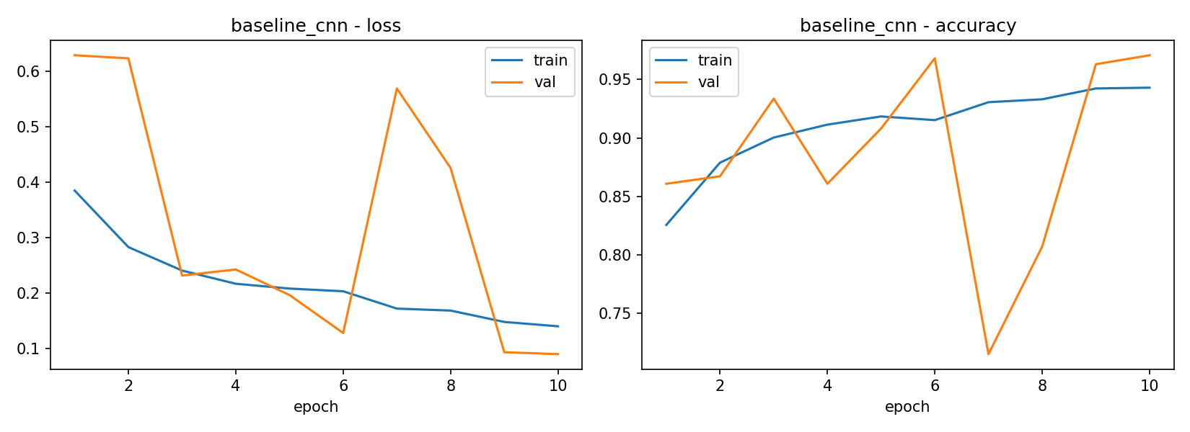
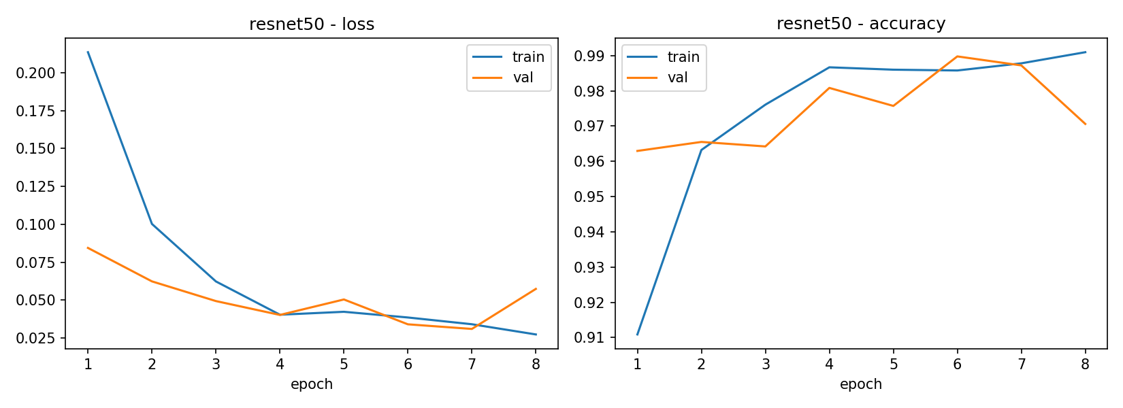
Results: Training Behaviour
Baseline CNN
ResNet50
Baseline is unstable. Validation loss jumps at epoch 7 (val accuracy drops to 71.5%): learning from scratch on ~4.4k images is noisy.
ResNet50 converges fast and smoothly. 96% validation accuracy after one epoch, 99% by epoch 6, thanks to pre-trained features.
Notes:
Early stopping on validation loss kept the best checkpoint for each model (ResNet50 best at epoch 7, val loss 0.031).

Slide 8
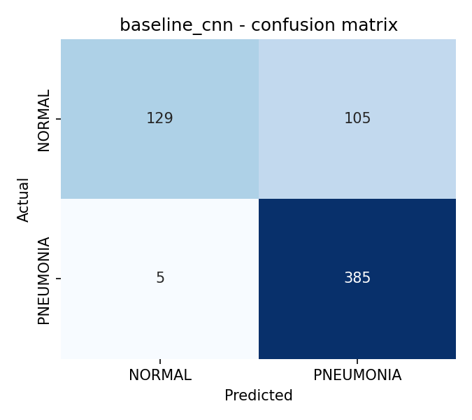
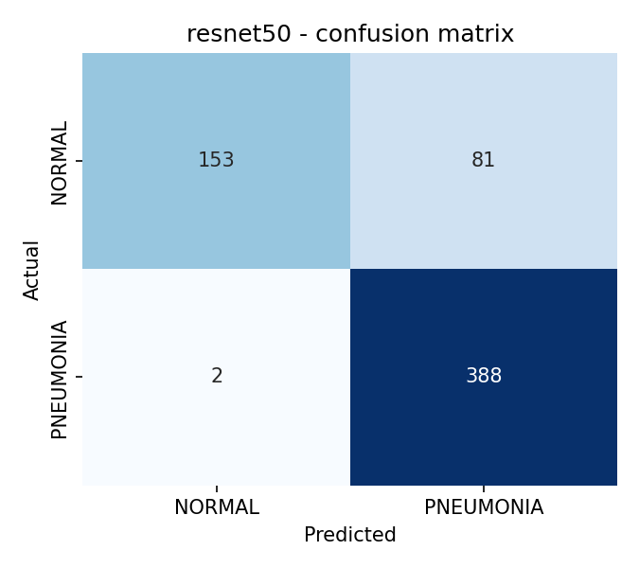
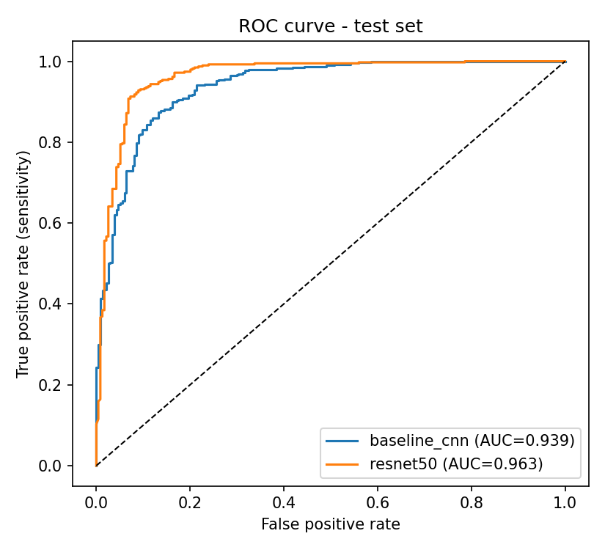
Results: Confusion Matrices & ROC Curve
5 → 2
105 → 81
0.939 → 0.963
Missed pneumonia (FN) · baseline → ResNet50
False alarms (FP) · baseline → ResNet50
ROC-AUC · baseline → ResNet50
Notes:
Transfer learning reduces both error types. The ROC curve shows ResNet50 dominating at almost every threshold; the threshold could be tuned to trade sensitivity for specificity.

Slide 9
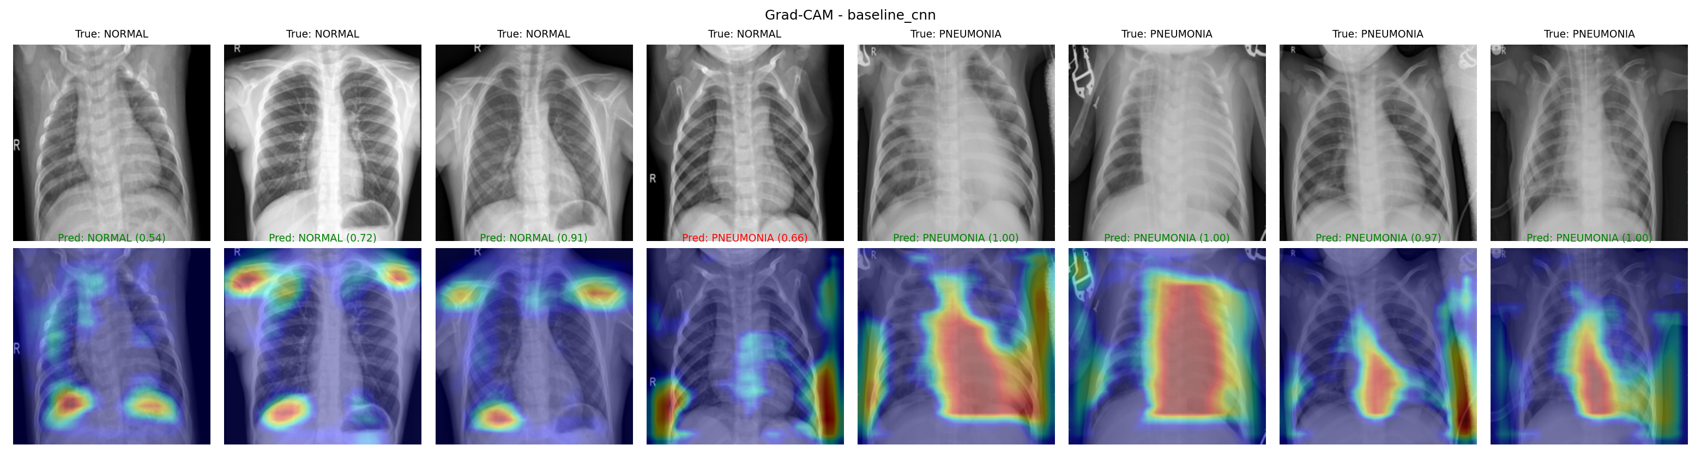
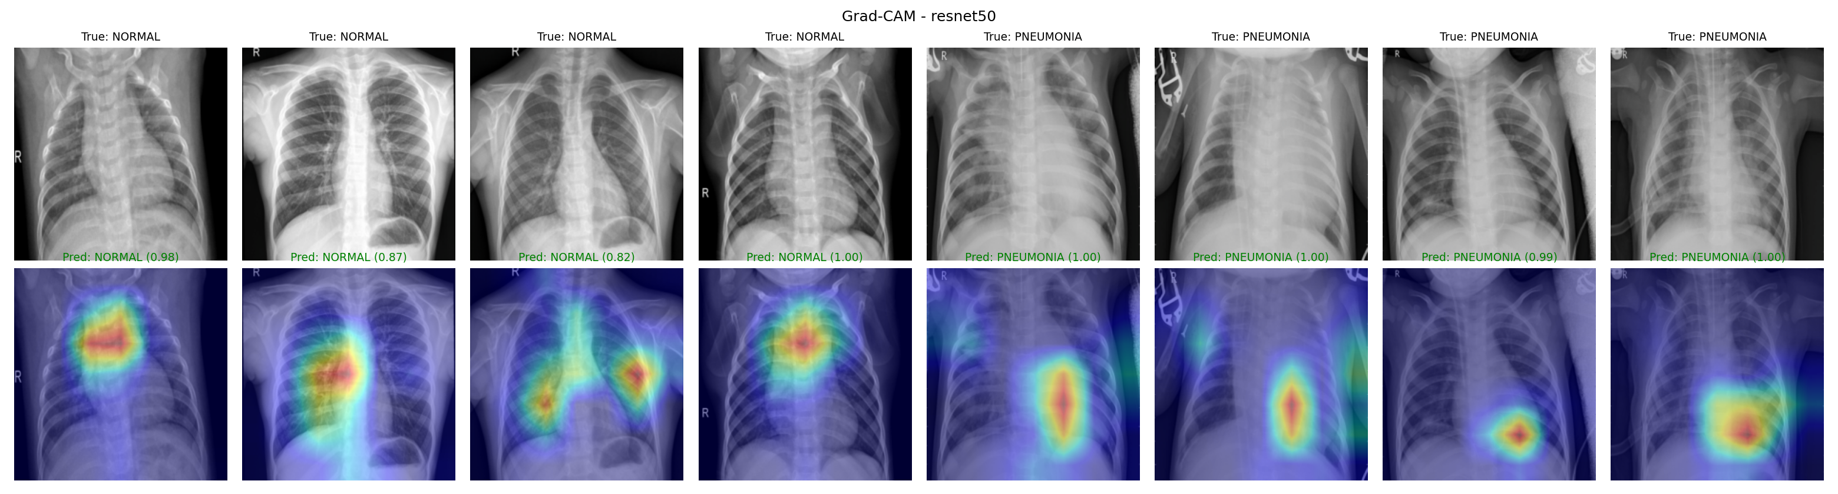

Explainability: Grad-CAM Heatmaps
Baseline CNN
For normal X-rays it often looks at the collar bones and diaphragm edges, not the lungs: a sign of shortcut learning. 1 of 4 normals misclassified.
ResNet50
Attention falls inside the chest cavity, on the lung fields and opacity regions. All 8 samples classified correctly with high confidence.
Notes:
Grad-CAM weights the last convolutional feature maps by their gradients for the predicted class. Red = regions that most influenced the decision. This builds trust and exposes models that 'cheat'.

Slide 10
Conclusion & Future Work
Key findings
Limitations
Future work
Transfer learning (ResNet50) outperformed a CNN trained from scratch on every metric
99.5% recall: suitable as a screening aid
Grad-CAM confirms ResNet50 focuses on clinically relevant lung regions
Single-hospital paediatric data; may not generalise to adults
Specificity of 65%: many false alarms
Validation (97–99%) vs test (87%) gap shows distribution shift
Tune the decision threshold for better specificity
Validate on external data (e.g. NIH ChestX-ray14)
Multi-class: bacterial vs viral pneumonia
Thank You · Questions?
Notes:
Close with the main message: transfer learning plus explainability gives an accurate and trustworthy pneumonia screening aid, but it needs external validation before any clinical use.

