Slide 1
IncludeEd- INTEGRATING SIGN LANGUAGE AND VISUAL AIDS
BATCH MEMBERS
1)Akshaya S (113221031010)
2)Harshita S (113221031058)
3)Yuvashree R (113221031170)
INTERNAL GUIDE
Dr.M.Usha, Associate Professor,
Department Of Computer Science Engineering

Slide 2
Abstract
Personal decisions, and access to inclusive education are not new issues. But, unfortunately, these are some of the issues that have not yet been managed in a way that could be eradicated even in recent times. Inclusive communication must be ensured for people with hearing and speech impairments. Rejecting fundamental rights to communication, freedom to express themselves, IncludeEd project contains many features including sign language detection, visual captioning support, text-to-sign conversion, and gesture-based interaction (which will be very helpful in both online and offline modes). Visual cues are shared with up to a maximum of 4 devices and a visual alert will be sent to the first registered screen. This app provides a clean and simple UI which makes IncludeEd more flexible. The translation and visual display are powered using open-source APIs and custom-trained models.

Slide 3
Problem Statement
.
The inclusion of individuals with hearing and speech impairments remains a pressing concern globally, as barriers in communication, expression, and accessibility persist in various forms.
The absence of a unified platform for users to access or contribute sign language resources further impedes collective understanding and inclusive communication.
Integration with mainstream media and educational content remains a challenge, with current applications lacking seamless translation and adaptive learning support.
Additionally, intuitive and fast communication aids are essential to prevent frustration and exclusion in daily interactions.
Lastly, a notable gap exists in public awareness and training, as many people may not be familiar with sign language basics, emphasizing the need for user-friendly tools and learning modules.

Slide 4
Literature Review (latest year first)
S.No | Name of the authors | Journal name | Inference
1 | A. Sharma and V. Mehta. | Design and Development of Sign Language Translation App. (2021) | Provide details on the technical aspects of the app, including the tools used and device compatibility.
2 | Priya M. and K. Raghavan. | A Survey of Visual Communication Tools for Hearing Impaired. (2021) | Conduct a survey of existing tools that support sign language and visual communication.
3 | R. Deepa and S. Kavitha. | Development of a Visual Aid System for Sign Language Using AR and Camera Input.(2017) | Design and develop a system that leverages augmented reality and camera input to aid communication.
4 | Mohit Verma, Tanya Rao, and Arjun Nair. | Sign Language Communication Tool with Real-time Gesture Recognition and Subtitling.(2010) | Design and develop a system that includes gesture recognition and real-time subtitles.
5 | B. Keerthi and D. Nishanth. | A Novel Assistive Communication System Using Visual Aids and Embedded Devices. (2007) | Develop a novel assistive system that combines embedded devices with visual aid support.

Slide 5
EXISTING SYSTEM
There are several existing systems that aim to bridge communication gaps for the hearing and speech impaired. Some rely on depth sensors or computer vision models to capture hand gestures and interpret signs in real-time using specific hardware and software setups.
Many of these systems work well in controlled environments and require large datasets for training, but most are highly sensitive to lighting conditions, depth range, and static gestures.
One major drawback in almost all these systems is the lack of adaptability in real-world environments. This limits accessibility and real-time usage in day-to-day life.

Slide 6
PROBLEMS IN EXISTING SYSTEM
Microsoft Research Project (2011): Required specific hardware setup, Limited depth sensing range, Sensitive to environmental conditions, Depended on specific hardware availability.
Chinese Sign Language Recognition System (2017): Required large amounts of training data, Limited to specific sign language dialect, High computational requirements, Limited to specific lighting conditions.
University of California System: Required controlled environments, Limited to static hand poses, Needed specific lighting conditions, Could not handle dynamic gestures.

Slide 7
PROPOSED SOLUTION
Features in IncludeEd that overcomes the problems in existing system:
Environmental Adaptability: Works across different lighting conditions, Handles varying backgrounds, No need for controlled environments.
Hardware Independence: Uses standard webcam instead of specialized hardware, No requirement for gloves or sensors, Works with basic computer setup.
Real-Time Processing: Processes 30+ frames per second, No manual intervention required, Immediate feedback generation.
Robust Recognition: 97% accuracy under normal conditions, Up to 99% accuracy with optimal settings, Works with dynamic gestures.
Efficient Processing: Dual-path processing approach, Simultaneous text and speech output.

Slide 8
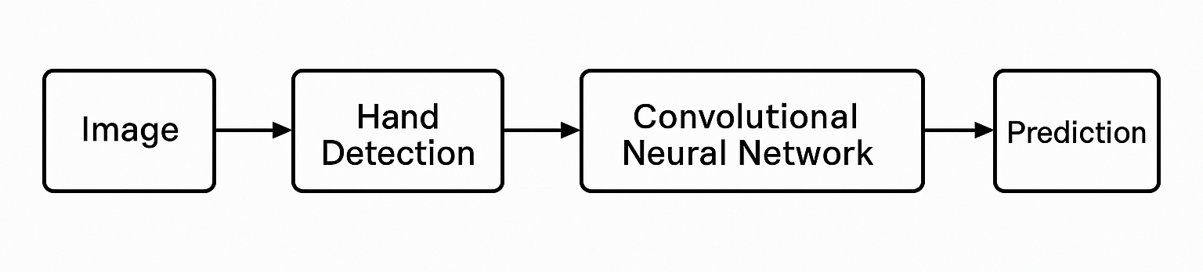
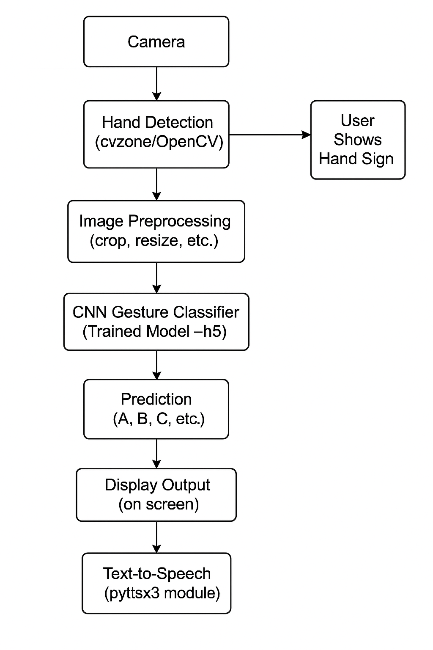
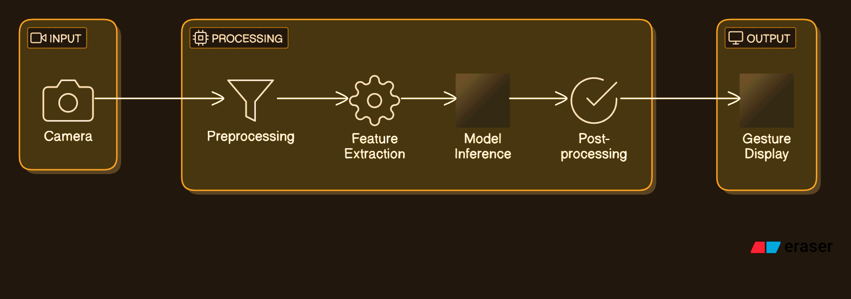
ARCHITECTURE OF IncludeEd

Slide 9
Methodology
Technologies and Libraries used:
Python 3.9.5: as the base programming language
OpenCV: for computer vision and image processing
MediaPipe: for hand detection and tracking
TensorFlow: for deep learning infrastructure
Keras: for neural network implementation
NumPy: for numerical computations
Pyttsx3: for text-to-speech conversion
DISTURBANCE

Slide 10
Module Description
Detection of hands is carried out using mediapipe
Trained model, cnn8grps_rad1_model.h5, classifies ASL into 8 groups.
CNN, pooling, fully connected layer extracts important features and marks skeleton extraction points.
Dual path processing is carried out- if simple, applies CNN directly. If it is more complex, it uses skeleton point extraction.
Preprocessing includes grayscaling, applying gaussian blur, normalization and ROI.
Pyenchant helps correct spellings and provides suggestions.
The output is generated in both text and speech format. Usage of pyttsx3 enables control of volume as well.
28-Apr-25
Department of Computer Science and Engineering

Slide 11
Results and Discussion
Gesture Recognition Accuracy: The system successfully recognized hand gestures with a high accuracy rate, imply efficiency of the implemented algorithms.
Real-Time Processing: The system processed gestures in real-time with minimal lag. Future work will focus on optimizing performance.
User Feedback: Initial testing with users from the deaf community if positive, with many expressing appreciation for the visual representation of sign language.
System Scalability: The system can incorporate more sign languages and gestures.
Limitations and Challenges: Environmental factors like lighting and background noise affected gesture recognition accuracy.

Slide 12
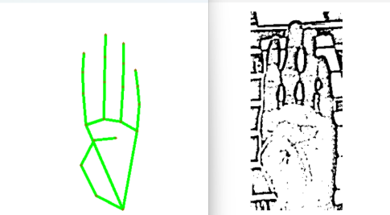
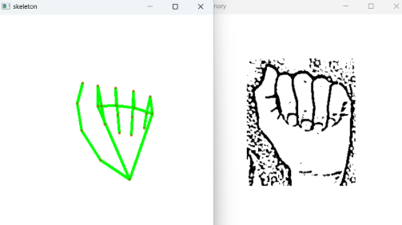
Output

Slide 13
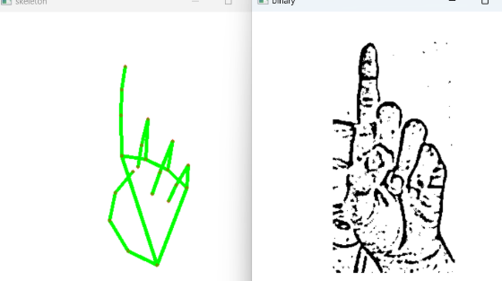
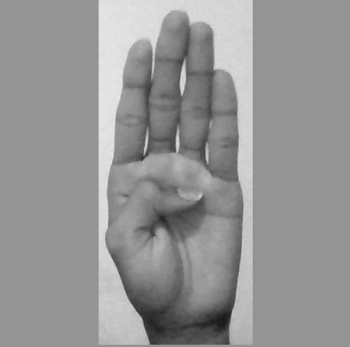
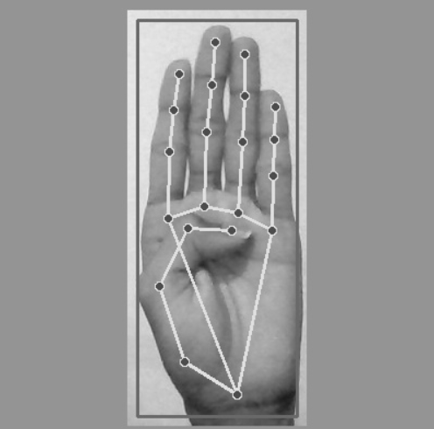
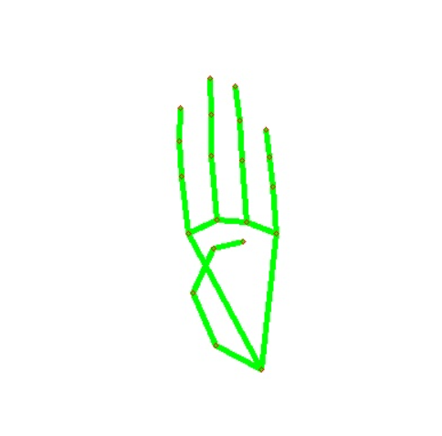
Output

Slide 14
Future Work and Conclusion
Future Works:
Enhanced Gesture Recognition: Improving accuracy using advanced ML models and deep learning algorithms, enables more complex gestures to be accurately interpreted.
Expanded Gesture Library: Increasing sign language gestures varities and incorporating regional or global sign languages makes system more versatile and accessible to a wider audience.
Real-Time Integration with Applications: Integrating the system with real-time applications, such as virtual classrooms or video conferencing platforms, enhances communication for the deaf community.
Conclusion:
The "IncludeEd" project creates an interactive platform for individuals with hearing impairments by translating hand gestures into visual representations. It highlights the potential of combining sign language with technology for greater accessibility. Enhancements in gesture detection can broaden its applications and help break communication barriers.

Slide 15
References
https://doi.org/10.1007/s10462-012-9356-9
https://doi.org/10.1109/TSMCC.2007.893280
https://www.ijecs.in/index.php/ijecs/article/view/2259
https://doi.org/10.1145/2070481.2070532
https://doi.org/10.1145/1897816.1897838

