Slide 1
OBJECT ORIENTED
ANALYSIS AND DESIGN
A study material for the students of GLS University

Slide 2
Session 1 — Why OOAD? Importance, Industry Relevance & Course Overview

Slide 3
Session Objectives
What is OOAD?
Why is this subject included in MSc IT?
How is OOAD used in the software industry?
Why do companies design software before coding?
What will they learn throughout the semester?
How does OOAD help in interviews and real projects?

Slide 4
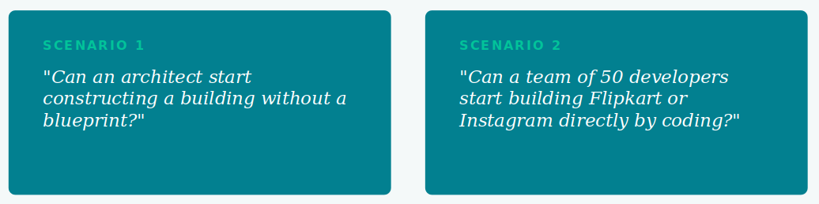
The Blueprint Analogy
Just as civil engineers create a blueprint before construction, software engineers create a design before development. OOAD is the process of creating that software blueprint.

Slide 5
Why Has This Subject Been Added in MSc IT?
Most students focus only on:
Programming Languages
Databases
Web Development
Mobile Apps
But in industry, coding is only one part of software development.
Companies need professionals who can:
Understand client requirements
Analyze business problems
Design software solutions
Communicate ideas with team members
Create documentation before coding
The purpose of this subject: “How to think like a Software Engineer rather than only a Programmer.”

Slide 6
Real Industry Problem
Client says: “I want a Student Feedback Management System.”
Immediately, questions arise:
Who will use it — students, faculty, admin?
What reports are required?
How is feedback stored?
Can feedback be edited?
Should login be required?
Without analysis → Result:
Confusion
Requirement changes
Bugs
Rework
Project delays
Industry solution — before coding:
1. Understand requirements
2. Analyze the system
3. Design the solution
4. Then start development

Slide 7
What Exactly Is OOAD?
OOAD is the process of understanding a problem and designing a software solution before writing code.
Analysis (Understanding) -
• What problem needs to be solved?
• Who are the users?
• What are the requirements?
Example: Online Food Delivery App
Analysis identifies: Customer · Restaurant · Delivery Partner · Admin
Design (Planning how the solution will work) -
Classes
Modules
Relationships
Workflows

Slide 8
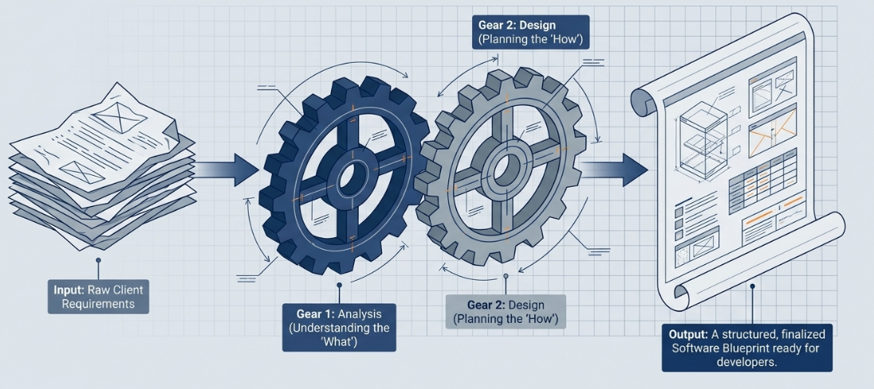
The engine of software architecture

Slide 9
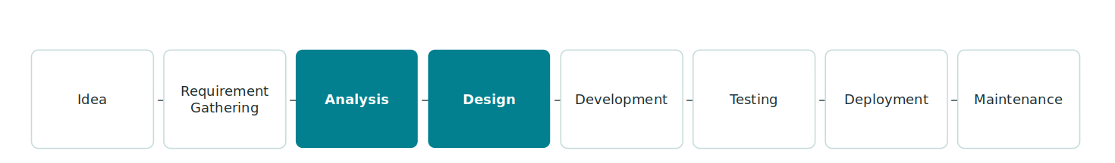
Where OOAD Fits in
Software Development
OOAD primarily focuses on the Analysis and Design phases — the critical steps before a single line of code is written. This is where requirements are clarified, system structure is planned, and potential problems are identified early.

Slide 10
Industry Importance of OOAD
Better Communication - Developers, testers, managers and clients understand the same design.
Reduces Errors - Problems are identified before coding starts.
Faster Development - design means less confusion.
Easier Maintenance - Future developers can understand the system.
Team Collaboration - Large teams can work on different modules efficiently.

Slide 11
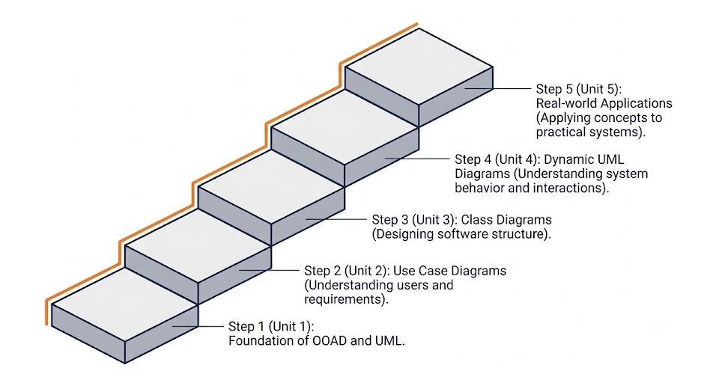
What We Will Learn in This Subject

Slide 12
How This Subject Helps
in Placements
Many interview questions are based on:
UML
use case
class diagram
inheritance
object oriented concepts
system design basics
Typical interview / design questions:
Design a Library Management System
Design an ATM System
Design an Online Shopping System
Design a Food Delivery App

Slide 13
Thank You

