Slide 1

“Share Your Feelings, Uplift Your Mood, and Connect with Yourself!”
Created By Team Hikers:
Harshita Gupta
Avika Goel
Fabeha Khalid

Slide 2
Using Open Innovation for Mental Health
Feel Well Embraces Open Innovation:
Collaborative Development
Integrates AI, psychology, and user feedback for enhanced mental health support.
User-Centered Approach
Personalized mood-based features for emotional well-being.
Technology & Well-being
AI-powered chat, speech analysis, and music recommendations for better mental health.

Slide 3

Mental Health
Mental health plays a crucial role in daily life, affecting emotions, decisions, and overall well-being. Mood swings can disrupt focus and productivity, making it essential to manage emotions effectively. FeelWell helps users understand and regulate their moods by offering mood-based song recommendations, a supportive chatbox, and interactive features designed to enhance emotional well-being. By integrating technology with mental health support, FeelWell aims to create a positive and comforting space for users to improve their mood and overall mental health.

Slide 4
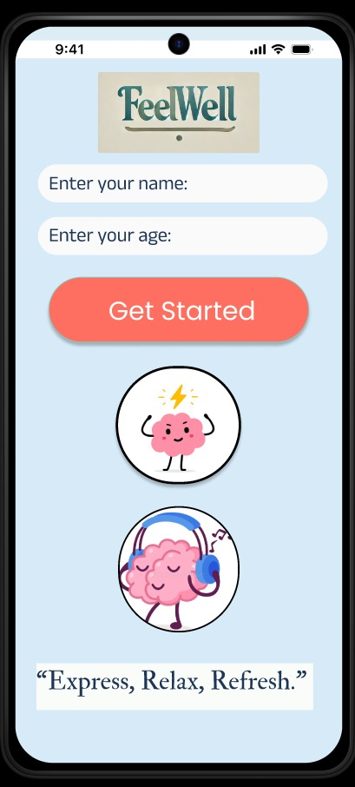
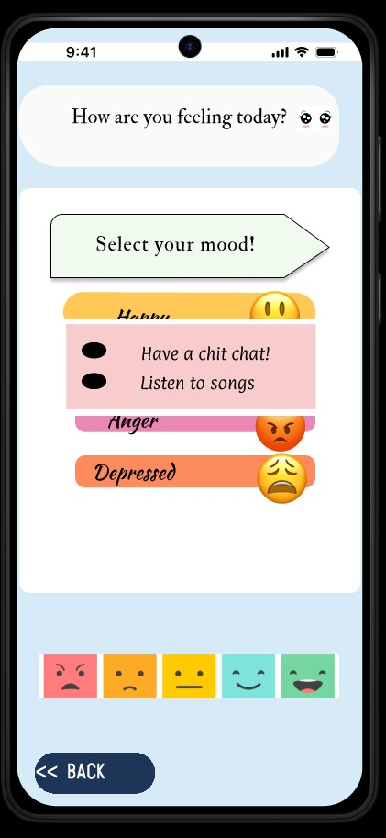
FeelWell – Your Emotional Well Being Companion
Mood-Based Song Recommendations
Our app suggests personalized songs based on the user’s selected mood, helping to uplift their spirits, relax, or provide comfort through music therapy.
Guided Exercises
FeelWell includes relaxation techniques, deep breathing exercises, and short workouts designed to reduce stress and promote mental well-being.
Chatbox for Different Moods
An AI-powered chatbox offers emotional support, listens to users, and helps them process their feelings, providing a safe space for self-expression and guidance.

Slide 5
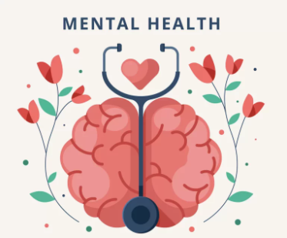

Upcoming Modifications of Our App
Our App already includes chat sessions and mood-based song playlists, which are great features. Here are some potential modifications and additions to enhance its impact:
1. Mood Tracker with Analytics
Allow users to log their daily emotions.
Show patterns with graphs to help them understand their triggers and progress.
2. Community & Peer Support
Introduce a safe, moderated forum for users to share experiences.
Option for anonymous posting to encourage open conversations.
3. Therapist Directory & Appointments
Provide an option to connect with professionals.
Integrate appointment booking with therapists.
4. Voice Interaction & Mood Detection
Let users talk instead of typing, using voice notes for mood tracking.
AI can analyze voice tone to detect emotional states and suggest suitable content.

Slide 6
Conclusion
Our mental health and well-being app is designed to provide a holistic support system for users by integrating personalized features such as mood-based song playlists, interactive chat sessions, and innovative relaxation techniques. By incorporating AI-driven support, mood tracking, guided mindfulness, and a strong community space, we aim to make mental wellness accessible and engaging.
Our goal is to create a safe, supportive, and effective digital companion that empowers individuals to manage their emotions, build resilience, and prioritize their mental well-being.

Slide 7
Thank You!

