Slide 1

Python
Raghu Prasad K S

Slide 2
Introduction
Raghu Prasad – BE, MS
Total of 23 years of experience
7 years as a lecturer in Engineering College
16 Years into IT
Worked with companies like CISCO,CSC,ICICI,First Apex – NTT Data
Currently into Corporate training and consultancy
Worked with corporates and public sector
Technologies – Java,Python,Web technologies,Java Script technologies (MEAN stack),IOT,Test Automation – Selenium,JMeter

Slide 3
Course Outline
Introduction to Python
Installation of Python and getting started with python
Introduction to IDE and Installation of Pycharm
Features of Python
Object Orientation
File Operations
Networked Programs
Using Webservices
Using Database and SQL

Slide 4
Objectives
Learn Python
Understand the usages of Python
Understand the applications built on Python
Understand the domains
Hands-on coding

Slide 5
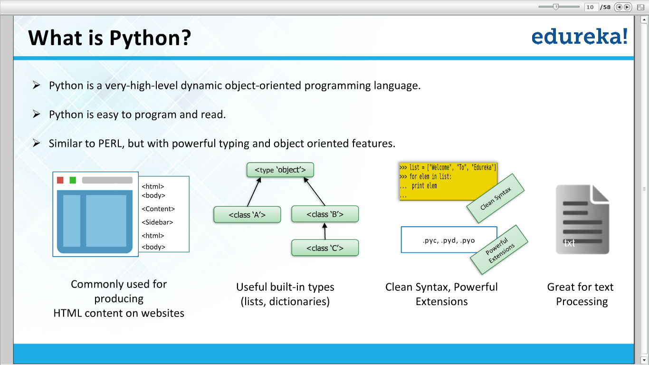

Slide 6
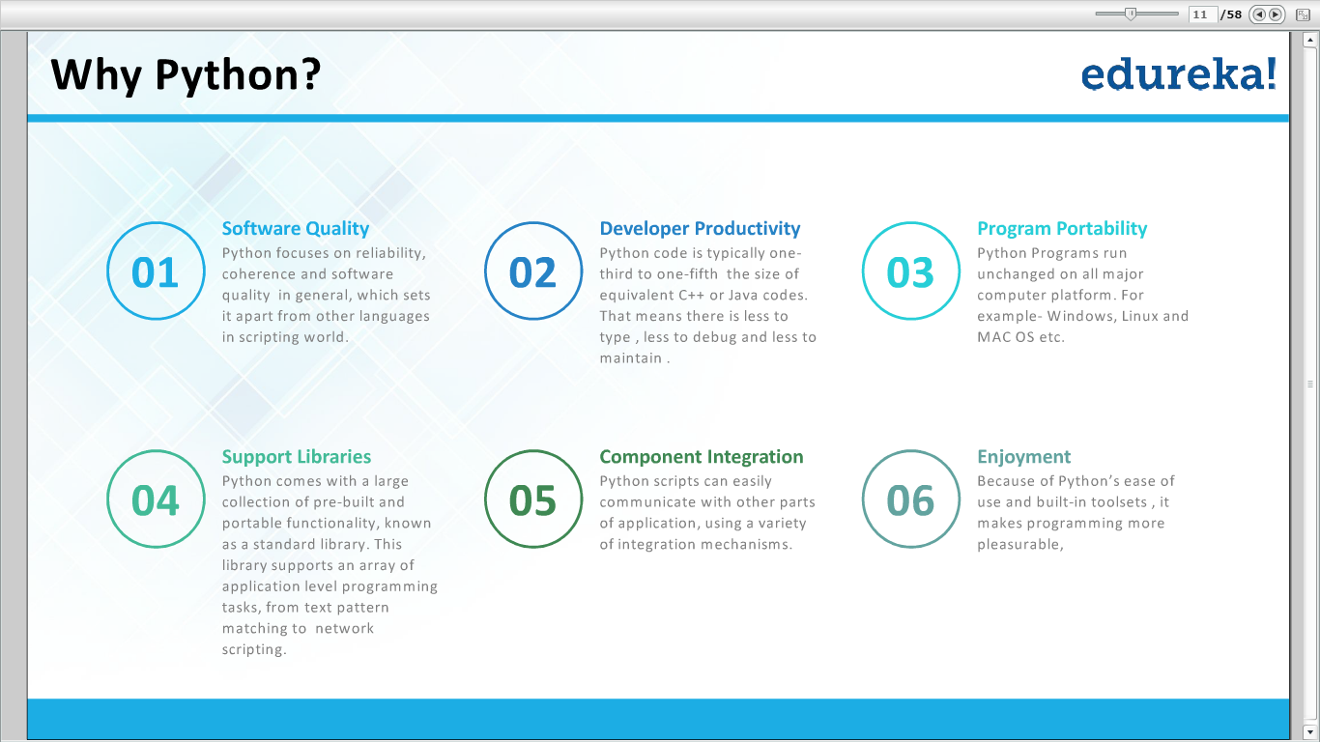

Slide 7
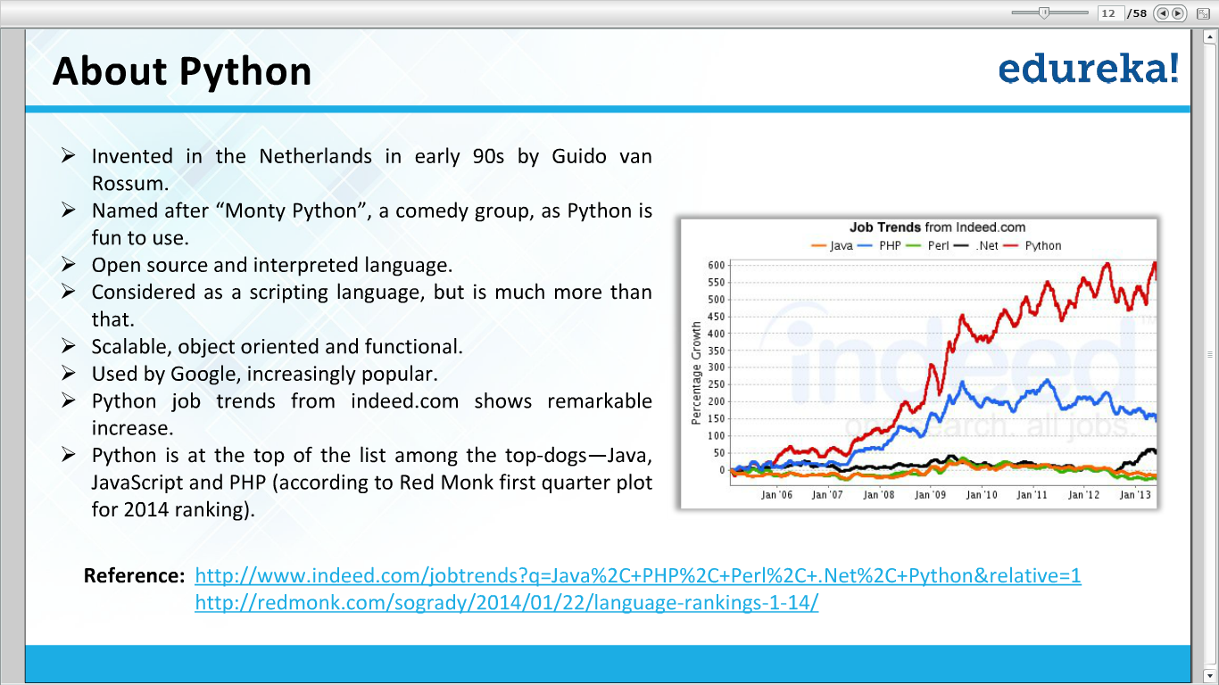

Slide 8
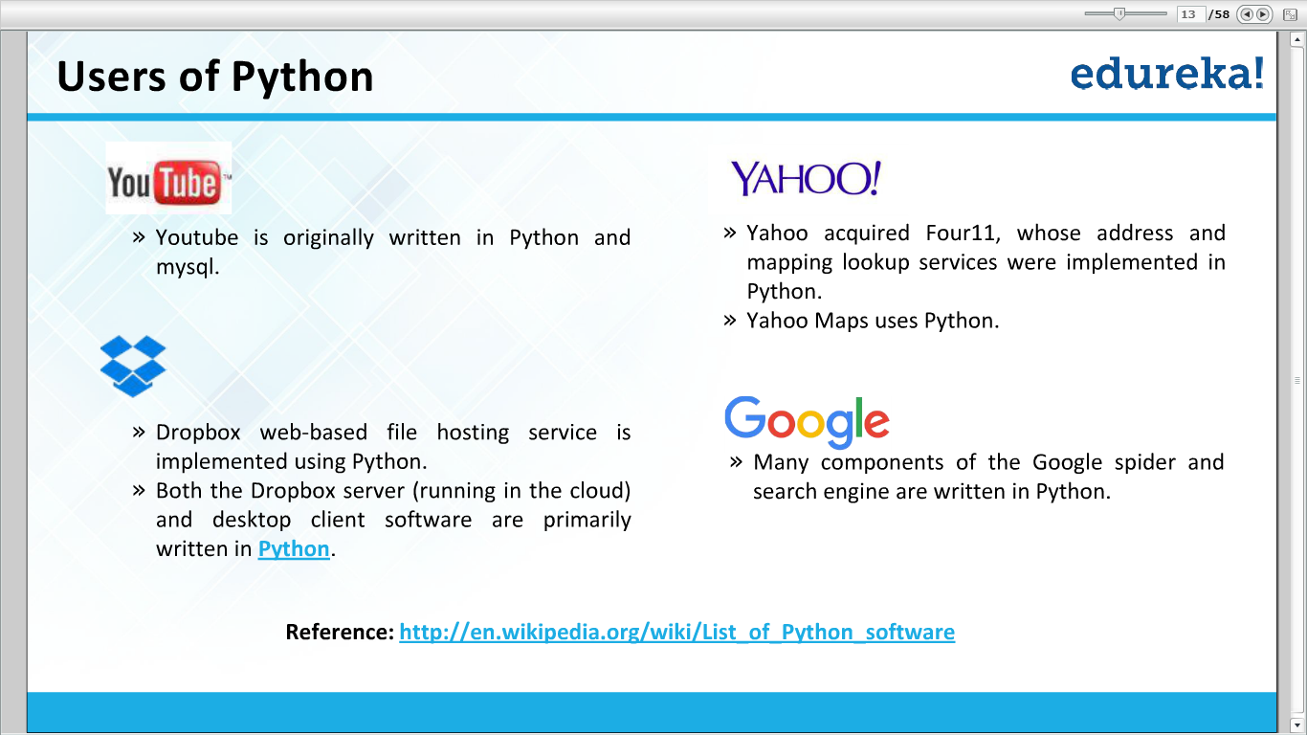

Slide 9
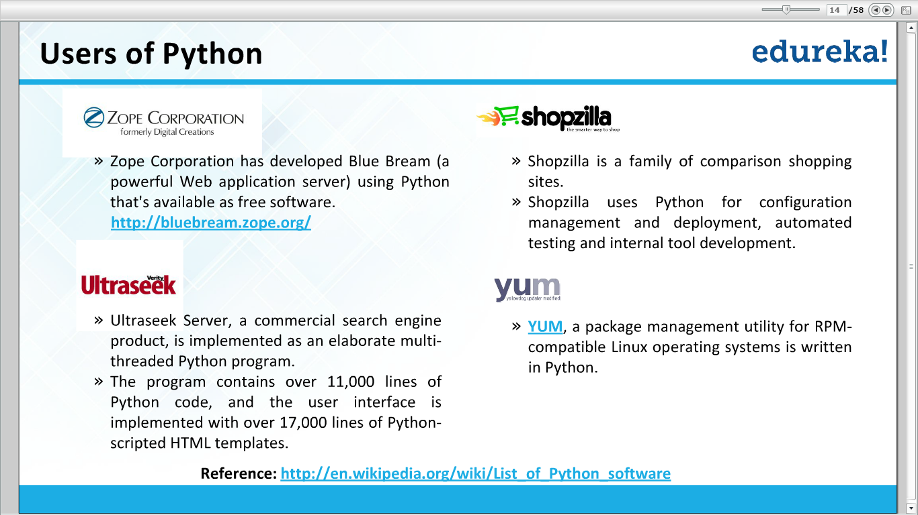

Slide 10
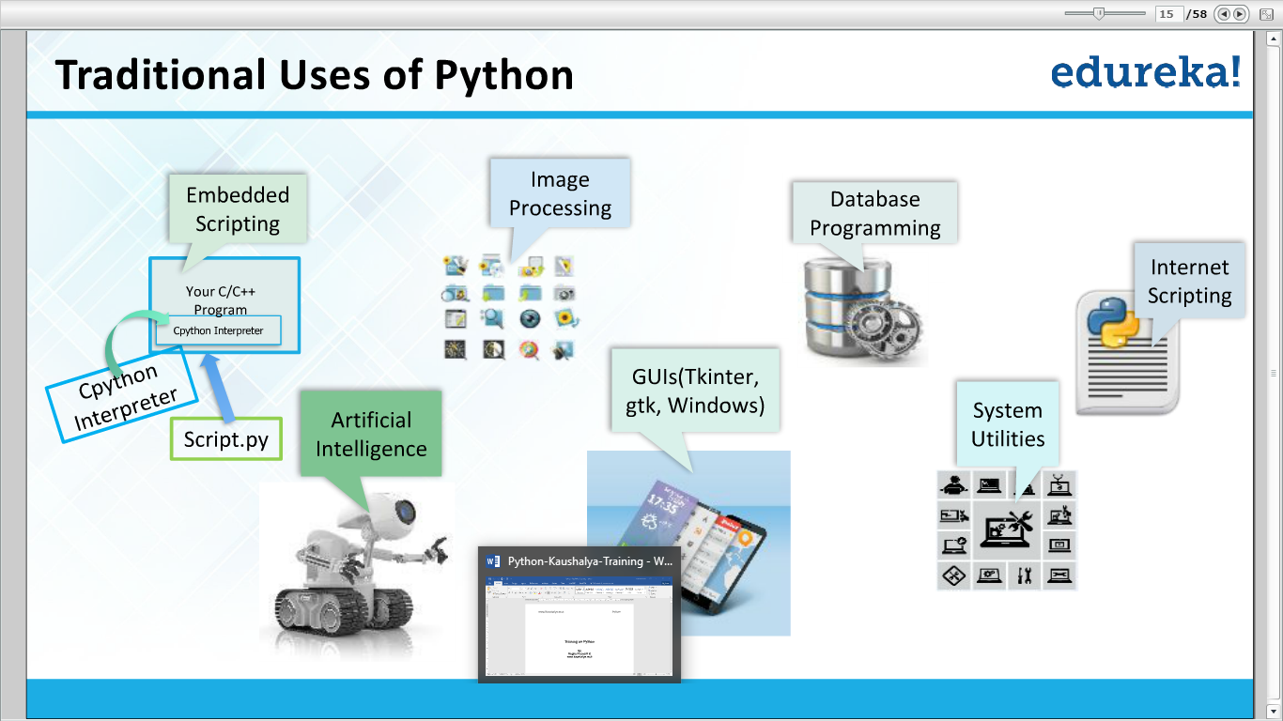

Slide 11
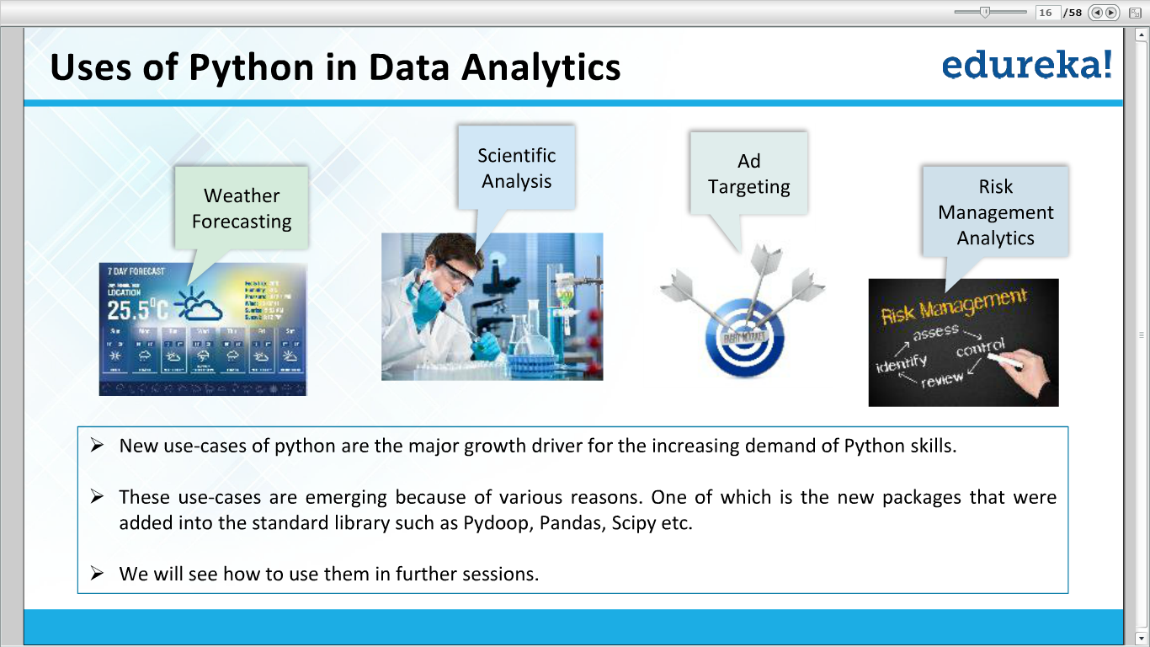

Slide 12
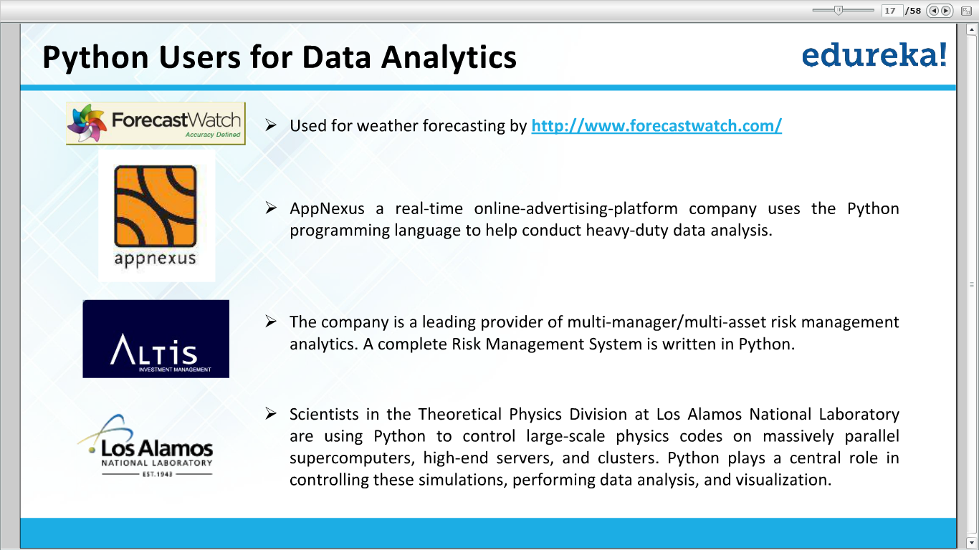

Slide 13
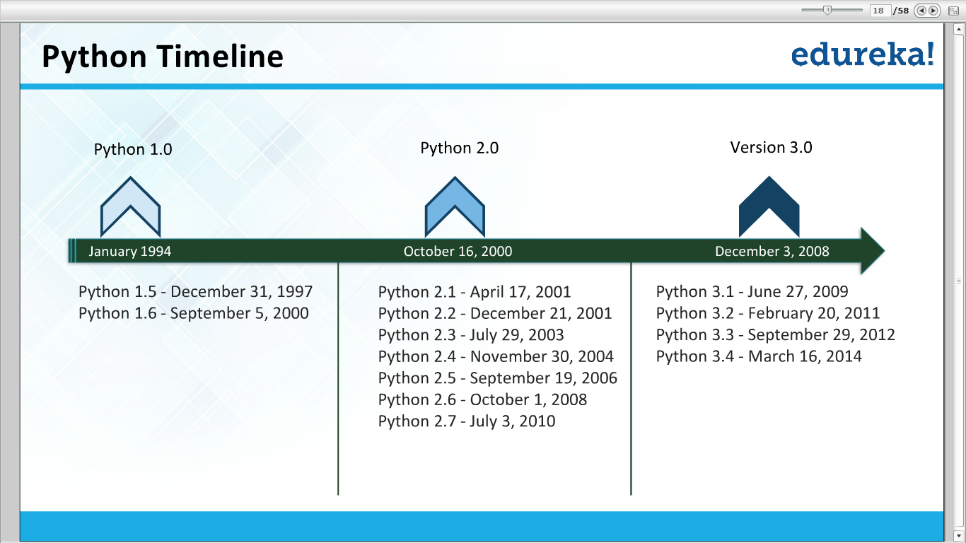

Slide 14
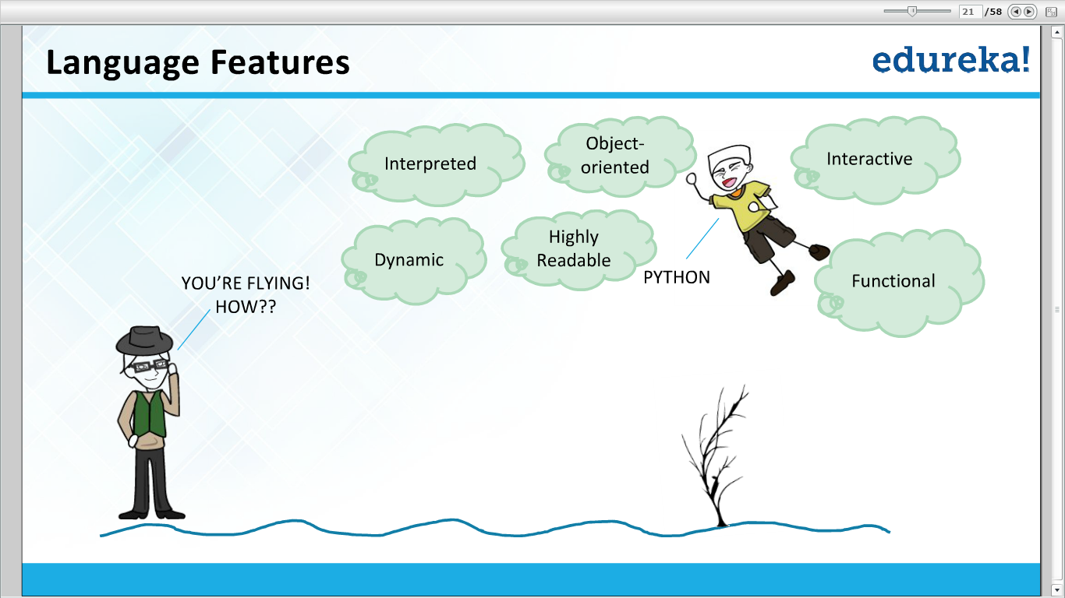

Slide 15
Thank You

