Slide 1
Project Title:
Digital Analytics- Analysis Deck
Domain:
E-Commerce

Slide 2
Understanding the Business Context
Business Context
The client is a newly launched e-commerce startup preparing for its next round of funding. As the business scales, leadership requires transparent and reliable insights into website traffic, customer behavior, product performance, and marketing efficiency.
Currently, performance data exists across multiple datasets but is not consolidated into a single analytics view. A centralized analytics solution is required to:
Track business growth
Evaluate marketing effectiveness
Assess product and customer quality
Support investor discussions with factual performance indicators

Slide 3
Formulating the Business Problem
Business Problem Statement
The organization lacks a centralized analytics framework to monitor end-to-end business performance. Although data is available, it is fragmented and not structured into actionable insights.
As a result:
Stakeholders struggle to identify growth trends
Funnel drop-offs and conversion inefficiencies are unclear
Marketing ROI cannot be accurately evaluated
Product and customer quality signals (refunds, repeat behavior) are difficult to track

Slide 4
Clarifying the Business Objectives
Business Objectives
The organization lacks a centralized analytics framework to monitor end-to-end business performance. Although data is available, it is fragmented and not structured into actionable insights.
As a result:
Stakeholders struggle to identify growth trends
Funnel drop-offs and conversion inefficiencies are unclear
Marketing ROI cannot be accurately evaluated
Product and customer quality signals (refunds, repeat behavior) are difficult to track

Slide 5
Identifying the Stakeholders & their Needs(1/2)
1. Cindy Sharp – CEO
The CEO is interested in overall business performance and long-term growth patterns. Her focus is on understanding where traffic is coming from, how free and paid channels contribute to growth, and whether the business shows clear seasonality and repeatable patterns. She closely monitors product-level sales, new product launch performance and cross-sell opportunities. Product refund rates are critical to ensure growth quality. These insights help her evaluate investment readiness and strategic direction.
Morgan Rockwell – Website Manager
The Website Manager is focused on how users interact with the website and convert. He is interested in traffic conversion rates, identifying top website and entry pages, and analyzing bounce rates to understand user engagement. He closely tracks landing page trends, and conversion funnel performance to identify drop-off points. Product pathing and product-level funnels help him optimize user journeys. His goal is continuous website optimization through data-driven decisions.
The CEO is interested in overall business performance and long-term growth patterns. Her focus is on understanding where traffic is coming from, how free and paid channels contribute to growth, and whether the business shows clear seasonality and repeatable patterns. She closely monitors product-level sales, new product launch performance and cross-sell opportunities. Product refund rates are critical to ensure growth quality. These insights help her evaluate investment readiness and strategic direction.
The Website Manager is focused on how users interact with the website and convert. He is interested in traffic conversion rates, identifying top website and entry pages, and analyzing bounce rates to understand user engagement. He closely tracks landing page trends, and conversion funnel performance to identify drop-off points. Product pathing and product-level funnels help him optimize user journeys. His goal is continuous website optimization through data-driven decisions.

Slide 6
Identifying the Stakeholders & their Needs(2/2)
3. Tom Parmesan – Marketing Director
The Marketing Director is interested in marketing efficiency and channel performance. His focus is on traffic source trends, performance of different traffic segments, and identifying which channels deliver high-quality users. He evaluates channel portfolios, compares channel characteristics, and uses bid optimization insights to allocate marketing budgets effectively. Tracking repeat visitors helps him assess customer quality and retention. These insights support optimizing marketing strategies while maximizing return on marketing spend.
The Marketing Director is interested in marketing efficiency and channel performance. His focus is on traffic source trends, performance of different traffic segments, and identifying which channels deliver high-quality users. He evaluates channel portfolios, compares channel characteristics, and uses bid optimization insights to allocate marketing budgets effectively. Tracking repeat visitors helps him assess customer quality and retention. These insights support optimizing marketing strategies while maximizing return on marketing spend.

Slide 7
Identifying the Stakeholders & their Needs(2/2)
3. Tom Parmesan – Marketing Director
The Marketing Director is interested in marketing efficiency and channel performance. His focus is on traffic source trends, performance of different traffic segments, and identifying which channels deliver high-quality users. He evaluates channel portfolios, compares channel characteristics, and uses bid optimization insights to allocate marketing budgets effectively. Tracking repeat visitors helps him assess customer quality and retention. These insights support optimizing marketing strategies while maximizing return on marketing spend.
The Marketing Director is interested in marketing efficiency and channel performance. His focus is on traffic source trends, performance of different traffic segments, and identifying which channels deliver high-quality users. He evaluates channel portfolios, compares channel characteristics, and uses bid optimization insights to allocate marketing budgets effectively. Tracking repeat visitors helps him assess customer quality and retention. These insights support optimizing marketing strategies while maximizing return on marketing spend.

Slide 8
Stakeholder Business Questions(1/7)
A. CEO – Business & Investor-Level Questions
(Cindy Sharp)
Overall Business Performance
Is Website traffic increasing over time?
Is Profit, revenue and order volume showing consistent growth?
Is there some seasonality patterns in traffic and sales?
Business performance variation by day of week and hour of day.
Traffic & Channel Health
Which traffic sources contribute the most to sessions and revenue?
What proportion of traffic comes from free vs paid channels?
Are free channels growing sustainably over time?

Slide 9
Stakeholder Business Questions(2/7)
A. CEO – Business & Investor-Level Questions (continued)
Product & Portfolio Performance
1.Which products generate the highest revenue and orders?
2.How concentrated is revenue across products?
3.New product launch has been contributing to incremental sales?
4.Which products are most frequently purchased as cross-sell items?
5.Is portfolio expansion improving overall revenue performance?
Business Quality & Risk
What are the refund rates at product level?
Is growth of revenue is coherent with acceptable refund rates over time?

Slide 10
Stakeholder Business Questions(3/7)
B. Website Manager – Website & Conversion Questions
(Morgan Rockwell)
Website Engagement
Which website pages receive the highest traffic?
Which pages act as top entry pages for users?
Which pages have the highest bounce rates?
Conversion Performance
What is the overall website conversion rate?
How does conversion rate vary by traffic source?
How does conversion differ between new and repeat sessions?
Funnel Analysis
Where do users drop off in the conversion funnel?
How effective is the journey from landing page to checkout?
Which funnel stages show the highest leakage?

Slide 11
Stakeholder Business Questions(4/7)
B. Website Manager – Website & Conversion Questions (continued)
Landing Page & Experiment Analysis
How do different landing pages perform over time?
What impact do landing page tests have on conversion?
How does /billing compare with /billing-2 in conversion performance?
Product Journey Optimization
How do users navigate between products before purchase?
Which products lead to additional product purchases?
At which stage do users drop off for specific products?

Slide 12
Stakeholder Business Questions(5/7)
C. Marketing Manager – Marketing & Channel Efficiency Questions
(Tom Parmesan)
Channel Performance
How is traffic distributed across marketing channels?
Which channels generate the highest conversion rates?
Which channels contribute the most revenue?
Channel Trends & Optimization
How are traffic sources trending over time?
Are some channels becoming more or less effective?
How does channel performance vary by segment?

Slide 13
Stakeholder Business Questions(6/7)
C. Marketing Manager – Marketing & Channel Efficiency Questions(continued)
Bid & Portfolio Optimization
Which paid channels deliver better quality traffic?
How should bid allocation be adjusted across channels?
Is the marketing channel portfolio balanced or over-dependent?
Customer Quality
Which channels bring repeat visitors?
How does repeat behavior differ by channel?
Are new vs repeat visitor patterns different across channels?

Slide 14
Stakeholder Business Questions(7/7)
D. New Product & Growth Story Questions
How does a new product perform after launch compared to existing products?
Does a new product cannibalize existing product sales or add incremental revenue?
How quickly does a new product start contributing to total revenue?
Are new products being adopted through cross-sell paths?

Slide 15
Mapping Business Questions to KPI’s(1/7)
A. CEO – Business & Investor-Level Questions → KPIs
Q1: Is overall business performance growing?
Mapped KPIs
Total Orders
Total Revenue
Total Sessions
Conversion Rate (%)
Q: Is overall business performance growing?
Mapped KPIs
Total Orders
Total Revenue
Total Sessions
Conversion Rate (%)
Q2: Is revenue growth sustainable and profitable?
Mapped KPIs
Total Revenue
Total Cost
Total Profit
Profit Margin (%)

Slide 16
Mapping Business Questions to KPI’s(2/7)
A. CEO – Business & Investor-Level Questions → KPIs(continued)
Q3: Are there seasonality and business patterns?
Mapped KPIs
Total Sessions (time-based)
Total Revenue (time-based)
Total Orders (time-based)
Revenue by Day of Week
Revenue by Hour of Day
Q: Is overall business performance growing?
Mapped KPIs
Total Orders
Total Revenue
Total Sessions
Conversion Rate (%)
Q4: Are new products performing well?
Mapped KPIs
Revenue by Product
Highest Revenue Product
Lowest Revenue Product
Revenue from New Products

Slide 17
Mapping Business Questions to KPI’s(3/7)
A. CEO – Business & Investor-Level Questions → KPIs(continued)
Q5: Is portfolio expansion improving overall revenue?
Mapped KPIs
Revenue by Product
Cross-sell revenue (via non-primary items)
Revenue contribution of new vs existing products
Orders containing multiple products
Q6: Are refunds increasing for specific products?
Mapped KPIs
Total Refund Amount
Refund Rate (%)
Refund Rate by Product
Refund Trend over Time
Q7: Is growth coming with acceptable quality signals?
Mapped KPIs
Refund Rate (%)
Repeat Sessions Rate (%)

Slide 18
Mapping Business Questions to KPI’s(4/7)
B. Website Manager – Website & Conversion Questions → KPIs
Q1: How is website traffic and engagement?
Mapped KPIs
Total Sessions
Total Pageviews
Bounce Rate (%)
Q2: How well is the website converting?
Mapped KPIs
Conversion Rate (%)
Average Revenue per Session
Average Order Value (AOV)
Q3: Which pages drive or lose users?
Mapped KPIs
Total Pageviews
Bounce Rate (%)
Bounce Rate by Page
Sessions by Landing Page

Slide 19
Mapping Business Questions to KPI’s(5/7)
B. Website Manager – Website & Conversion Questions → KPIs(continued)
Q4: How do landing pages perform (tests & trends)?
Mapped KPIs
Conversion Rate (%)
Revenue per Session
Conversion Rate by Landing Page
Revenue per Session by Landing Page
Landing Page Performance over Time
Q5: Where do users drop off in funnels?
Mapped KPIs
Conversion Rate (%)
Funnel Step Conversion Rates (Landing → Product → Cart → Billing → Order)
Q6: How do users move between products?
Mapped KPIs
Revenue by Product
Cross-sell indicators (non-primary items)
Product-to-Product Path Counts
% Orders with Add-on Products

Slide 20
Mapping Business Questions to KPI’s(6/7)
C. Marketing Manager – Marketing Questions → KPIs
Q1: How do channels perform?
Mapped KPIs
Source Rate (%)
Conversion Rate (%)
Average Revenue per Session
Q2: Which channels drive quality traffic?
Mapped KPIs
Conversion Rate by Source
Revenue per Session by Source
Q3: Is the channel mix balanced or risky?
Mapped KPIs
Source Rate (%)
Total Sessions by Source
Revenue Share by Source

Slide 21
Mapping Business Questions to KPI’s(7/7)
C. Marketing Manager – Marketing Questions → KPIs(continued)
Q4: How should bid allocation be adjusted?
Mapped KPIs
Conversion Rate by Source
Revenue per Session by Source
Q5: Are channels bringing repeat visitors?
Mapped KPIs
Repeat Visitors
Repeat Sessions Rate (%)
Average Days Between Sessions

Slide 22
Data Dictionary(1/8)
Overview
The analytics solution will be built using structured transactional and digital interaction data stored in a relational database. The data represents end-to-end user behavior starting from website sessions, page interactions, product views, orders, and post-purchase refunds.
All datasets are historical in nature and will be processed using batch-based analytics workflows.
Data Format: Structured relational tables (CSV Files)
Table Name | Data Type | Grain | Description
orders | Transactional | One record per order | Stores order-level transaction and revenue information
order_items | Transactional | One record per product per order | Captures item-level purchase details within orders
order_item_refunds | Transactional | One record per refunded item | Tracks refunds and post-purchase quality signals
products | Master | One record per product | Product master data including launch information
website_sessions | Behavioral | One record per session | Tracks website visits, acquisition source, and session attributes
website_pageviews | Behavioral | One record per pageview | Captures user navigation and clickstream behavior

Slide 23
Data Dictionary(2/8)
Primary & Foreign Key Relationships
orders.order_id → Primary key for order-level analysis
order_items.order_id → Foreign key linking items to orders
order_item_refunds.order_item_id → Foreign key linking refunds to order items
products.product_id → Foreign key in order_items
website_sessions.website_session_id → Primary key for session analysis
orders.website_session_id → Links sessions to conversions
website_pageviews.website_session_id → Links pageviews to sessions
These relationships enable creation of integrated analytical views such as Order_360, Product_360, Customer_360, Website_360, and Channel_360 tables.

Slide 24
Data Dictionary(3/8)
1. Orders Table: Captures order-level transaction and profitability information
Column Name | Meaning | Analytical Use
order_id | Unique identifier for each order | Primary key; joins with order_items and refunds
created_at | Timestamp when order was placed | Time-series analysis, seasonality
website_session_id | Session that led to the order | Session-to-order conversion analysis
user_id | Unique customer identifier | Customer-level aggregation, repeat behavior
primary_product_id | Main product purchased in the order | Entry product analysis
items_purchased | Total number of items in the order | Cross-sell and basket size analysis
price_usd | Total order revenue | Revenue, AOV, growth analysis
cogs_usd | Cost of goods sold for the order | Profit and margin analysis

Slide 25
Data Dictionary(4/8)
2. Order Items Table: Captures item-level purchase behaviour.
Column Name | Meaning | Analytical Use
order_item_id | Unique identifier for order line item | Primary key
created_at | Timestamp of item purchase | Item-level trend analysis
order_id | Associated order identifier | Join to orders
product_id | Product purchased | Product-level performance
is_primary_item | Flag indicating main product in order | Entry vs add-on analysis
price_usd | Revenue for the item | Product revenue contribution
cogs_usd | Cost of item | Product-level profitability

Slide 26
Data Dictionary(5/8)
3. Order Item Refunds Table: Tracks refunds and quality signals
Column Name | Meaning | Analytical Use
order_item_refund_id | Unique refund identifier | Primary key
created_at | Timestamp of refund | Refund trend analysis
order_item_id | Refunded order item | Join to order_items
order_id | Associated order | Order-level quality analysis
refund_amount_usd | Amount refunded | Refund rate, revenue quality

Slide 27
Data Dictionary(6/8)
4. ProductsTable: Product master data
Column Name | Meaning | Analytical Use
order_item_refund_id | Unique refund identifier | Primary key
created_at | Timestamp of refund | Refund trend analysis
order_item_id | Refunded order item | Join to order_items
order_id | Associated order | Order-level quality analysis
refund_amount_usd | Amount refunded | Refund rate, revenue quality

Slide 28
Data Dictionary(7/8)
5. Website Sessions Table: Tracks acquisition, engagement, and session quality
Column Name | Meaning | Analytical Use
website_session_id | Unique session identifier | Join with pageviews and orders
created_at | Session start time | Traffic trend analysis
user_id | Visitor identifier | New vs repeat analysis
is_repeat_session | Flag for repeat visitor | Retention & loyalty
utm_source | Marketing traffic source | Channel performance
utm_campaign | Campaign identifier | Campaign effectiveness
utm_content | Creative or ad content | Creative-level analysis
device_type | Device used (desktop/mobile) | UX & device performance
http_referer | Referring website | Organic/referral analysis

Slide 29
Data Dictionary(8/8)
6. Website Pageviews Table: Tracks user navigation and content interaction
Column Name | Meaning | Analytical Use
website_pageview_id | Unique pageview identifier | Primary key
created_at | Pageview timestamp | Clickstream sequencing
website_session_id | Associated session | Funnel & path analysis
pageview_url | URL visited | Entry pages, drop-off analysis

Slide 30
Technology Stack Details
Layer | Tools | Justification
Data Storage | SQL Server | Relational integrity, scalability
Data Processing | SQL, Python | KPI creation, Analysis, Validation
Visualization | Power BI | Interactive dashboards, investor-grade visuals
Deployment | Streamlit / Render | Web-based access to insights
Version Control | GitHub | Code collaboration

Slide 31
Data Aggregation at Various Levels(1/5)
Order_360 Table
Purpose
To understand transaction-level performance and purchase behavior.
Revenue & profitability analysis
Revenue, cost, and profit per order
Profitability distribution across orders
Time-to-order analysis (speed of conversion)
Product purchase behavior
Primary vs add-on product analysis
Cross-sell patterns (multi-product orders)
Product combinations frequently bought together
Refund & quality analysis
Refund frequency per order
Product-level refund behavior
Relationship between cross-sell and refunds
Channel attribution (order quality)
Profitability by acquisition channel
Refunds by channel
High-value vs low-value orders by channel

Slide 32
Data Aggregation at Various Levels(2/5)
Website_360 Table
Purpose
To understand how users arrive on the website and behave before converting.
Traffic & acquisition analysis
Free vs paid traffic analysis
Channel-wise session trends
New vs repeat session behaviour
Landing page analysis
Landing page performance comparison
Landing page trends over time
Bounce rate analysis by page
Funnel analysis
Product → Cart → Checkout → Order funnel
Drop-off points in the website journey
Funnel comparison by channel or device
Conversion behaviour
Session-to-order conversion rate
Conversion rate by traffic source
Conversion differences between new vs repeat sessions

Slide 33
Data Aggregation at Various Levels(3/5)
Channel_360 Table
Purpose
To evaluate marketing performance and channel portfolio risk.
Channel performance comparison
Sessions, orders, and revenue by channel
Conversion rate comparison across channels
Revenue per session by channel
Channel quality & efficiency
Repeat session rate by channel
Refund rate by channel
High-value channel identification
Portfolio risk analysis
Traffic share by channel
Revenue share by channel
Dependency on a single channel
Budget optimization
Identify channels to scale up
Identify underperforming channels

Slide 34
Data Aggregation at Various Levels(4/5)
Products_360 Table
Purpose
To evaluate product performance, portfolio strength, and scalability.
Product performance analysis
Revenue and profit by product
Units sold and order contribution
Top and bottom performing products
New product launch analysis
Time to first sale
Revenue contribution of new products
Adoption speed of new products
Cross-sell & portfolio analysis
Products frequently bought as add-ons
Products acting as entry vs add-on items
Portfolio expansion impact on revenue
Quality & risk analysis
Refund rate by product
High-refund products identification
Quality comparison between new vs existing products

Slide 35
Data Aggregation at Various Levels(5/5)
Customer_360 Table
Purpose
To understand customer value, loyalty, and long-term sustainability of growth.
Customer lifecycle analysis
First-time vs repeat customer behavior
Customer lifetime duration
Frequency of purchases
Value & profitability analysis
Revenue and profit per customer
High-value vs low-value customers
Average order value by customer type
Loyalty & stickiness
Repeat purchase rates
Orders per customer
Cross-sell adoption at customer level
Quality & risk analysis
Refund-prone customers
Refund concentration among customers
Relationship between refunds and customer value

Slide 36
CEO- Executive Business Overview Dashboard Layout
Image and title
KPI’s: 1. Total Orders 2. Total Revenue 3. Total Profit 4. Profit Margin 5. Refund Rate
Slicers:
Year
2. Month
3. Day type
4. Session Type
5. Campaign
Column Chart; Total Orders by Year
Line Chart: Total revenue and Profit margin by month
Pie Chart: Total Orders by Products
Column Chart: Total Revenue vs Total Profit by Product
Bar Chart: Total Revenue by Day of week

Slide 37
CEO- Product & Profitability Strategy Dashboard Layout
Image and title
KPI’s: 1. Total Cost 2. Average Order Value 3. Total refunds 4. Refund Item cost
Slicers:
Year
2. Month
3. Day type
4. Session Type
5. Campaign
Line Chart: Profit Margin by month over products
Pie Chart: Primary items distribution among Products
Bar Chart: Refund Rate by Products
Column Chart: Refund Rate of Primary and Non-Primary Products
Stacked Column Chart: Product Launch Sales Analysis

Slide 38
Website Manager- Website Performance Dashboard
Image and title
KPI’s: 1. Total Sessions 2. Repeat Sessions 3. New Sessions 4. Revenue per session
Slicers:
Year
2. Month
3. Day type
4. Session Type
5. Campaign
Area Chart: Total Sessions by months
Donut Chart: Conversion rate by Device Type
Bar Chart: Refund Rate by Products
Column Chart: Refund Rate of Primary and Non-Primary Products
Stacked Column Chart: Product Launch Sales Analysis

Slide 39
Website Manager - Conversion Funnel and Drop off Analysis Dashboard
Image and title
KPI’s: 1. Total Sessions 2. Bounce Rate 3. Conversion rate 4. Total bounced sessions 5. Total pages viewed
Slicers:
Year
2. Month
3. Day type
4. Session Type
5. Product Name
6.Pageview Url
Line Chart: Conversion rate by months
Bar Chart: Top landing pages by sessions
Column Chart: Session by page type
Bar Chart: Conversion Rate by Landing Page
Funnel Chart: Bounce Rate by Landing page

Slide 40
Marketing Manager – Traffic and Channel Performance Dashboard
Image and title
KPI’s: 1. Repeat Visitors 2. repeat session 3.Total Channels 4. Repeat session rate
Slicers:
Year
2. Month
3. Day type
4. Campaign
5. Channel
Line Chart: Total sessions by month rate and channel
Donut Chart: Repeat Visitors by Channel
Bar Chart: Conversion rate by Channel
Funnel Chart: Conversion Rate by utm_source
Clustered column Chart: Traffic source segment trending

Slide 41
Marketing Manager – Customer Retention Analysis Dashboard
Image and title
KPI’s: 1. Avg Days from first session 2. Free Revenue 3.Paid Channel Revenue 4. Repeat session rate
Slicers:
Year
2. Month
3. Day type
4. Campaign
5. Channel
Line Chart: Repeat sessions trend by month
Bar Chart: Repeat sessions by days since first session
Bar Chart: Repeat Revenue by Channel type
Funnel Chart: Repeat session by product
Column Chart: Repeat session by Channel

Slide 42
EXPLORATORY DATA ANALYSIS
Total Orders
Total Profit
Gross Revenue
Net Revenue
32,313
$1,162,780($1.16M)
$1,938,509 ($1.94 M)
$1,853,171($1.85M)
Total Gross Cost
Net Total Cost
Total Units Sold
Units Returned
$7,22370($0.72M)
$690,391($0.69M)
40,025
1,731
Total Refund Amount
Total Customers
$ 85,338
31,696

Slide 43
EXPLORATORY DATA ANALYSIS
Average Order Value
Average Customer Revenue
Average Items per Order
$ 59.99
$ 61.16
1.24
Profit per Customer
Profit Percentage
Average Sessions per user
$ 36.69
168.42%
1.19
Average Gross Revenue per Session
Bounce Rate
Conversion Rate
$ 4.099
44.76%
6.83%
Free Channel Revenue
Paid Channel Revenue
$ 371,433
$ 1,567,077($1.57 M)

Slide 44
EXPLORATORY DATA ANALYSIS
Total Sessions
Total Pageviews
Total Visitors
472,871
1,188,124
394,318
One-time Visitors
Repeat Visitors
Bestseller
343,048
51,270
Original Mr. Fuzzy
One-time Buyers
Repeat Buyers
Best Ordered Channel
31,105
591
Paid Search Channel

Slide 45
Revenue & Orders Growth and Seasonality Trends

Slide 46
Revenue & Orders Growth and Seasonality Trends
Overall Performance Trend
Revenue & Orders shows a consistent year-on-year upward trajectory.
Sustained Growth observed across all years from 2012 which indicates strong long-term demand expansion
Month 6 -----> Growth Inflection Month
Month 6 is the growth inflection point in the annual cycle .
From this month onwards there is constant acceleration in Orders & Revenue begin.
Indicates transition from steady growth to high momentum.
Month 3 -----> Seasonal Dip
Month 3 (March) there is consistently shows a seasonal decline in orders & revenue across years.
Pattern suggest recurring softness in demand in this month.
This is the lowest point in yearly cycle.
Month 11,12 -----> Peak Months
Month 11,12 represent the peak sales period.
Orders & Revenue reach their highest level during these periods
These month indicates a strong seasonal demand concentration in these months

Slide 47
Revenue & Orders Growth and Seasonality Trends
Recommendations
Strategy to Address March Demand Decline
Introduce bundle pricing & discounts to incentives to increase the demand in this month.
Run-off marketing campaigns to stimulate marketing campaigns.
Re-engaging with existing customer through CRM /email campaigns.
Launch a dedicated March sales event (e.g., Spring or Year-End Sale) to stimulate demand during the seasonal low period.
Strategy to Optimize Sales Peak Months
Leverage Peak Months to strengthening customer loyalty and lifetime value.
Offers loyalty points or cash-backs during these months to encourage repeat visits .
Sends follow-up actions after the peak month.
Provide next order discounts valid Jan – Mar.
Encourage second purchase withing 30-60 days.

Slide 48
Quarterly Business Performance

Slide 49
Quarterly Business Performance
Observations
Q4 demonstrates the strongest performance across all key metrics — including volume of items sold, revenue, and profits.
The consistent upward trend in Q4 indicates strong market demand and effective sales performance during this period.
Q1 shows the lowest performance compared to other quarters in terms of sales volume, revenue, and profitability.
The comparison clearly highlights a seasonal or cyclical pattern, with Q4 leading across all metrics while Q1 remains the weakest quarter.

Slide 50
Quarterly Year –Over-Year Change Analysis
Profit shows a sharp spike in 2013 across all quarters, followed by continued but moderating growth during 2014 –2015.
Post-2013, profit continues to increase, but at a slower and more stable growth rate, indicating normalization after the initial expansion phase.

Slide 51
Customer Purchase Frequency: Overall and Monthly

Slide 52
Customer Purchase Frequency: Overall and Monthly
Observations
Overall, one-time customers account for about 98% of the customer base, while repeat customers contribute only around 2%.
The repeat rate is approximately 1.86%.
Months 1–2 have the highest repeat customer presence.
Months 11–12 attract the most new customers.
Month 4 attracts the fewest customers, contributing to lower revenue due to weaker traffic.
This very low repeat rate indicates the business is largely driven by one-time purchasers, raising concerns about long-term retention.
Month 6 has the lowest repeat customer count, after which new customer acquisition begins to dominate.

Slide 53
Customer Base Composition: New vs Existing

Slide 54
Customer Base Composition: New vs Existing
Observations
Existing Customer are those customer which are in the business with more than 30 days of there customer lifetime.
New Customer are those customer whose customer lifetime is less than or equal to 30 days.
Overall , Existing customer are around only 1% which depicts that customer are not retaining more than 30 days in business & New customers are 99%.
Month 1,2 having highest existing customer .
Month 11,12 are the customer acquisition month where new customer are more.
Month 9 there is a sudden increase in existing customer.
Month 4 having lowest new customer acquisition that depicts the sales are done in this month by existing customers .
Month 6 having lowest existing customers.

Slide 55
Customer Acquisition vs Retention: Key Improvement Areas
Recommendations
The repeat rate is extremely low (~1.84%), indicating a need to strengthen customer retention through loyalty programs, targeted discounts, and reward incentives to encourage repeat purchases.
Months 1, 2, 9, 11, and 12 show relatively higher repeat activity; targeted retention campaigns during these periods can help convert engaged customers into long-term buyers.
Month 12 has the highest one-time customers; cross-sell and post-purchase engagement strategies should be deployed to convert these new buyers into repeat customers in subsequent months.
Month 6 shows a dip in repeat customers, indicating reliance on one-time buyers; seasonal campaigns and remarketing efforts are recommended to stabilize repeat behavior during this period.
Months 3–4 show declines in both one-time and repeat customers, suggesting seasonal slowdown; promotional or acquisition campaigns may help mitigate this dip.

Slide 56
Monthly Conversion Rates & Session Counts

Slide 57
Monthly Conversion Rates & Session Counts
Month of 2 (February) having the Highest Conversion Rates.
In month of Nov , Dec(11,12) having the highest session counts but less conversion rates as compare to month 2 where
Session counts are comparatively low.
Month 11,12 having more session counts than conversion which means more customer are just engaging in scrolling not buying .
Month 4 having lowest session counts and Conversion rates which is the reason decrease in revenue in that month
Compare to other months.
Month 2 having higher conversion rate as the repeat customers are also high there so mostly the customer who are making purchase are the existing one and making repeat purchases.
Month 11,12 attracting new customer and these months are helping in increase on traffic on websites
Month 11–12:more visitors , browsing heavy , lower intent %.
Month 2:fewer visitors , targeted/returning , higher intent %.

Slide 58
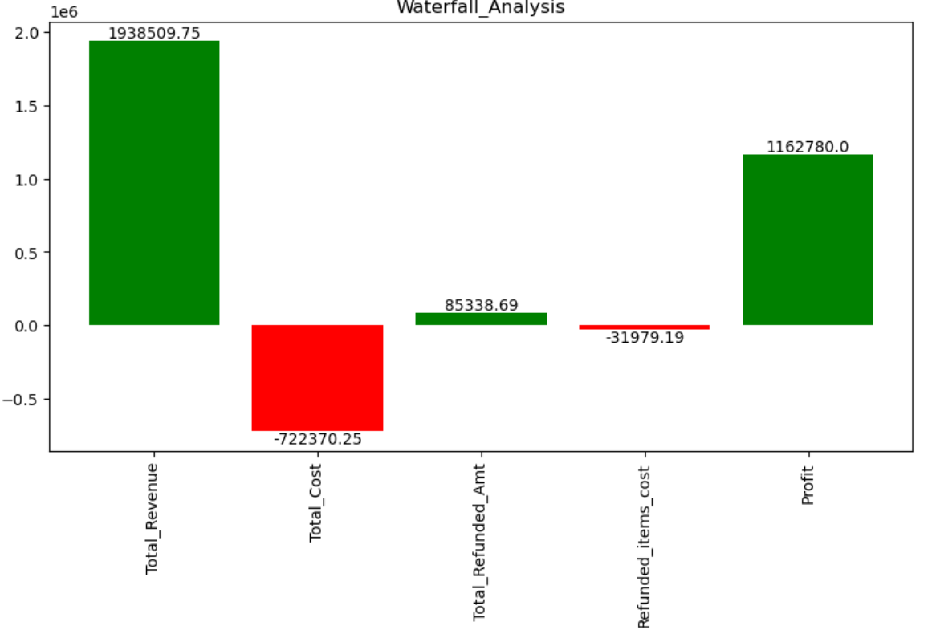
Revenue to Profit Bridge
Revenue, Cost, Refunds, and Profit Waterfall
The waterfall illustrates the key drivers contributing to the change from the starting value to the final outcome.
This shows how the revenue gets beaked down and at last we get the profit

Slide 59
Sales Driver: Purchase Volume
Relationship Between No items purchased & Revenue
Relationship Between No items purchased & Revenue
There is a very strong positive correlation (0.92) between number of items purchased and revenue, indicating that revenue growth is primarily driven by higher purchase volume.
As customers buy more items per order, overall revenue increases.
 | No items purchased | Revenue
No items purchased | 1.000000 | 0.920044
Revenue | 0.920044 | 1.000000

Slide 60
Impact of Price on Order Frequency
Relationship Between Total Orders vs Price
There is a very low correlation (0.011) between number of total orders and price, indicating that price are not a driver for orders .
This implies that factors other than price — such as product need, assortment, or customer intent — are the primary drivers of order frequency..
Correlation: Median Price vs Total Orders per Customer
 | Total Orders | Price
Total Orders | 1.000000 | 0.011
Price | 0.011 | 1.000000

Slide 61
Revenue Growth Strategy: Volume-Led Approach
Recommendations
Focus on increasing basket size through:
Cross-sell & upsell strategies
Product bundling
Personalized product recommendations
Optimize product assortment based on past purchase behavior.
Avoid heavy discounting, as price is not a key demand driver.
•Introduce premium options since customers are not price sensitive.

Slide 62
Relation of Orders count & Conversion Rates By Time Buckets

Slide 63
Relation of Orders count & Conversion Rates By Time Buckets
Observations
Orders are highest in afternoon about 33% and least at night 10%.
Although the Traffic is high in afternoon as well as most order are lie in afternoon but in case of conversion
Rates by sessions is stable which means there is no dramatic demand is time concentrated not urgency driven.
Buying intent is same across day .
Since buying intent does not significantly vary by time, increased afternoon sales are likely driven by higher customer presence rather than urgency-based purchasing.

Slide 64
Relation of Orders count & Conversion Rates By Time Buckets
Recommendations
Leverage high afternoon activity by implementing cross-sell and upsell strategies to increase basket size.
Introduce loyalty incentives during peak hours to convert first-time buyers into repeat customers.
Deploy personalized follow-ups (email/push notifications) post-purchase to improve retention.

Slide 65
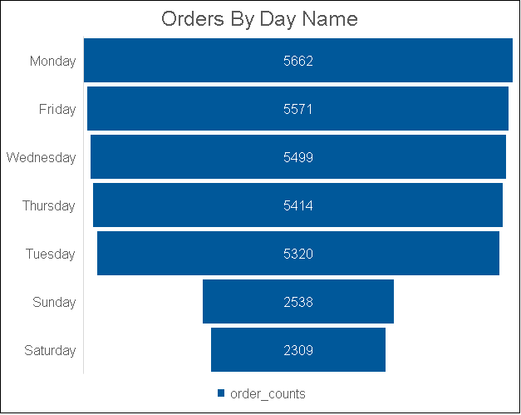
Order Distribution by Day of Week (Weekday vs Weekend)

Slide 66
Order Distribution by Day of Week (Weekday vs Weekend)
Observations
85% of total orders occur on weekdays, while only 15% occur on weekends.
Lower weekend orders suggest comparatively lower customer activity during weekends.
Monday records the highest order volume, whereas Saturday has the lowest.
Recommendations
Introduce weekend-specific promotions (e.g., “Weekend Specials” or limited-time offers).
Launch targeted marketing campaigns during weekends to increase engagement.
Offer exclusive weekend discounts or bundled deals to drive traffic and conversions.
Consider loyalty incentives for weekend purchases to balance weekly demand.

Slide 67
Hourly Order Distribution

Slide 68
Hourly Order Distribution
Observations
Hourly order volume peaks at 11:00 AM and 3:00 PM, indicating strong customer activity during late morning and mid-afternoon hours.
• Order volume gradually increases from morning hours, reaches peak in the afternoon, and then declines toward late evening.
• The lowest number of orders is recorded at 00:00 (midnight), reflecting minimal customer activity during late-night hours.
• The concentration of orders during business hours suggests purchases are more convenience-driven rather than urgency-driven.
• This pattern aligns with earlier time-bin analysis, confirming that afternoon hours contribute significantly to overall daily sales.

Slide 69
Orders & Revenue Distribution By Device Type

Slide 70
Orders & Revenue Distribution By Device Type
Observations
The sessions are being largely dominated by Desktop users compared to mobile users
The orders from desktop is high as compare to mobile users
85% of revenue is contributed by desktop alone and remaining with Mobile users.
The average price per order is nearly identical across desktop and mobile devices.
The difference (~$0.60) is minimal and does not indicate any significant pricing variation by device type.

Slide 71
Relation Between Device Type Based on Users Count & Conversion Rates

Slide 72
Relation Between Device Type Based on Users Count & Conversion Rates
Observations
Around 60% of customers start their journey on desktop and later shift to mobile, while 40% begin on mobile and move to desktop.
This suggests that desktop is primarily used for product exploration and browsing.
However, the conversion rate from mobile to desktop (54%) is higher compared to desktop to mobile (46%).
This indicates that customers who initiate their journey on mobile demonstrate slightly stronger purchase intent and are more likely to convert.
Overall, customer behavior reflects a multi-device journey where exploration and final purchase may occur across different platforms.

Slide 73
Relation Between Device Type Based on Users Count & Conversion Rates
Recommendations
Improve Cross-Device Continuity
Ensure seamless cart synchronization across devices.
Enable persistent login & saved carts across desktop and mobile.
Improve Mobile Conversion Experience
Since mobile users demonstrate higher conversion efficiency so it is better to optimize UX optimizations.
Simplify checkout process in mobile.
Smart Retargeting
If someone viewed the products on desktop but did not go for purchase trigger personalized mobile push notifications.

Slide 74
Channel Contribution Analysis

Slide 75
Channel Contribution Analysis
Observations
The business is largely dominated by paid channels across all key metrics — sessions, orders, and revenue.
Approximately 80% of total revenue is generated through paid channels, while only 20% comes from free (organic) channels , Direct Channels.
Around 82.3% of total website sessions are driven by paid channels, compared to 17.6% from free channels.
Consequently, 81.1% of total orders originate from paid channels, whereas free channels contribute approximately 18.9%.
The near alignment between paid session share and paid order share suggests that order contribution is primarily volume-driven rather than higher efficiency.

Slide 76
Channel Performance & Conversion Analysis

Slide 77
Channel Performance & Conversion Analysis
Observations
The business is highly dependent on paid channels, contributing approximately 84.7% of total traffic, while free channels account for only 15.3%.
Paid channels dominate in terms of sessions, orders, and revenue, primarily due to higher traffic acquisition.
However, the conversion rate of organic (free) channels is higher compared to paid search.
This suggests that paid channels are effective in driving awareness and scale, whereas organic channels attract customers with stronger purchase intent.
Customers may interact with multiple channels before conversion, indicating a multi-touch journey (e.g., influenced by paid, converted via organic).
While paid channels drive volume, free channels demonstrate greater efficiency in converting traffic into orders.

Slide 78
Cross-Channel Path Analysis

Slide 79
Cross-Channel Path Analysis
Observations
The analysis highlights how customers transition between different acquisition channels during their journey.
Paid Search acts as the primary discovery channel, while Organic Search and Direct channels play a significant role in final conversion or revisit stages.
It shows: Paid = Awareness / Acquisition Organic & Direct = Consideration / Conversion
Relatively fewer customers remain within the same channel (e.g., Direct → Direct = 169, Organic → Organic = 185), suggesting that most users interact with multiple channels before conversion.

Slide 80
Channel Strategy for Sustainable Growth
Recommendations
Reduce Over-Dependence on Paid Acquisition
Gradually increasing investments on organic growth strategies(SEO, content marketing, brand building).
Strength brand recalls so that customer revisits directly instead of via paid ads.
Improve Retention of Customer to Lower Customer Acquisition Cost
Since Repeat Rate is very low so it is very important to increase that in order to decrease the acquisition cost.
Use remarketing to convert first-time buyers into repeat customers
Offer post-purchase engagement campaigns
Send personalized email recommendations

Slide 81
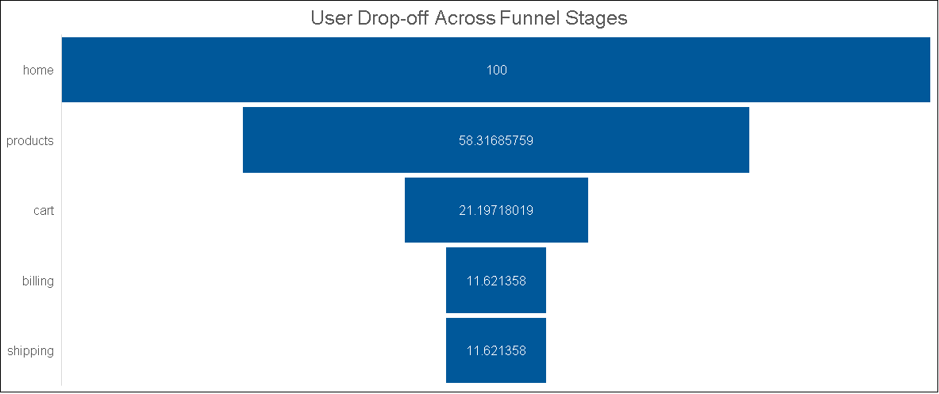
Conversion Funnel Reveals Key User Drop-offs

Slide 82
Funnel Drop-Off Analysis by Page Type
Observations
The funnel analysis shows a significant drop-off at the Product to Cart stage, where only ~36% of users proceed, indicating a major point of user abandonment.
User movement from Home to Product (~58%) is relatively strong, suggesting that initial engagement and product discovery are effective.
The transition from Cart to Billing (~55%) shows moderate drop-off, indicating some friction during the checkout initiation phase.
The Billing to Shipping stage (~100%) shows no drop-off, suggesting that users who reach billing are highly likely to complete the process.
Overall, the Product to Cart stage emerges as the primary conversion bottleneck, significantly impacting the final conversion rate.

Slide 83
Funnel Stage Distributions

Slide 84
Funnel Stage Distributions
Observations
The funnel Stage is being classified into 3 stages – Beyond cart page, Cart Abandonment , Not yet reached to cart.
Approximately 80% of sessions fall under “Not Yet Reached Cart,” indicating that the majority of users explore products but do not add items to the cart.
• Around 6% of sessions represent cart abandonment, where users add products but do not proceed to checkout.
• Only 14% of sessions progress beyond the cart stage, indicating a limited proportion of high-intent users completing the purchase journey.
• The primary leakage occurs before cart addition, while cart abandonment remains a secondary but important concern.

Slide 85
Funnel Stage Recommendations
Recommendations
Improve Product Visibility
Make it easier for users to find relevant products through better search, filters, and personalized recommendations.
Strengthen Product Persuasion
Enhance product pages with clear descriptions, high-quality images, reviews, and return policy details to build confidence.
Highlight Strong Call-to-Action
Make the “Add to Cart” button more visible and compelling to encourage immediate action.

Slide 86
High Bounce Rate on Key Landing Pages

Slide 87
High Bounce Rate on Key Landing Pages
Observations
The highest bounce rate is observed on /lander-1 (53.24%), indicating that more than half of the users leave immediately after viewing this page.
This suggests that Landing Page 1 may not be effectively matching user expectations or campaign messaging.
Landing pages /lander-3 (50.29%) and /lander-4 (51.68%) also show relatively high bounce rates, indicating potential optimization needs.
The lowest bounce rate is observed on /lander-5 (36.86%), suggesting stronger engagement and better alignment with user intent.
The homepage (/home) also performs relatively better (41.68%) compared to most landing pages.

Slide 88
High Bounce Rate on Key Landing Pages
Recommendations
Optimize High Bounce Pages (/lander-1, 3, 4)
Improve headline clarity, value proposition, and page design to better match user intent.
Align Ad Messaging with Landing Content
Ensure paid campaign messaging matches what users see on the landing page.
Replicate Best Practices from /lander-5
Analyze layout, CTA placement, and content structure of /lander-5 and apply similar improvements to weaker pages.

Slide 89
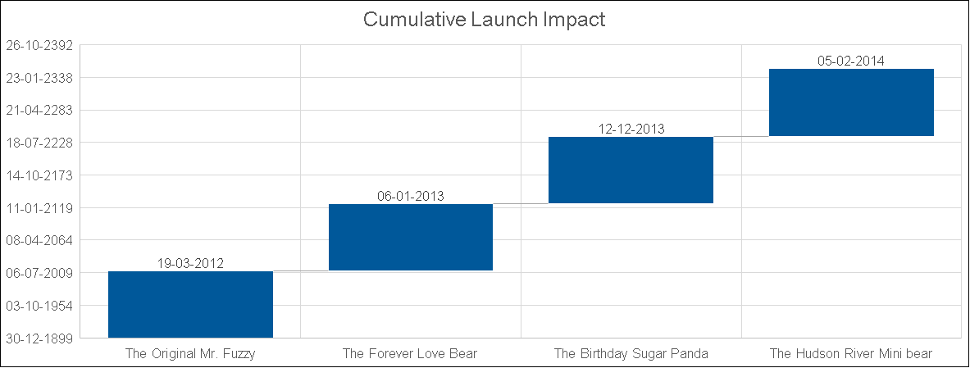
Portfolio Growth Progression

Slide 90
Product Launch Timeline
This waterfall chart illustrates the sequential launch of our product portfolio, highlighting the order in which each product entered the market.
🧸The Original Mr. Fuzzy was the first product launched, establishing the foundation for the brand.
💖 The Forever Love Bear was introduced next, expanding the emotional and gifting segment.
🎂 The Birthday Sugar Panda followed, diversifying the portfolio with a playful and character-driven offering.
🐻 The Hudson River Mini Bear was launched last, completing the product expansion cycle.
The waterfall structure clearly demonstrates the step-by-step progression of product introductions, showing how each launch built upon the previous one to grow the overall portfolio.

Slide 91
Product Performance Analysis

Slide 92
Product Performance Analysis
🧸 The Original Mr. Fuzzy
The Original Mr. Fuzzy is the top-performing product, generating the highest number of orders and the most revenue per day.
It contributes the largest share of overall sales, making it the primary driver of business revenue.
⚠️ Business Risk Insight: A significant portion of total sales depends on Mr. Fuzzy. This heavy reliance may create business vulnerability, as any decline in demand for this product could negatively impact overall performance.
🎂 The Birthday Sugar Panda
The Birthday Sugar Panda shows moderate growth compared to Mr. Fuzzy.
Despite similar product age to other recently launched products, it has achieved approximately 45% relative growth, indicating stronger customer adoption.

Slide 93
Product Performance Analysis
🐻 Hudson River Mini Bear
Hudson River Mini Bear contributes around 33% of relative growth.
While it performs well in terms of sales volume, its overall growth contribution is lower compared to The Birthday Sugar Panda.
❤️ Forever Love Bear
Forever Love Bear contributes to product sales but shows lower relative growth compared to the other products.

Slide 94
Monthly Sales Trend by Product

Slide 95
Monthly Product Items Sold
🧸 Original Mr. Fuzzy records the highest sales across all months, making it the dominant product in the portfolio.
❤️ Forever Love Bear shows an increase in sales during Month 2.
Between Month 4 and Month 8, sales of 🎂 Birthday Sugar Panda, ❤️ Forever Love Bear, and 🐻 Hudson River Mini Bear remain relatively stable with minimal fluctuations.
During this same period, most of the variation in sales is driven by 🧸 Original Mr. Fuzzy.
In Months 10 and 11, there is a noticeable increase in sales for ❤️ Forever Love Bear.
In Month 12, 🎂 Birthday Sugar Panda and 🐻 Hudson River Mini Bear both experience an increase in sales.
In Month 1, sales across most products remain relatively consistent, with 🧸 Original Mr. Fuzzy showing a slight increase compared to others.

Slide 96
Customer Purchase Sequence & Cross-Sell Opportunities

Slide 97
Customer Purchase Sequence & Cross-Sell Opportunities
Original Mr. Fuzzy contributes the highest number of first purchases, indicating it is the primary product attracting customers.
Hudson River Mini Bear, despite being the most recently launched product, is more frequently purchased as a second product, making it a strong cross-sell opportunity.
This pattern suggests that customers tend to start with Mr. Fuzzy and later purchase additional products, particularly Hudson River Mini Bear.

Slide 98
Product Recommendation
🧸 Original Mr. Fuzzy
Use as the primary acquisition product and bundle with other items to increase average order value.
🎂 Birthday Sugar Panda
Leverage peak demand periods (e.g., Month 12) with targeted promotions to accelerate growth.
🐻 Hudson River Mini Bear
Position as a cross-sell add-on product through bundles and checkout recommendations.
❤️ Forever Love Bear
Capitalize on seasonal sales spikes (Month 2, 10–11) with event-based marketing campaigns.

Slide 99
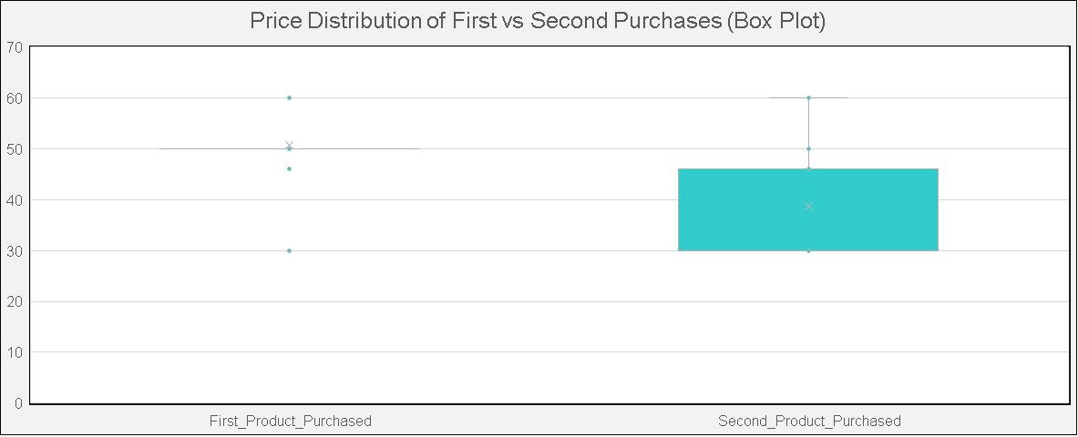
Price Distribution Across First and Second Purchases

Slide 100
Price Distribution Across First and Second Purchases
First purchases are highly concentrated around ~$50, largely driven by Original Mr. Fuzzy, which results in low price variability for first purchases.
Second purchases show greater price variation, generally ranging between $30–$46, as they include multiple products across different price tiers.
Although overall demand is not strongly correlated with price, customers appear to select relatively lower-priced products for their second purchase.
Hudson River Mini Bear, being one of the lower-priced items, fits naturally into this secondary purchase pattern.

Slide 101
Most Frequently Bought Together Products

Slide 102
Most Frequently Bought Together Products
The combination “The Original Mr. Fuzzy + The Hudson River Mini Bear” is the top performer, generating ~$250K revenue from 3,126 orders, making it the most impactful cross-sell pair.
Other strong-performing combinations include:
“The Original Mr. Fuzzy + The Birthday Sugar Panda” → ~$168.8K revenue from 1,759 orders
“The Original Mr. Fuzzy + The Forever Love Bear” → ~$95.9K revenue from 872 orders
Combinations without “The Original Mr. Fuzzy” show significantly lower performance:
“The Forever Love Bear + The Birthday Sugar Panda” → ~$14.4K revenue from 136 orders
Other pairs involving The Hudson River Mini Bear alone contribute minimal revenue

Slide 103
Customer Upsell Behaviour

Slide 104
Customer Upsell Behaviour
Only ~4% of customers opt for an upsell, while ~96% do not upgrade to a higher-priced product.
This indicates that upselling currently plays a very small role in total purchases.
The low adoption suggests significant untapped potential for improving upsell strategies.

Slide 105
Upsell Behavior Analysis by Product

Slide 106
Upsell Behavior Analysis by Product
❤️ Forever Love Bear shows the highest upsell rate (~16%), indicating strong potential as a premium upgrade product.
🎂 Birthday Sugar Panda has moderate upsell potential (~8%).
🧸 Original Mr. Fuzzy shows lower upsell movement (~4.6%), likely because it already acts as a primary purchase product.
🐻 Hudson River Mini Bear has very low upsell rates (~0.9%), suggesting it is typically purchased as a lower-priced add-on rather than an upgrade.

Slide 107
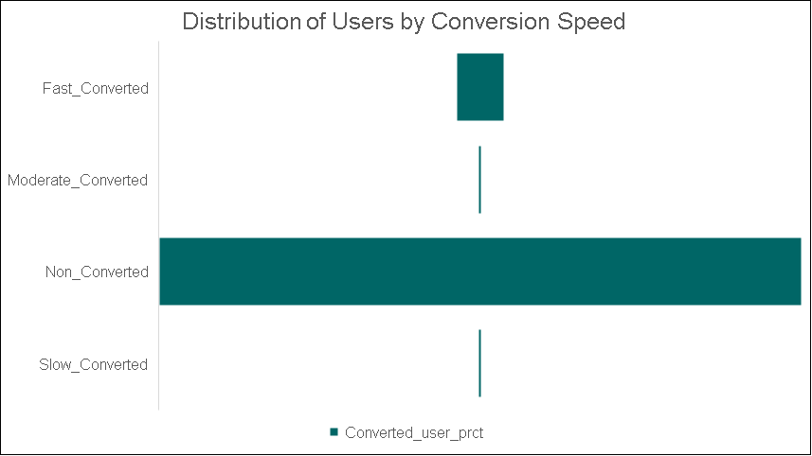
User Conversion Behavior by Time to Purchase

Slide 108
User Conversion Behavior by Time to Purchase
Non-Converted Users dominate the platform (≈92%), indicating that the majority of visitors leave without completing a purchase.
Fast Converters (~6.9%) complete a purchase within 10 days, suggesting a segment with high purchase intent.
Slow Converters (~0.6%) take more than 30 days to convert, indicating delayed decision-making.
Moderate Converters (~0.4%) convert within 10–30 days, representing a very small portion of users.

Slide 109
Customer Segmentation Using RFM Analysis

Slide 110
Customer Segmentation Using RFM Analysis
Customers are classified based on their RFM Score (Recency, Frequency, Monetary):
High Value Customers: RFM Score ≥ 7
Medium Value Customers: RFM Score between 4 and 6
Low Value Customers: RFM Score ≤ 3
Based on this segmentation:
High Value Customers represent the largest segment with 13,888 users, indicating strong customer engagement and higher spending behavior.
Medium Value Customers account for 8,933 users, representing customers with moderate purchase activity.
Low Value Customers include 8,875 users, indicating customers with lower purchasing frequency or spending.

Slide 111
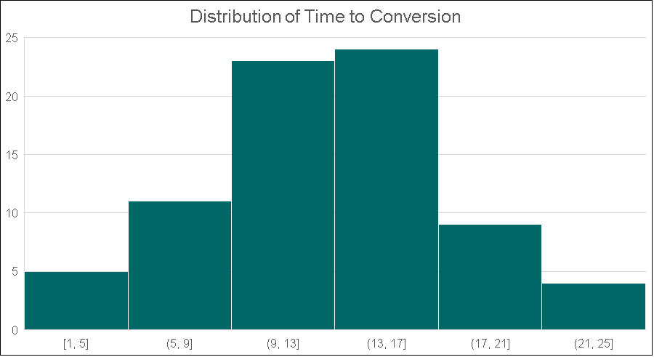
User Conversion Speed Analysis
Most customers complete their purchase within the first 15 minutes of visiting the website, indicating strong immediate purchase intent.

Slide 112
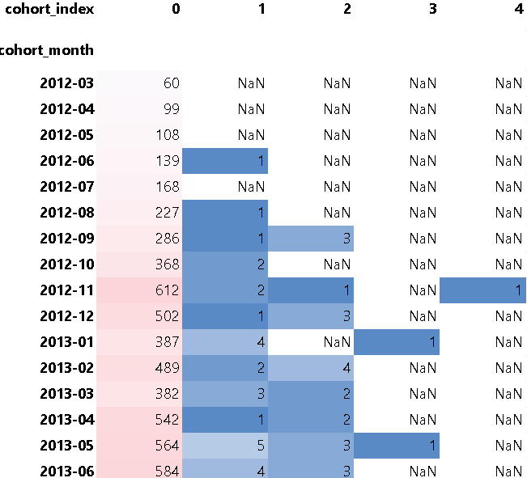
Customer Retention Cohort Analysis

Slide 113
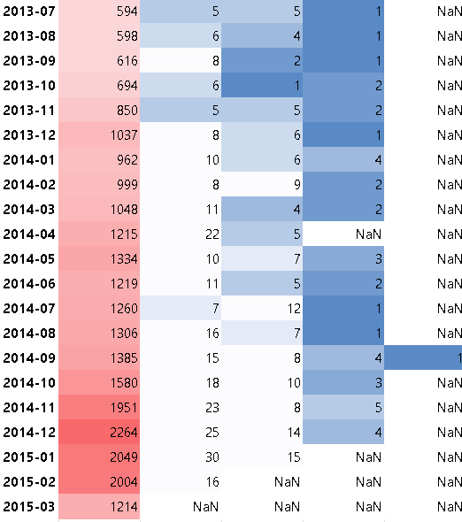
Customer Retention Cohort Analysis

Slide 114
Customer Retention Cohort Analysis
The number of customers acquired each month increases steadily over time, growing from 60 customers in March 2012 to over 2,000 customers by early 2015, indicating strong growth in customer acquisition.
Repeat purchases are very limited after the first month, with only a small fraction of customers returning in subsequent months across most cohorts.
Even in larger cohorts (e.g., 2014–2015), the number of returning customers remains relatively small compared to the initial cohort size, suggesting low customer retention.
Some later cohorts show slightly higher repeat purchases in the first follow-up month, but this pattern still represents a very small percentage of the total cohort.

Slide 115
Campaign Performance and Effectiveness
Nonbrand campaign dominates acquisition, contributing ~70% of total traffic and revenue.
Revenue share closely mirrors traffic share → acquisition quality is stable.
Brand campaign contributes lower traffic (~9%) but slightly higher revenue share (~10%), suggesting stronger conversion efficiency.
Desktop targeted and Pilot campaigns have negligible contribution to total revenue.

Slide 116
Campaign Performance and Effectiveness
Nonbrand drives the highest user reach and session volume, confirming it as the primary growth engine.
Brand traffic demonstrates strong repeat engagement, reinforcing customer loyalty impact.
Refund rates are relatively stable across major campaigns (~5–5.5%).
Desktop targeted campaign shows the highest refund rate (~6.6%), indicating potential targeting or expectation mismatch.
Pilot campaign has limited scale and minimal contribution to user retention.

Slide 117
Campaign Performance and Effectiveness
Brand campaign delivers the highest conversion rate (~7.8%) and revenue per session.
Nonbrand campaign combines scale with strong conversion (~6.7%), making it the primary revenue driver.
Desktop targeted shows moderate conversion but weaker revenue efficiency.
Pilot campaign has the lowest conversion rate and weakest monetization efficiency.
Higher bounce rates in Pilot and Desktop targeted indicate weaker audience alignment.

Slide 118
Campaign Performance and Effectiveness
Recommendations
Increase budget allocation to Brand campaigns to capitalize on highest conversion efficiency.
Audit Desktop targeted targeting parameters to reduce refund rates.
Reassess or restructure Pilot campaign before further budget allocation.
Develop campaign-specific landing pages to reduce bounce.
Introduce cross-sell bundles for Nonbrand traffic.

Slide 119
Multi Touch Attribution Analysis

Slide 120
Multi Touch Attribution Analysis
Insights
Non-Brand Dominates Entire Funnel. It contributes 81% of first touch attribution revenue and 86% of last touch attribution revenue.
Brand Campaign is Under-Leveraged. It has strong presence in early journey (₹338K first touch)but weaker conversion impact (₹186K last touch)
Desktop Targeted & Pilot Are Marginal. They are associated with<2% of total attributed revenue.
Funnel Concentration Risk due to overdependence on only one campaign.
Recommendations
Scale Non-Brand with Controlled Testing
Reposition Brand Campaign for Retargeting
Rebuild the Pilot campaign

Slide 121
Retargeting Performance By Campaign
Insights
Only the Brand Campaign is targeted towards retargeting.
We see that we are getting a strong Conversion rate in brand campaign retargeted sessions.
Large portion of repeat revenue coming from No campaign. This means retargeting is under-structured.
Recommendations
Formalize Brand as Retargeting Engine and shift it to loyalty reinforcements, remarketing ads, abandoned cart recovery etc.
Improve Retargeting Tracking Infrastructure
Introduce Personalized Retargeting

Slide 122
Campaign Reach, Frequency and Quality Diagnostics

Slide 123
Campaign Reach, Frequency and Quality Diagnostics
Insights
Nonbrand = Pure Reach Engine
Brand is Retention & High-Intent engine
Desktop Targeted has major quality concern
Campaign Portfolio is Structurally Imbalanced
Recommendations
Formalize Campaign Roles for better structuring and targeting
Reduce Over-Concentration Risk by introducing new acquisition campaigns.

Slide 124
Campaign Funnel Analysis

Slide 125
Campaign Funnel Analysis

Slide 126
Campaign Funnel Analysis
Observations
In the Early funnel stage, brand brings highest quality traffic (lowest first drop).
In the Mid funnel stage, all campaigns suffer heavy product-to-cart leakage (~80%+).
Cart abandonment is structurally high across all campaigns.
The real problem is NOT traffic. Product Page to Cart leakage and cart abandonment.
This implies that website UX & pricing strategy may be bigger bottleneck than marketing.

Slide 127
Audience Overlap Analysis

Slide 128
Audience Overlap Analysis
Observations
Multi-Ad Exposure Improves Conversion
Ad Overlap is Limited (only around 12%)
Overlap is Platform-Concentrated . 98% multi-ad overlap occurs within Google ad variants. Very little cross-platform exposure (Google + Bing + Social).
No Evidence of Severe Ad Fatigue. Higher exposure → Higher conversion
Recommendations
Expand Controlled Multi-Ad Strategy by testing structured cross-platform exposure.
Avoid redundant same-platform duplication. Since Google overlap dominates we should Ensure creatives differ so as to avoid cannibalism

Slide 129
Ad Copy Performance Analysis
Google Advertisement Comparison
Metric | g_ad_1 | g_ad_2
Sessions | 282,706 | 33,329
Conversion Rate | 6.66% | 7.53%
Revenue per Session | ₹3.98 | ₹4.55
Repeat Rate | 0% | 63.6%
Observations
g_ad_2 drives Higher Quality Traffic as visible through higher conversion rate, AOV and repeat rate.
g_ad_1 Is Scale-Heavy but Lower Quality. Likely that it is optimized for broad acquisition.
Creative Messaging Impacts Retention i.e. g_ad_2 resonates beyond first session as suggested by repeat rate gap
Recommendations
Reallocate Budget Toward g_ad_2
Segment by Funnel Role like g_ad_1 for broad discovery and g_ad_2 for high intent targeting.

Slide 130
Ad Copy Performance Analysis
Bing Advertisement Comparison
Metric | b_ad_1 | b_ad_2
Sessions | 54,909 | 7,914
Conversion Rate | 6.95% | 8.86%
Revenue per Session | ₹4.11 | ₹5.45
Repeat Rate | 0% | 63.4%
Observations
b_ad_2 outperforms b_ad_1 across all KPIs
High Intent Audience in b_ad_2. 8.86% conversion rate is strongest across all search ads indicating Highly aligned targeting.
b_ad_1 Is volume driver but is less efficient
Recommendations
Scale b_ad_2 aggressively
Segment by Funnel Role like g_ad_1 for broad discovery and g_ad_2 for high intent targeting.
Reduce spend on b_ad_1 or rework Creative

Slide 131
Ad Copy Performance Analysis
Socialbook Advertisement Comparison
Metric | social_ad_1 | social_ad_2
Sessions | 5,095 | 5,590
Conversion Rate | 1.08% | 5.15%
Revenue per Session | ₹0.73 | ₹3.31
Repeat Rate | 0% | 0%
Observations
social_ad_2 Significantly Outperforms social_ad_1
social_ad_1 Is Structurally Inefficient
Social advertisements underperforms search advertisements
Recommendations
Pause or Redesign social_ad_1
Optimize social_ad_2 for funnel role, positioning it for awareness or mid-funnel retarget and not for conversion.

Slide 132
Ad Trend Performance Analysis

Slide 133
Ad Trend Performance Analysis
Obseravtions
Structural performance improvement over time. Search ads shows rising conversion rates, rising revenue per session and a sustained upward trend from 2012 to 2015. It Indicates learning curve and optimization maturity.
2014–2015 marks the acceleration phase. We see noticeable uplift in conversion rate and Revenue per session .
Social ads are underdeveloped.
No Evidence of Creative Fatigue in search ads.
Recommendations
Continue search engine led growth strategy.
Institutionalize quarterly optimization reviews i.e. shifts budgets based on momentum.
Social channel can used for awareness and mid-funnel targeting rather than for conversion.

Slide 134
THANK YOU!

