Slide 1
RETAIL Insights ANALYTICS
NAME : HARSHITA SAHU
DATE : 3/10/2025

Slide 2
Retail
What are the Points to Focus on :
Customer Analytics
Product Analytics
Sales & Revenue Analytics
Inventory & Supply Chain
Store / Channel Performance
Customer Experience
KPIs to Track
Retail is all about Selling Goods & Services directly
To end Customers for Personal Use
Retailers are the intermediaries between Wholesaler , Retailers & end Customers.

Slide 3
Types Of Analytics
Diagnostic
Analytics
Predictive
Analytics
Prescriptive
Analytics
Descriptive Analytics
Demographic Analytics
Difference Between the Different Types Of Analytics
Cognitive
Analytics
Descriptive Analytics | Diagnostic Analytics | Predictive Analytics | Prescriptive Analytics | Cognitive Analytics | Real-Time Analytics
* Summarize past data to understand patterns and trends | * Investigate reasons Behind Past Trends or Issues | * Uses Past Data and Historical Trends to forecast Future | * Suggest Action To achieve Desired Actions | * Uses Ai to make Decisions and act upon data . | * Monitors Live Data And take decisions Immediately
Real-Time
Analytics

Slide 4
Slide(1-3)
Use Case Of Analytics in Case Study
Demographic Analytics
Customer Segmentation based on Sales – Low ,Medium, High.
Which Gender is Contributing more , which city customer are from.
Preferences of Demographic Grp’s Based on Channels like if the online channels are target by Youngsters .
Which grp is more go for Discounted Products .
Which grp is paying through which Payment Type .
Which Segments is More Satisfied by seeing their Customer Scores .
Which Segment is Purchasing What Type of Products .
By analyzing Categories & Products & Stores we can analyze which product is more Demanding and keep that in stock
Descriptive Analytics
How many order placed on last month
Avg order size
Weekly Sales (In which week there is high Sales), Finding Out Seasonality Trends
Total Revenue Earned
Discount is affecting our sales or not .
Through which Payment Type earned More.

Slide 5
Slide(2-3)
Use Case Of Analytics in Case Study
Which Product is Giving more sales so we can stock that up.
10 Top selling Items
Which store Location Having Sales in Last Quarter
Which Customer are located more in which state and How much Sales they are generating so that we can target them more.
Avg Ratings
Diagnostic Analytics
Where there is a sudden decrease in orders in particular week and finding out the reason is the stock available
Why Order got cancelled is it is because sudden change in mind or what.
Why there is a sudden drop of specific Products what are the reason is quality is not meeting the Standards .
Why there is Spike in Return is product is not meeting the Standards .
Why the Payment is getting Cancelled is it because it is Taking to much time to get deliver.
Predictive Analytics
We can predict from the Customer Buying Patterns Who are customer which are likely to churn .
Can use KMeans Clustering to segment the Customer on the Basis of Loyalty.
By Increasing of Discount on Festive Season to Increase the Sales.
By analyzing of Patterns of Sales we can analyze which product is having high chance to got sold .(use apriori technique).

Slide 6
Slide(3-3)
Prescriptive Analytics
By doing predictive analyses we can recommend which product to stock up and in which location .
Which store can be expanded and in which district
Recommending Discount on which category more and on which to provide cashback which can maximize the sales .
To deal with Negative reviews we can redirect those to faster Deliveries & Courier Services.
For Loyalty of we can use Personalized Recommendations.
Cognitive Analytics
Can use A/B testing to increase the sales and see which product is more preferable by Customers.
For understanding customer satisfaction in better way we can use polarity to understand the text also.
Can use preferences of customer and there buying patterns and recommending products more effectively.
Can use to detect Fraudulent transactions by analyzing abnormal Behavior or Anomaly.
Real Time Analytics
Basis of Customer it can personalize instant discount to users .
For 1 Star Review it can use trigger alerts within the hour of launch .
Use Case Of Analytics in Case Study

Slide 7
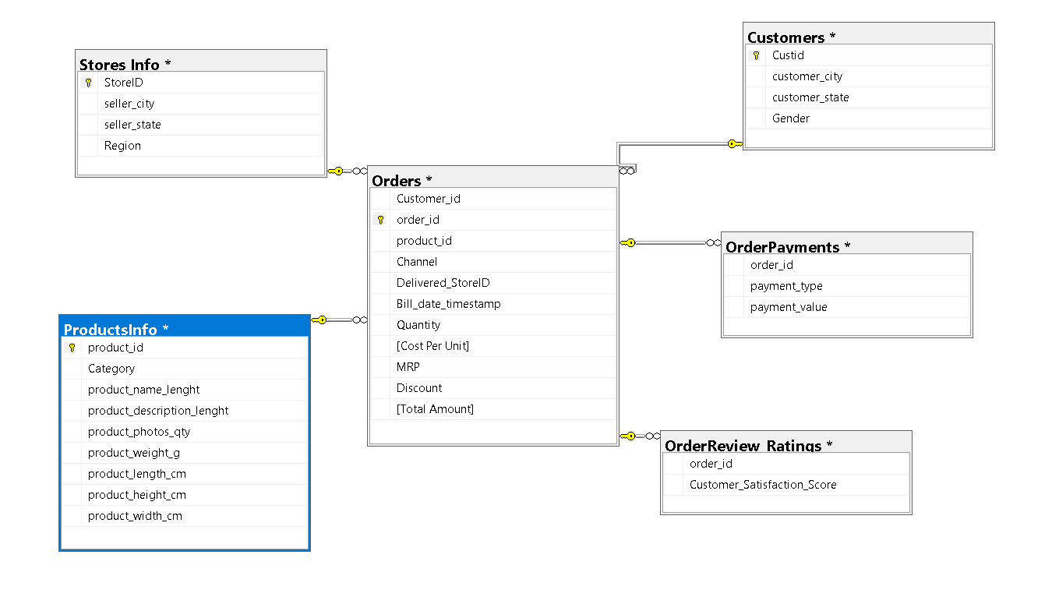
ERD DIAGRAM(Entity Relationship Diagram)
Relationships
1)Customer – Orders [One to Many]
2) Orders – Orders_Payments [One to Many]
3) Orders – Orders_Review_Ratings
[One to Many]
4) Orders – Stores_Info [Many to One]
5) Orders – Product_Info [ Many to One]
*Star Schema
Orders Table = Fact_Table
Other Tables = Dimension_Table

Slide 8
Slide(1-2)
Table Summaries
Tables | Details | Rows and Columns
Customers | Custid – float Customer_city – nvarchar(255) Customer_state –nvarchar(255) Gender – nvarchar(255) | 4 columns , 99441 rows
Orders | Customer_id – float , order_id – nvarchar(255) Product_id –nvarchar(255),channel – nvarchar(255),delivered_storeid – nvarchar(255),bill_date_timestamp – nvarchar(255),quantity (float), cost_per_unit (float),mrp – float,discount(float),total_amount(float) | 11 columns,112650 rows
Order_Payment | Order_id – nvarchar(255) Payment_type – nvarchar(255) Payment_value – float | 3 columns ,103866 rows
OrderReviews_Rating | Order_id – nvarchar(255) Customer_Satisfaction_score - Float | 2 columns,100000 rows

Slide 9
Slide(2-2)
Table Summaries
Tables | Details | Rows and Columns
OrderReviews_Rating | Order_id – nvarchar(255) Customer_Satisfaction_score - Float | 2 columns,100000 rows
Products_Info | product_id-nvarchar(255),Category – nvarchar(255),product_name_length-float,product_description_length – float, product_photos_qty-float,product_weight_g –float,product_length_cm – float,product_height_cm-float,product_weidth_cm-float | 9 columns ,32951 rows
Store_Info | Store_id- nvarchar(255),seller_city –nvarchar(255),seller_state – nvarchar(255),region-nvarchar(255) | 4 columns,535 rows

Slide 10
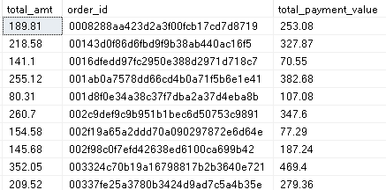
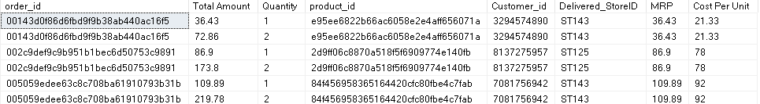
Slide(1-2)
Discrepancies in Data
1) There are 12,685 rows in order table where there is a mismatch in Total_Amount and Payment_Value
2)There are 8847 records with same id’s ,cost_per_unit and same discount but different total_amount and qty (we can merge it together to decrease the duplicate records)

Slide 11
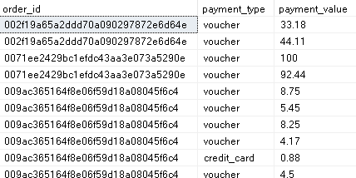
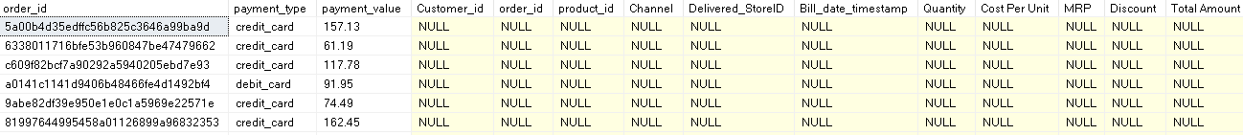
Slide(2-4)
Discrepancies in Data
3) There are 3367 duplicates in orders_payments table .
4) There are 830 rows which are there is orders Payment table but not present in orders table

Slide 12
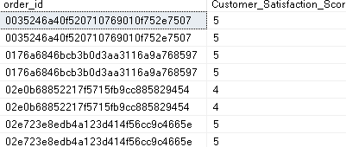
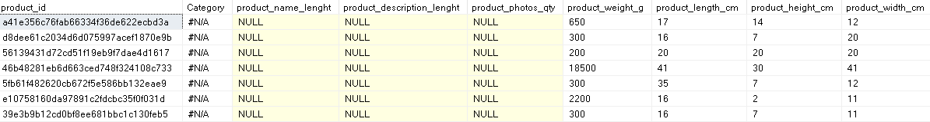
Slide(3-4)
Discrepancies in Data
5) There are 700 duplicated Records in Order_Review_Ratings
6) There are 623 rows where category is not available

Slide 13

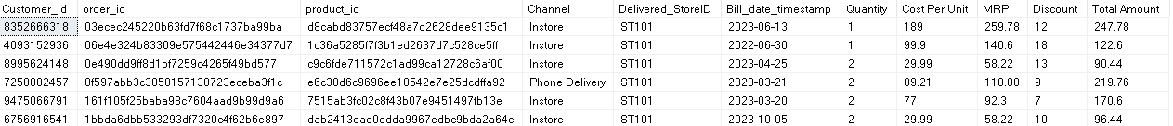
Slide(4-4)
Discrepancies in Data
7) There is Store_id = ST410 is duplicated in [Stores Info] Table.
8) Bill_Date_Timestamp is also not in the correct format .
9) There are 6730 rows in orders table whose total_amount is itself not correct
Total_amt = qty * mrp - discount

Slide 14
Cleaning The Datasets
Slide(1-2)
Bill_date_timestamp is not in the correct format in orders table so converted that into correct date_time format and filter out on the basis of date from Sept_2021 to Oct_2023.
Orders table the total_amount is not in the correct format updated that
[Total Amount] = Quantity*MRP-Discount (2,261 rows not following the correct total_amount).
Orders_payments there are 722 rows where order_id is there in orders_payment but they are not present on orders table so here I removed them.
There are 12,685 rows where total_payment and total_amt are not matching .
There are 8847 duplicate records where in orders table by Qty and then found out there are cumulative quantity so I have deleted the repeated records and kept the cumulative quantity records.
Then aggregated the orders table on the basis of ids and created this as a new table called orders_aggregate.
Now in orders_aggregate table there are records where the channel is instore and multiple orders from different stores are there for a single order so for continuity updated the storied for those records with the store_id whose total_amt is more for that same order_id .

Slide 15
Cleaning The Datasets
Slide(2-3)
There are records where the channel is instore and the order is placed with different timestamp or dates for the same order_id so updated all such records with min timestamp (6279 rows affected )
In orders payment there are 3667 records are there where it having duplicates by order_id and order_payments.
There are 3 records in order_payments where payment_value is null so removed it
Created orders_payment_clean table in which Transpose orders_payments tables in such that where created columns of there respective payments_type and the amt and a column called total_payment_value and there order_id .
In the store_info table there is 1 duplicate records removed that and created a table called store_info_clean
In products_info there are categories which is having null so updated category column with others where there are null and removed all other table and named the table called product_info_clean.

Slide 16
Slide(3-3)
Cleaning The Datasets
Order_Review_Ratings there are 1,00,000 records where there are many reviews by one customer so aggregated that and now there are 99,441 records.
Between orders and orders_payments there is 3,252 records where there is a mismatch between total_amount and total_payments ( as per the client requirement I am keeping those records also )

Slide 17
Slide(1-3)
Updated Records
Orders_Table
1,12,650 records
1,02,425
records
By Merging order tables basis of ids
Updated Total_Amt = mrp*(qty-discount)
3,252records mimatch between total_amt and payment_value
By keeping only Cumulative Qty
Orders_Payments_Table
103886 records
99,437
records
Cleaned the order payment_value by payment_types and order_id and to match with payment_value
Remove Duplicates basis of order_ids and payment_type by aggregating
Adjusted the Rows in the Order_payments where the order id is available in orders_payment but not in orders

Slide 18
Updated Records
Slide(2-3)
Store_Info_Table
Store_Info_Table
535 records
534 records
After Removing Duplicates here
Order_Review_Ratings_Table
Orders_Review_Ratings
1,00,000 records
99,441
records
After aggregating the records

Slide 19
Updated Records
Slide(3-3)
Products_Info_Table
Updating the null categories as not available .
Product_Info
32951 records
Customer_Table
Customer_Table
99,441 records
The table is cleaned.

Slide 20
Retail_Analysis 360

Slide 21
Business Overview
Our Business operates across 39 stores and 19 states divided into 4 regions.
The analysis focuses on understanding sales performance, customer behavior, and product trends across these regions to uncover growth opportunities and improve profitability .
Total orders - “98663”
Total Customers – “98572”
Almost 1:1 ratio which means that each customer had made roughly one order on average.
The Revenue generated is 16.35 million
Business running efficiently as it is generating nearly 14.3% of profit margin indicating it is a healthy relationship.
Average discount % is 3.1 which means for every 100 sales business gives on average 3.1 as discount which is a good sign means the business is not running based on discount showing healthy demand.

Slide 22
High-Level Business Metrics & Insights
Metrics | Values
Total Orders | 98,663
Total_Customers | 98,572
Total_Revenue | 16.35 M
Profit Margin % | 14.3%
Total_Profit | 2.34 M
Avg_Customer_Value | 165.89
Avg_Discount_Per_cust | 5.16%
Top Perfoming Region | South
Least Performing Region | East

Slide 23
Revenue Growth Analysis & Interpretation (2022–2023)
Our Total Revenue is almost 16.35 M
The data is divided into 2021,2022,2023 in which 2021 has only 2 months data .
These are the below analysis related to how changes in revenue is happened from 2022 to 2023
Our products price ranges from 6.08 mrp to 7,060 mrp.
The number of customer in 2022 is 45,282 and it increase 11k new customer in 2023 which is one of the reason of revenue gets increased in 2023
Revenue in 2022 - 7.22M
Revenue in 2023 - 9.06M [Hike of 25.5%]
The average customer value is same in both year kind of constant 177 means customers is purchased once as the repeat rate in both year is also same a slight change which means the customer retention is low
The Quantity plays a major role in revenue expansion from 2022 to 2023
“The revenue growth was volume-driven rather than value-driven, suggesting that the business successfully expanded its customer base and boosted unit sales while maintaining its low-cost, high-volume model.”

Slide 24
Revenue Growth Analysis & Interpretation (2022–2023)
Metric | 2022 | 2023 | Change
Total Revenue | 7.22M | 9.06M | +25.5% ↑
Total Customers | 45,282 | 56,808 | +25.4% ↑
Avg Customer Value | 177.69 | 177.97 | ≈ Same
Avg Discount per Customer | 5.01 | 5.28 | Slight ↑
High-Value Customers (>2000) | 78 | 98 | +25.6% ↑
Qty Sold (Products <2000) | 52,035 | 65,219 | +25.4% ↑
Customers Buying Products <2000 | 43,486 | 54,620 | +25.6% ↑

Slide 25
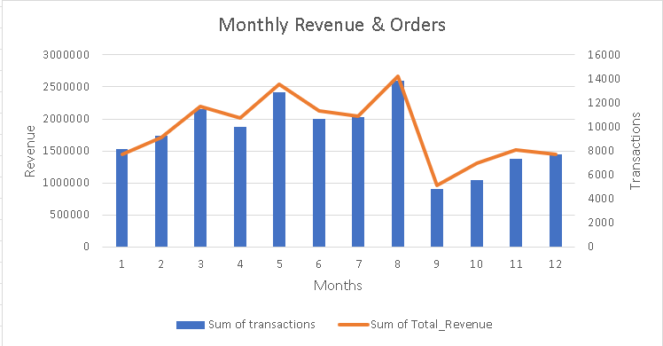
Monthly Sales and Order Trends
This combo chart shows our monthly trend of total revenue and total orders.
Revenue is shown as bars, and orders are represented by the line on the secondary axis.
Observations
The number of orders as well as revenue trends are increasing until august and then there is sudden decrease in orders as well as revenue and then there is a rise
The peak month is august which has 13,857 as number of orders and 2.6 million as revenue generated

Slide 26
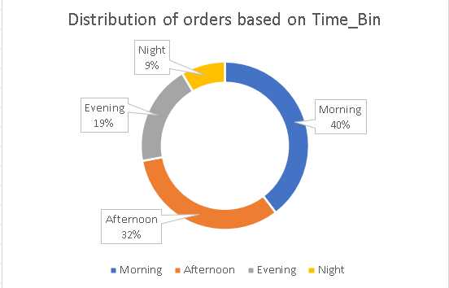
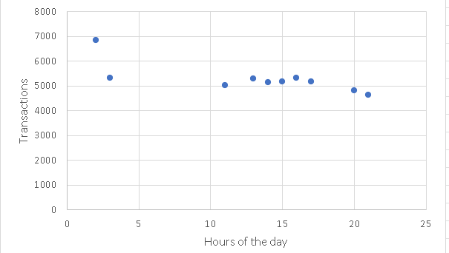
Distribution Of Orders by Time_Bin
Observations -
The chart Shows how the Total Orders – 98,663
Getting distributed between different times of the day we
Can say most customer giving orders in morning which is
majorly contributing to 40% of total orders , Afternoon
Also Contributing well but least orders are at
Night which is only 9%.
We can also see the customer visiting more in 2 am
which we can say it as a peak hour and Total_customers
are 7370 customers
Peak time of Customer visits

Slide 27
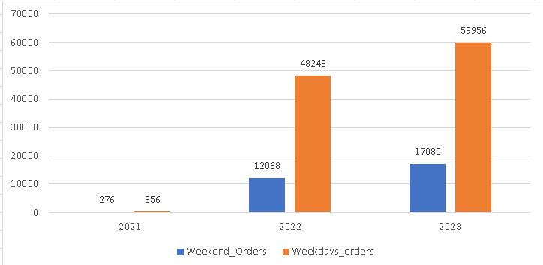
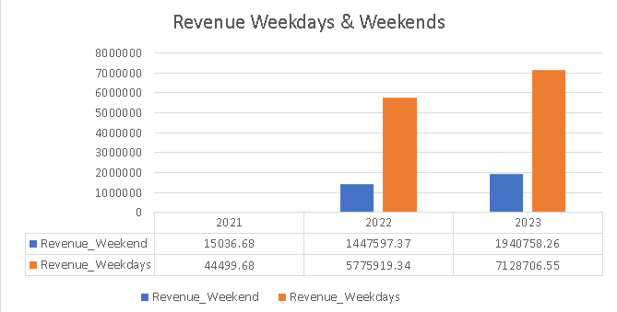
Weekends/Weekdays
Number of Orders on Weekends and Weekdays
Observations –
Numbers of Orders on Weekdays are more
than Weekends and we can see this Trends across all Years.
The Most orders and Revenue Generated in 2023 with orders count in weekdays as 59956 and in weekends as 17080
The least orders and revenue is contributed in Year 2021 which is only 15 thousand as revenue.
The 2022 is also doing well in revenue as well as in orders count
“weekday orders consistently outperform weekends orders across all years”
Revenue Based on Weekends and Weekdays

Slide 28
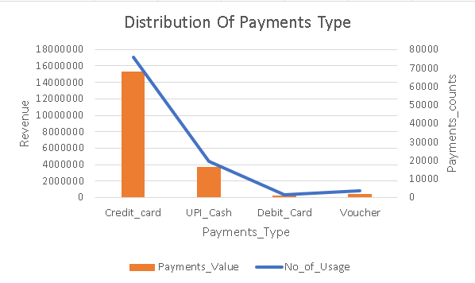
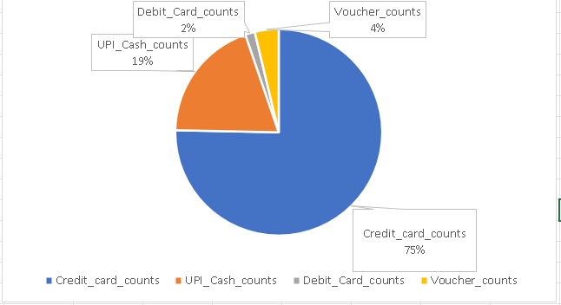
Payment Type Distribution
Observations –
Usage of Credit Cards are total of 75%
Which means customer are making payments
Majorly by credit cards and Total Revenue
Generated by credit cards are 13.19 M .
Payment done by UPI/Cash is about 19% and
Revenue generated by that is 3M in Total
Least used payment channel is Debit card which
Is only 2% and the revenue is generated by it is
2.3 lakh.
“Preferred channel of payments by Customer is Credit Card and lest used is Debit card”

Slide 29
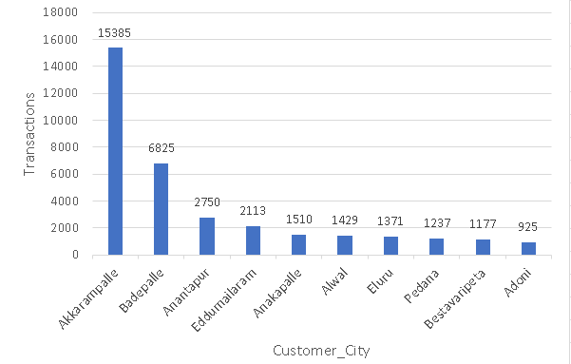
Customer_Analysis
Top 10 customer_city on based of orders
Akkarampalle city contributes the most in terms of count of orders as well as in revenue about 2.2M sales
Top 1 customer_city on based of Transactions
Total_transactions | Customer_city | Customer_state
15385 | Akkarampalle | Andhra Pradesh
Top 1 customer_city on based of Revenue
Total_Revenue | Customer_city | Customer_state
2253297.94 | Akkarampalle | Andhra Pradesh

Slide 30
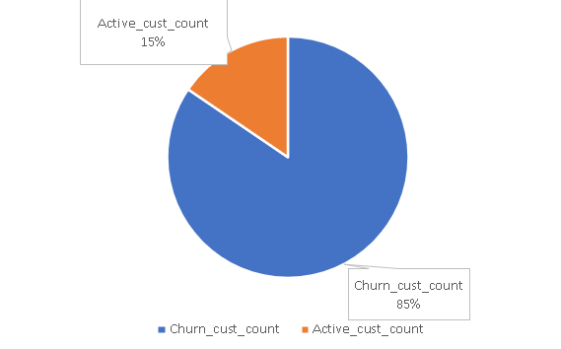
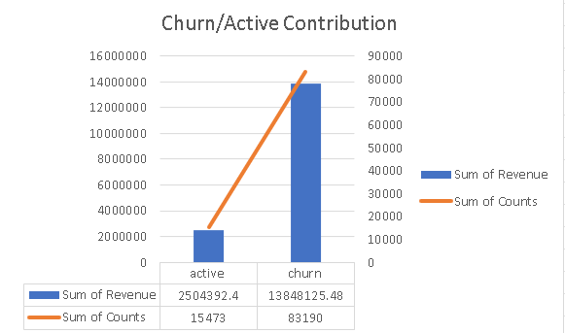
Customer Status Distribution: Active vs Churned
Distribution of Active and churned customer
Churned customer are those who haven’t done any purchase in last 3 months else they are Active Customer
Churned customer are 85% on the other hand active customer are only 15% which means customer are not actively making purchases .
The revenue generated by churned customer are 13.8M so we really need to focus on churned customer to retain them.
There is a potential to convert these customer from churned to active by taking some actions like personalized offers and communication.
“There are more churned customer as compare to Active Customer”
Revenue by Active & churned &customer counts

Slide 31
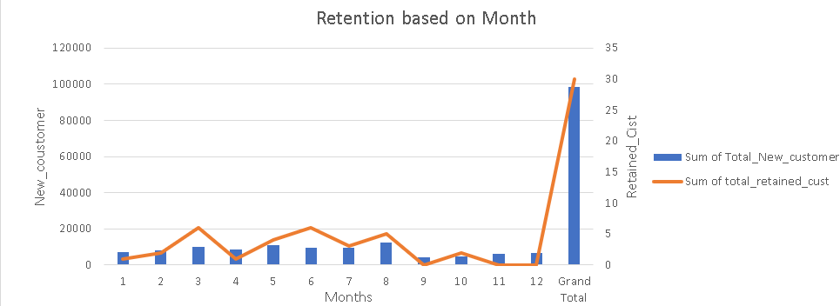
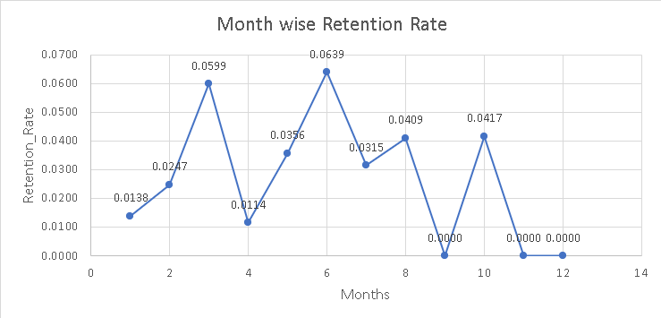
Monthly Customer Retention
Observations –
The chart shows the new_customers coming per month and in orange line shows how much retained out of the new_customer
Customer Retention is almost 0.03 which means 3% only are the retained customer which are distributed across months.
June having most retained_cust which is 6 .
Customer Retention is so less as it is only 3% which means 97% are the churned customer in short customer loyalty lacks .
We need to increase the retention rate
“Retention rate is less means one_time customer is more”

Slide 32
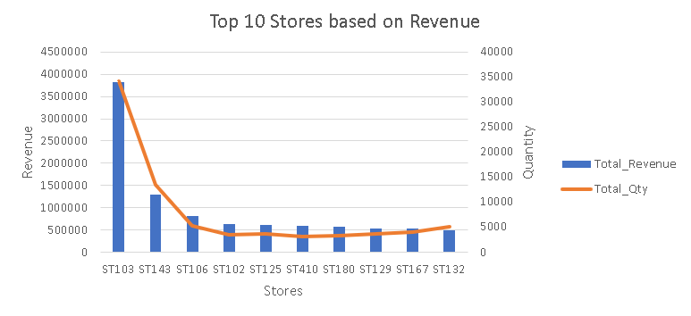
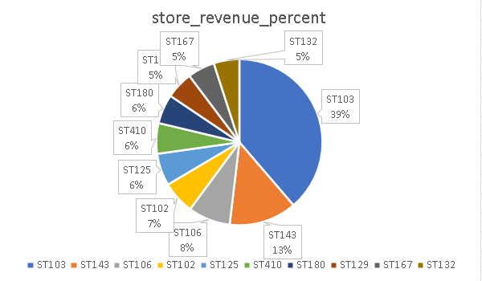
Top Performing Stores Overview
Out of 37 stores these are the Top 10 stores which contributes the most on the based on Revenue as well as Quantity sold.
ST103 store sole contributes about 39% of revenue and we can conclude it as a profitable store.
ST103 is a preferred store by customer it has about 4.06 as average satisfaction score and about 26,037 as customer visits
The least visit store is ST354 with only 617 vists
The least profitable store is ST463 with only 1.13%

Slide 33
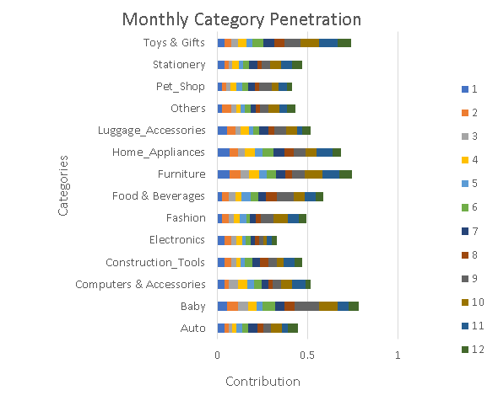
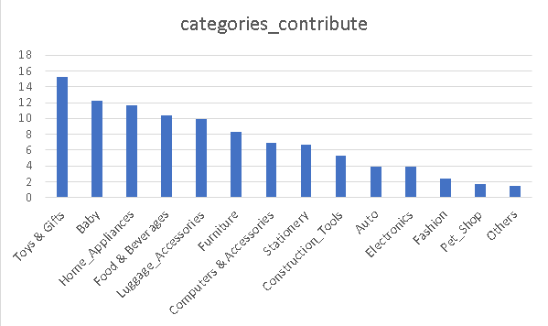
Category_Penetration_Analysis
Observations –
Category Penetration = number of orders containing the category/number of orders
Category Penetration helps us to find how widely a product category is purchased or used among the total set of customers
The above charts shows how the category is spread across months and Toys and gifts and baby products contributes the more across different months.
Here we can see the Toys and Gifts contributes the most about 15.24% and then the Baby products contribute about 12.21%.
“Toys and gifts have the most spread and then baby category and at lest contribute is Others.”

Slide 34
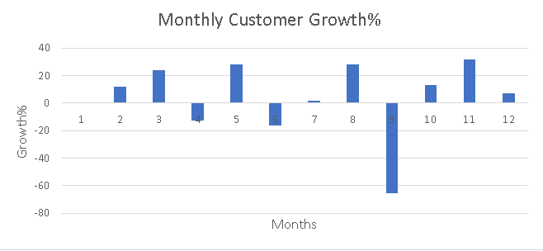
Customers Monthly Growth
Observations –
Customer Growth on Monthly Basis which means how much % of customer are new customer & how much % of customer left the business.
First purchase count of customer by months *100/ total customer in that month
In November and in march there is a significant growth is new customer about 31.49% in November and 23.87% in march
In September there is a significant drop in new customers which means many of them leaved the business about -65.3%
“This indicates there is a sharp increase in certain months due to marketing campaigns but in September there is a significant decrease maybe due to less offers of decrease in services”

Slide 35
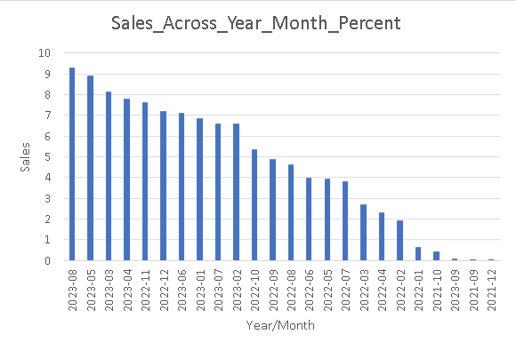
Sales Acosss Months_Year
Observations –
Sales percent- Sales in particular month/total sales
This shows how our sales is getting fluctuated between year and months
The most sales we are getting in August 2023 with 1.5 M and least order in December 2021 which kind negligible compared to total revenue maybe there is so less orders as the total revenue itself is just 19.62 in that month
The 2023 is doing great and 2022 is also doing well
“Sales most in august 2023 maybe because of better marketing and offers”

Slide 36
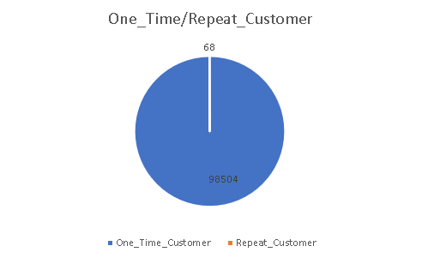
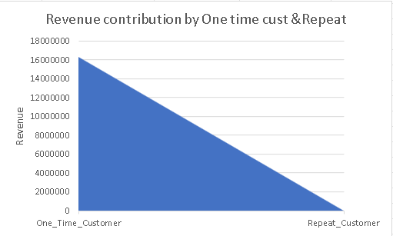
New/Repeat Customer
Observations –
One time customer are the new customer who has make there first purchases and repeat customer are purchased more than ones.
The above Pie chart shown one time customer counts and repeat customer counts and we can observe that repeat customer are 68 only and remaining are one time.
The revenue generated by repeat are 29 thousand only whereas 16.32 M revenue is derived by one time customers.
“ The Business is failing to retain the customers.”

Slide 37
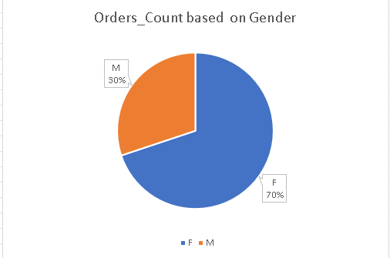
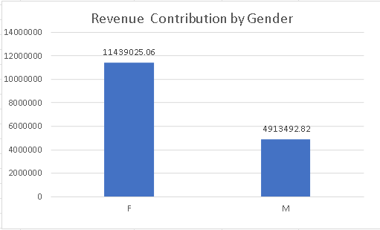
Gender Contribution
Observations –
Gender contribution is an important factor in identifying which segment to focus on for retention and which one to engage more actively.
Females contribute about 70% of our total sales, generating approximately ₹11.43M in revenue,
while males contribute around 30%, accounting for ₹4.9M in revenue.
“We need to focus on retaining our female customers by offering better facilities and personalized experiences,
and implement strategic initiatives to attract and increase engagement among male customers.”

Slide 38
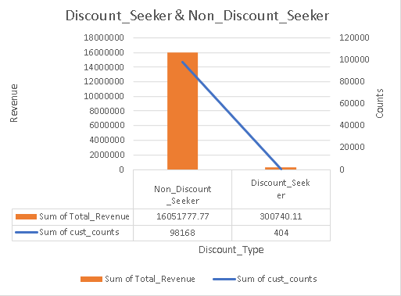
Discount-Seeking Behaviour Analysis
Observations –
Discount seekers are customers who make most of their purchases using discounts,
while non-discount seekers are those who are not influenced by discounts and continue to purchase even without them.
There are 404 customer only or 4% who are seeking discount and 96% are non_discount_seeker
“There is no need to give much discount as customers are not geTting impacted by discounts they are making purchases without discounts also”

Slide 39
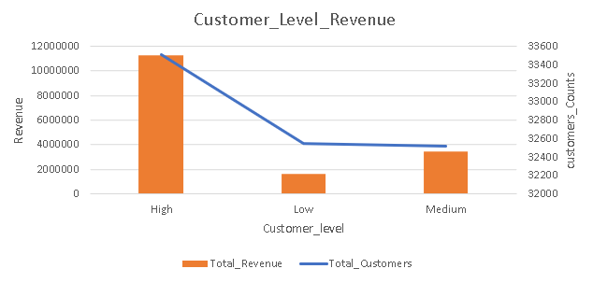
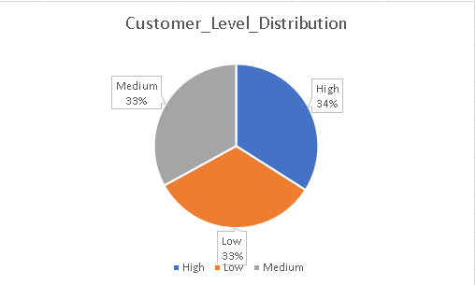
Customer Value Segmentation
Observations –
The customer is broadly classified on the basis of Revenue into High/Medium/Low level customers
Low_Level customer are those whose total revenue percentile_cont is less than equal to 0.33
Medium level customer are whose Total revenue percentile_cont is less than equal to 0.66 and else are high customer
“There is no significant difference in customer counts across these segments, indicating that the customer base is evenly distributed across all spending levels.”

Slide 40
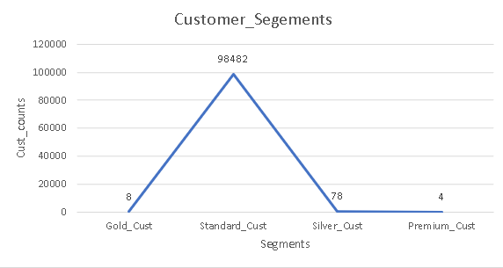
Customer Segmentation Based on RFM
Customers are categorized into Premium, Gold, Silver, and Standard segments based on a combined score derived from recency of purchase, number of orders, and total spending.
Premium Customers are the top-tier buyers who have made recent, frequent, and high-value purchases.
Gold Customers are active and consistent buyers with strong purchase value.
Silver Customers have moderate purchase frequency and value.
Standard Customers are low-engagement customers with limited spending or older transactions.
“Standard Customers are 99% then the standard and then we are having gold at last premium which means customer are not engaging much also spending is limited”

Slide 41
Cross_Selling
Orders Count | Product Pairs
34 | 36f60d45225e60c7da4558b070ce4b60 , e53e557d5a159f5aa2c5e995dfdf244b
29 | 35afc973633aaeb6b877ff57b2793310 , 99a4788cb24856965c36a24e339b6058
17 | 4fcb3d9a5f4871e8362dfedbdb02b064 , f4f67ccaece962d013a4e1d7dc3a61f7
12 | 36f60d45225e60c7da4558b070ce4b60 , 3f14d740544f37ece8a9e7bc8349797e
11 | 389d119b48cf3043d311335e499d9c6b , 422879e10f46682990de24d770e7f83d
9 | 389d119b48cf3043d311335e499d9c6b , 53759a2ecddad2bb87a079a1f1519f73
8 | 368c6c730842d78016ad823897a372db , 53759a2ecddad2bb87a079a1f1519f73
7 | 18486698933fbb64af6c0a255f7dd64c , dbb67791e405873b259e4656bf971246
7 | 422879e10f46682990de24d770e7f83d , 53759a2ecddad2bb87a079a1f1519f73
6 | 060cb19345d90064d1015407193c233d , 98d61056e0568ba048e5d78038790e77
“Top 10 Products combination which are buying by customer repeatedly together and those pairs orders counts”.

Slide 42
Cohort Analysis
Slide- (1-3)
Cohort Analysis is how the customer is interacting with the business from its first purchase and then tracks how their behavior is getting changed.
Cohort Analysis can be classified into Two ways :
WaterFall Analysis
Here the customers retention is compared with its previous month not with its first purchase month
WaterFall method helps in focusing on small term customer retention.
WaterFall = count active customer in Month X / count of active customer in Month (X-1)
Non – WaterFall Analysis
Here the customers retention is compared with each month active customer with the original number of customer in Cohort 0.
Non – WaterFall focuses on Long-Term Retention Performance
Non_WaterFall = count active customer in Month X / count of active customer in cohort 0

Slide 43
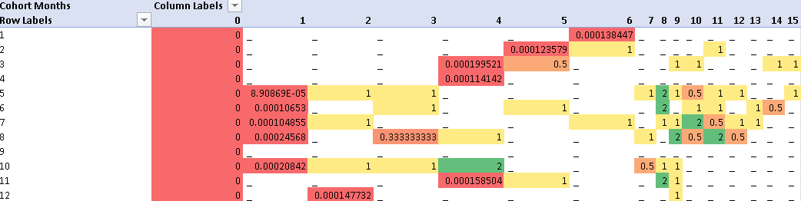
Waterfall Cohort Analysis
Slide- (2-3)
Waterfall Cohort Analysis Table
This type of cohort table helps analyze how customers behave across months after their previous month’s purchase.
How it works :
The rows is showing the cohort month(first purchase month) and columns are the months of purchases and cell are the retention value
Waterfall = count active customer month X / count of active customer (X-1)*100
Color of Retention Performance
Green = Strong Retention
Yellow = Medium Retention
Red = Least Retention
Blanks = Churned customer (no return)

Slide 44
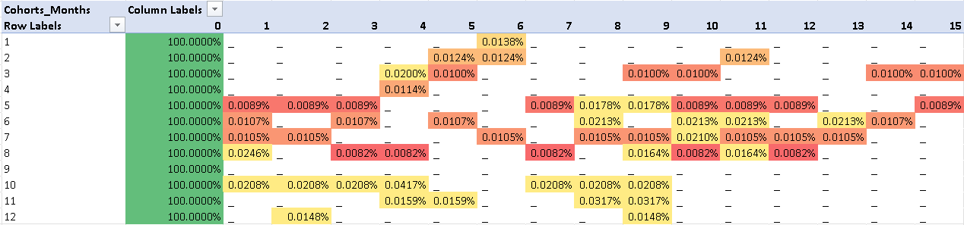
Non_Waterfall Cohort Analysis
Slide- (3-3)
This type of cohort table helps analyze how customers behave across months after their first purchase month
How it works :
The rows is showing the cohort month(first purchase month) and columns are the months of purchases and cell are the retention value
Waterfall = count active customer in month X / Customers in cohort Month 0
Color of Retention Performance
Green = Strong Retention
Yellow = Medium Retention
Red = Least Retention
Blanks = Churned customer (no return)

Slide 45
Thank You

