Slide 1



E‑Commerce Shopping Cart System
Java-based application demonstrating core Object‑Oriented Programming principles for a simulated online store.

Slide 2

Introduction — What this project does
The E‑Commerce Shopping Cart System simulates a typical online shopping flow in Java. It provides a lightweight, educational platform to practise OOP design while delivering end‑to‑end cart and billing functionality.
Add & Manage Items
Add items to cart, adjust quantities and remove unwanted products.
Automatic Calculations
Automatic subtotal, discount, tax computation and final payable amount.
OOP & Data Structures
Built with classes, encapsulation, constructors and Collections/arrays for storage.

Slide 3


Technologies & Architecture
Language: Java
Design: Core OOP — Classes, Objects, Encapsulation
Data: Arrays or Collections (ArrayList, HashMap) ,Constructors,
Methods for cart operations
Features: Add/Remove/View items, Discounts, Tax, Billing
Extensibility: Modular classes for Product, Cart, Billing, User

Slide 4





How the System Works — Process Flow
Select Product
Add to Cart
View Cart
Apply Discount
Calculate Tax
1. Product Selection
Product objects (ID, name, price, qty) are created and selected by the use
2. Cart Management
Cart stores items using Collections; supports update
3. Billing & Checkout
Subtotal → Discount → Tax → Final total. Bill generated as text or GUI receipt.

Slide 5
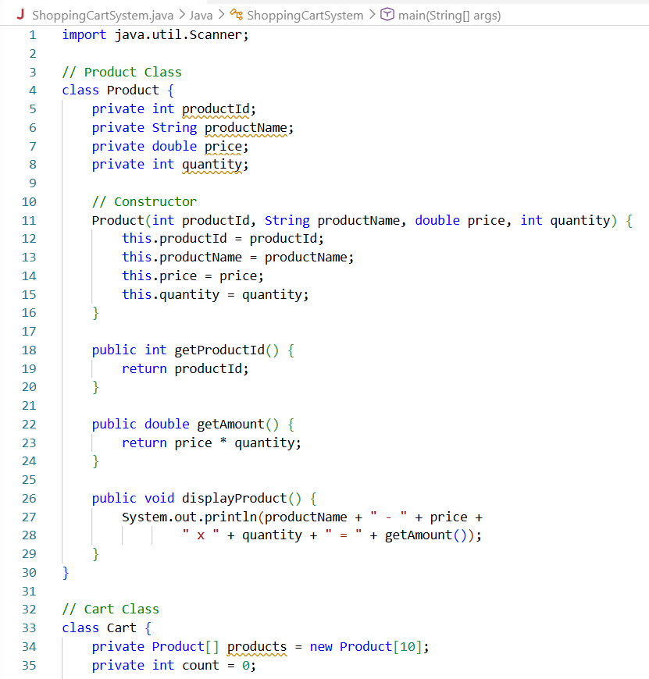
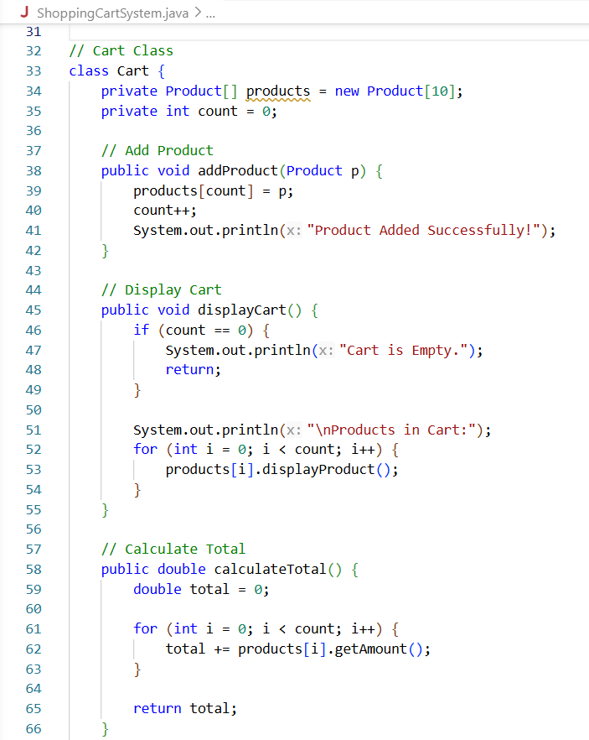
Screenshots — Product Management

Slide 6
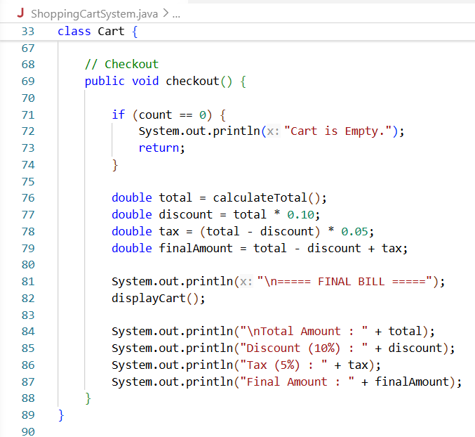
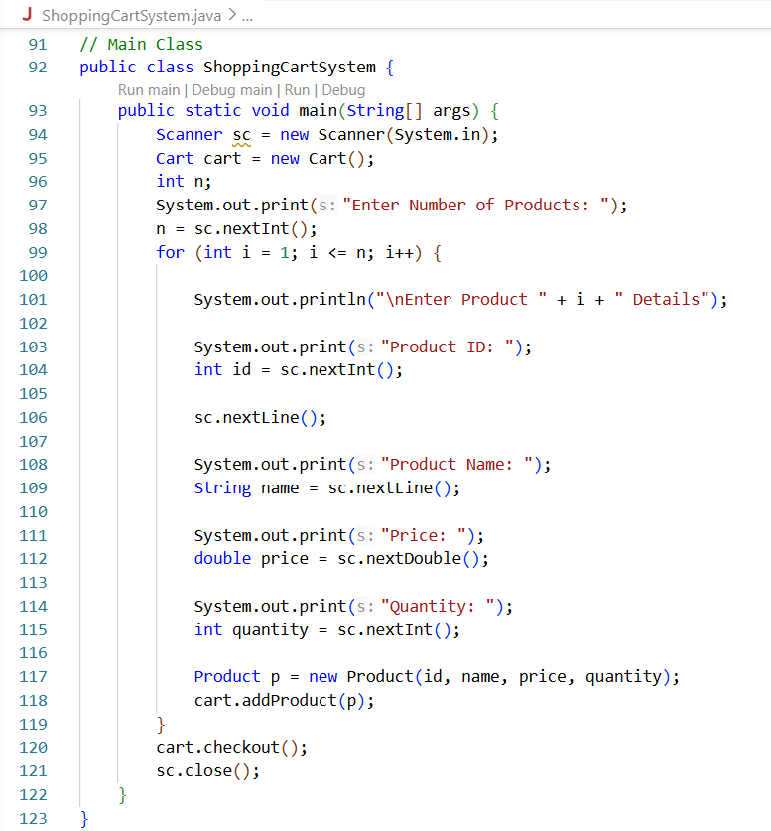
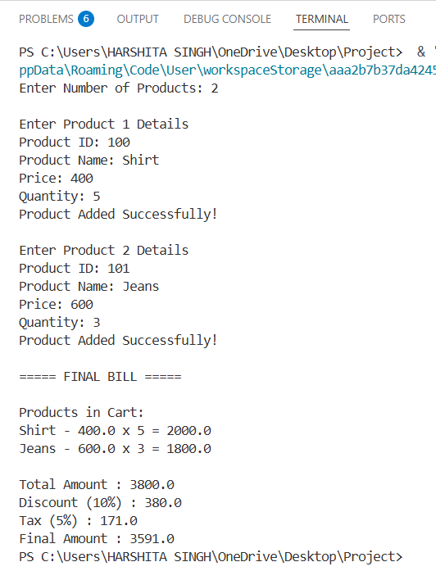
Output:-

Slide 7
Conclusion & Future Scope
Project Outcome
Functional Java shopping cart demonstrating practical OOP design and automated billing features.
Immediate Improvements
Refine GUI with Java Swing, add input validation, unit tests and better error handling.
Planned Extensions
Database integration (MySQL), user accounts, coupon codes, web frontend and payment gateway integration.

Slide 8
Thank
You

