Slide 1
Drug, Side Effects & Medical Condition Analysis
Presented by: Harshita Lalawat
Domain: Data Analyst & Data Scientist | Difficulty: Intermediate
Tools: Python, ML, SQL, Excel
Date: June 2025

Slide 2
Objective
Analyze relationships between: Drugs, Side effects, Conditions, Ratings
Extract insights for pharma analytics & patient safety
Support better treatment decisions

Slide 3
Tools & Technologies
Python (Pandas, NumPy, Seaborn, Matplotlib)
Jupyter / VS Code Notebook
Tableau Public for Dashboard
GitHub for version control

Slide 4
Dataset Overview
2931 rows, 17 columns
Key Features: drug_name, condition, side_effects, rating, pregnancy_category, CSA class
Source: https://drive.google.com/file/d/1zowlhj1S3NY0zHR0tQMoFv_vpgxdCmYL/view

Slide 5
Data Cleaning
Handled missing values (side_effects, ratings, etc.)
Encoded categorical variables (LabelEncoder)
Scaled numerical data (StandardScaler)
Removed duplicates

Slide 6
Exploratory Data Analysis
Ratings: Most drugs rated between 6–8
Top Conditions: Pain, Cold & Flu, Acne
Common Side Effects: Hives, Itching, Breathing issues

Slide 7
Tableau Dashboard
Interactive drug-condition insights
Ratings by drug class
Pregnancy safety categories
Condition-based filters for easy navigation
Link : https://public.tableau.com/app/profile/harshita.lalawat/viz/Drugs_Side_Effects/Dashboard1?publish=yes

Slide 8
Advanced Features
Correlation Heatmaps
Side effect frequency parsing

Slide 9
Conclusion
Pain & Acne are most treated conditions
Hives & Breathing difficulty are common concerns
Ratings vary by class, alcohol interaction, pregnancy safety
Data analytics aids safe prescriptions

Slide 10
Future Scope
Build ML model to predict ratings
Classify side effect severity
Deploy dashboard via Flask/Django
Integrate with hospital APIs

Slide 11
Visualization

Slide 12
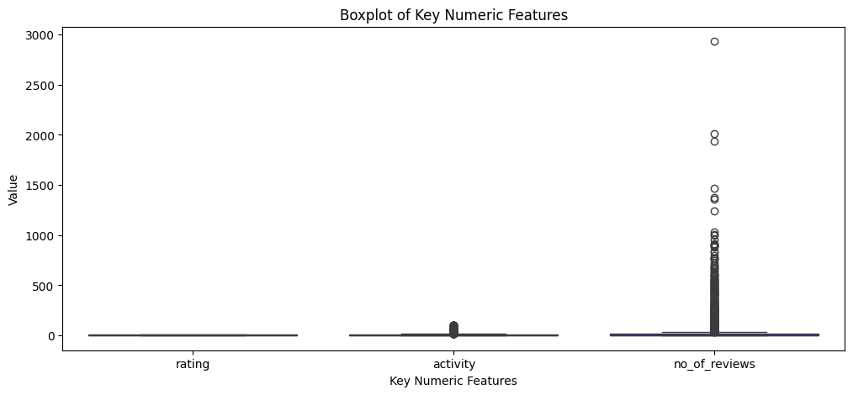
Outliers

Slide 13
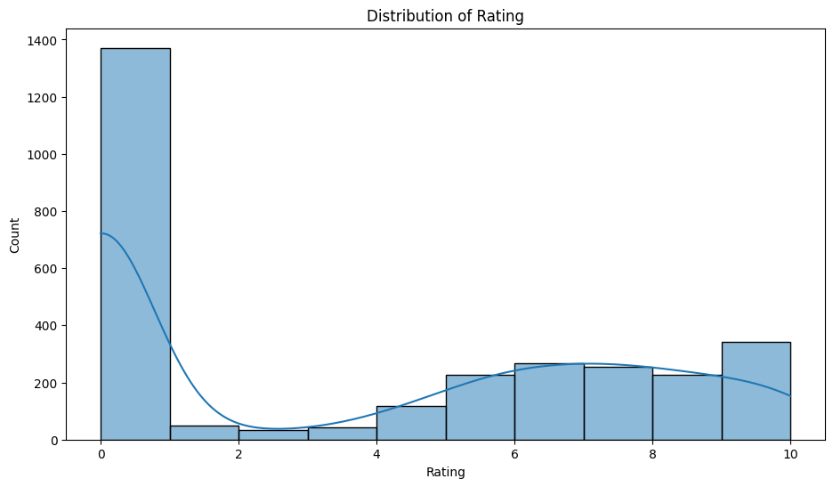
Rating Distribution

Slide 14
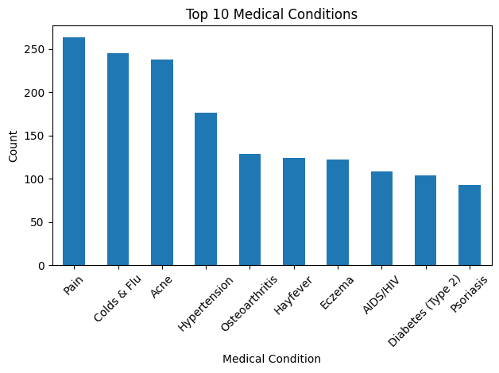
Top 10 Medical Condition

Slide 15
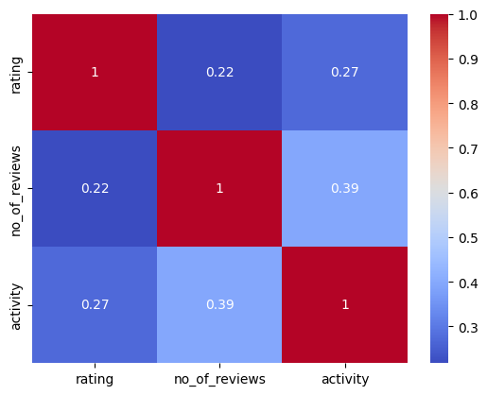
Heatmap for correlation

