Slide 1

SHRI VISHNU ENGINEERING COLLEGE FOR WOMEN (AUTONOMOUS)Bhimavaram COMPUTER SCIENCE AND ENGINEERING II YEAR-II SEMESTER Batch no : 12 MINI PROJECT TOPIC :YOUTUBE TRANSCRIPT SUMMARIZER PRESENTED BY : V.HARSHITA SAI [19B01A05A2] M.SARVANI [19B01A0590] N.RISHIKA [19B01A05C0] M.HARSHITHA [19B01A05A9] K.JAYA SRAVANI [19B01A0571]
GUIDED BY :
MR.A.SEENU M.TECH(PH.D.)

Slide 2
CONTENTS :
1. Introduction
2. Problem Statement
3. Requirements
4. Objectives
5. Proposed System
6. Modules
7. UML diagrams
8. Implementation
9. Conclusion
10. References

Slide 3
INTRODUCTION :
Enormous number of video recordings are being created and shared on the Internet through out the day. It has become really difficult to spend time in watching such videos which may have a longer duration than expected and sometimes our efforts may become futile if we couldn't find relevant information out of it. Summarizing transcripts of such videos automatically allows us to quickly look out for the important patterns in the video and helps us to save time and efforts to go through the whole content of the video.

Slide 4
PROBLEM STATEMENT:
We spend a noticeable amount of our weekly time watching YouTube videos, be it for entertainment, education, or exploring our interests. In most cases, the overall intent is to obtain some form of information from the video. We were seeking a solution to increase the efficiency of this "information extraction" process as YouTube's speed adjustment option is the only relevant tool. And so we decided to develop YouTube Summarizer!

Slide 5
REQUIREMENTS :
SOFTWARE:
IDE : Colab Notebook
Language : Python
Browser : Any type
HARDWARE :
Processor : intel I3
RAM : 8GB
Space on Hard Disk : 500GB

Slide 6
OBJECTIVES :
In our project ,we will be developing a python code in which the the video url is taken as the input parameter
Youtube videos containing transcript are considered becaue youtube transcript api imports only the videos containing transcript.
Here the summarization is based on TextRank algorithm.
The generated summary can be manipulated in terms of length that is the generated summary can be x% of the total summary, x can be either 50.
In the end the generated summary is translated into other languaged using gooletrans python module

Slide 7
PROPOSED SYSTEM :
Even though our current version of Youtube summarizer is able to provide users with valuable information regarding the videos they watch and can provide a compact summary of the video, we believe that this tools can be further developed to meet the needs of YouTubers. While we used advanced online services to provide a summary of the description more accurately analyse and summarize the video more briefly. we believe that we can use a variety of text, audio and video analysis tool to provide valuable information and more accurate summaries for videos. In addition, we believe that using Youtube’s video API, we will be able to provide more control for our users and give them more freedom when using this tool.

Slide 8
MODULES :
1. Extract Transcript text from the given YouTube Video
2. Summarizing the extracted Text (Transcript)
3. Summarize the summary
4. Convert the summary into other major languages

Slide 9
1.Extract Transcript text from the given YouTube Video :
1. Firstly, we would be giving the URL of the video assigning to youtube_video.
2. But it is not necessary of having the complete link we need the video id from that. So, we need to split it as the index value is 1 as assign it to the video_id .
3. from IPython.display import YouTubeVideo
4. This is going to extract the transcript as it is assigning to transcript.From this we would be obtaining a dictionary for list at every point where ever there is a transcript that means for every duration there is a speech (caption) it is going to be recorded and shown.

Slide 10
2. Summarizing the extracted Text (Transcript)
1. We have to summarize the text that we have got (large amount of text) in a meaning full way.We will be using the transformers summary pipeline that is imported from transformers.
2. Here we will be initializing a pipeline for summarization by default it is going to take this model,by this model summerizer that may not work as we have got the large text by default would support this large text and tokens.So, we are creating chunks of the text from the input text that we got.
3. Then print Summarized Text.

Slide 11
3. Summarize the summary
1.We will be having raw text .This raw text is cleaned (text pre-processing).Next it would be dividing the whole text into sentences so that the important sentences will be identified .
2.After that it tokenize the sentences(into words).Then converts these into vectors(numeric values) and then append the word vectors to get a long sentence vector.
3.After that creating a similarity matrix(having n rows and n columns where n is no of sentences) and then create a graph out of similarity matrix (for text summarization)we need to extract the sentences. So,nodes will be sentences ,edges are similarity.Next rank the nodes(using page ranking algorithm).Next output the top key sentences.
4.In this way the summary will be summarized. For this process it is needed to install summa.
5. Next we will be converting the text1 which is list into string and store in text.And the we will be given ratio so that according to that ratio the summary would get summarized

Slide 12
4. Convert the summary into other major languages
1.We can convert one/more statements or passages from one
language to another language.We have to specify which language
we have to covert.
2. For this , we have to install google trans module for doing this
translation.
3. Print Translated Text.

Slide 13
UML DIAGRAMS :
UML diagrams is a visualizing model for representing the system architecture and design. These diagrams help us to know the flow of the system.
Some of them are
1. Use Case Diagram
2. Class Diagram
3. Sequence Diagram
4. Activity Diagram
5. State Chart Diagram

Slide 14
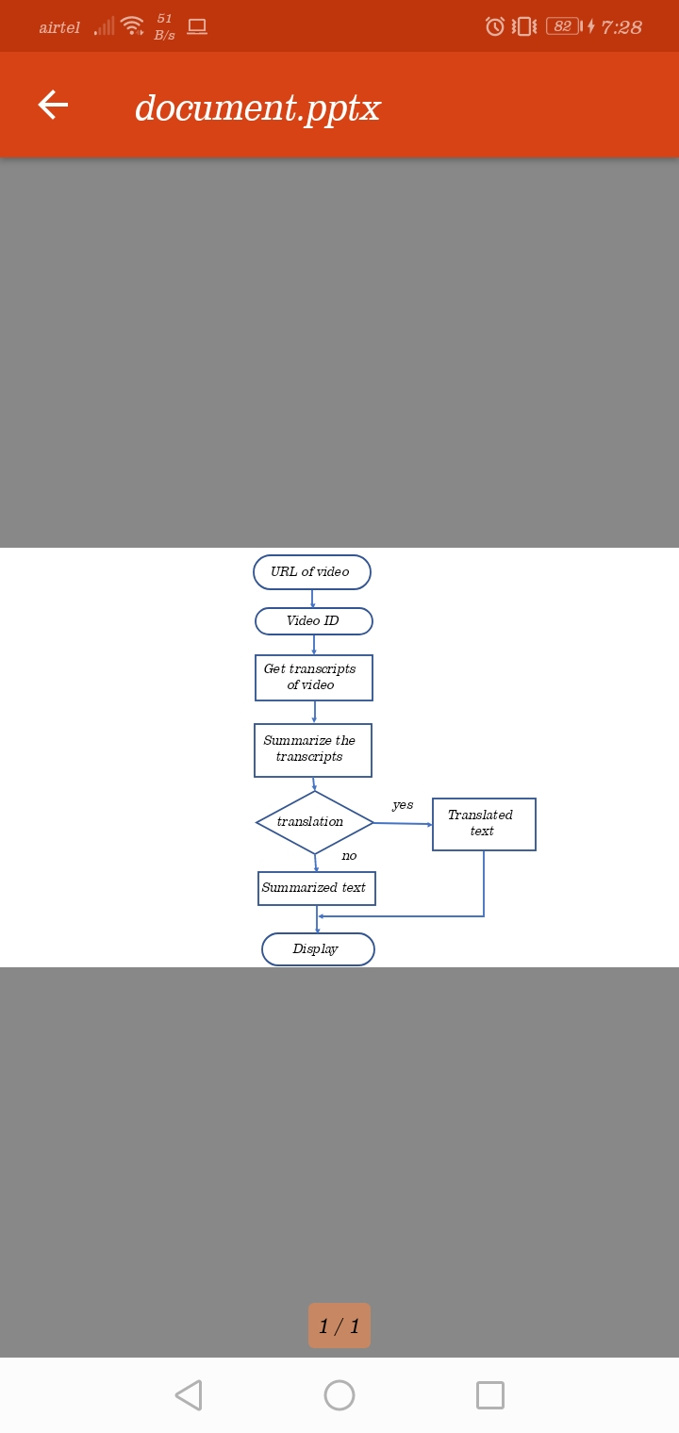
SYSTEM DESIGN :

Slide 15
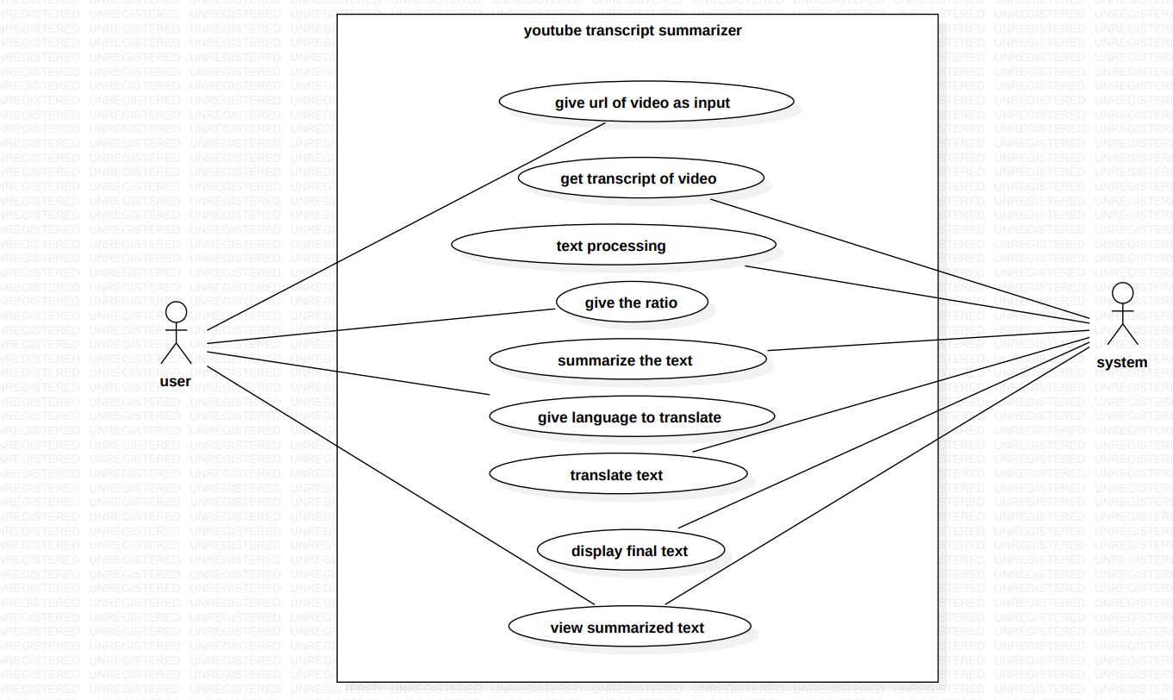
USE CASE DIAGRAM:

Slide 16
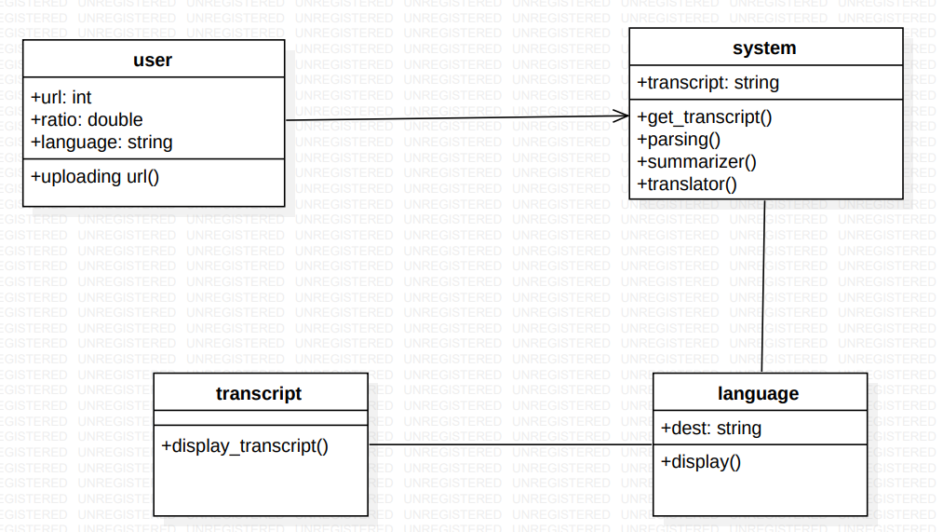
CLASS DIAGRAM

Slide 17
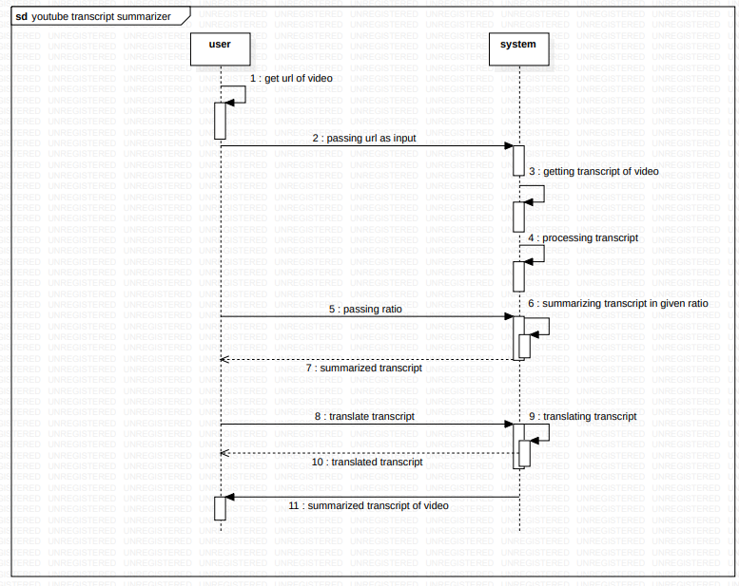
SEQUENCE DIAGRAM

Slide 18
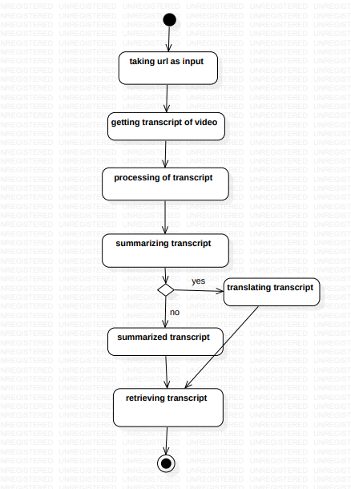
ACTIVITY DIAGRAM

Slide 19
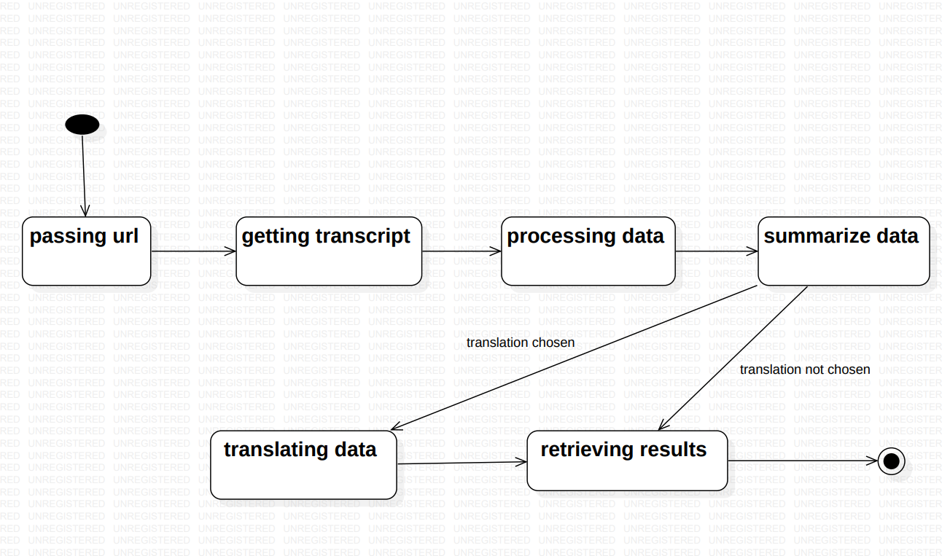
STATE CHART DIAGRAM

Slide 20
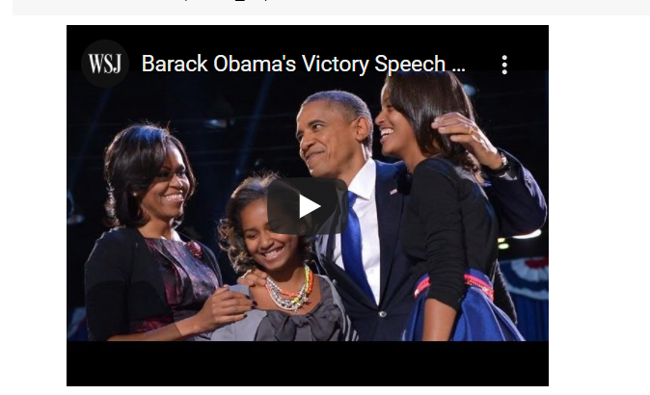
IMPLEMENTATION :
1. Youtube Video

Slide 21
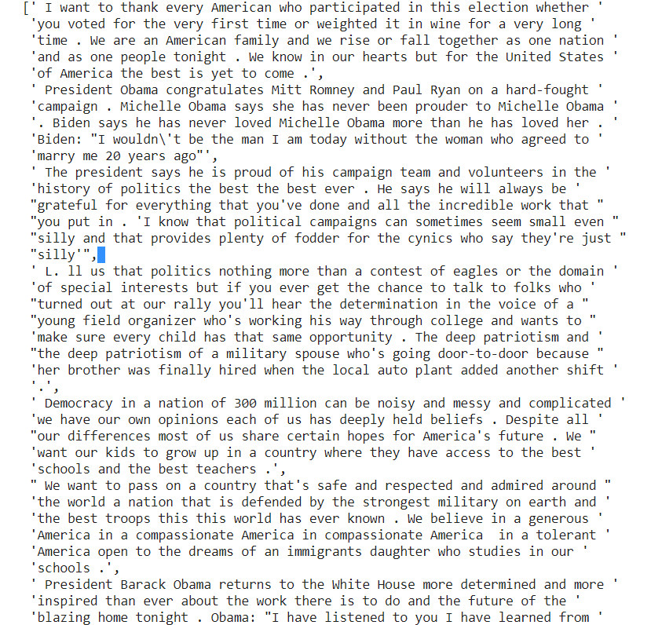
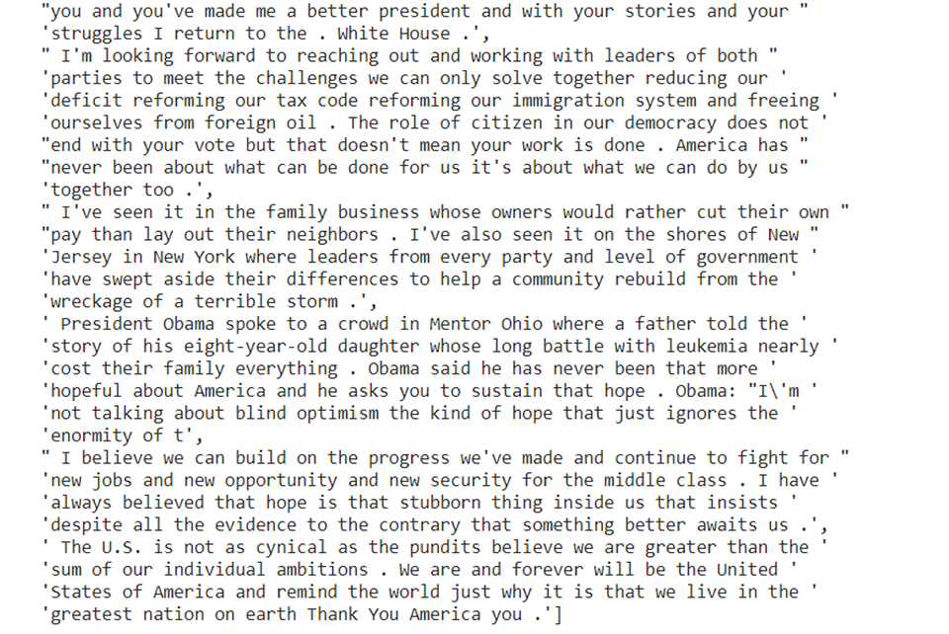
2.Summarized text

Slide 22
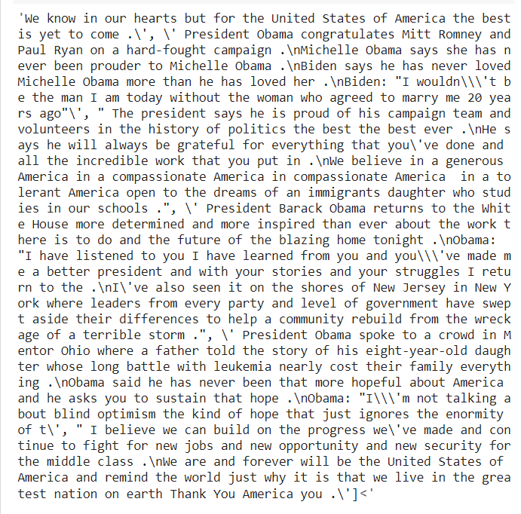
3.Summarization based on ratio

Slide 23
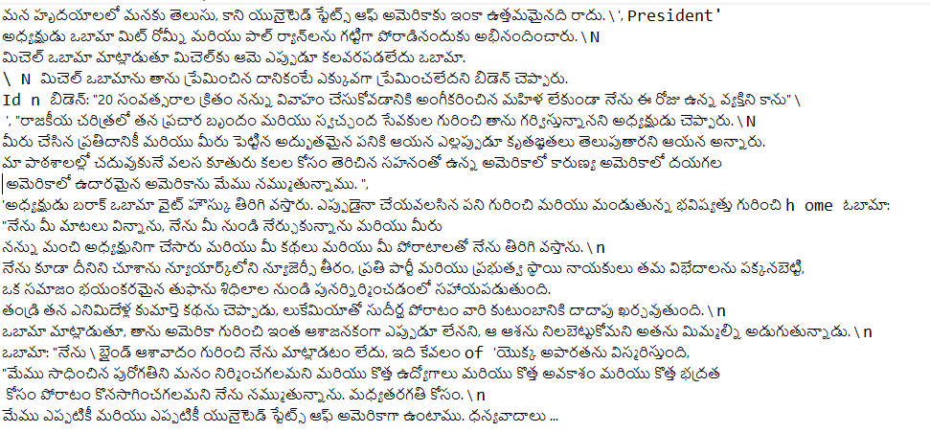
4.Translate to other languages

Slide 24
CONCLUSION:
This project is mainly focused on the shortening of the valuable time of the people by summarising a huge amount of information that people tend to get on daily bases via youtube. In our project along with the text summarization we performed text translation that is the generated text can be translated into different languages
The main objective of translation is to transfer the intent of a message and original tone, taking into consideration regional and cultural differences between target and source languages.
Nowadays, translation is a field that is seeing a lot of activity these days, it’s all because of the increasing globalization of businesses. There is a large number of people in a country that do not speak their local language well.
So even if any person encountering the problem would rely on this tool for the information needed in one's daily life

Slide 25
REFERENCES :
1. https://youtu.be/XO97Uon83Os
2. https://youtu.be/aOL7wzEIZSc
3. https://pypi.org/project/youtube-transcript-api/
4. https://www.kdnuggets.com/2021/02/hugging-face-transformer-basics.html

Slide 26


