Slide 1
FINAL PROJECT
PLANT DISEASE CLASSIFICATION
HARSHITAA G A
PSG Institute of Technology and Applied Research
B.E. Computer Science and Engineering
NM id: au715521104016
Email: harshitaa1103@gmail.com
3/21/2024 Annual Review

Slide 2
PLANT DISEASE CLASSIFICATION
The project focuses on leveraging deep learning techniques for plant disease classification, aiming to assist farmers and agricultural experts in early disease detection and management. By harnessing the power of convolutional neural networks (CNNs) and image processing algorithms, this system can accurately identify various diseases affecting crops based on images of plant leaves.
3/21/2024 Annual Review

Slide 3


AGENDA
Problem Statement
Project overview
End Users
Proposed solution
Algorithm & Deployment
Modelling
Result
3/21/2024 Annual Review

Slide 4

PROBLEM STATEMENT
Plant diseases pose a significant threat to crop health and agricultural productivity, leading to substantial yield losses and economic hardships for farmers worldwide. Early detection and effective management of these diseases are crucial for mitigating their impact and ensuring food security. The task is to develop a robust and efficient plant disease classification system using deep learning techniques to accurately identify diseases affecting various crops based on images of plant leaves.
3/21/2024 Annual Review

Slide 5

PROJECT OVERVIEW
The plant disease classification project aims to develop a robust and efficient deep learning-based system for accurately identifying diseases affecting various crops based on images of plant leaves. The project encompasses several key components, including dataset collection, model development, training, evaluation, deployment, and impact assessment.
3/21/2024 Annual Review

Slide 6

WHO ARE THE END USERS?
Farmers: Need accurate disease identification for crop protection.
Extension Officers: Use system for on-field assessments and advice.
Researchers: Study disease patterns and enhance algorithms.
Agri-Tech Companies: Integrate system for monitoring and advisory services.
Government Agencies: Monitor outbreaks and formulate interventions.
Educational Institutions: Use for practical learning in agriculture.
3/21/2024 Annual Review

Slide 7

YOUR SOLUTION AND ITS VALUE PROPOSITION
A deep learning-based plant disease classification system that accurately identifies diseases in crops using image processing techniques and machine learning algorithms.
Accuracy: Enables precise disease identification for timely intervention.
Efficiency: Automates detection, saving time over manual methods.
Scalability: Handles large datasets and diverse crops effectively.
Innovation: Leverages technology for sustainable agriculture solutions.
3/21/2024 Annual Review

Slide 8

THE WOW IN YOUR SOLUTION
The plant disease classification system utilizes a curated dataset and ResNet-34(is a CNN) model with pretrained weights for accurate disease detection. Managed by the Trainer class, training is streamlined for iterative model refinement. Dynamic optimizer selection and scheduler configuration enable tailored training parameters, while integrated logging provides comprehensive insights into training metrics for informed decision-making. This system enhances crop health management for sustainable agriculture.The dataset contains three labels: Healthy, Powdery, Rust referring to plant conditions. There is a total of 1530 images divided into train, test, and validation sets.
3/21/2024 Annual Review

Slide 9
MODELLING
In modeling the plant disease classification system, a ResNet-34 architecture serves as the backbone for effective disease detection. This model, pre-trained on ImageNet, offers a robust foundation for feature extraction and classification. With its deep layers and skip connections, ResNet-34 can capture intricate patterns in plant images, crucial for distinguishing between healthy and diseased plants. Additionally, a custom fully connected layer is integrated to adapt the model for plant disease classification, enabling it to output probabilities through softmax activation. By leveraging this powerful model architecture, the system can achieve high accuracy in identifying various plant diseases, aiding farmers and agricultural professionals in timely and precise intervention measures.
3/21/2024 Annual Review

Slide 10
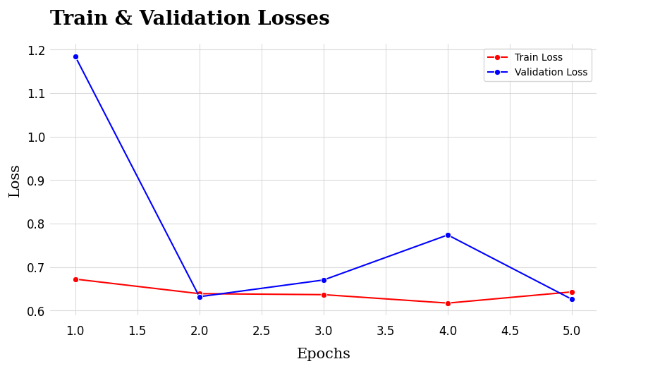
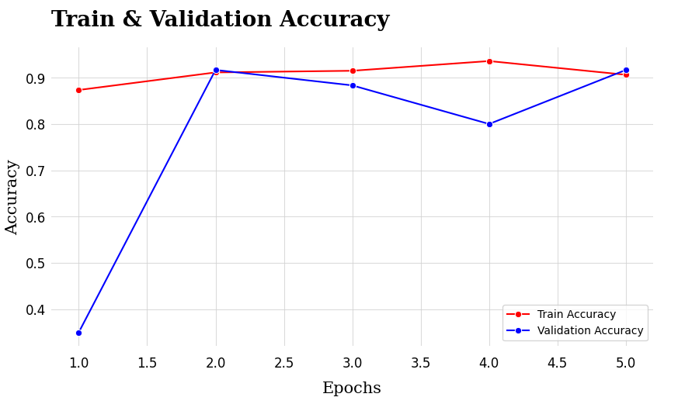
RESULTS
Demo Link
3/21/2024 Annual Review

