Slide 1
FINAL PROJECT
PLANT DISEASE CLASSIFICATION
HARSHITAA G A
PSG Institute of Technology and Applied Research
B.E. Computer Science and Engineering
NM id: au715521104016
Email: harshitaa1103@gmail.com
3/21/2024 Annual Review

Slide 2
PROJECT TITLE
Title: Plant Disease Classification System
Description : The project focuses on leveraging deep learning techniques for plant disease classification, aiming to assist farmers and agricultural experts in early disease detection and management. By harnessing the power of convolutional neural networks (CNNs) and image processing algorithms, this system can accurately identify various diseases affecting crops based on images of plant leaves.
3/21/2024 Annual Review

Slide 3


AGENDA
Problem Statement
Project overview
End Users
Proposed solution
Algorithm & Deployment
Modelling
Result
3/21/2024 Annual Review

Slide 4

PROBLEM STATEMENT
Plant diseases pose a significant threat to crop health and agricultural productivity, leading to substantial yield losses and economic hardships for farmers worldwide.
Early detection and effective management of these diseases are crucial for mitigating their impact and ensuring food security.
The task is to develop a robust and efficient plant disease classification system using deep learning techniques to accurately identify diseases affecting various crops based on images of plant leaves.
3/21/2024 Annual Review

Slide 5

PROJECT OVERVIEW
The plant disease classification project aims to develop a robust and efficient deep learning-based system for accurately identifying diseases affecting various crops based on images of plant leaves.
Including a curated dataset and a state-of-the-art ResNet-34 convolutional neural network (CNN) model with pretrained weights, ensuring highly accurate disease detection.
The project encompasses several key components, including dataset collection, model development, training, evaluation, deployment, and impact assessment.
3/21/2024 Annual Review

Slide 6

WHO ARE THE END USERS?
Farmers: Primary users who benefit from accurate and timely disease identification for crop protection and increased yield.
Agricultural Extension Officers: Utilize the system for on-field assessments and providing technical advice to farmers.
Researchers and Scientists: Employ the system for studying disease patterns, developing new management techniques, and enhancing detection algorithms.
Agri-Tech Companies: Integrate the system into agricultural technology solutions to enhance monitoring and advisory services.
Government Agencies and Policy Makers: Use the system for monitoring disease outbreaks, assessing impact, and formulating targeted interventions for food security.
Educational Institutions: Incorporate the system into curriculum and research activities for practical learning in agriculture and machine learning applications.
3/21/2024 Annual Review

Slide 7

YOUR SOLUTION AND ITS VALUE PROPOSITION
A deep learning-based plant disease classification system that accurately identifies diseases in crops using image processing techniques and machine learning algorithms.
Accuracy: Enables precise disease identification for timely intervention.
Precision: Ensures precise identification of diseases in crops, providing farmers and agricultural professionals with accurate diagnostic results.
Efficiency: Automates detection, saving time over manual methods.
Scalability: Handles large datasets and diverse crops effectively.
Innovation: Leverages technology for sustainable agriculture solutions.
Timeliness: Enables timely intervention and treatment, helping to prevent the spread of diseases and minimize crop damage.
3/21/2024 Annual Review

Slide 8

THE WOW IN YOUR SOLUTION
This plant disease classification system distinguishes itself through the integration of advanced deep learning techniques, including a curated dataset and a state-of-the-art ResNet-34 convolutional neural network (CNN) model with pretrained weights, ensuring highly accurate disease detection. Additionally, this solution offers dynamic optimizer selection, with the ADAM optimizer being a key component, and scheduler configuration, enabling users to tailor training parameters to diverse agricultural settings. This level of customization enhances adaptability and effectiveness. The inclusion of integrated logging provides comprehensive insights into training metrics, empowering users with valuable information for informed decision-making. Featuring a robust dataset with three distinct labels (Healthy, Powdery, Rust) and a total of 1530 images divided into train, test, and validation sets, this system underscores reliability and robustness, making it a remarkable tool for plant disease classification and management. Moreover, this solution's contributions to sustainable agriculture practices and food security highlight its broader societal impact, further emphasizing its significance in crop health management.
3/21/2024 Annual Review

Slide 9
MODELLING
Training: Utilize transfer learning with ResNet-34 pre-trained on ImageNet.Fine-tune the fully connected layer for plant disease classification.Apply data augmentation techniques such as rotation, flipping, and scaling to improve model generalization.
Performance Evaluation: Assess model accuracy, precision, recall, and F1-score on a validation dataset.Monitor loss curves during training to ensure convergence and prevent overfitting.Conduct error analysis to identify common misclassifications and areas for improvement.
Hyperparameters: Experiment with learning rate, batch size, and regularization techniques (e.g., weight decay, dropout) to optimize model performance.Adjust the number of training epochs based on validation performance to prevent underfitting or overfitting.
Deployment: Convert the trained model to a deployable format such as ONNX or TensorFlow SavedModel.Develop an inference pipeline for real-time or batch prediction.Deploy the model in a web service or mobile application, ensuring monitoring for performance and usage.
3/21/2024 Annual Review

Slide 10
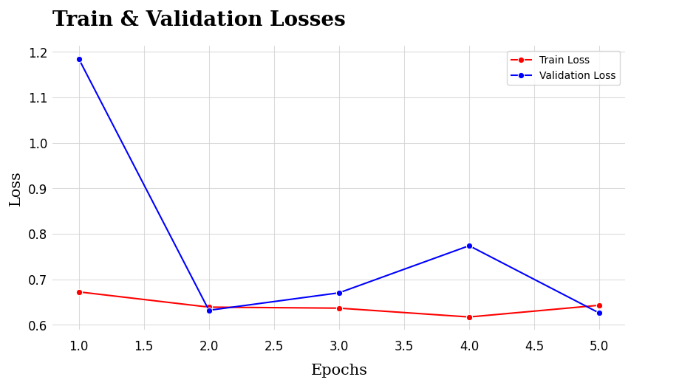
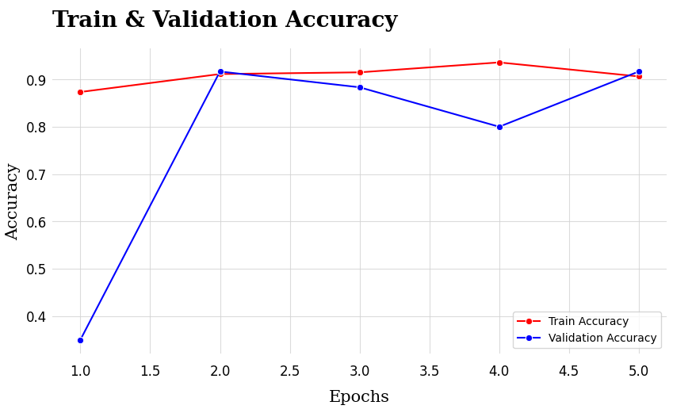
RESULTS
Demo Link
3/21/2024 Annual Review

