Slide 1
FINAL PROJECT
PLANT DISEASE CLASSIFICATION
HARSHITAA G A
PSG Institute of Technology and Applied Research
B.E. Computer Science and Engineering
NM id: au715521104016
Email: harshitaa1103@gmail.com
3/21/2024 Annual Review

Slide 2
PROJECT TITLE
Title: Plant Disease Classification System
Description : The project focuses on leveraging deep learning techniques for plant disease classification, aiming to assist farmers and agricultural experts in early disease detection and management. By harnessing the power of convolutional neural networks (CNNs) and image processing algorithms, this system can accurately identify various diseases affecting crops based on images of plant leaves.
3/21/2024 Annual Review

Slide 3


AGENDA
Problem Statement
Project overview
End Users
Proposed solution
Algorithm & Deployment
Modelling
Result
3/21/2024 Annual Review

Slide 4

PROBLEM STATEMENT
Plant diseases pose a significant threat to crop health and agricultural productivity, leading to substantial yield losses and economic hardships for farmers worldwide.
Early detection and effective management of these diseases are crucial for mitigating their impact and ensuring food security.
The task is to develop a robust and efficient plant disease classification system using deep learning techniques to accurately identify diseases affecting various crops based on images of plant leaves.
3/21/2024 Annual Review

Slide 5

PROJECT OVERVIEW
The plant disease classification project aims to develop a robust and efficient deep learning-based system for accurately identifying diseases affecting various crops based on images of plant leaves.
Including a curated dataset and a state-of-the-art ResNet-34 convolutional neural network (CNN) model with pretrained weights, ensuring highly accurate disease detection.
The project encompasses several key components, including dataset collection, model development, training, evaluation, deployment, and impact assessment.
3/21/2024 Annual Review

Slide 6

WHO ARE THE END USERS?
Farmers: Primary users who benefit from accurate and timely disease identification for crop protection and increased yield.
Agricultural Extension Officers: Utilize the system for on-field assessments and providing technical advice to farmers.
Researchers and Scientists: Employ the system for studying disease patterns, developing new management techniques, and enhancing detection algorithms.
Agri-Tech Companies: Integrate the system into agricultural technology solutions to enhance monitoring and advisory services.
Government Agencies and Policy Makers: Use the system for monitoring disease outbreaks, assessing impact, and formulating targeted interventions for food security.
Educational Institutions: Incorporate the system into curriculum and research activities for practical learning in agriculture and machine learning applications.
3/21/2024 Annual Review

Slide 7

YOUR SOLUTION AND ITS VALUE PROPOSITION
A deep learning-based plant disease classification system that accurately identifies diseases in crops using image processing techniques and machine learning algorithms.
Accuracy: Enables precise disease identification for timely intervention.
Precision: Ensures precise identification of diseases in crops, providing farmers and agricultural professionals with accurate diagnostic results.
Efficiency: Automates detection, saving time over manual methods.
Scalability: Handles large datasets and diverse crops effectively.
Innovation: Leverages technology for sustainable agriculture solutions.
Timeliness: Enables timely intervention and treatment, helping to prevent the spread of diseases and minimize crop damage.
3/21/2024 Annual Review

Slide 8

THE WOW IN YOUR SOLUTION
Our plant disease classification system stands out for its utilization of advanced deep learning techniques, including a curated dataset and a state-of-the-art ResNet-34 convolutional neural network (CNN) model with pretrained weights, ensuring highly accurate disease detection. Moreover, our system offers dynamic optimizer selection and scheduler configuration, allowing users to tailor training parameters to their specific needs. This level of customization enhances the system's adaptability and effectiveness across diverse agricultural settings. Additionally, the inclusion of integrated logging provides comprehensive insights into training metrics, empowering users with valuable information for informed decision-making. By leveraging these cutting-edge technologies and techniques, our solution significantly enhances crop health management, contributing to sustainable agriculture practices and food security. The dataset, featuring three distinct labels (Healthy, Powdery, Rust) and a total of 1530 images divided into train, test, and validation sets, underscores the robustness and reliability of our system, making it a truly remarkable tool for plant disease classification and management.
3/21/2024 Annual Review

Slide 9
MODELLING
In the modeling phase, the utilization of ResNet-34 architecture stands out as a cornerstone for robust disease detection. Leveraging pre-trained weights from ImageNet via transfer learning, this architecture offers a solid foundation for feature extraction and classification. ResNet-34 demonstrates remarkable proficiency in capturing intricate patterns inherent in plant images.
To tailor the model specifically for plant disease classification, a custom fully connected layer is seamlessly integrated. This additional layer enables the model to adapt its learned features precisely to the task at hand, facilitating the generation of accurate predictions through softmax activation. By harnessing the potency of this sophisticated model architecture, the system is well-equipped to achieve remarkable accuracy in identifying a diverse range of plant diseases.
This modeling approach not only enhances the efficiency of disease detection but also underscores the system's potential to revolutionize crop health management practices.
3/21/2024 Annual Review

Slide 10
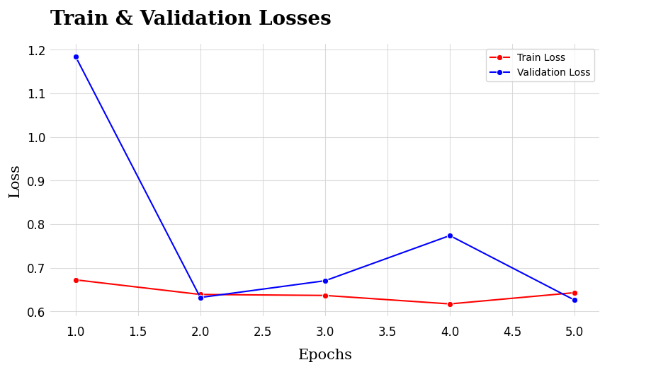
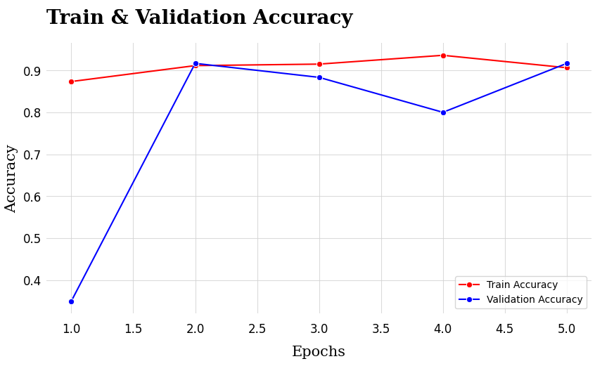
RESULTS
Demo Link
3/21/2024 Annual Review

