Slide 1
Python Calculator with Voice Input
Project 2 | NextHikes IT Solutions
Presented by Harshita
Python
Tkinter
VS Code
GitHub
Notes:
Hello. My name is Harshita. This is my Project 2: a calculator built with Python and Tkinter that also understands voice.

Slide 2
About the Project
A desktop calculator made with Python and Tkinter.
Learn by building
Practise Python on a real working app.
Clean dark design that is easy on the eyes
Basic keys in the main window
Advanced keys in a separate Advance window
Works with mouse, keyboard and voice
Create a GUI
Make windows, buttons and a display with Tkinter.
Easy to use
Simple layout so anyone can use it quickly.
Notes:
Explain simply: it is a desktop calculator. I built it to learn Python by making something real.

Slide 3
Tools and Technologies
Python 3
Tkinter
VS Code
The programming language used for all the logic.
Python's built-in library for windows and buttons.
Code editor used to write, run and fix the code.
GitHub
SpeechRecognition + sounddevice
Online storage that keeps my code safe and shareable.
Listen to the microphone and turn speech into text.
Notes:
Say what each tool does in one line. Python is the language, Tkinter makes the window, VS Code is where I wrote the code, GitHub stores it.

Slide 4
Features
Main Calculator
Advance Window
Add, subtract, multiply, divide and %
Clear (C), backspace and +/- keys
Decimal point for numbers like 2.5
Clear message for divide by zero
sin, cos, tan and their inverse (2nd key)
log, ln, square root, power and n!
pi, e, brackets and 1/x
DEG / RAD angle mode
Voice input | History | Keyboard support
Notes:
Main window has everyday keys. The Advance window has science keys. Voice, history and keyboard work with both.

Slide 5
How It Works
Keys and keyboard
Press a key
Mouse or keyboard
Display
Text is shown
Safe evaluator
Solves the text
Answer
Shown and saved
>
>
>
Voice
Speak
Mic listens 5 sec
Speech to text
Google service
Words to maths
'5 plus 3' = 5+3
Same evaluator
Answer shown
>
>
>
Safe evaluator: only numbers, operators and allowed functions are solved.
Notes:
Every input becomes text on the display. A safe evaluator solves it. I did not use eval() because it can run unsafe code.

Slide 6
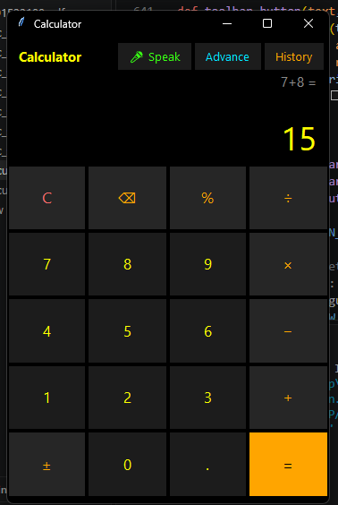
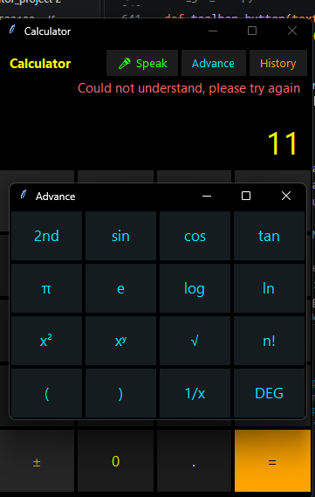
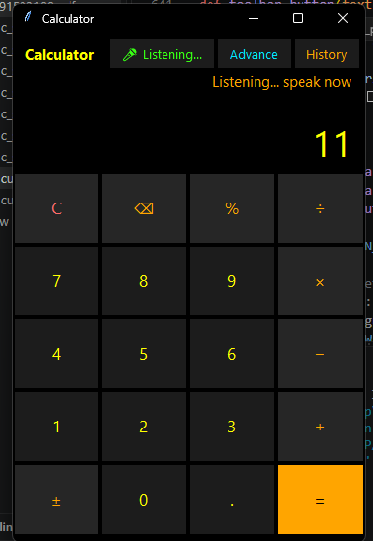
Output
Paste screenshot here
Paste screenshot here
Paste screenshot here
Main Calculator
Advance Window
Voice Input
Notes:
Show each screenshot and explain it: first the main window, then Advance, then a voice calculation.

Slide 7
What I Learned and Challenges
What I learned
Challenges and solutions
Functions, loops and if / else
Error handling with try / except
Lists and dictionaries
Building a GUI with buttons and events
Using libraries and GitHub
eval() can run unsafe code
Wrote a safe evaluator instead.
Long numbers did not fit
Display font shrinks automatically.
Voice library failed on Python 3.14
Used sounddevice instead of PyAudio.
Notes:
Be honest about problems. Each problem taught me something useful.

Slide 8
Conclusion and Future Scope
Conclusion
Future scope
Works with mouse, keyboard and voice
Safe, accurate and easy to use
Good practice of Python, GUI and GitHub
Memory keys (M+ and M-)
Unit converter
Save history in a file
Light and dark theme switch
Hindi voice support
Thank you!
Notes:
Finish with what works and what I want to add next. Then show the GitHub link.

