Slide 1
Detecting Deepfake Images using Convolutional Neural Networks
Prof. Syed Jawad Shah
Venkat Lakkireddy
Pratyusha Kasireddygari
Harshith Reddy Revoori

Slide 2
Project Objective
Develop a deep learning model to classify images as real or fake.
Use CNNs for their ability to capture spatial hierarchies in images.

Slide 3
Dataset Description
Source: Kaggle, “Deepfake and Real Images” dataset.
Structure:Train: Images for training the model.
Test: Images for evaluating model performance.
Validation: Images for tuning the model.
Subfolders: Real and Fake images in each directory.

Slide 4
Data Preparation
Organized images into respective directories.
Preprocessed images by resizing to 32x32 pixels.
Normalized pixel values to [0, 1] range.

Slide 5
Data Augmentation
Techniques: Rescaling, Shear Transformation, Zoom, Horizontal Flip.
Helps to generalize the model and prevent overfitting.

Slide 6
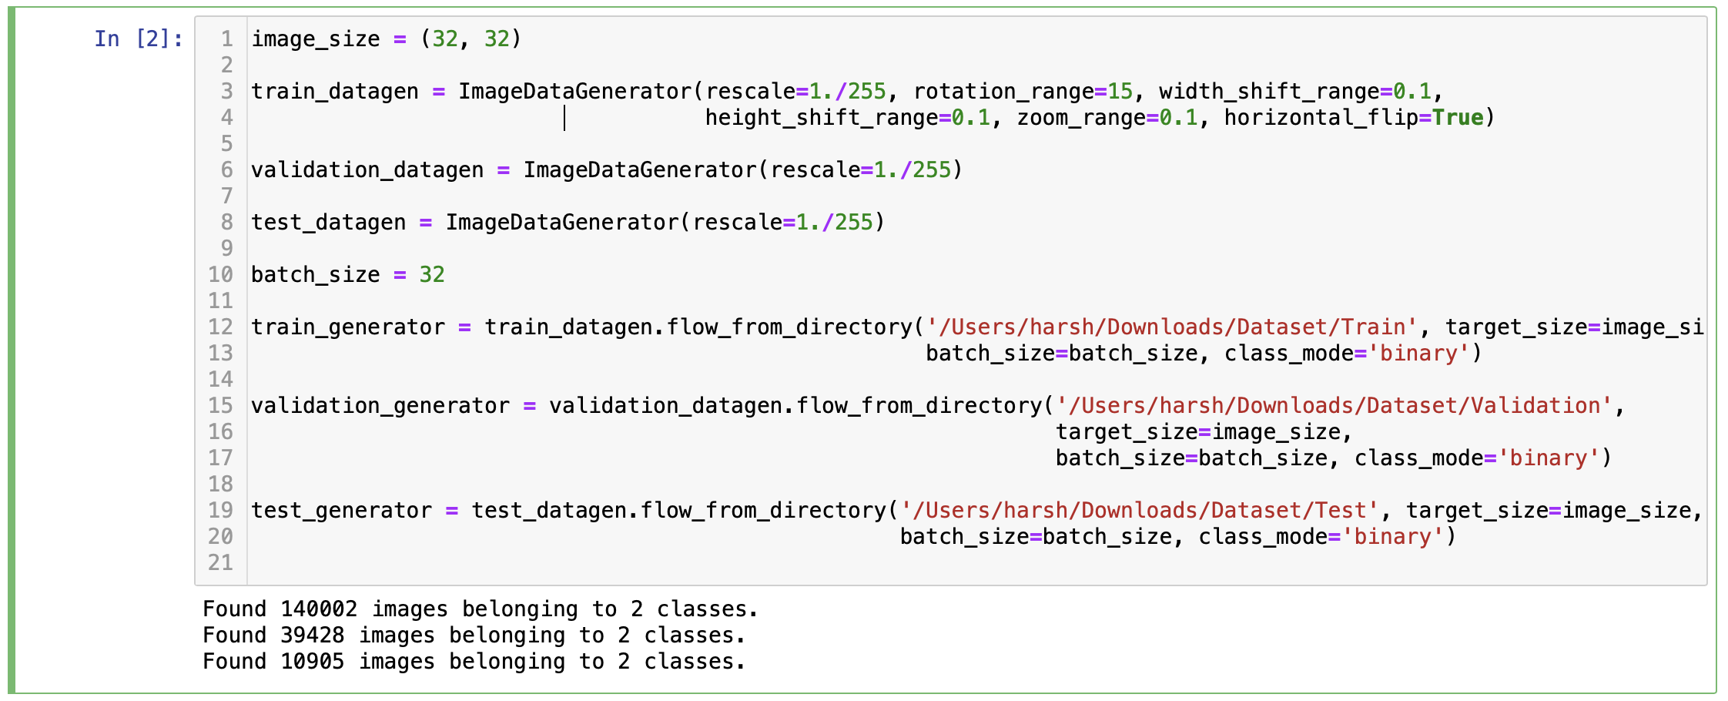

Slide 7
CNN Architecture
Layers: Convolutional: Extract features using filters.
MaxPooling: Reduce spatial dimensions.
Flatten: Convert 2D matrices to 1D.
Dense: Fully connected layers for classification.
Dropout: Prevent overfitting by randomly dropping neurons.

Slide 8
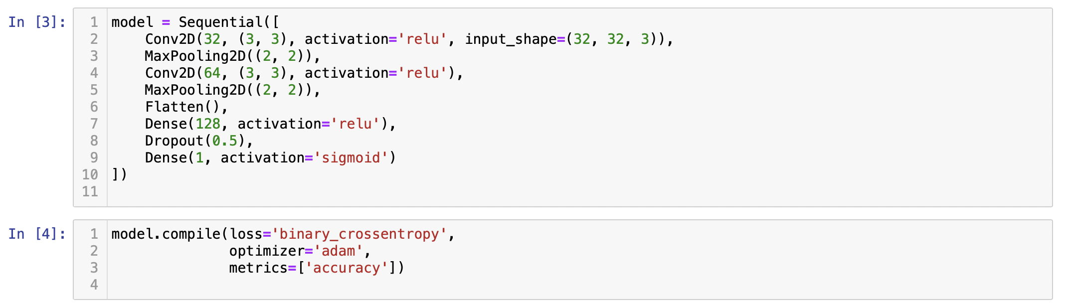

Slide 9
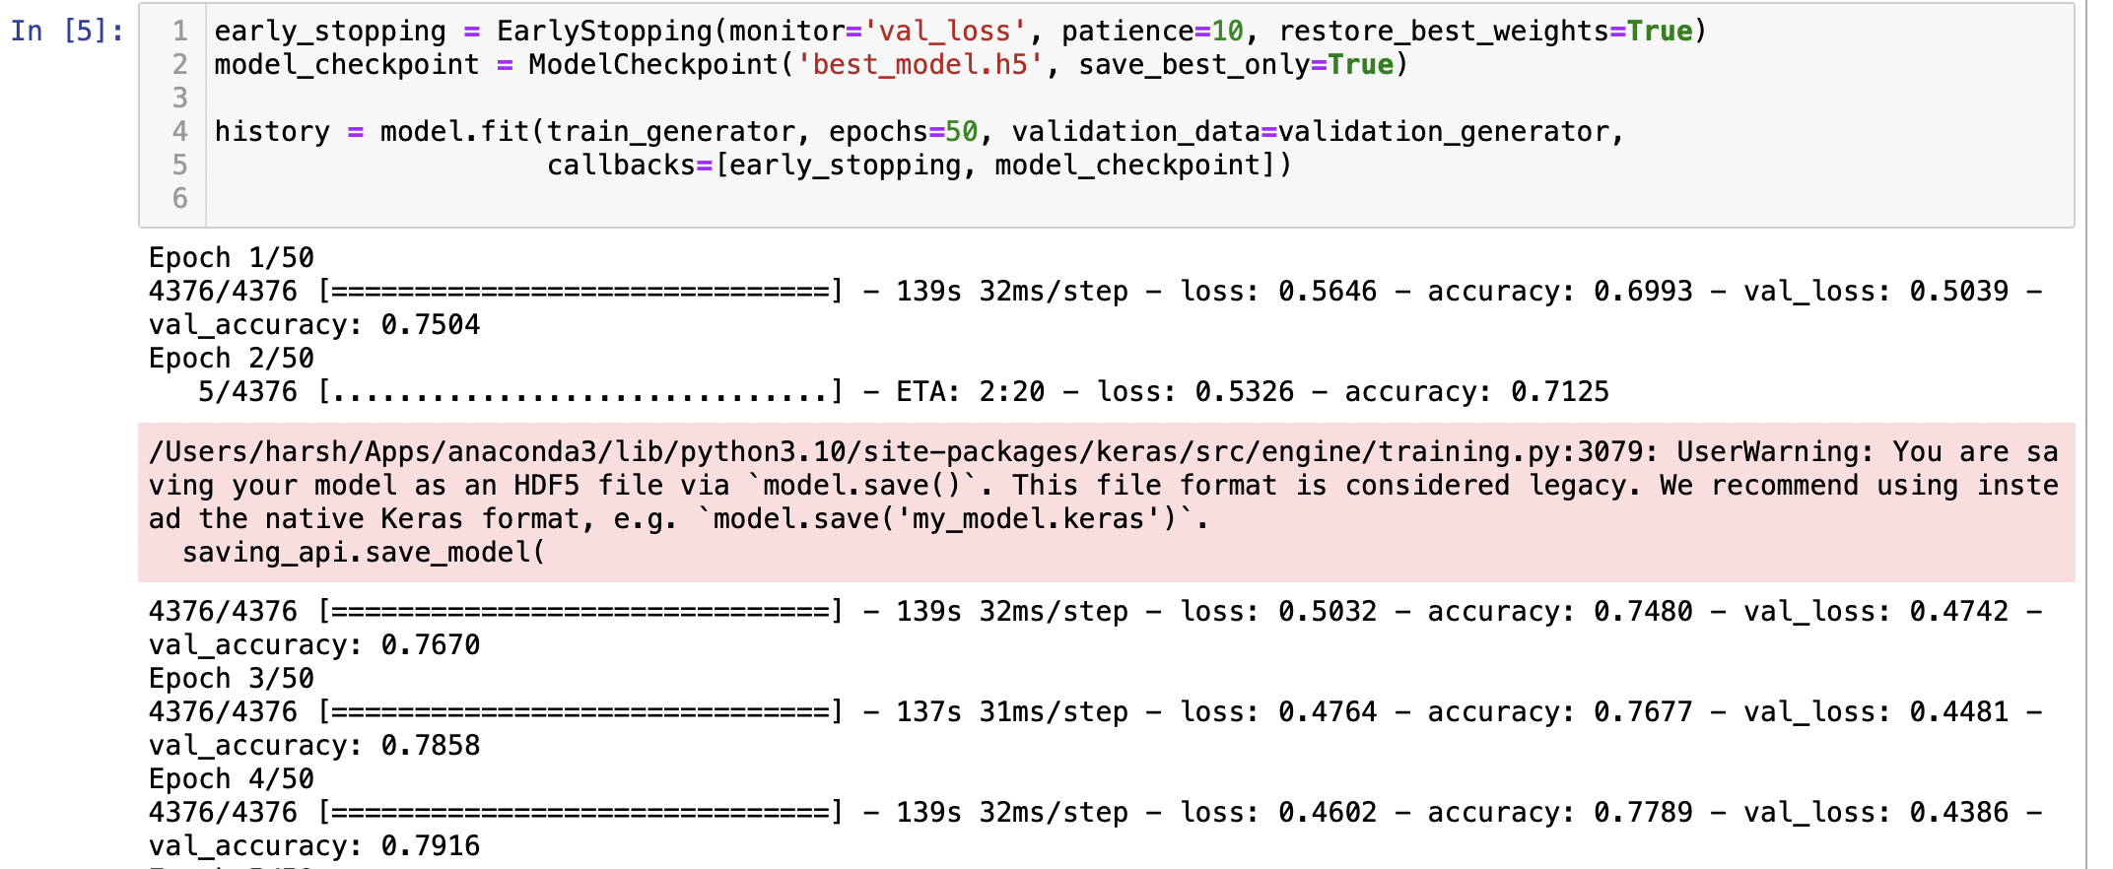
Training the Model
Trained for 50 epochs.
Batch size of 32 for efficient processing.

Slide 10
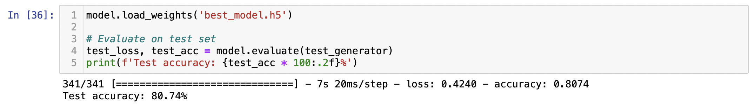
Model Performance
Training and validation accuracy/loss graphs.
Demonstrated the model’s learning curve.

Slide 11
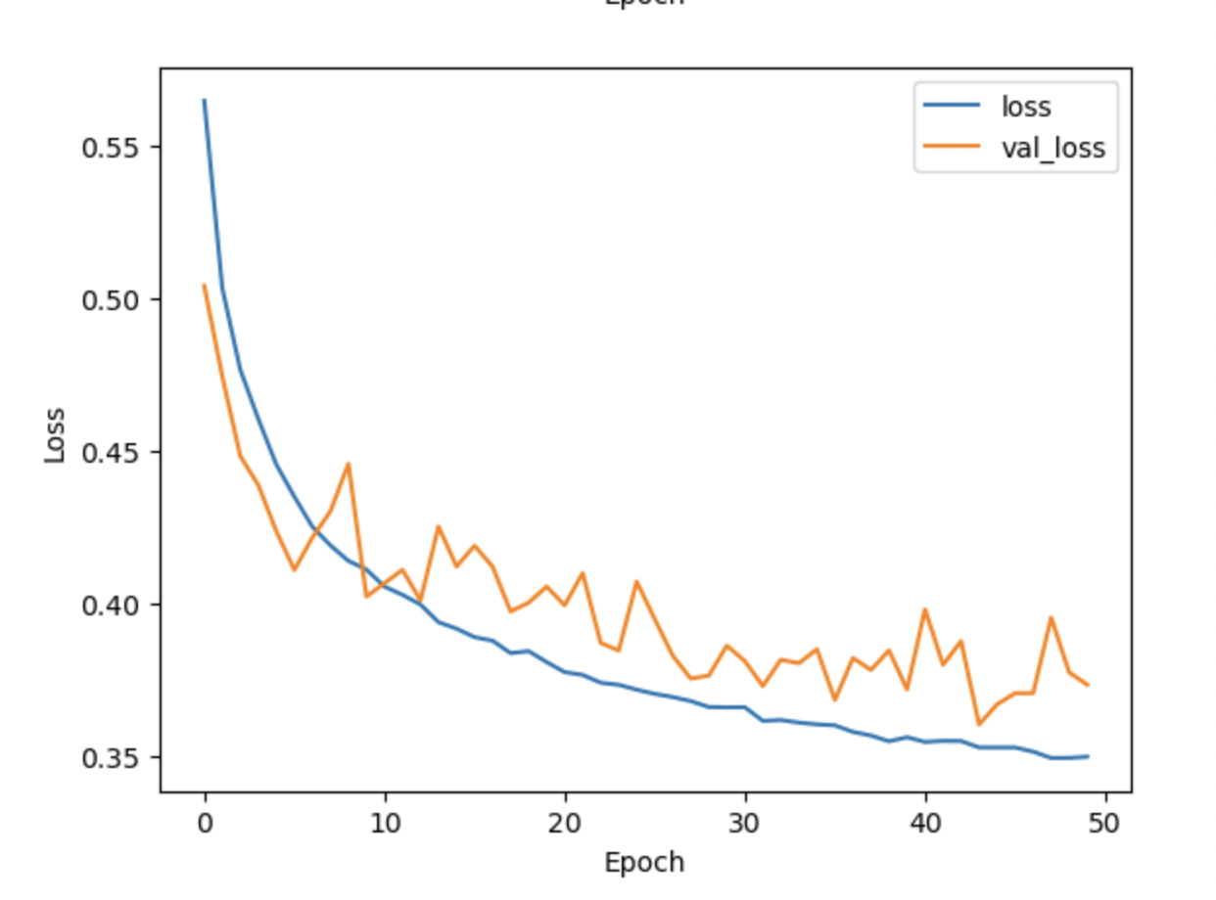
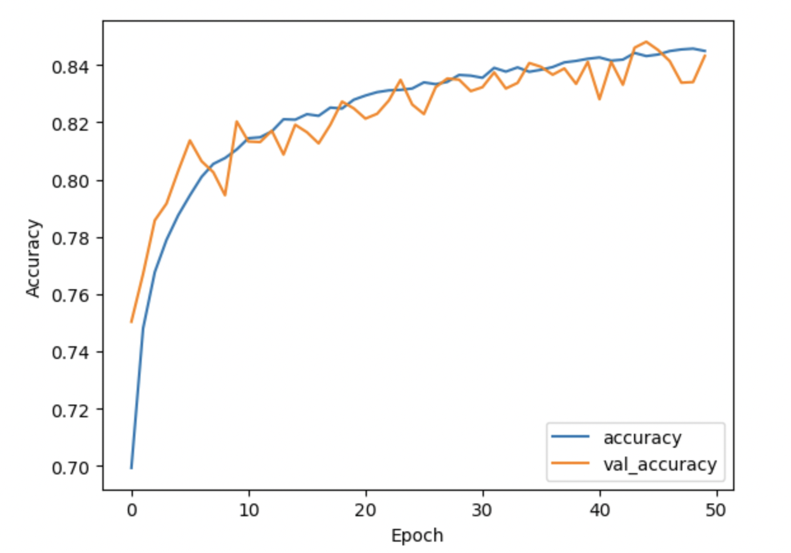
Plotting training & validation accuracy and loss

Slide 12
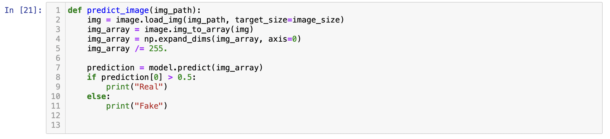
Predict Image Function

Slide 13
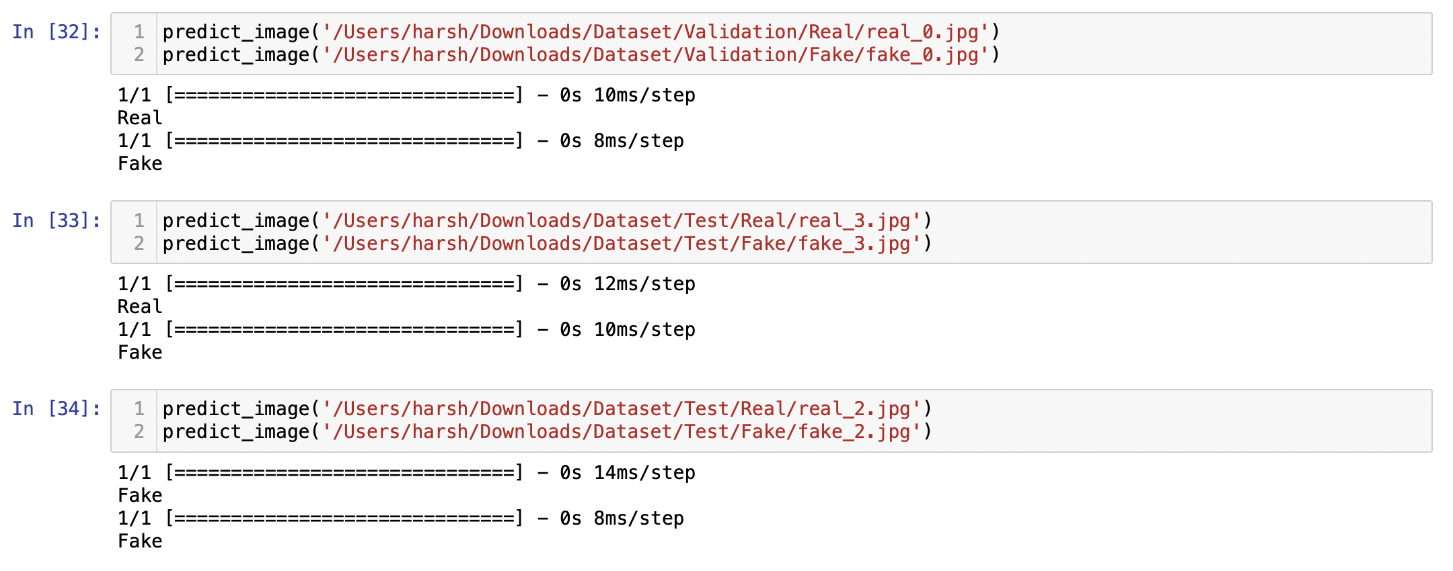

Slide 14
Future Work
Improvements:
Use a larger, more diverse dataset.
Experiment with more complex CNN architectures.
Apply transfer learning with pretrained models like VGG16, ResNet.
Applications:
Extend to video deepfake detection.
Develop real-time deepfake detection systems.

Slide 15
Thank You

