Slide 1
AEM CLIENT LIBRARIES & DESIGNS

Slide 2
Content
What is Client Library ?
Why are we using Client Library?
Various locations to create Client Libraries
Difference in Previous versions
Creating Client Library Folders
Useful Properties in Client Libraries
Calling Client Library in AEM
How to Minify, Gzip, Debug and restrict C.L creation under libs

Slide 3
What is Client Library ?
It helps to get look and feel for a website with the help of CSS and JS.
Clientlibs or Client libraries in AEM is one of the most widely used features provided by Adobe, it allows us to not only manage our client side resources like ( JavaScript, CSS, images, fonts etc.), but also provide options to debug, minify, merge and gzip the client-side code

Slide 4
Why we are using Client Library?
Modern websites uses complex JavaScript and CSS code. Organizing and optimizing the serving of this code can be a complicated issue.
To help deal with this issue, AEM provides Client-side Library Folders which allow you to,
Store your client-side code in the repository
Organize it into categories
define when and how each category of code is to be served to the client.
Client-side libraries are more flexible and easier to use in comparison to server-side libraries. They are used for the front-end development.
To keep all the client-side resources organized in project folders in the CRX Repository

Slide 5
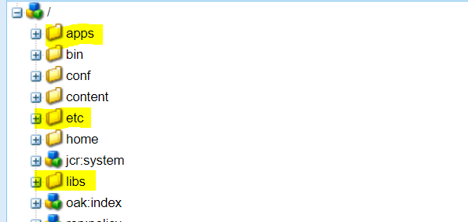
Various locations to create Client Libraries
Using Client libraries in AEM is very easy, we can create a client library folder either under apps, etc or libs, but it is strongly recommended not to create client library folder under libs.
A client-side library folder is a repository node of type cq:ClientLibraryFolder
Client library folders located below /apps take precedence over same-named folders that are similarly located in /libs.
Precedence : /apps/cq/ui/widgets > / libs/cq/ui/widgets

Slide 6
Difference in Previous versions
In Previous versions of AEM, client libraries were created under etc/designs.
This is still supported in higher versions.
However, it is recommended that client libraries now be located under /apps.
This is to locate the client libraries near the other scripts, which are generally found below /apps and /libs.

Slide 7
Creating Client Library Folders
Below steps will provide an idea about creating Client Libraries
Go to CRXDE.
Select the folder where you want to locate the client library folder and click Create > Create Node. (Select apps/project/<component>)
Name: clientlib (You can use any name)
Type: cq:ClientLibraryFolder
Add categories property to clientlib node(Only mandatory property).
Name: categories
Type: String[]
Value: apps.aem.traning (This name will be used to identify respective clientlibs folder- It can be any name)
Create a css and js folders parallel to clientlib folder (with jcr:primaryType is nt:folder), where our CSS and JS files will be placed.

Slide 8
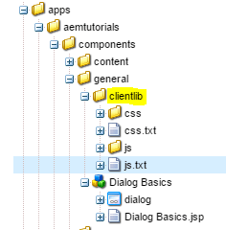
Creating Client Library Folders
Create a js.txt and css.txt file parallel to clientlib folder with jcr:primaryType is nt:file
Add the names of all js files created under js folder into js.txt .
Add names of all css files created under css folder into css.txt
This is to load the files properly under the same category client library

Slide 9
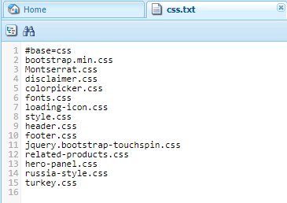
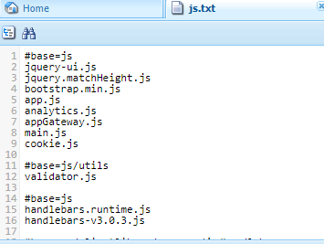
Creating Client Library Folders

Slide 10
Creating Client Library Folders
We must add following text to identify the root of the path of the source files:
#base=[root]
Replace [root] with the path to the folder that contains the source files
In our case,
For js.txt #base=js
For css.txt #base=css

Slide 11
Useful Properties in Client Libraries
We can see some terms using for client libs
jcr:primaryType – The “clientlib” node must be of type cq:ClientLibraryFolder.
So that AEM understand that this is client lib folder.
categories – It is used to categorize or identify respective client library folder from where js and css files needs to be included.
Type: String array .
you could use an existing name here, which means that when we include client library in component jsp/htl file using a category name that is available in more than one client library folder, then js and css files of all such folder will be send in the response.
If you want to include files from a particular clientlib folder then keep the category name unique. Note:- categories value is not a unique identifier. It can be assigned to multiple client lib folders.
It is advisable to preface the category value by ‘apps’ or ‘etc’ to specify location of clientlibs.

Slide 12
Useful Properties in Client Libraries
dependencies – when your client library files are dependent on some other files, you can use dependencies.
For example if Clientlib A depends on Clientlib B which depends on Clientlib C, then all clientlibs A,B and C will be included in the page. The order in which they will be included is First C the B then A.
embed – AEM will merge all embedded clientlibs into the current clientlib. This is usually used for minimizing requests and for accessing clientlibs. Remember it might have size/speed issues if used frequently.
For example if Clientlib A embed Clientlib B which embed Clientlib C, then Clientlib A will be loaded by embedding Clientlib B code. Remember Clientlib C will not be embedded in this case.
Linking to Dependencies
The dependencies must be another cq:ClientLibraryFolder . To identify dependencies, add a property to your cq:ClientLibraryFolder node with the following attributes:
Name: dependencies
Type: String []
Values: The value of the categories property of the cq:ClientLibraryFolder node that the current library folder depends on.

Slide 13
Useful Properties in Client Libraries
Embedding Code From Other Libraries
You can embed code from a client library into another client library. At runtime, the generated JS and CSS files of the embedding library includes the code of the embedded library.
Use the categories property to identify the client library folder to embed. To embed the library, add a property to the embedding cq:ClientLibraryFolder node, using the following property attributes:
Name: embed
Type: String []
Value: The value of the categories property of the cq:ClientLibraryFolder node to embed.

Slide 14
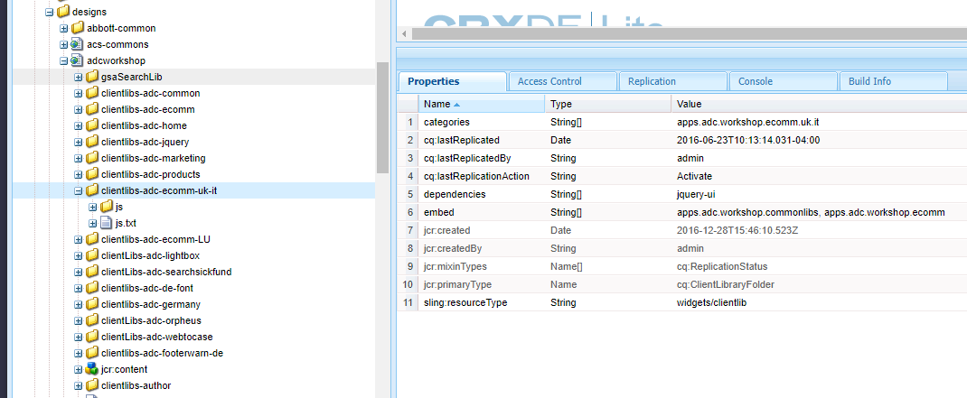
Useful Properties in Client Libraries
Ex : Given Clientlibs:
/apps/genc-aem-training/clientlibs/depA with categories=["depA"]
/apps/genc-aem-training/clientlibs/depB with categories=["depB"]
/apps/genc-aem-training/clientlibs/depC with categories=["depC"]
/apps/genc-aem-training/clientlibs/useA with categories=["useA"], dependencies=["depA", "depB"]
/apps/genc-aem-training/clientlibs/useB with categories=["useB"], embed=["depB", "depC"]
If a page uses clientlib "useA" then the HTML should have independent requests for depA, depB, useA
If a page uses clientlib "useB" then the HTML should have only a request for useB. The contents would be the concatenation of contents of depB, depC, useB.

Slide 15
Calling Client Library in AEM
Calling client Library in HTL:
Calling CSS alone:
<sly data-sly-use.clientLib="/libs/granite/sightly/templates/clientlib.html“ data-sly-call="${clientLib.css @ categories='your.clientlib'}“ />
Calling JS alone
<sly data-sly-use.clientLib="/libs/granite/sightly/templates/clientlib.html“ data-sly-call="${clientLib.js @ categories='your.clientlib'}“ />
Calling CSS and JS together:
<sly data-sly-use.clientLib="/libs/granite/sightly/templates/clientlib.html“ data-sly-call="${clientLib.all @ categories='your.clientlib'}“ />

Slide 16
Calling Client Library in AEM
Calling External js and css in htl:
<link rel="stylesheet" href="https://maxcdn.bootstrapcdn.com/bootstrap/3.3.7/css/bootstrap.min.css">
<script src="https://ajax.googleapis.com/ajax/libs/jquery/3.4.1/jquery.min.js"></script>
<script src="https://maxcdn.bootstrapcdn.com/bootstrap/3.4.0/js/bootstrap.min.js"></script>

Slide 17

How to Minify, Gzip, Debug and restrict C.L creation under libs
Debugging Tools
In the address box of your web browser, append the following text to the URL of your HTML:
?debugClientLibs=true
When the page loads, view the page source.
Click the link that is provided as the href for the link element to open the file and view the source code.
To optimize AEM performance, it is recommended to minify and gzip client libraries.
Follow below steps to minify, gzip, and debug client library
Login to Felix console and navigate to config manager
Search for “Adobe Granite HTML Library Manager” (previously known as “Day CQ HTML Library Manager“).
Click on Adobe Granite HTML Library Manager below pop up will show up

Slide 18
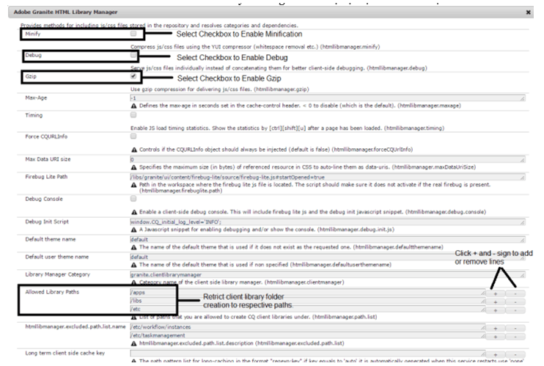
How to Minify, Gzip, Debug and restrict C.L creation under libs
OSGI Configuration

Slide 19
Questions?

Slide 20
Thank You All!

Slide 21
Reference Links
https://experienceleague.adobe.com/docs/experience-manager-65/developing/introduction/clientlibs.html?lang=en

