Slide 1

SMART INDIA HACKATHON 2026
FieldTest Recorder
Problem Statement ID – SIH26231
Problem Statement Title – Digital Companion for Field Drug Testing
Theme – MedTech / BioTech / HealthTech
PS Category – Software
Team ID – [Team ID]
Team Name – [Team Name]

Slide 2
FieldTest Recorder
[Team Name]
A guided, measured and signed field test for NCB's Narcotic Drugs Detection Kit
THE GAP TODAY
HOW IT WILL WORK (PHONE, OFFLINE)
WHAT IS NEW
Read by eye. Officers match the kit's colour against a printed chart; nothing proves a test happened at a place and time (NCB, this problem statement).
No standard. Bombay HC (2021): NCB "has not prescribed the standards"; field testing is "arbitrary", and a bare mention in the panchnama is not enough.
Wrong drug, wrong quantity. Kerala HC (2024, Anuraj): seized "MDMA" was methamphetamine, which changes the NDPS quantity category.
So: disputed seizures, bail on procedure, and field results that cannot later be checked against the lab report.
1
Guide
NCB kit Tests A–E in the order of the kit's printed flow charts, with the drops and steps printed for each test
Says only what the chemistry supports
Test E blue = "cocaine or methaqualone" until E3/E4 narrows it; warns when the NDPS quantity category can't be told in the field.
2
Capture
Photo of the reaction on a reference colour card beside a reagent-only blank well (spot-plate tests first; tube holder for Tests B and E next)
SIMULATED
Designed for varying sample amounts
In simulation, colour bands + a blank well gave 0% false positives where our first single-point rule gave up to 11.7%. Real reactions: next.
3
Read
Colour bands from the kit's printed ranges: positive / no colour change / inconclusive, plus every drug on the kit chart that the colour fits
4
Sign
Time, GPS, officer and image hash in every record, signed and hash-chained (designed for the phone's secure hardware key)
PROVEN IN CODE
Proves completeness, not just integrity
Once the panchnama code is written, deleted or re-run tests are caught, and a server admin cannot forge a record (prototype, test keys).
5
Anchor
A 14-character code written into the witness-signed panchnama
No new hardware
Existing NCB kit + officer's phone + a printed card. Designed to work offline and to be embeddable in apps such as e-Sakshya.
6
Verify
Anyone can check the records offline with our verifier. Planned: Field Test Memo, Form-1 item 5 text, BSA s.63 data

Slide 3
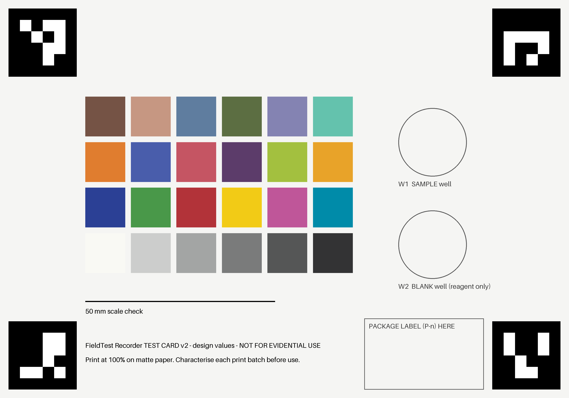
TECHNICAL APPROACH
[Team Name]
OFFICER'S PHONE APP (design, offline)
THIN SERVER (design): NIC / MeitY cloud
Guided NDDK protocol
signed file: steps, drops, flow charts (in prototype)
Enrolment
attestation + supervisor DSC (checker prototyped)
Capture
CameraX / Camera2 RAW; card found by ArUco markers
Sync
idempotent, fork/replay checks (protocol prototyped)
sync when online
Colour engine
card correction, blank well, colour bands (in prototype)
Storage
PostgreSQL + S3 write-once (prototype: SQLite)
Record core
ECDSA P-256 + SHA-256 chain; key in StrongBox/TEE
Search + lab loop
case search (prototyped); lab-result link (planned)
Log + reports
searchable log (in prototype); memo, Form-1 (planned)
Never trusted
records verify without the server
Reference card v2 (printable, 150 x 105 mm). Tested on the print file; photos of real prints on real phones come next.
BUILT SO FAR
Trust without trusting us: NCB signs the supervisor list; a supervisor's key (a Class 3 DSC in production) binds officer + phone + key; the phone signs and chains every test; every phone's chain head goes into the witness-signed panchnama. Our offline verifier checks all of it (prototype uses test keys).
PROVEN IN CODE
PROVEN IN CODE
Python reference prototype + one-command demo, 47 tests: github.com/Harshith029/fieldtest-recorder
SIMULATED
Colour, liveness, night-light and amount experiments on simulated photos
Planned stack: Kotlin · CameraX/Camera2 · OpenCV · Android Keystore + attestation · SQLCipher · RFC 8785 JSON · ECDSA P-256 · Spring Boot · PostgreSQL · S3. Prototype today: Python, OpenCV, SQLite.
Deliberately not used: blockchain, cloud AI, a neural-network "drug detector" (a colour test cannot identify a drug; the court must be able to re-run the reading)
NEXT
Android app; real-phone and real-reaction validation

Slide 4
FEASIBILITY AND VIABILITY
[Team Name]
18/18
PROVEN IN CODE
15/15
PROVEN IN CODE
11.7% → 0%
SIMULATED
≤ 1%
NEXT
of our tampering attacks caught by the verifier, incl. insider-admin forgery and deleted records
sync and failure scenarios handled by the reference sync protocol, incl. an old-backup restore
false positives as sample amount varies: our first single-point rule vs colour bands (published US colours)
false-positive target for real-kit validation: 1,296 captures, 3 sample amounts, 95% confidence
CHALLENGES AND HOW WE HANDLE THEM
WHY IT IS VIABLE
Challenge / risk | Strategy
Real reaction colours differ from the printed chart | Validation by NCB/CFSL chemists under their licences: 1,296 captures at 3 sample amounts; we never handle narcotics
Phones and light vary; glare; night raids | Reference card + RAW capture and a bad-light gate (prototype); say "inconclusive" rather than guess; flash/no-flash night mode (simulated, not yet integrated)
Staged or swapped sample | Planned: capture from before the reagent drop, liveness check (simulated so far), package label in frame, link to the s.105 video
Rooted phone, insider, deleted records | Supervisor-signed binding, panchnama anchor, untrusted server (prototype); hardware keys + attestation (designed; checker prototyped)
Access to SIMS / e-Sakshya not confirmed | File exports first; the engine is designed as an SDK that e-Sakshya could embed
Existing kit, existing phones: NCB already supplies the kit free; the additions are a printed colour card per kit and a few reagent drops for the blank well.
Small infrastructure (estimate): one app server pair, PostgreSQL, 1–3 TB a year of storage on NIC or MeitY-empanelled cloud.
Government-owned by design: NCB would hold the signing keys, the colour standard and the code; open formats, no licences.
Pass criteria set in advance: false positives at most 1%, proven at 95% confidence (at least 299 negative controls); "inconclusive" at most 15%.
Clear status: every number is labelled proven in code, simulated or next. No real phone photo or real reaction has been tested yet; that is the next stage.

Slide 5
IMPACT AND BENEFITS
[Team Name]
WHO BENEFITS
WHAT CHANGES FOR ONE SEIZURE
SO
Seizing officer
A guided test and a signed record that shows good-faith action; planned: Field Test Memo and Form-1 item 5 filled in.
Today (paper) | With FieldTest Recorder
Colour judged by eye | Measured against a signed colour standard
"Dark brown" written in the panchnama | Photo + reading + every drug on the kit chart the colour fits
No proof of time or place | Signed time, GNSS time, GPS and officer
Records can be rewritten later | Deletions and re-runs are detectable
Quantity category guessed | Flagged when it can't be told in the field
No kit accuracy data | Field result vs lab result, per kit batch (planned)
IO
Investigating officer, prosecutor
Checkable records for remand and bail; planned: a Rule 10(2) grouping check and the lab result linked back.
CT
Courts, defence, the accused
Any expert can re-check the record offline; the quantity category is flagged as uncertain until the lab confirms.
Why a field report must not overstate: a real case
Anuraj v. State of Kerala (2024): police alleged commercial-quantity MDMA; the lab found methamphetamine in intermediate quantity (MDMA 0.5 g / 10 g vs methamphetamine 2 g / 50 g). Our record states only what the kit's colour supports, lists every drug on the kit chart that the colour fits, and warns when they fall under different NDPS thresholds.
HQ
NCB headquarters and labs
Planned: field-vs-lab accuracy per kit batch and per test, from lab reports the IO already receives.
Social
Fairer remand and bail decisions; fewer cases lost on procedure; honest officers protected.
Economic
No new hardware; reuses the free NCB kit and officers' phones; small hosting cost.
Environmental
Paperless records; the only extra consumables are a printed card per kit and blank-well reagent drops.
Scale
1,15,236 NDPS cases in 2022 (MHA); each seized package can get a recorded field test.

Slide 6
RESEARCH AND REFERENCES
[Team Name]
[1] SIH26231 problem statement — Narcotics Control Bureau, MHA; sih.gov.in
[2] NCB Narcotic Drugs Detection Kit — NICFS, A Forensic Guide for Crime Investigators, ch. 8, Figs 8.12–8.16 (Tests A–E, flow charts)
[3] NDPS (Seizure, Storage, Sampling and Disposal) Rules 2022 — GSR 899(E): Rules 3, 5, 10(2), 13, 14
[4] Sagar Parshuram Joshi v. State of Maharashtra — Bombay HC, 15 Jan 2021 (indiankanoon.org/doc/90970274)
[5] Masibur Khan v. State — Delhi HC, 31 May 2023 (indiankanoon.org/doc/91398841)
[6] Anuraj v. State of Kerala — Kerala HC, 2024: alleged MDMA found to be methamphetamine
[7] NDPS small and commercial quantities — S.O. 1055(E), 19 Oct 2001
[8] NCB Drug Law Enforcement Field Officers' Handbook — narcoticsindia.nic.in
[9] BPR&D SOP: audio-video recording under BNSS; BSA 2023 s.63 — hash value in the electronic-record certificate
[10] NIJ Standard-0604.01 — Color Test Reagents/Kits for Preliminary Identification of Drugs of Abuse (US DoJ)
[11] Android key attestation; RFC 8785 (JSON canonicalisation) — developer.android.com; rfc-editor.org
[12] MHA Rajya Sabha USQ 1832 (11 Dec 2024) — NDPS case statistics
OUR CODE AND RESEARCH: github.com/Harshith029/fieldtest-recorder
Working Python reference prototype with a one-command demo and 47 automated tests: record format and offline verifier, colour engine, NCB kit protocol, searchable log, sync protocol. Photos in the demo are simulated; the Android app must match its outputs.
17 experiments with 95% confidence intervals, including 18 tampering attacks and 15 failure scenarios (real code) and colour, sample-amount, night-light and staged-sample tests (simulated photos).
Reviewed adversarially, claim by claim: confirmed defects are either fixed and re-tested or listed openly in the repository's problem register.
Safety and law: our team never handles narcotics; colour tests use published colours, the kit chart and safe dyes. Real-kit validation is designed for NCB or CFSL chemists.

