Slide 1

AWS CLOUD COMPUTING PROJECT · RETAIL & E-COMMERCE
Inventory Demand
Forecasting Platform
A serverless multi-AZ system for predicting weekly demand across 85 retail stores
PRESENTED BY
AP23110010170 G Harshith Sai
AP23110010055 P Sathvika
AP23110010221 Nissi Praharsha C
AP23110010019 D Manogyna
AWS
Lambda
DynamoDB
Cognito
AWS · 3rd Year Project
Notes:
1

Slide 2
01
The Problem
Two opposite inventory failures eating into retail margins
STOCKOUTS
OVERSTOCKING
18% Revenue Loss
Capital Tied Up
Grocery & FMCG categories run out during weekends and festival seasons. Restocking arrives 3 days too late.
Slow-moving household appliances pile up in warehouses, eventually sold at markdown prices.
Popular SKUs run out before reorder
Customers walk out empty-handed
Lost revenue compounds weekly
Working capital frozen each quarter
Storage and handling costs accumulate
End-of-quarter markdown losses
INVENTORY DEMAND FORECASTING · AWS SERVERLESS PLATFORM
01
Notes:
2

Slide 3
02
Why It Stays Broken
The current data pipeline is fundamentally too slow
85
2,400
Submit weekly data in inconsistent formats — CSV exports, scanned ledgers, typed notes
But only the top 50 receive analyst forecasts. The other 2,350 rely on guesswork
STORES
ACTIVE SKUs
8 days
2
Reorder recommendations arrive 8 days after week ends — well after stockouts occur
Two people manually forecast for an entire 85-store chain. Cannot scale further
DELAY
ANALYSTS
→ The result: every week, the chain loses money to BOTH stockouts and overstocking simultaneously.
INVENTORY DEMAND FORECASTING · AWS SERVERLESS PLATFORM
02
Notes:
3

Slide 4
03
Proposed Solution
An intelligent, automated, serverless forecasting platform
Replace manual planning with a cloud-native pipeline that ingests data automatically, runs forecasting models for every SKU in every store, and alerts managers BEFORE stockouts occur.
Multi-Format Ingestion
Automated Forecasting
Proactive Alerts
Accepts CSV exports, scanned PDF ledgers (Textract OCR), and typed notes (Comprehend NLP) — no manual data entry
Statistical demand models run for every SKU × store combination, accounting for weekday/weekend patterns and seasonality
When projected stock will fall below safety threshold, system generates purchase orders before stockouts happen
INVENTORY DEMAND FORECASTING · AWS SERVERLESS PLATFORM
03
Notes:
4

Slide 5
04
System Architecture
End-to-end serverless flow inside a custom Multi-AZ VPC
DATA SOURCES
AWS PROCESSING (PRIVATE SUBNETS)
USER-FACING LAYER
S3 Data Lake · 5 buckets
Amazon Cognito
CSV Sales
Signup · Login · Forgot Password
POS exports
Lambda Functions (7)
Web Dashboard
process-csv-sales · process-scanned-ledger
process-typed-sales · forecast-demand
check-stockouts-alert · api-get-forecasts
cognito-post-signup
Scanned PDFs
5 stat cards · 4 chart types
Live forecast table · Alerts panel
Per-store demand insights
Handwritten ledgers
DynamoDB
Stockout Alerts (Email)
Typed Notes
Forecasts · Inventory · Stores · Users
Manager memos
API Gateway · REST
Store Managers
INVENTORY DEMAND FORECASTING · AWS SERVERLESS PLATFORM
04
Notes:
5

Slide 6
05
VPC Network Design
Custom 10.0.0.0/16 VPC spanning two Availability Zones
VPC 10.0.0.0/16 · Region: ap-south-1 (Mumbai)
Availability Zone · ap-south-1a
Availability Zone · ap-south-1b
PUBLIC SUBNET · 10.0.1.0/24
PUBLIC SUBNET · 10.0.2.0/24
NAT Gateway · Internet Gateway
NAT Gateway
Outbound internet for private subnets
Outbound internet for private subnets
PRIVATE APP SUBNET · 10.0.11.0/24
PRIVATE APP SUBNET · 10.0.12.0/24
Lambda Functions
Lambda Functions
All compute · 7 functions · No internet exposure
All compute · 7 functions · No internet exposure
PRIVATE DATA SUBNET · 10.0.21.0/24
PRIVATE DATA SUBNET · 10.0.22.0/24
DynamoDB · S3 (via VPC Endpoint)
DynamoDB · S3 (via VPC Endpoint)
All persistent storage · Encrypted at rest
All persistent storage · Encrypted at rest
Security: Least-privilege Security Groups · VPC Flow Logs to CloudWatch · S3 Gateway Endpoint avoids public traffic
INVENTORY DEMAND FORECASTING · AWS SERVERLESS PLATFORM
05
Notes:
6

Slide 7
06
AWS Services Used
14+ services orchestrated in a single platform
COMPUTE & API
STORAGE
AI / ML
AWS Lambda (7 functions)
Amazon API Gateway (REST)
Amazon DynamoDB (4 tables)
Amazon S3 (5 buckets)
AWS Textract (OCR)
Amazon Comprehend (NLP)
AUTHENTICATION
NETWORKING
MONITORING
Amazon Cognito (User Pool)
AWS IAM (least-privilege)
VPC · Subnets · NAT · IGW
Security Groups · VPC Endpoints
AWS CloudTrail (audit logs)
Amazon CloudWatch (metrics)
INVENTORY DEMAND FORECASTING · AWS SERVERLESS PLATFORM
06
Notes:
7

Slide 8
07
Multi-Format Data Ingestion
Three Lambda functions handle every input format automatically
1
CSV Sales Data
λ
process-csv-sales
Validates POS exports, cleans missing values, normalizes SKU codes, writes to DynamoDB
2
Scanned PDF Ledgers
λ
process-scanned-ledger
AWS Textract extracts handwritten and typed text from scanned documents — even tables
3
Typed Manager Notes
λ
process-typed-sales
Amazon Comprehend parses unstructured notes, extracts entities and product mentions
INVENTORY DEMAND FORECASTING · AWS SERVERLESS PLATFORM
07
Notes:
8

Slide 9
08
Forecasting & Alert Pipeline
Daily scheduled Lambdas predict demand and warn of stockouts
FORECASTING FLOW
STOCKOUT ALERT FLOW
1
EventBridge daily trigger
1
Daily alert Lambda runs
Scheduled rule fires forecast Lambda
check-stockouts-alert scheduled by EventBridge
2
forecast-demand Lambda
2
Compares projected vs safety stock
Reads historical sales from DynamoDB
For every SKU in every store
3
Statistical model runs
3
Identifies at-risk SKUs
Predicts next 7 days of demand per SKU
Items predicted below reorder point
4
Confidence scoring
4
Sends email notification
Each prediction gets a confidence value
Uses verified email channel
5
Write to Forecasts table
5
Manager reorders BEFORE stockout
Results stored with date and store_sku key
Proactive intervention prevents loss
INVENTORY DEMAND FORECASTING · AWS SERVERLESS PLATFORM
08
Notes:
9

Slide 10
09
Security & User Management
Cognito-based auth with automated profile provisioning
SECURITY LAYERS
AUTHENTICATION FLOW
1
User signs up via web form
Identity
Cognito User Pool — email verification, password reset, JWT tokens
2
Cognito creates user account
Network
Lambdas in private subnets, no direct internet access
3
Post-confirmation Lambda triggers
Access Control
IAM least-privilege roles, granular per Lambda
4
User profile written to DynamoDB
Audit
CloudTrail logs every API call · VPC Flow Logs capture network traffic
5
User logs in → JWT token issued
Encryption
DynamoDB at-rest encryption · TLS in transit everywhere
INVENTORY DEMAND FORECASTING · AWS SERVERLESS PLATFORM
09
Notes:
10

Slide 11
10
Web Dashboard
What store managers actually see and use
LIVE DEMO · STORE008 (CHENNAI)
DASHBOARD FEATURES
Secure Authentication
38
Forecast records returned
Login, signup, and forgot-password flows powered by Cognito
Store Selector
2
Unique SKUs tracked
Switch between any of the 7 active stores instantly
5 Live Stat Cards
221
Total predicted units (7 days)
Forecasts count, unique SKUs, predicted units, revenue, confidence
4 Interactive Charts
₹38,771
Projected revenue
Trend line, weekday/weekend split, top SKUs, confidence radar
High-Demand Alerts
Top 3 SKUs flagged when predicted volume exceeds threshold
75%
Average model confidence
Detailed Data Table
Every forecast with SKU, date, day type, quantity, price
INVENTORY DEMAND FORECASTING · AWS SERVERLESS PLATFORM
10
Notes:
11

Slide 12
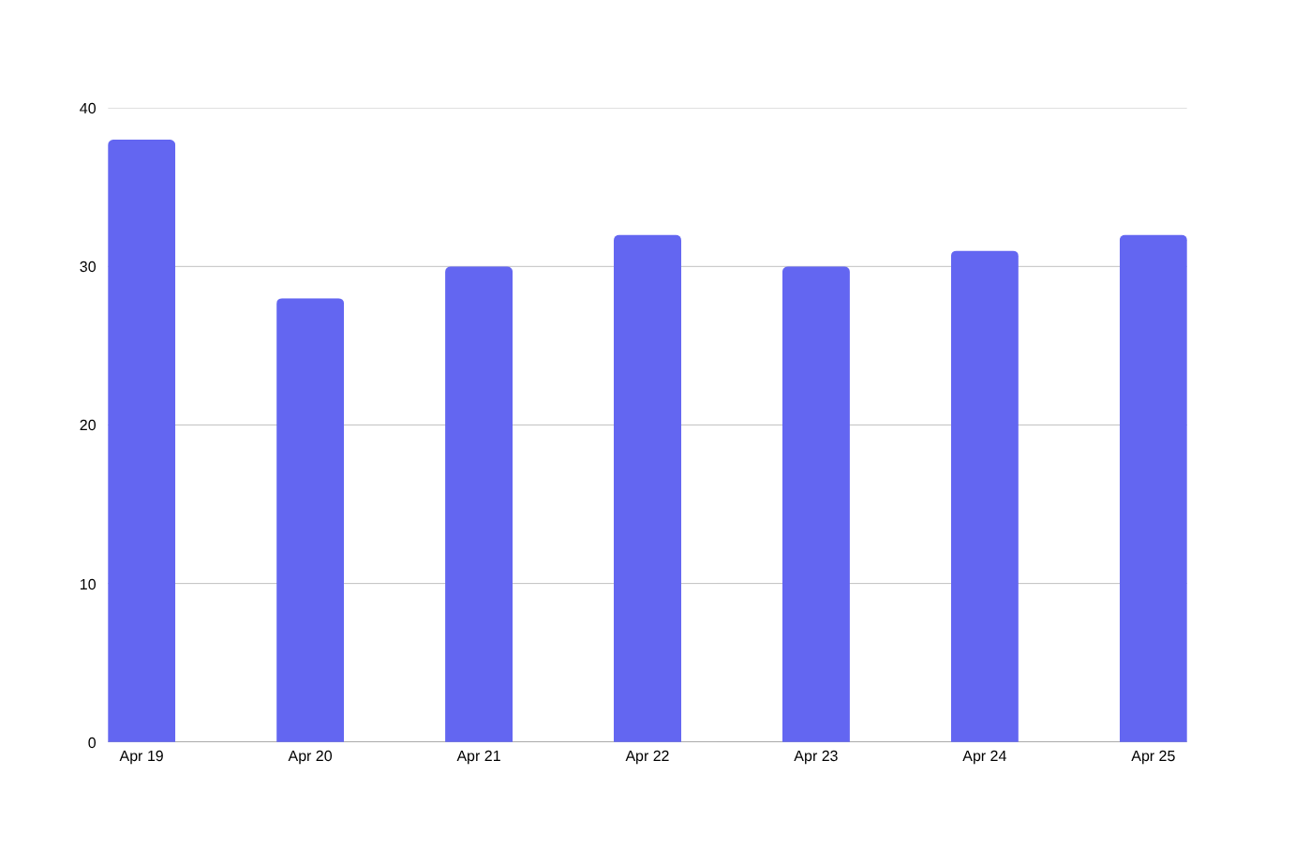
11
Sample Forecast Output
Real data flowing through the system · STORE008 / 7 days
KEY INSIGHTS
38
Peak day predicted (Apr 19, weekend)
75%
Average forecast confidence score
2
SKUs flagged for high demand
1.2×
Weekend uplift vs weekday baseline
INVENTORY DEMAND FORECASTING · AWS SERVERLESS PLATFORM
11
Notes:
12

Slide 13
12
Business Impact
Quantifiable value from automation, accuracy, and speed
85→0
8 days → 0
Manual planners needed
Reorder delay eliminated
All 85 stores forecast automatically
Alerts arrive BEFORE stockouts
50 → 2,400
Pay-per-use
SKUs forecasted
Cost model
Every active product, every store
No idle servers · Scales to zero overnight
→ Eliminates the 18% revenue loss from stockouts AND reduces working capital tied up in overstock
INVENTORY DEMAND FORECASTING · AWS SERVERLESS PLATFORM
12
Notes:
13

Slide 14
13
Technology Stack
What's under the hood
BACKEND
DATA
FRONTEND
INFRASTRUCTURE
Python 3.12
DynamoDB
HTML5 / CSS3 / JS
Custom VPC
Lambda runtime
NoSQL storage
Single-page app
Multi-AZ
boto3
S3
Chart.js 4.4
IAM Roles
AWS SDK
Data lake
Data viz
Least-privilege
API Gateway
Textract / Comprehend
Cognito JS SDK 6.3
CloudTrail / CloudWatch
REST endpoints
AI ingestion
Auth
Audit & logs
INVENTORY DEMAND FORECASTING · AWS SERVERLESS PLATFORM
13
Notes:
14

Slide 15
Thank You
Questions · Discussion · Live Demo
Inventory Demand Forecasting Platform · Built on AWS
Notes:
15

