Slide 1

Amazon UK Shoes Content-Based Recommendation System
DATA 606 Capstone in Data Science (03.2293) SP2024
Chaojie Wang
Group 3:
Harshith Molugu
LI73411

Slide 2

INTRODUCTION
Objective: Develop a recommendation engine for Amazon UK shoes using product descriptions and brands.
Aim: To provide personalized shoe recommendations based on textual data extracted from product features

Slide 3
Data Outline
Data Sources: The dataset used in this project is sourced from data.world.
Data Size: 13,474 Kb
Data Shape: (11605, 19).

Slide 4
Data Preprocessing
Initial Dataset Structure: Consolidated key fields including 'title', 'price', 'brand', 'product_details', 'breadcrumbs', and a detailed 'features' list.
Data Cleaning: Standardized 'price' values and converted 'features' into structured columns, removing non-essential fields to streamline the dataset.
Text Processing: Merged text-rich fields into a comprehensive description per listing, then cleaned and processed the text to prepare for analysis.
Feature Engineering: Executed TF-IDF vectorization on the processed text to create a feature matrix, paving the way for subsequent recommendation modeling.

Slide 5
EDA
Keyword Analysis from Product Descriptions: The word cloud reveals the most prominent terms used in the shoe descriptions, with "Shoes", "Sneaker", "Women", "Men", and "Running" standing out. This indicates a diverse product range with potential focus areas for further analysis or targeted marketing.
Pricing Strategy by Top Brands: The horizontal bar chart indicates that brands like MBT and Lottusse have higher price points on average, suggesting a positioning towards the premium market segment. This could inform stock selection or promotional strategies based on brand tiering.
Feature Importance in Product Listings: The bar chart showcases the relative importance of product features based on their TF-IDF scores. Features such as "Women", "Shoes", "Sneaker", and "Running" have the highest scores, implying these terms are crucial in distinguishing products. Such insights could drive the refinement of recommendation algorithms.

Slide 6
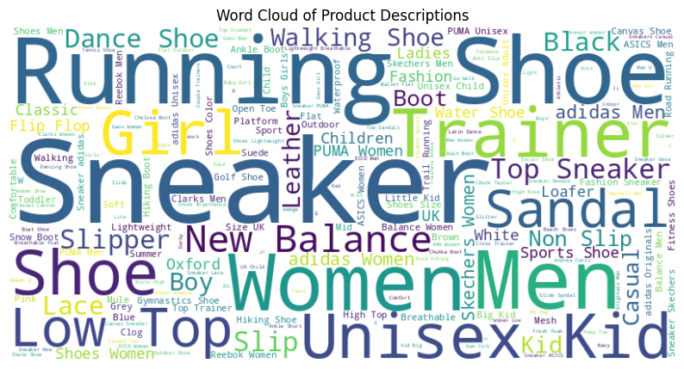
VISUALIZATION CHARTS

Slide 7
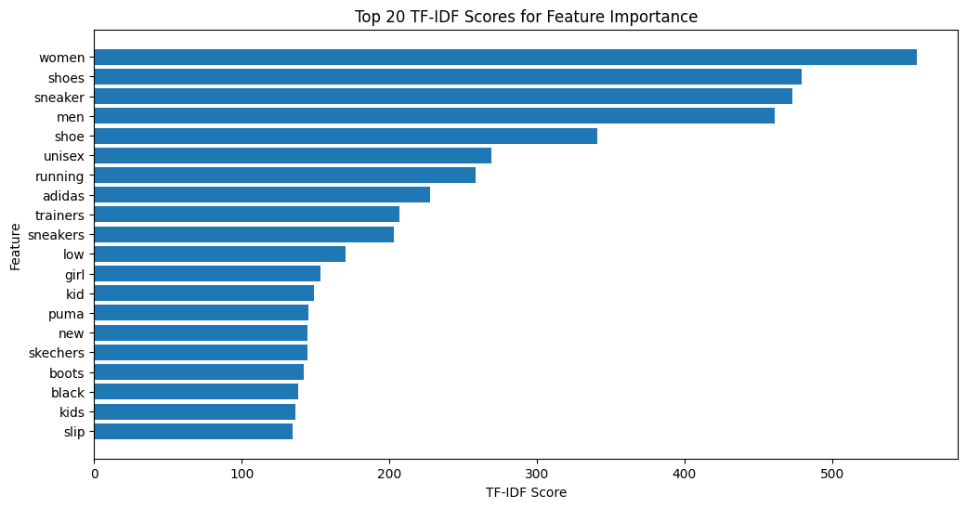
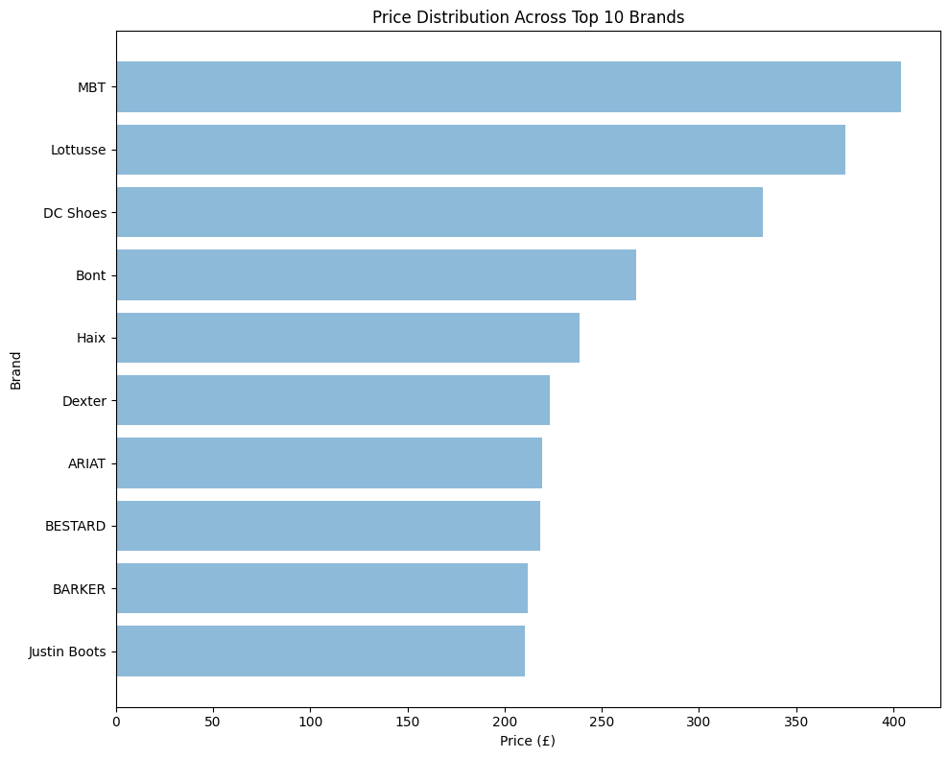
VISUALIZATION CHARTS

Slide 8

Model
Employed SVD algorithm trained on a TF-IDF transformed dataset to predict user preferences with a focus on price and textual features.
Visualized product category frequencies and personalized top picks for users, highlighting the model's nuanced understanding of consumer choice.
Demonstrated predictive accuracy through visualizations, confirming the model’s capability in delivering tailored recommendations.

Slide 9
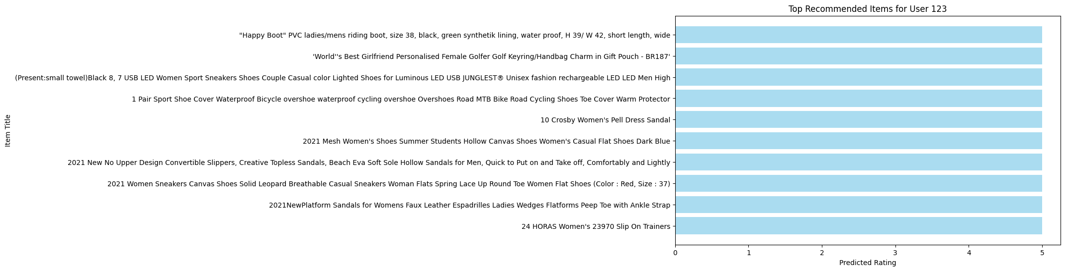
Model

Slide 10
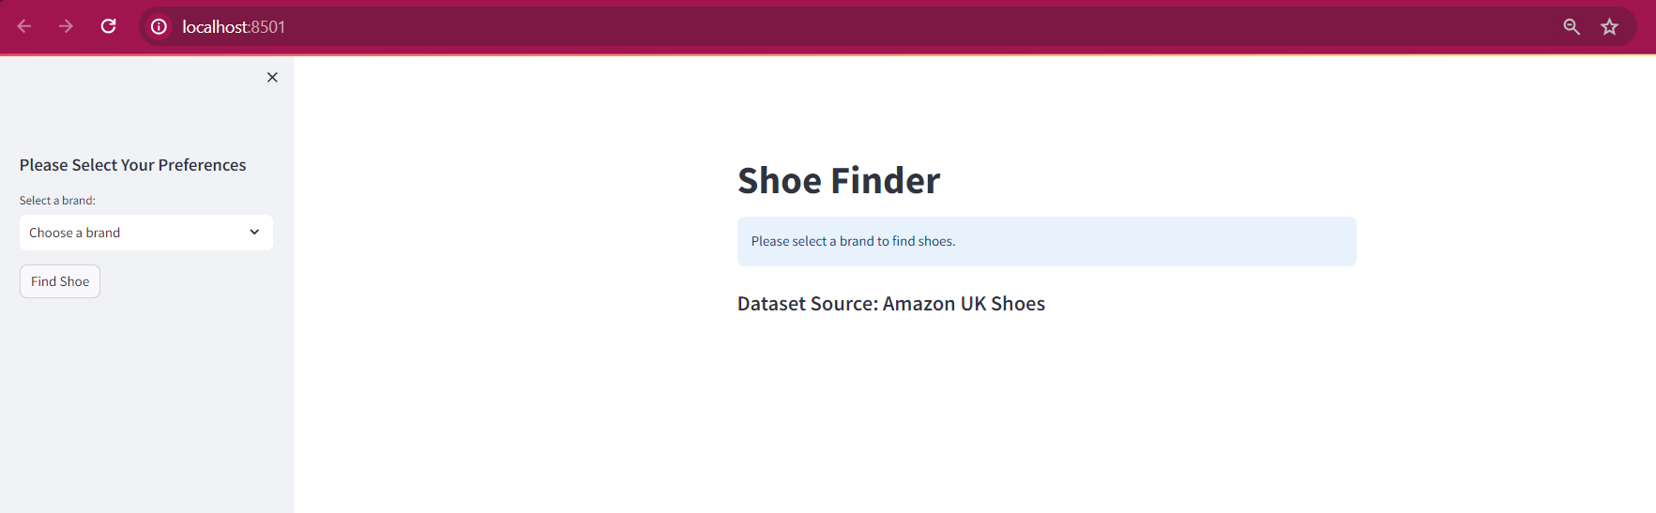
Website

Slide 11
CONCLUSION
Our project successfully developed a content-based recommendation system that leverages textual data from Amazon UK's shoe listings to deliver personalized product suggestions.
Through meticulous data preprocessing, we cleaned and transformed product descriptions into a structured format, allowing us to utilize the SVD algorithm effectively.
The exploratory data analysis illuminated key trends and preferences, guiding our model to discern consumer behavior accurately, while our predictive model demonstrated its capacity to recommend with precision, catering to individual tastes and price sensitivity.

Slide 12
FUTURE SCOPE
To refine our recommendation engine, future work will explore the incorporation of additional metadata, user reviews, and ratings to enhance the recommendation's relevancy and accuracy.
We plan to implement hybrid models that combine content-based filtering with collaborative filtering techniques, capturing a broader spectrum of user preferences and interactions.
Continuous improvement efforts will also include adopting machine learning advancements and exploring real-time recommendation capabilities to keep pace with dynamic consumer trends.

Slide 13
THANK YOU

