Slide 1
Intel Products Sentiment Analysis from Online Reviews

Slide 2
Abstract
The title of the project is “Intel Products Sentiment Analysis from Online Reviews”.
The aim of this project is to understand Intel customer opinion and improve product quality.
This project applies sentiment analysis and topic modeling techniques to a large dataset of online reviews on intel products.
The goal is to uncover the underlying sentiment and topics of discussion in online reviews, and to identify key areas of improvement for businesses operating in this space.

Slide 3
Using a combination of machine learning and natural language processing techniques, we analyze the sentiment and topic distribution of over 400 reviews, and identify key themes and trends that emerge from the data.
Our results show that whether is a positive, negative or neutral, and highlight the importance of product in shaping customer opinions and preferences.
This helps in understanding of online reviews and their role in shaping business strategy, and provides actionable insights for businesses seeking to improve their online reputation and customer satisfaction.

Slide 4
What is Sentimental Analysis?
Sentiment analysis, also known as opinion mining.
It is a natural language processing (NLP) technique.
It used to determine the emotional tone conveyed by a piece of text, such as a review.
It involves analyzing text data to identify the sentiment expressed.
It gives a positive, negative, or neutral review.

Slide 5
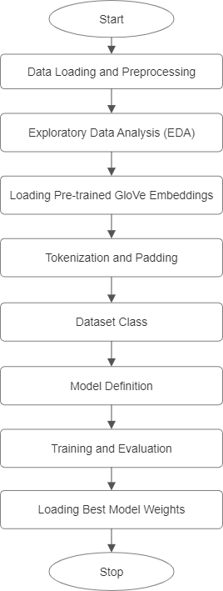
Process Flow

Slide 6
Data Loading and Preprocessing
Data Preparation
Load Intel product reviews from an Excel file.
Preprocess text data by filling missing values, converting to lowercase, removing punctuation and special characters, and removing stopwords.

Slide 7
Exploratory Data Analysis (EDA)
Data Exploration
Analyze distribution of :
Ratings
Reviews over time
Reviews by SKU
Reviews by Geo

Slide 8
Loading Pre-trained GloVe Embeddings
GloVe Embeddings
Load pre-trained GloVe embeddings from a file.
Create an embedding matrix using the ‘create_embedded_matrix’ function.

Slide 9
Features Offered
Rating: Analyze overall rating distributions (e.g., 1-5 stars) to understand the general sentiment towards a product or service.
Reviews over time: Visualize the sentiment trend over time to identify patterns, seasonality, or changes in customer opinions.

Slide 10
Reviews by SKU: Break down sentiment analysis by specific product SKUs (Stock-Keeping Units) to identify which products are driving positive or negative sentiment.
Reviews by Geo: Analyze sentiment by geographic location to understand regional differences in customer opinions and preferences.

Slide 11
Tokenization and Padding
Tokenization
Fixed-length input
Preprocessing step
Padding

Slide 12
Dataset Class
Preparing data for modeling.
Creating a PyTorch dataset.
Defining the Review Dataset class.
Initializing the dataset.
Implementing the ’_getitem_’ method.

Slide 13
Model Definition
Model Architecture
The model consists of an embedding layer, a recurrent neural network (RNN) layer, and a fully connected layer.
Define a SentimentRNN model, which is a PyTorch neural network that uses pre-trained GloVe embeddings and a BERT tokenizer.

Slide 14
Training and Evaluation
Model Training and Evaluation
Prepare data for training and evaluation by splitting the data into training and validation sets.
Define hyperparameters for the model, including the learning rate, batch size, and number of epochs.
Train the model using the ’train’ function and evaluate the model using the ’evaluate’ function.
Save the best model weights based on the validation loss.

Slide 15
Loading Best Model Weights
Saving the best model.
Loading the saved model.
Assigning the loaded weights.
Using the loaded model for evaluation or deployment.

Slide 16
Overview
The project aims to provide actionable insights for businesses operating in the intel sector, including:
Identification of key areas of improvement for customer satisfaction.
Insights into customer preferences and opinions.
Recommendations for business strategy and improvement.

