Slide 1
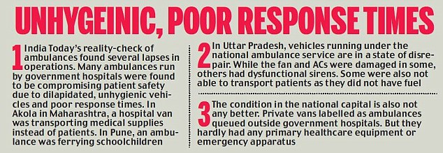
problem statement
In emergency situations such as accidents or sudden medical crises, the immediate transportation of individuals to a healthcare facility can be a matter of life and death. Our project aims to create a comprehensive emergency transportation booking system that can save lives in situations such as accidents or sudden medical crises. We recognize that the current system for booking emergency transportation nearby is often inefficient and unreliable, resulting in delays, inadequate care, and sometimes tragic outcomes. Here are the few challenges faced by the emergency services to reach any medical crisis or accidents
Delays in transportation can worsen a patient’s condition.
Emergency services are not optimally utilized
Safety protocols

Slide 2
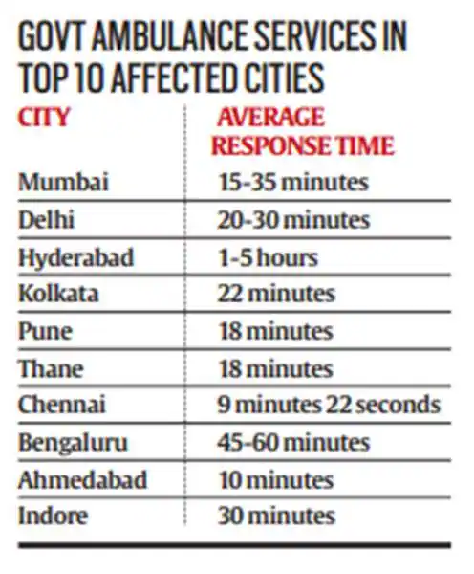
problem statement
Traffic Jams
Reaching remote areas
Here is the news article about Emergency medical services in India click here to visit the article.
To address this critical issue, we propose the development of a comprehensive emergency transportation booking system aimed at rescuing people from accidents or medical emergencies.
We aim to create a detailed solution that significantly improves the efficiency and effectiveness of emergency medical transportation, ultimately saving lives and reducing impact of medical emergencies.

Slide 3
Proposed solution (200 words)
Rescue Wheel :
To address this problem, we propose a detailed solution for that will leverage the latest technologies and best practices to ensure that people who need urgent medical attention can be quickly transported to a healthcare facility with all the necessary precautions. Our objective is to create a user- friendly, efficient, and secure emergency transportation booking system. Our proposed service name is Rescue Wheel. Rescue Wheel allows individuals to request emergency transportation with ease.
Rescue Wheel Ensures that all vehicles are equipped with necessary medical supplies and follow strict safety and infection control protocols. we aim to create a comprehensive solution that significantly improves the efficiency and effectiveness of emergency medical transportation, ultimately saving lives and reducing the impact of medical emergencies on individuals and communities.
our emergency transportation system uses Machine Learning (ML) to find the easiest and most efficient path from the patient to the hospital. It uses Real time data analysis which collects and analyzes real time data like traffic congestion, weather conditions etc.
These ML algorithms take account into all the available data and predict the optimal route from the patient’s location to the hospital.

Slide 4
How does your innovation accelerate change with the power of Technology?
(200 words)
Rescue Wheel is a combination of both technology and medical emergency transportation. It uses Smart routing, real-time monitoring and predictive analysis. Users can access Rescue wheel from any smart device or can also use a registered toll free number to provide a service
Rescue Wheel uses Machine Learning and other technologies to improve medical emergency transportation like
Machine Learning models can predict optimal rotes for transportation including traffic data, weather etc.
Machine Learning plays a crucial role in navigation and decision making of vehicle selection and safe transportation.
The deployment of 5G networks enables Rescue wheel to be more reliable on communication between emergency vehicles and healthcare facilities to improve response time.
Rescue Wheel uses Bluetooth technology to initial diagnosis of the patient and provides a report to doctors and nurses before arriving to the hospital
This application connects the nearby employers to help them to get into hospitals from accidents.

Slide 5
How is your solution different/unique from other solutions in market (150 words)
Rescue Wheel distinguishes itself through its innovative use of technology, , strong commitment to safety, user-friendly design, and data-driven approach. These unique features collectively make it a standout choice for emergency transportation services, ensuring that it meets the evolving needs of individuals and communities in crisis situations.
Integration of Technology : Rescue Wheel uses advanced communication tools to ensure swift and efficient response time
Various services : Rescue Wheel encompasses various emergency transportation options, such as medical cabs, specialized vehicles, providing a broader range of solutions for different situations User friendly : Rescue Wheel is designed to be user friendly making it accessible to a wide range of individuals
Rescue Wheel emergency vehicles will roam around urban and rural areas to reduce response time.
PATENT FILED: No

