Slide 1


PROJECT WORK
ON
ACADEMIC PROGRESS SCORE
VTU, Belagavi
Submitted by
AISHWARYA R (1AP18IS002)
HARSHITH S (1AP18IS008)
NAYAN V KUSTAGI (1AP18IS017)
AJITHGOPAL S KULKARNI (1AP17IS002)
Under the Guidance of
Name: Mrs. Pallavi H B
Designation: Asst. Professor
Department of Information Science & Engineering
A P S College of Engineering
Somanahalli, Kanakapura Road, Bangalore - 560082

Slide 2
AGENDA OF THE PRESENTATION
INTRODUCTION
SUMMARY OF LITERATURE SURVEY
MOTIVATION TO PROJECT
OBJECTIVE OF THE PROJECT
METHODOLOGY
APPLICATION DESIGN & CALCULATION
RESULTS
CONCLUSION

Slide 3
INTRODUCTION
Academic Progress Score (APS) is an application designed for both student and faculties.
This application provides a platform to students to give feedback for lecturers through online mode.
For any institution, company or industries feedback plays an important role for their development and growth.
Reviewing the employee will not only benefit the organizations it will also help in the overall development of individuals.

Slide 4
Even today many institutions considers only the student feedback and doesn’t not consider the individual previous efforts and achievements.
Rating individuals only on one factor will not provide scope for betterment and growth.
Hence our application have made an attempt to consider student feedback along with the faculty qualification, works and achievements.
This application focus to provide unbiased cumulative way of providing academic progress score to each faculty.

Slide 5
SUMMARY OF LITERATURE SURVEY
Sl. No. | Title of the Article | Year of Publication | Findings
01. | Effect of student feedback on the motivation of Indian university teachers: Ananta Kumar Jena from Assam University, Assam. | 1971 | Discovered student feedback help for advancement to the enhancement of teaching learning method.
02. | Rating and matching in peer review systems: Florian Dofler, Monticello, IL, USA. | 2014 | Mechanism which assigns and updates ratings for the researchers and matches researcher’s papers to reviewers with similar ratings.

Slide 6
Sl. No. | Title of the Article | Year of Publication | Findings
03. | Identifying the influence of various factor of apps on google play apps ratings: Ahsan Mahmood from COMSATS University, Islamabad. | 2019 | App ratings have a very small scale, even a minor change in the rating can help getting a better outcome and more downloads and visibility.
04. | Feature-Level Rating System Using Customer Reviews and Review Votes: Ankit Rai. | 2020 | It tells how we can obtain feature-level ratings of the mobile products from the customer reviews and review votes to influence decision-making, both for new customers and manufacturers.

Slide 7
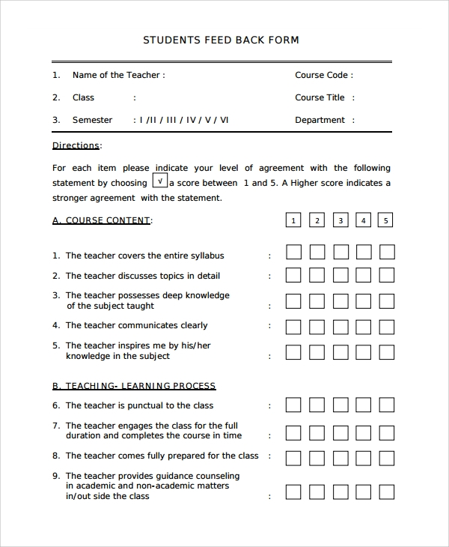
MOTIVATION TO PROJECT
In the present system, the student feedback is collected by the institution through pen and paper mode.
This system is time consuming and requires lot of hard materials. Going paper less is our motivation.
The demand in making of Digitalized system for feedback for better data utilizations.
Can reveal the students identity in the paper system.

Slide 8
PROBLEM IDENTIFICATION
Collected feedback is not utilized effectively or can be sabotaged by different means of issues.
In the present system the collected results is not taken cumulatively as the older results are neglected.
For present there is no application which helps with cumulative faculty academic progress.

Slide 9
OBJECTIVE OF THE PROJECT
To design and develop an application which can collect the feedback in digital format.
To provide a feedback score to each faculty in response to the collected feedback from students and to consider other works and achievements of faculty.
To provide a rating system which help in overall development of faculty and institution.
To display cumulative academic progress score to each faculty.

Slide 10
METHODOLOGY
BLOCK DIAGRAM
Student Feedback
Previous 3 sem plus present /4
VTU Individual Subject outcome
Total Score with Addition of Previous 3 sem of Data
Consoling Data
Faculty Qualification
Research Work Contribution
SF
50%
VTU Score
20%
FQ
5%
Final Faculty Academic Progress Score
TB& Fund’s
5%
FDP’s
5%
RWC
10%
Workshop & FDP’s
Contribution to Textbook
D&C Committee
5%
Contribution to Department Fund’s
Additional Missing Values/Constraints
Department and College Level committee and activities
TUNE

Slide 11
HIERARCHICAL DATA FLOW

Slide 12
SYSTEM REQUIREMENTS
SOFTWARE
Frontend: Java and XML
Backend: PHP
Database: MySQL
XAMPP Server
Android Studio
HARDWARE
Processor: AMD Ryzen 5 3500U
RAM: 8GB
Hard disk: 1TB
Android Phone (Project Deployment)

Slide 13
APPLICATION DESIGN
This application have Seven modules, as listed:
Student Feedback
Results Achieved in Subjects Handled
Research Work Contribution
Qualification
Workshop, Conference & Faculty Development Programs (FDPs)
Textbook and Funds
Department & College Level Committees & Activities

Slide 14
CALCULATION
a) STUDENT FEEDBACK:
Form created in an application to collect feedback through students with eight parameters.
1. Time Management
2. Coverage of Syllabus
3. Control over Class
4. Command on Subject
Using these parameters the output of this module will have 50% of progress score.
5. Board Management
6. Communication Skills
7. Interaction with Students
8. Motivation for Students

Slide 15
b) RESULTS ACHIEVED IN SUBJECTS HANDELED:
The number of students passed in the subject reflects on the faculty score. This module includes 20% of the progress.
c) RESEARCH WORK CONTRIBUTION:
This module includes Paper Published by the faculty and contributes total 10%. This 10% is divided into Journal Paper, International Conference Paper and National Conference Paper.
d) QUALIFICATION:
In this module system evaluate on the basis of their degree completion and have 5% progress.

Slide 16
e) WORKSHOP, CONFERENCE & FACULTY DEVELOPMENT PROGRAMS(FDPs):
If the faculty conducts any above programs will be rewarded with 5% and attended will be rewarded with 2%.
f) TEXTBOOK AND FUNDS:
Faculty either have to publish a technical paper or combinedly be an author to technical textbooks. If they publish and bring potential grants or funds to college then progressed 5%.
g) DEPARTMENT & COLLEGE LEVEL COMMITTEES & ACTIVITIES:
Faculty will be activity organizer or be a part of college/department level committee member and this module it contribute 5%.

Slide 17
WORKING WITH AN EXAMPLE
NAME: Dr. ABC QUALIFICTAION: B.E., M.TECH, PhD.
Student Feedback = 45
Results Achieved in Subject Handled = 20
Research Work Contribution = 10
Qualification = 5
Workshop and Faculty Development Programs = 5
Textbook and Funds = 5
Department and College Level Committees and Activities = 5
As system rewarded this faculty will have the progress of 95%
i.e., score = (total score obtained/total score)*100 = (95/100)*100 = 95%
Academic Progress Score = average of four scores including current score
i.e., APS = (score1+score2+score3+score4)/4 = (95+95+95+95)/4 = 95%

Slide 18
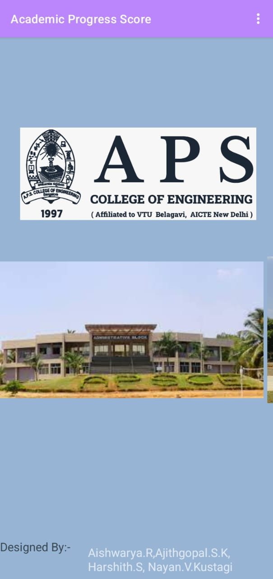
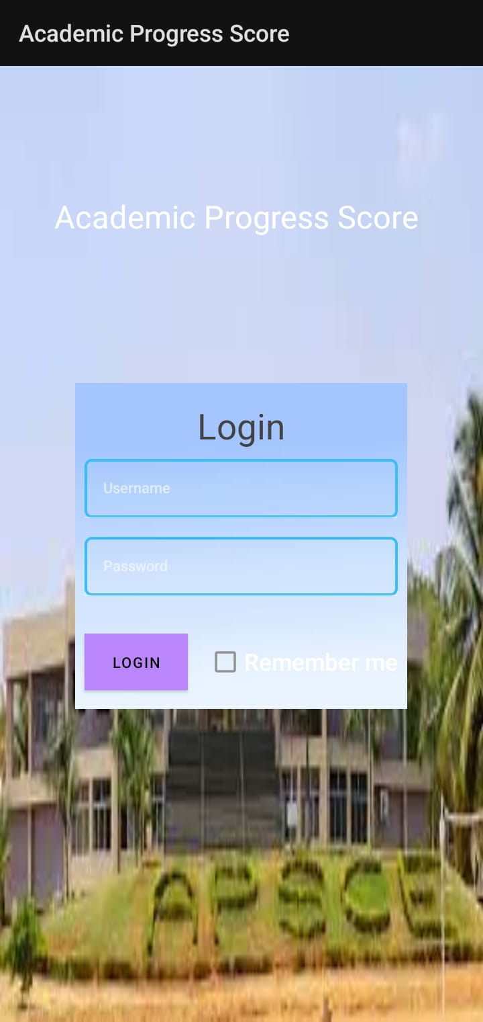
RESULTS

Slide 19

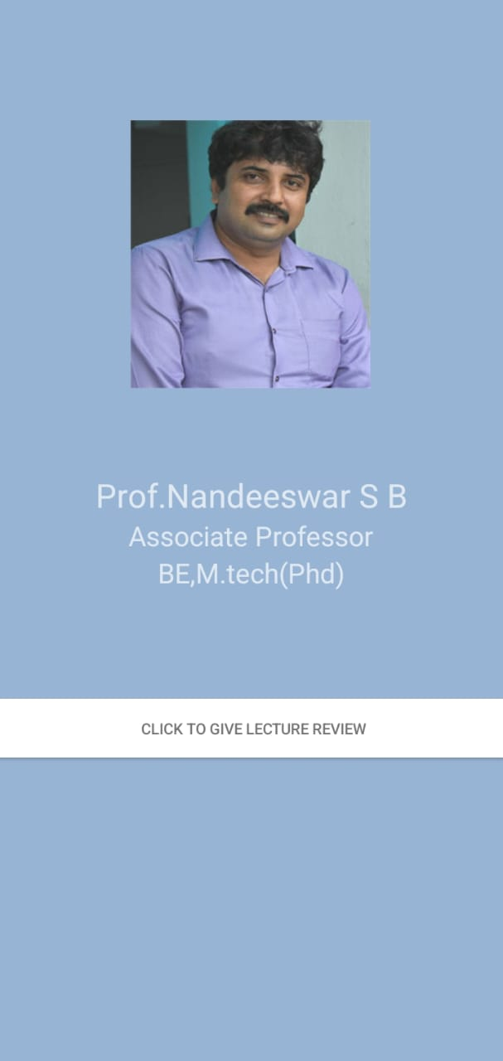


Slide 20
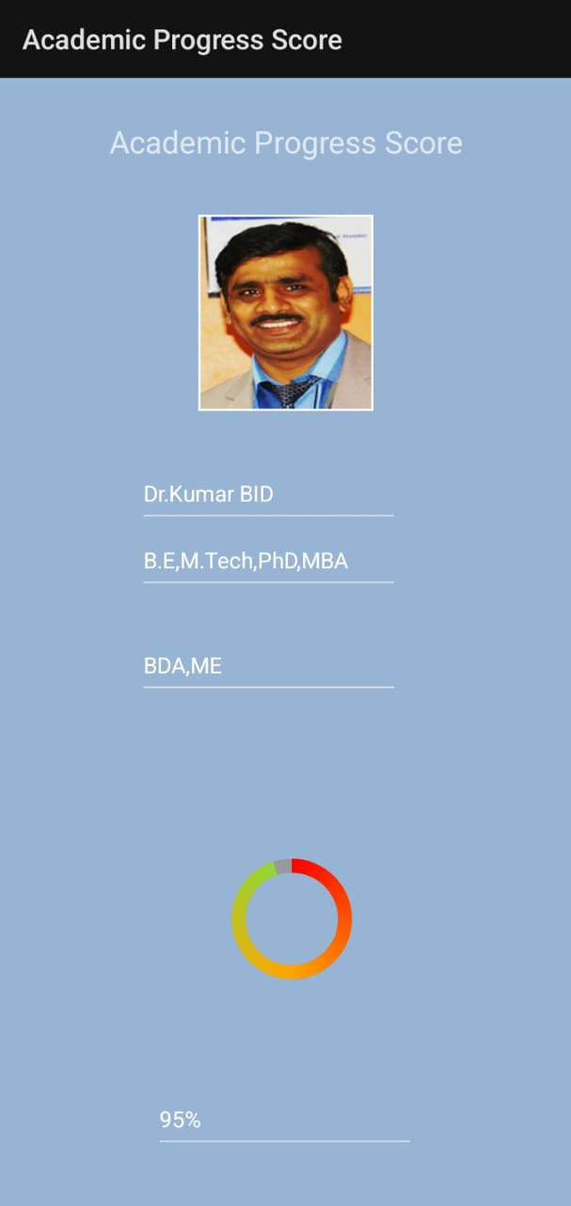
This application developed in order to automate the process of feedback system. It also displays the faculty profile with respective feedback score.

Slide 21
CONCLUSION
This application is designed to collect student feedback in digital form and give respective feedback score.
Faculty can use this application to view their score and profile.
REFERENCES
https://www.javatpoint.com/
https://developer.android.com/
Effect of student feedback on the motivation of Indian university teachers: Ananta Kumar Jena from Assam University, Assam.
Rating and matching in peer review systems: Florian Dofler, Monticello, IL, USA.

Slide 22
THANK YOU

