Slide 1


INTERNSHIP SEMINAR
ON
WEBSITE FOR VDP SOLUTIONS
VTU, Belagavi
Submitted by
HARSHITH S (1AP18IS008)
Under the Guidance of
Name: Mrs. Pallavi H B
Designation: Assistant Professor
Department of Information Science & Engineering
A P S College of Engineering
Somanahalli, Kanakapura Road, Bangalore – 560082.

Slide 2
AGENDA OF THE PRESENTATION
COMPANY PROFILE
INTRODUCTION
OBJECTIVE
MODULES & DATA FLOW DIAGRAM
REQUIREMENTS & ASPECTS
OUTCOMES
CONCLUSION

Slide 3
COMPANY PROFILE
IC Solution (ICS) is a digital service provider.
It aims to provide software, designing and marketing solutions to businesses.
It provide all kinds of technological and designing solutions from Billing Software to Web Designs or any custom demand that may have.

Slide 4
Mission: To provide more valued, timely and qualitative services and attain the client satisfaction through skill building, innovation and best practiced processes.
Vision: To build strategic partnerships globally with all clients, vendors, and investors. To nurture a winning team that has a passion for excellence.
Services: The services are development, mobile application, design, and consultancy.

Slide 5
INTRODUCTION
The internship is based on Web Development and its Applications.
The web development process includes web design, web content development and client-side/server-side scripting, among other tasks.
The website is about one of the greatest companies of all time “VDP Solutions Pvt Ltd.”
VDP Solutions is a digital service provider that Founded and Funded by Graphic designers from Jahirathu Junction.
VDP Solutions has now set a new path towards Digital Solutions.

Slide 6
OBJECTIVE
The objective of the internship is to learn the implementation of website using Django framework.
The objective of the website is to store the ratings and reviews of the products and also feedback given by the user in the backend.
The basic webpage of this project is created using HTML, styling using CSS and backend is done by using SQL.

Slide 7
MODULES & DATA FLOW DIAGRAM
Fig 1 (a): Zero Level DFD

Slide 8
Fig 1 (b): Second Level DFD

Slide 9
SYSTEM REQUIREMENTS
Software Used
Windows 11
Visual Studio Code
XAMPP Server
Google Chrome
Hardware Used
Processor: AMD Ryzen 5 3500U
RAM: 8GB
Hard disk: 1TB
Tools Used
Frontend: HTML, CSS, JavaScript
Backend: MySQL
Django Framework

Slide 10
ASPECTS
Technical Aspects
To work with databases using SQL.
To create views with Django.
To connect templates with models to serve data dynamically.
To create relative URLs with templates.
To use GitHub.
Non-Technical Aspects
Communication
Team Work
Time Management
Decision Making
Planning
Research/Critical Thinking

Slide 11
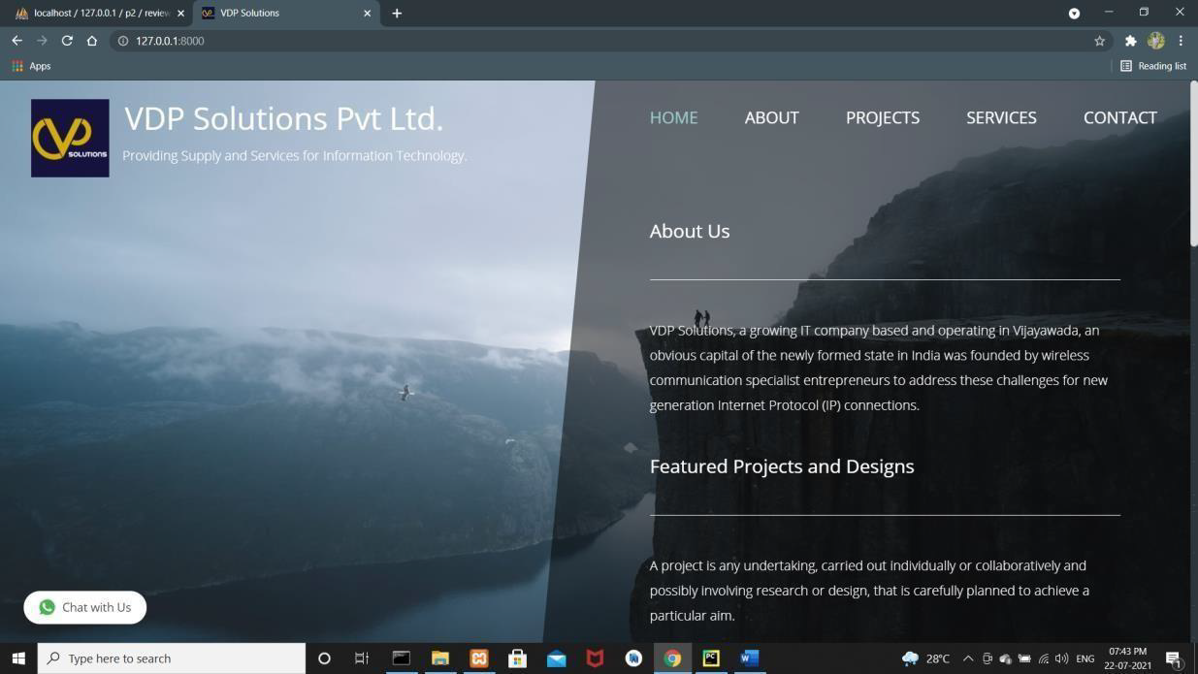
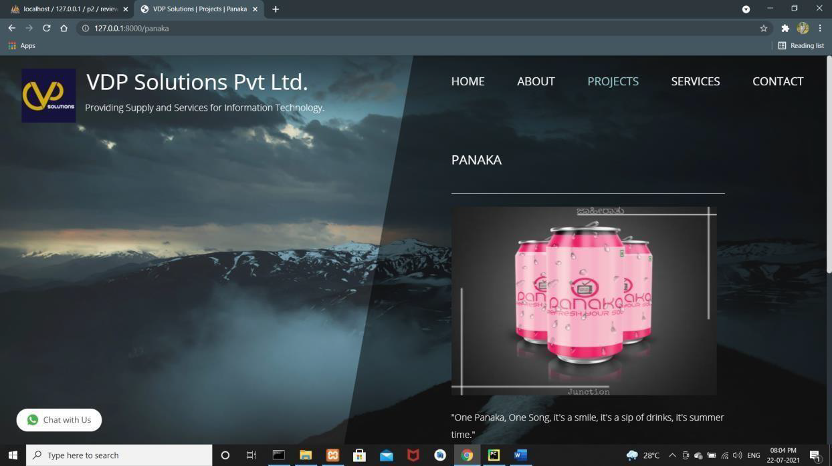
OUTCOMES
Fig 2 (a): Home Page
Fig 2 (b): Review Page of Panaka Product

Slide 12
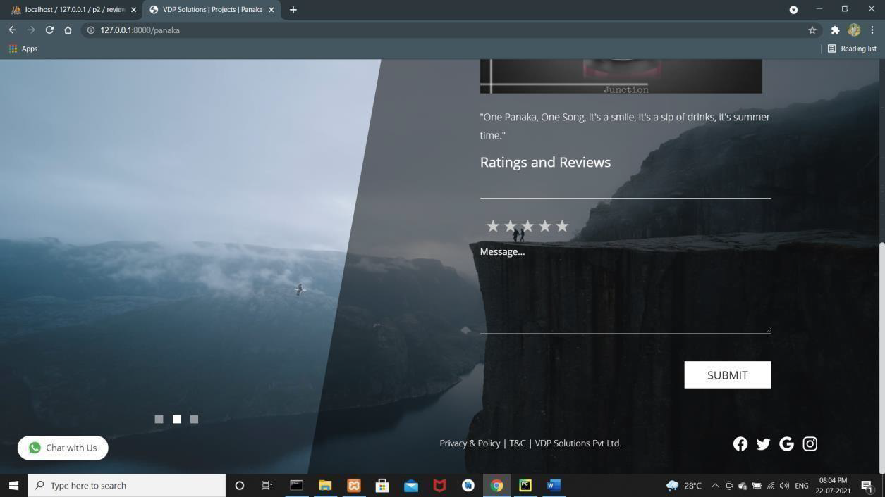
Fig 2 (c): Rating & Review Page
Fig 2 (d): WhatsApp

Slide 13
CONCLUSION
We can conclude that there is difference between the theoretical and practical work done.
As the scope of understanding and gaining of knowledge will be much more when practical work is done.
At the end, this internship gave me a new insights and experience to pursue my career.

Slide 14
THANK YOU

