Slide 1


INTERNSHIP SEMINAR
ON
WEBSITE FOR VDP SOLUTIONS
VTU, Belagavi
Submitted by
HARSHITH S (1AP18IS008)
Under the Guidance of
Name: Mrs. Pallavi H B
Designation: Assistant Professor
Department of Information Science & Engineering
A P S College of Engineering
Somanahalli, Kanakapura Road, Bangalore – 560082.

Slide 2


Slide 3
AGENDA OF THE PRESENTATION
COMPANY PROFILE
INTRODUCTION
SYSTEM REQUIREMENTS
MODULES
SNAPSHOTS
CONCLUSION

Slide 4
COMPANY PROFILE
IC Solution is a digital service provider which provide software, designing and marketing solutions to businesses.
Mission: To provide more valued and qualitative services and attain the client satisfaction through skill building, innovation and best practiced processes.
Vision: To build strategic partnerships globally with all clients, vendors and investors. To nurture a winning team that has a passion for excellence.

Slide 5
INTRODUCTION
The internship is based on Full Stack Web Development and its Applications.
The website is about one of the greatest companies of all time “VDP Solutions Pvt Ltd.”
It was founded and funded by graphic designers from Jahirathu Junction.
This website is to showcase their products and improving themselves by accepting the reviews and feedback given by the users.

Slide 6
SYSTEM REQUIREMENTS
Software Used
Windows 11
PyCharm
XAMPP Server
Google Chrome
Hardware Used
Processor: AMD Ryzen 5
RAM: 8GB
Hard disk: 1TB
Tools Used
Frontend: HTML, CSS and JavaScript
Backend: Python
Database: MySQL
Framework: Django

Slide 7
DJANGO
Django is a python framework used to create websites.
It follows Model, View and Template (MVT) design pattern.
Model provides data from database.
View is a function that takes http requests and sends required data to the template.
Template contains the html files.
It provides a way to navigate around the different pages in a website using URLs.

Slide 8
How to connect Backend to Database?
DATABASES = { 'default': { 'ENGINE': 'django.db.backends.mysql', 'NAME': 'p2', 'USER': 'root', 'PASSWORD': '', 'HOST': '127.0.0.1', 'PORT': '3306', } }

Slide 9
MODULES

Slide 10
RATINGS AND REVIEW PAGE

Slide 11
<form id="contact-form" action="teaform" method="POST"> {% csrf_token %} <div class="rate"> <input type="radio" id="star5" name="rate" value="5" /> <label for="star5" title="text">5 stars</label> <input type="radio" id="star4" name="rate" value="4" /> <label for="star4" title="text">4 stars</label> <input type="radio" id="star3" name="rate" value="3" /> <label for="star3" title="text">3 stars</label> <input type="radio" id="star2" name="rate" value="2" /> <label for="star2" title="text">2 stars</label> <input type="radio" id="star1" name="rate" value="1" /> <label for="star1" title="text">1 star</label> </div> <div class="form-group mb-5"> <textarea rows="6" name="message" class="form-control" placeholder="Message..." required=""></textarea> </div> <div class="text-right"> <button type="submit" class="btn btn-big btn-primary">SUBMIT</button> </div> </form> <br> {% if messages %} {% for message in messages %} {{ message }} {% endfor %} {% endif %}
path('tea', views.tea, name='tea'),
def tea(request): return render(request,'tea.html')
def teaform(request): if request.POST: rate = request.POST['rate'] message = request.POST['message'] cursor = connection.cursor() cursor.execute("INSERT INTO review VALUES('Tea','" +rate+ "','" +message+ "');") messages.error(request, 'Review Submitted.') return HttpResponseRedirect(reverse('tea'))

Slide 12
DATABASE OF RATINGS AND REVIEWS

Slide 13
CONTACT PAGE

Slide 14
<form id="contact-form" action="contactform" method="POST"> {% csrf_token %} <div class="form-group mb-4"> <input type="text" name="name" class="form-control" placeholder="Name" required="" /> </div> <div class="form-group mb-4"> <input type="email" name="email" class="form-control" placeholder="Email" required="" /> </div> <div class="form-group mb-4"> <input type="text" name="phno" class="form-control" placeholder="Phone Number" required="" /> </div> <div class="form-group mb-4"> <input type="text" name="subject" class="form-control" placeholder="Subject" required="" /> </div> <div class="form-group mb-5"> <textarea rows="6" name="message" class="form-control" placeholder="Message..." required=""></textarea> </div> <div class="text-right"> <button type="submit" class="btn btn-big btn-primary">SUBMIT</button> </div> </form> <br> {% if messages %} {% for message in messages %} {{ message }} {% endfor %} {% endif %}
path('contact', views.contact, name='contact'),
def contact(request): return render(request,'contact.html')
def contactform(request): if request.POST: name = request.POST['name'] email = request.POST['email'] phno = request.POST['phno'] subject = request.POST['subject'] message = request.POST['message'] cursor = connection.cursor() cursor.execute("INSERT INTO contact VALUES('"+name+"','" +email+ "','"+phno+"','"+subject+"','" +message+ "');") messages.error(request, 'Successfully Submitted.') return HttpResponseRedirect(reverse('contact'))

Slide 15
DATABASE OF FEEDBACK

Slide 16
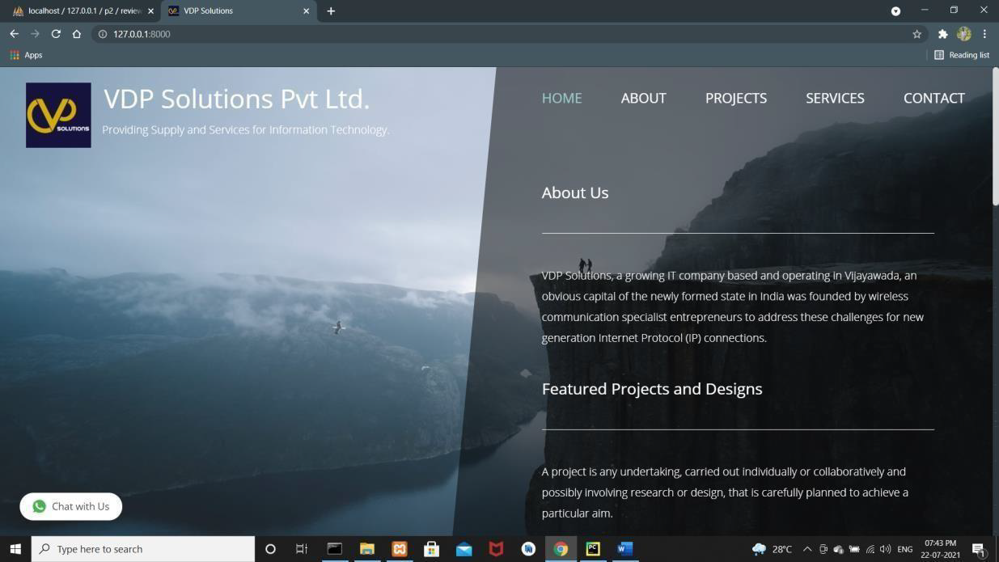
OTHER SNAPSHOTS
Home Page
Projects Page

Slide 17
CONCLUSION
The project aims at business process that is to computerise the various processes of the company.
It would help company to access the product reviews and feedback given by the users to improvise their company.
At the end, this internship gave me a new insights and experience on web development.

Slide 18
REFERENCES
https://w3schools.com
https://geeksforgeeks.org
https://codecademy.com
https://freefrontend.com
https://www.tutorialspoint.com/index.htm

Slide 19
THANK YOU

