Slide 1


INTERNSHIP SEMINAR
ON
WEBSITE FOR VDP SOLUTIONS
VTU, Belagavi
Submitted by
HARSHITH S (1AP18IS008)
Under the Guidance of
Name: Mrs. Pallavi H B
Designation: Assistant Professor
Department of Information Science & Engineering
A P S College of Engineering
Somanahalli, Kanakapura Road, Bangalore – 560082.

Slide 2
AGENDA OF THE PRESENTATION
COMPANY PROFILE
INTRODUCTION
OBJECTIVE
MODULES & DATA FLOW DIAGRAM
REQUIREMENTS & ASPECTS
OUTCOMES
CONCLUSION

Slide 3
COMPANY PROFILE
IC Solution (ICS) is a digital service provider.
It aims to provide software, designing and marketing solutions to businesses.
It provide all kinds of technological and designing solutions from Billing Software to Web Designs or any custom demand that may have.

Slide 4
Mission: To provide more valued, timely and qualitative services and attain the client satisfaction through skill building, innovation and best practiced processes.
Vision: To build strategic partnerships globally with all clients, vendors and investors. To nurture a winning team that has a passion for excellence.
Services: The services are development, mobile application, design and consultancy.

Slide 5
INTRODUCTION
The internship is based on Web Development.
Web development refers to the developing websites for hosting via internet.
The web development process includes web design, web content and client-side/server-side scripting.
The website is about one of the greatest companies of all time “VDP Solutions Pvt Ltd.”
VDP Solutions is a digital service provider that founded and funded by graphic designers from Jahirathu Junction.

Slide 6
OBJECTIVE
The objective of the internship is to learn the implementation of website using Django framework.
The objective of the website is to store the ratings and reviews of the products and also feedback given by the user in the backend.

Slide 7
MODULES
Figure 1: Modules

Slide 8
DATAFLOW DIAGRAM
Figure 2: Dataflow Diagram

Slide 9
SYSTEM REQUIREMENTS
Software Used
Windows 11
Visual Studio Code
XAMPP Server
Google Chrome
Hardware Used
Processor: AMD Ryzen 5
RAM: 8GB
Hard disk: 1TB
Tools Used
Frontend: HTML, CSS and JavaScript
Backend: Python
Database: MySQL
Framework: Django

Slide 10
DJANGO
Django is a python framework used to create websites.
It follows Model, View and Template (MVT) design pattern.
Model provides data from database.
View is a function that takes http requests, import relevant model, sends required data to template and returns final result.
Template contains the html files.

Slide 11
ASPECTS
Technical Aspects
To work with database using MySQL.
To create models with Django.
To connect templates with models.
To create views and to connect them with models and templates.
To create relative URLs with templates.
Non-Technical Aspects
Communication
Team Work
Time Management
Decision Making
Planning

Slide 12
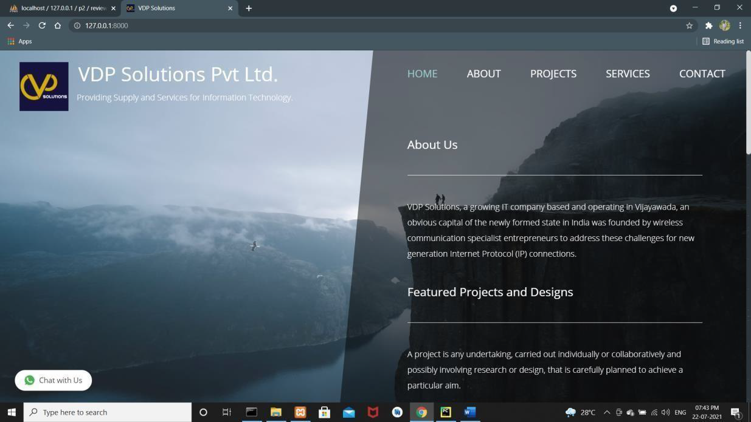
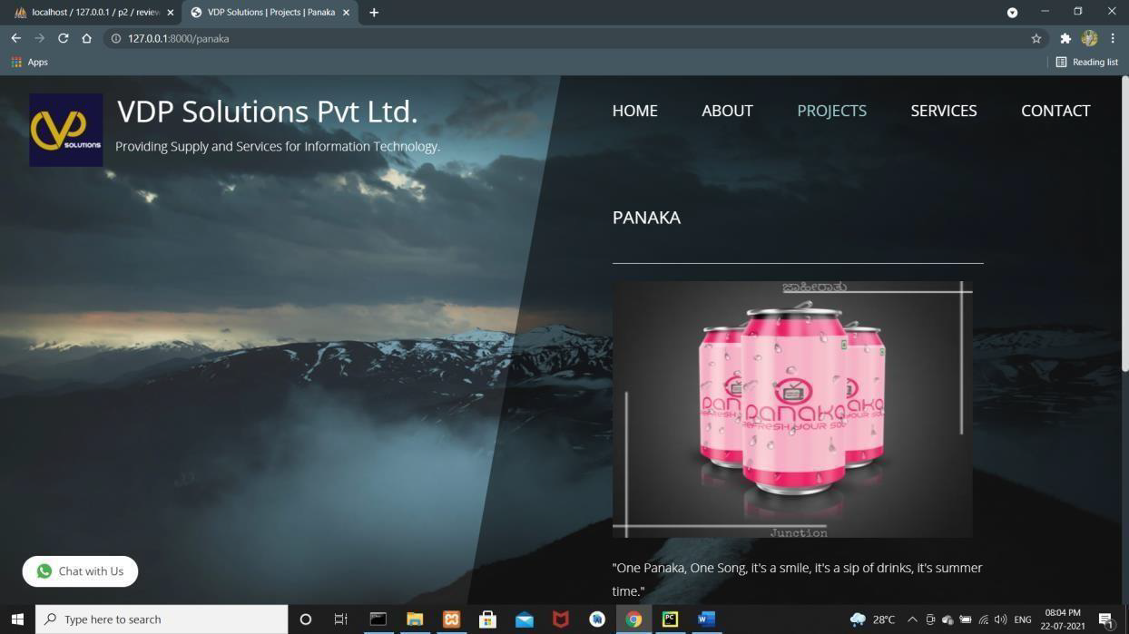
OUTCOMES
Figure 3a: Home Page
Figure 3b: Projects Page

Slide 13
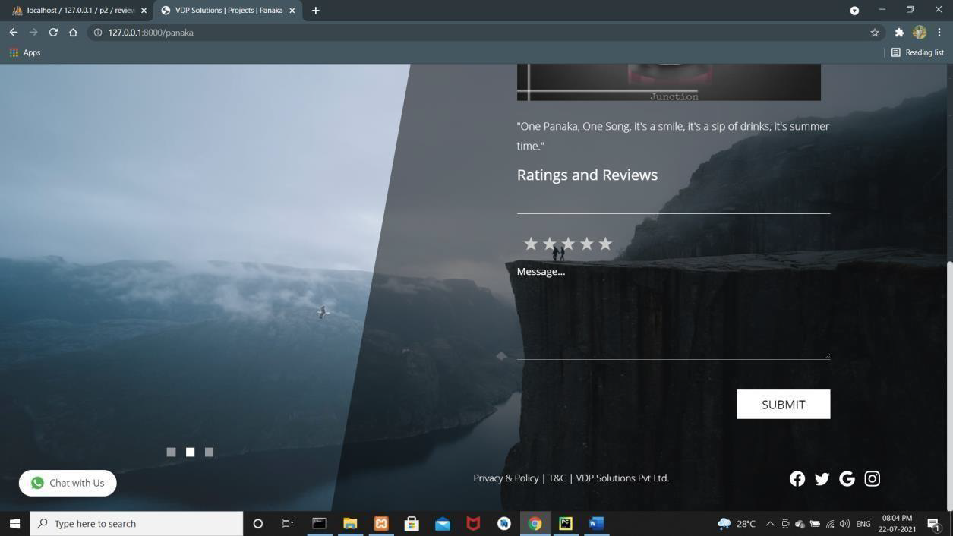
Figure 3c: Rating & Review Page
Figure 3d: WhatsApp

Slide 14
CONCLUSION
We can conclude that there is difference between the theoretical and practical work done.
As the scope of understanding and gaining of knowledge will be much more when practical work is done.
At the end, this internship gave me a new insights and experience to pursue my career.

Slide 15
REFERENCES
https://w3schools.com
https://geeksforgeeks.org
https://codecademy.com
https://freefrontend.com/
https://www.tutorialspoint.com/index.htm

Slide 16
THANK YOU

