Slide 1



A P S COLLEGE OF ENGINEERING
DEPARTMENT OF INFORMATION SCIENCE AND ENGINEERING
INTERNSHIP SEMINAR ON:
WEBSITE FOR VDP SOLUTIONS PVT LTD.
Under The Guidance Of :
Mrs. Pallavi H B
Asst. Prof , Dept of ISE
Head Of The Department :
Dr. Kumar B I D
Prof & HOD
Presented By:
Harshith S
(1AP18IS008)

Slide 2
CONTENTS
1
COMPANY
PROFILE
4
DATA FLOW DIAGRAM
2
INTRODUCTION
5
METHODOLOGY
3
OBJECTIVES
6
CONCLUSION

Slide 3
COMPANY PROFILE
IC Solution (ICS) is a digital service provider that aims to provide software, designing and marketing solutions to individuals and businesses. At ICS, we believe that service and quality is the key to success
We provide all kinds of technological and designing solutions from Billing Software to Web Designs or any custom demand that you may have. Experience the service like none other!

Slide 4
MISSION
To provide more value per dollar to our clients by providing timely and qualitative services/solutions and attain utmost client satisfaction through skill building, innovation and best practiced processes.
To offer total, cost-effective, next generation embedded hardware and software solutions in the shortest possible development time enabling our clients to launch their production.

Slide 5
VISSION
To bring best of the human assets by providing environment for grooming, nurturing, and growing talent to foster human growth and providing services and solutions to the IT companies globally creating value for our customers.
To lead in embedded hardware and software solutions and be known as an electronic product development company of repute.
To build strategic partnerships globally with all stakeholders - clients, vendors, and investors.
To stay abreast with technology and build our technical competence and domain expertise.
To nurture a winning team that has a passion for excellence.
To be the delight of our customers by achieving perfection in our processes and quality methods.

Slide 6
SERVICES
Development. We develop responsive, functional and super-fast websites. We keep User Experience in mind while creating websites. A website should load quickly and should be accessible even on a small view-port and slow internet connection.
Mobile Application. We offer a wide range of professional Android, iOS & Hybrid app development services for our global clients, from a start up to a large enterprise.
Design. We offer professional Graphic design, Brochure design & Logo design. We are experts in crafting visual content to convey the right message to the customers.
Consultancy. We are here to provide you with expert advice on your design and development requirement.
Videos. We create a polished professional video that impresses your audience.

Slide 7
INTRODUCTION
This project is based on Web Development and its Applications.
Web development broadly refers to the tasks associated with developing websites for hosting via intranet or internet.
The web development process includes web design, web content development, client-side/server-side scripting and network security configuration, among other tasks.
The website is about one of the greatest companies of all time “VDP Solutions Pvt Ltd.”
VDP Solutions is a digital service provider that aims to provide software, designing and marketing solutions to individuals and businesses.
At VDP, it is believed that service and quality is the key to success; Founded and Funded by Graphic designers from Jahirathu Junction.
VDP Solutions has now set a new path towards Digital Solutions.

Slide 8
OBJECTIVE
The main objective of the internship is to learn the implementation of website using Django framework.
The main objective of the website is to store the ratings and reviews of the products and also feedback given by the user in the backend.
The basic webpage of this project is created using HTML, styling using CSS and backend is done by using SQL.

Slide 9
DATA FLOW DIAGRAM
Fig 1 (a): Zero Level DFD

Slide 10
Fig 1 (b): Second Level DFD

Slide 11
METHODOLOGY
Software Used
Windows 11
Visual Studio Code
XAMPP Server
Google Chrome
Hardware Used
Processor: AMD Ryzen 5 3500U
RAM: 8GB
Hard disk: 1TB
Tools Used
Frontend: HTML, CSS, JavaScript
Backend: MySQL
Django Framework
Django
Django is a high level Python-based free and open-source web framework that assists in building and maintaining quality web applications. It helps eliminate repetitive tasks making the development process an easy and time saving experience. It encourages rapid development and clean, systematic design; easier to build better web apps quickly and with less code.

Slide 12
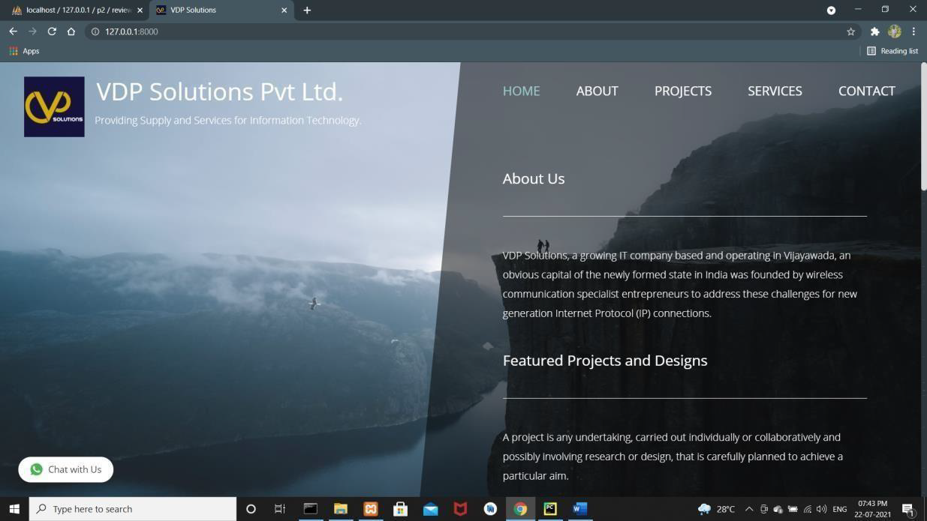
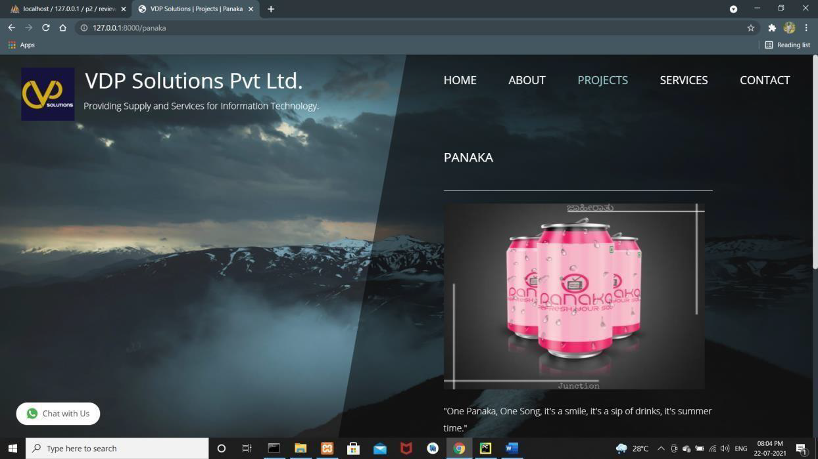
RESULTS
Fig 2 (a): Home Page
Fig 2 (b): Review Page of Panaka Product

Slide 13
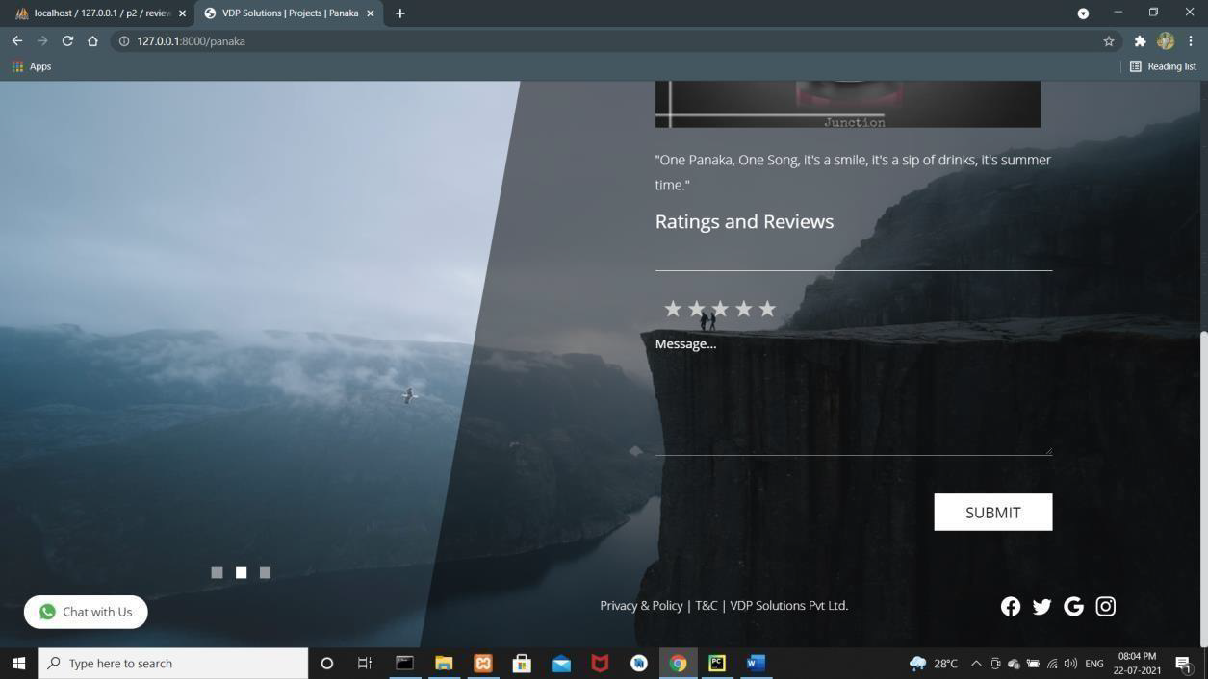
Fig 2 (c): Rating & Review Page
Fig 2 (d): WhatsApp

Slide 14
CONCLUSION
In review, this internship has been an excellent and rewarding experience.
I have been able to gain new skills, knowledge and to meet and network with many people and learn different techniques, plan of working from them.
We can conclude that there is difference between the theoretical and practical work done. As the scope of understanding and gaining of knowledge will be much more when practical work is done.
At the end, this internship gave me a new insights and experience to pursue my career. I hope my work on web development helps to meet its goals.

Slide 15


