Slide 1



  Automatic Traffic Signal Control using Object Detection

Slide 2

Learning Objectives
Understand how AI and computer vision can automate traffic management.
Learn how YOLOv8 object detection is used to detect normal and emergency vehicles.
Implement lane-wise traffic density estimation.
Design a smart traffic system that adapts signal timing based on real-time traffic.
Give priority clearance for emergency vehicles through model ensemble strategy.
Build a practical web-based traffic control demo.
GOAL
Source :
www.freepik.com/

Slide 3
Tools and Technology used
Python 3
YOLOv8 (Ultralytics)
OpenCV
Flask Web Framework
Google Colab (for GPU model training)
VS Code
HTML, CSS (Frontend UI)
GitHub (project repository)

Slide 4
Methodology
1)Dataset Preparation
Collected normal & emergency vehicle datasets
Annotated images and organized into train/val sets
2)Model Training
Trained YOLOv8 model for normal vehicles
Trained YOLOv8 model for emergency vehicles
3)Model Integration (Ensemble)
Combined outputs from both models
Applied Non-Max Suppression to remove duplicates
4)Traffic Logic Design
Lane-wise vehicle counting
Priority rules: Ambulance > Firetruck > Police > Density
Dynamic green-light duration calculation
5)Web Deployment
Built Flask web app interface
Supports image & video processing
Displays detection + signal decision

Slide 5
Problem Statement:
Urban traffic congestion is increasing rapidly, leading to:
    Long vehicle queues
Delayed emergency response
High CO₂ emissions
Inefficient fixed-timer traffic signals
Current manual or fixed-time traffic systems are not capable of adapting to real-time traffic density or identifying emergency vehicles when they appear.
The Goal is to develop an AI-based traffic signal control system that:
    1)Detects normal and emergency vehicles in real-time
    2)Calculates traffic density per lane
    3)Gives automatic green signal to the lane with highest density
    4)Gives priority clearance to emergency vehicles
    5)Works on both single-lane and dual-lane image/video inputs

Slide 6
Solution:
Our AI-based system provides:
1)Accurate vehicle detection using YOLOv8
      2)Dual-model ensemble system
3)Lane-wise vehicle counting
4)Automatic signal decision-making
5)Emergency vehicle priority
6)Dynamic green-light duration
7)Web app interface with real-time processing
The system significantly improves traffic flow and ensures emergency vehicles receive immediate road clearance.

Slide 7
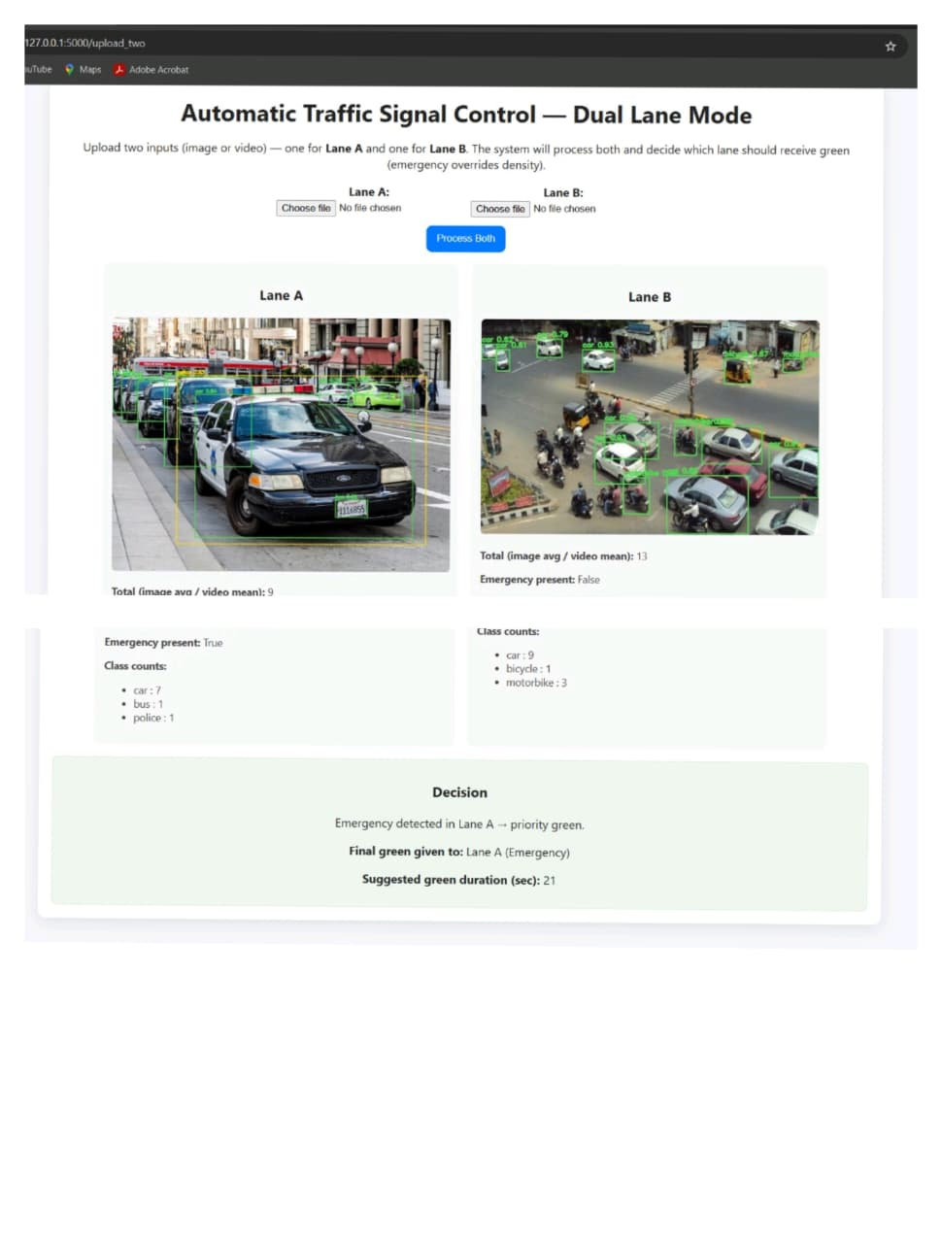
Screenshot of Output:
Git Hub Link:
https://github.com/Harshith810/Automatic-Traffic-Signal-Control-using-Object-Detection-.git

Slide 8
Conclusion:
Successfully implemented an AI-powered intelligent traffic signal system.
Achieved high detection accuracy:
Emergency Vehicle Model: 90.7% mAP50
Normal Vehicle Model: 88.3% mAP50
The ensemble strategy improved system reliability and detection accuracy.
Emergency vehicles receive immediate priority clearance, reducing response time.
The final web application supports dual-lane comparison, video processing, and live visualization.
Overall, the system offers a scalable, efficient, and smart solution for real-world traffic management.

