Slide 1
OCT4LLM
Simplifying LLM Fine-Tuning: Empowering Seamless Customization for All

Slide 2
Problem statement
Fine-tuning large language models (LLMs) for specific business needs is complex and resource-intensive.
Traditional fine-tuning processes require structured data, limiting flexibility for businesses with unstructured datasets.
Businesses lack the infrastructure, computational power, and expertise to efficiently fine-tune LLMs at scale.
The current fine-tuning approach is time-consuming, making it difficult to quickly deploy AI models for real-world applications.
Unstructured data, which makes up the majority of real-world data, remains underutilized in LLM training.
There is a need for an accessible platform that simplifies LLM fine-tuning, especially for businesses with limited technical resources.

Slide 3
Architecture Diagram

Slide 4
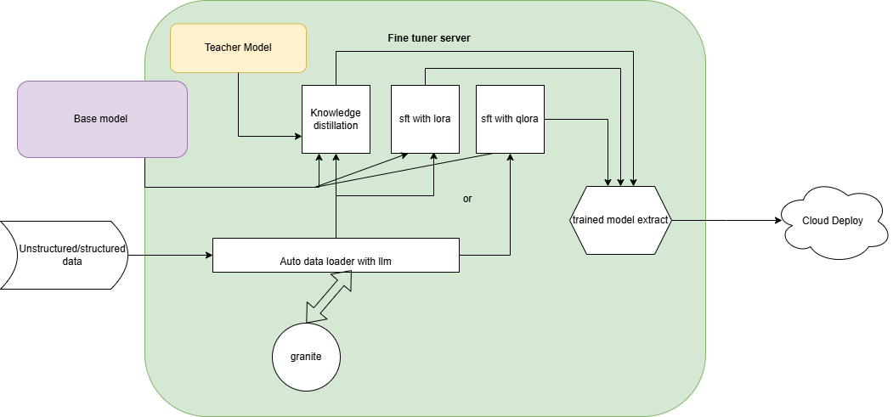
Architecture

Slide 5
Comparative Analysis

Slide 6
Comparison of our platform with existing LLM fine-tuning services
Feature | Our Platform | Hugging Face AutoTrain | 10Clouds | Azumo | Openxcell
Structured Data Support | Yes | Yes | Yes | Yes | Yes
Unstructured Data Support | Yes | Limited | Limited | Limited | Limited
User-Controlled Training Parameters | Full Control | Partial | Partial | Partial | Partial
One-Click Model Training | Yes | Yes | No | No | No
Retrieval-Augmented Generation | Yes | No | No | No | No

Slide 7
Who Needs This? (Client and Market Value)
SMEs: Access powerful AI fine-tuning without high costs or technical barriers.
Data-Intensive Industries: Leverage unstructured data for smarter insights in sectors like healthcare and e-commerce.
AI Developers & Startups: Simplify model training and deployment for faster innovation.
Enterprises Scaling AI: Deploy customizable models across multiple applications efficiently.

Slide 8
Unique Selling Propositions
Unstructured Data Processing: Seamlessly integrate and fine-tune models using unstructured data sources.
Enhanced User Control: Empower users with comprehensive control over training parameters for tailored model outcomes.
User-Friendly Interface: Simplify the fine-tuning process with intuitive, one-click training and deployment features.

Slide 9
Use Cases
Business Chatbots: Develop intelligent chatbots capable of understanding and responding to customer inquiries with contextually relevant information.
One-Click Classifier Models: Enable efficient building and deployment of classifier models for tasks like sentiment analysis and content categorization.
Enhanced Data Retrieval: Utilize RAG techniques to improve information retrieval from extensive datasets, facilitating quicker and more accurate data access.

Slide 10
Final tips & takeaways
Practice makes perfect
Continue improving
Consistent rehearsal
Strengthen your familiarity
Refine delivery style
Pacing, tone, and emphasis
Timing and transitions
Aim for seamless, professional delivery
Practice audience
Enlist colleagues to listen & provide feedback
Seek feedback
Reflect on performance
Explore new techniques
Set personal goals
Iterate and adapt

Slide 11
Speaking engagement metrics
IMPACT FACTOR | MEASUREMENT | TARGET | ACHIEVED
Audience interaction | Percentage (%) | 85 | 88
Knowledge retention | Percentage (%) | 75 | 80
Post-presentation surveys | Average rating | 4.2 | 4.5
Referral rate | Percentage (%) | 10 | 12
Collaboration opportunities | # of opportunities | 8 | 10

Slide 12
THANK YOU
Amith Ramaswamy
Harshith Deshalli Ravi
Sohan Mahadev

